Slide 1
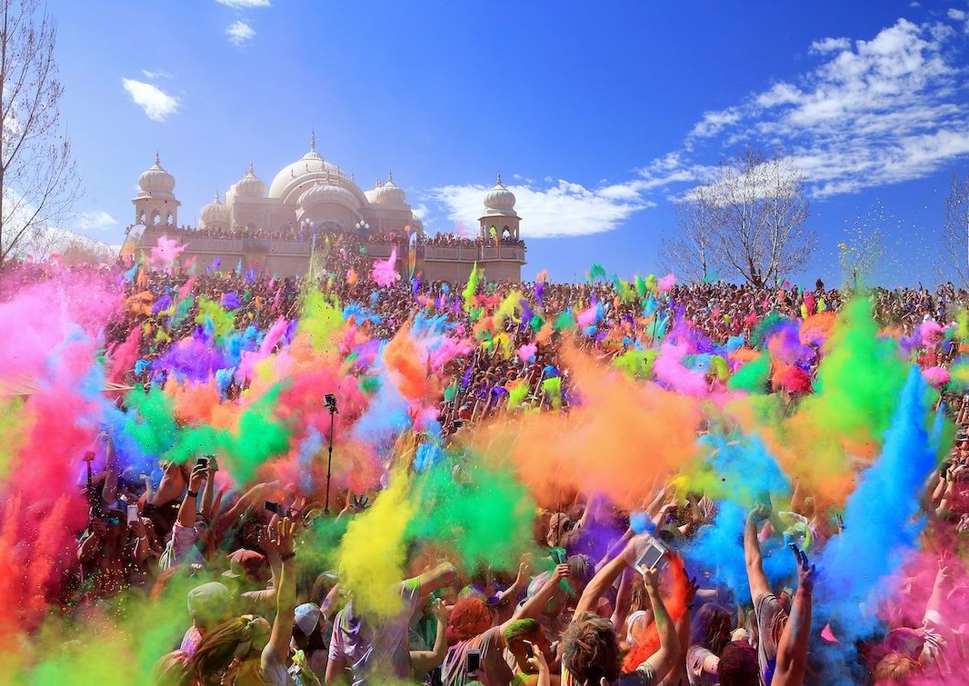
Do Now
Write down three things you know about India.

Slide 2
Do Now
Write down three things you know about India.
India has over 1 billion people.
India used to be a British colony.
India has 22 official languages and is the second-most English-speaking country in the world.

Slide 3
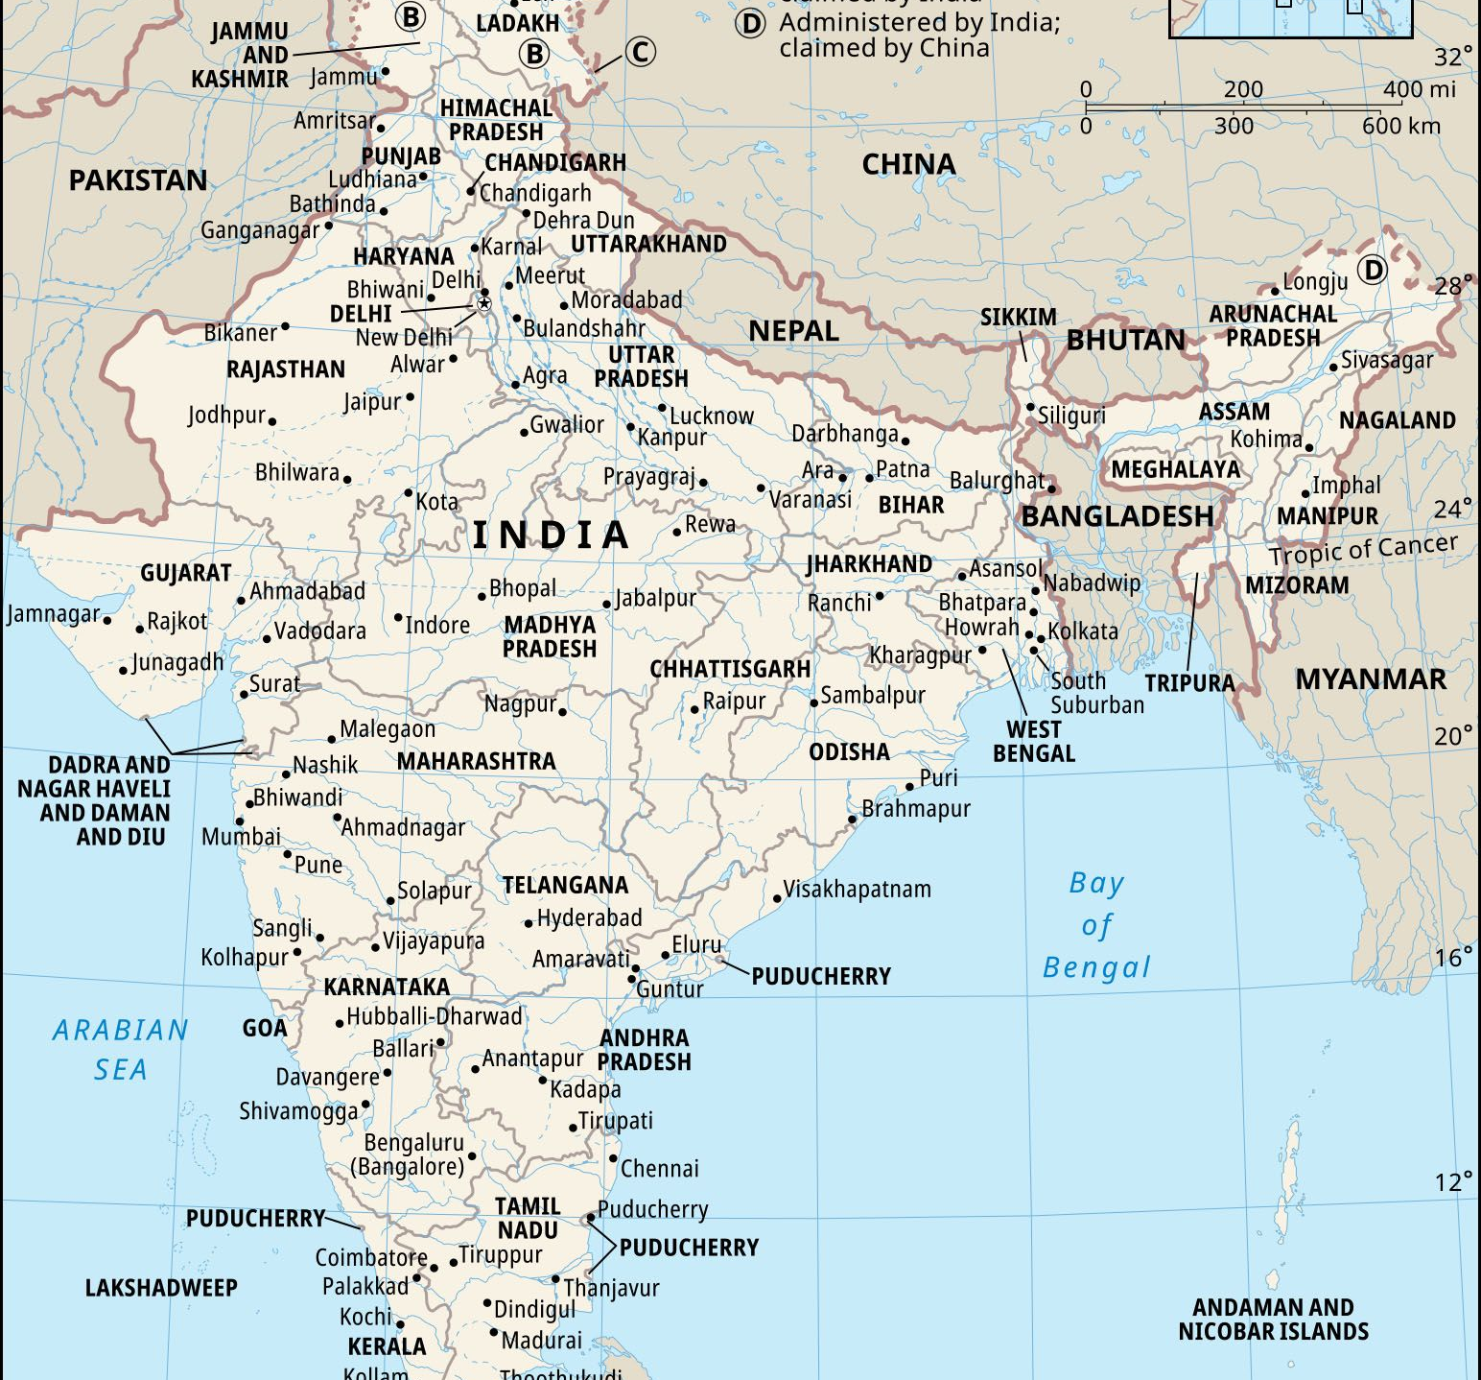
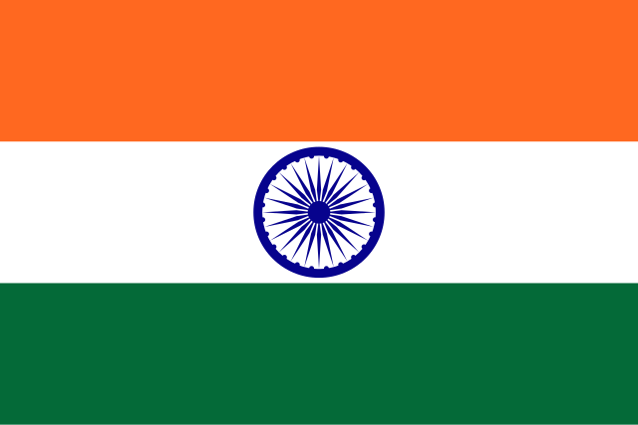
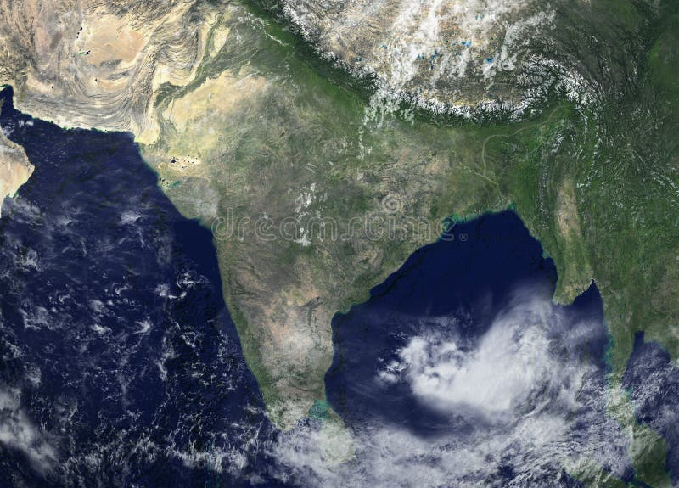

Slide 4
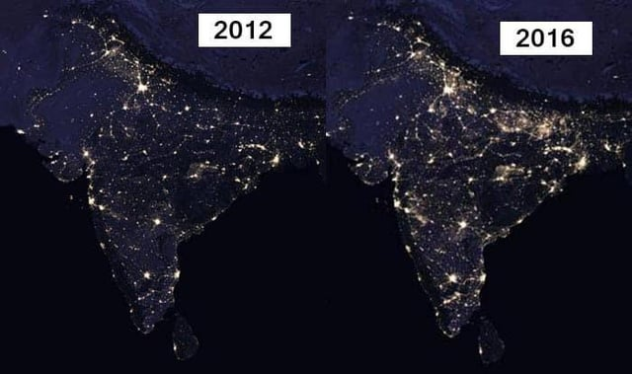

Slide 5
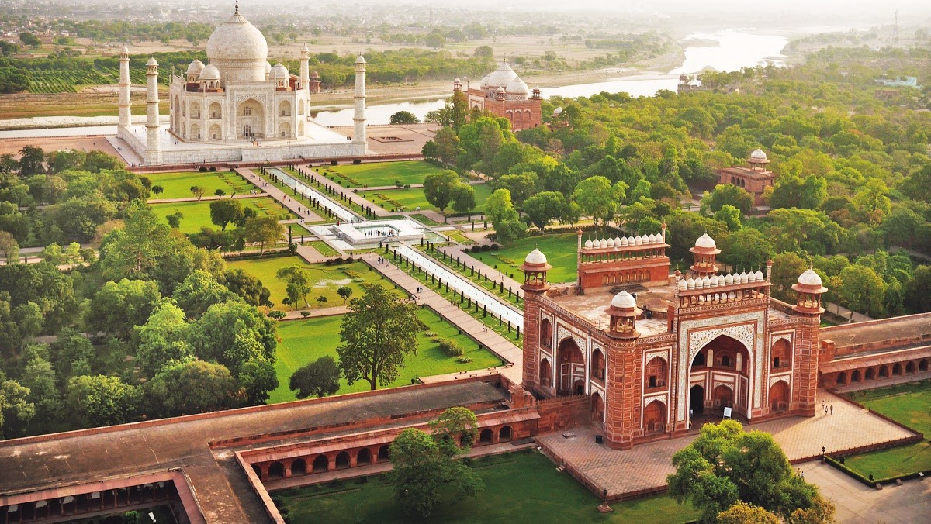

Slide 6
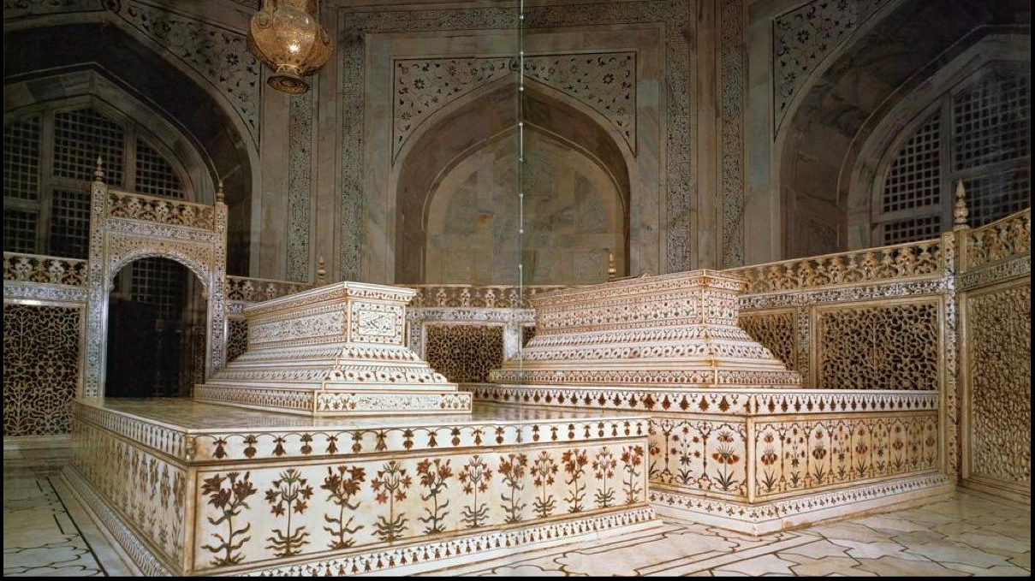
Notes:
It was commissioned in 1632 by the Mughal emperor, Shah Jahan (reigned from 1628 to 1658), to house the tomb of his favourite wife, Mumtaz Mahal.

Slide 7
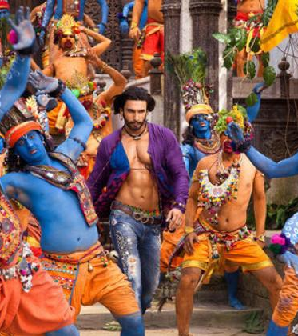
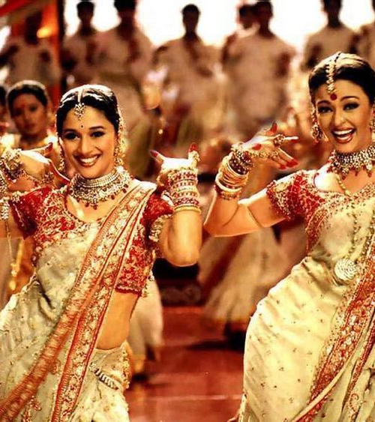
Notes:
Bollywood: Hindi film studios located in Mumbai

Slide 8
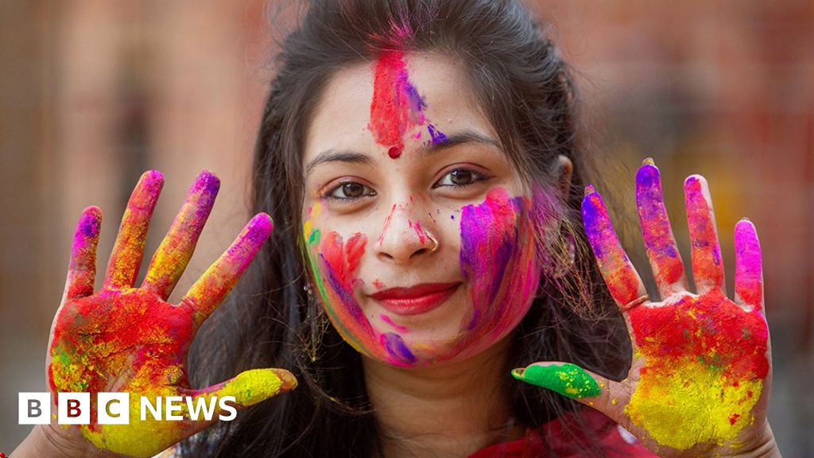
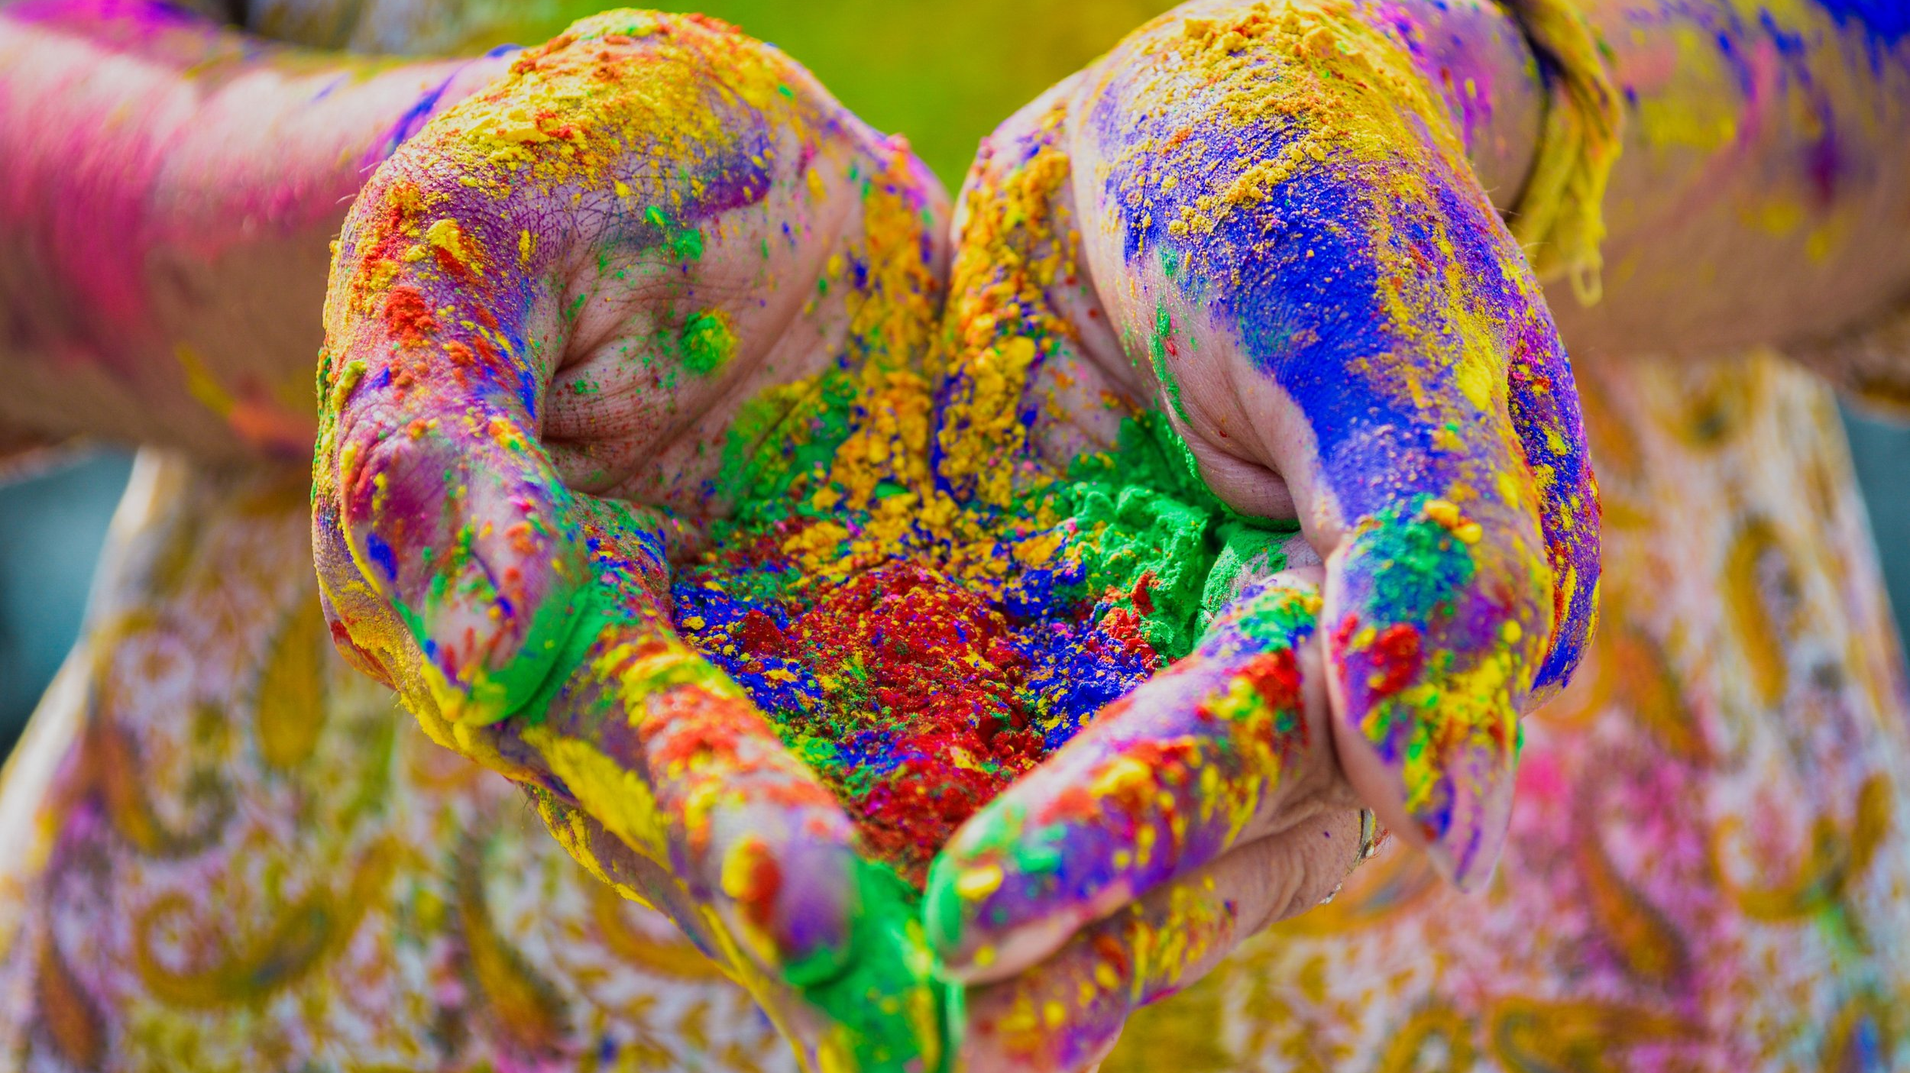
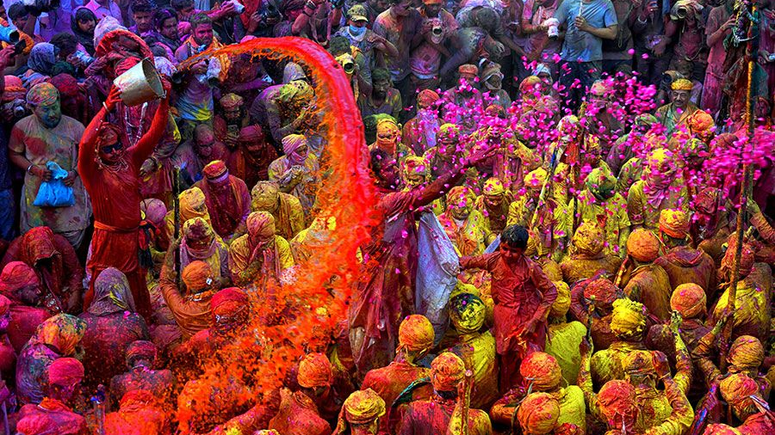
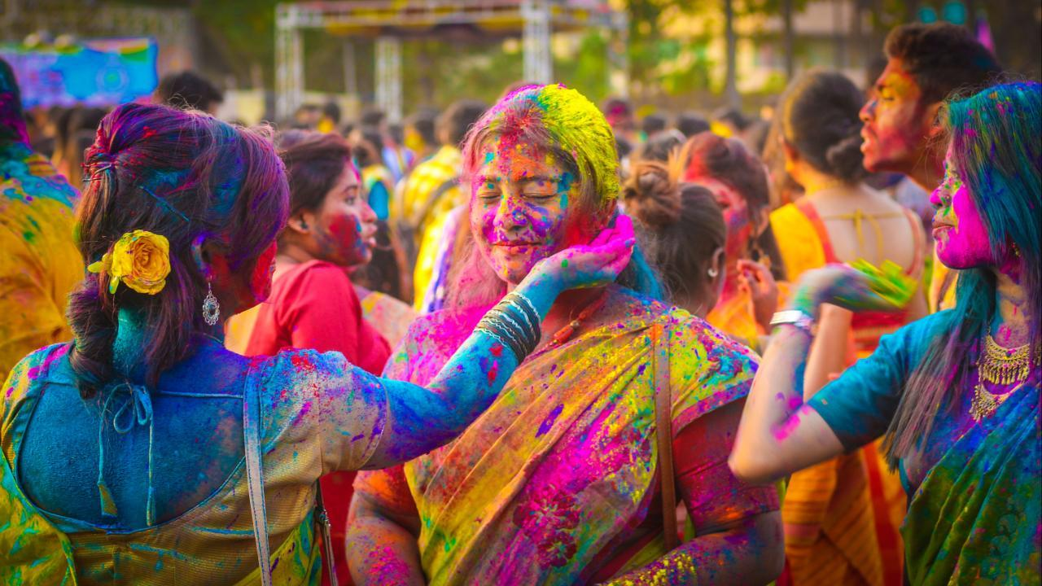
Notes:
Holi: Victory of good over evil; divine love; arrival of Spring (Friday, March 14, 2025)

Slide 10
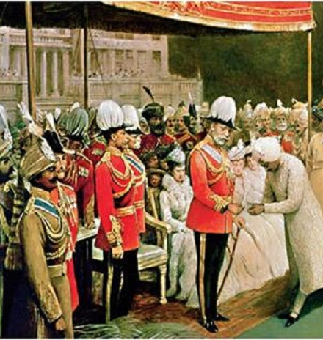
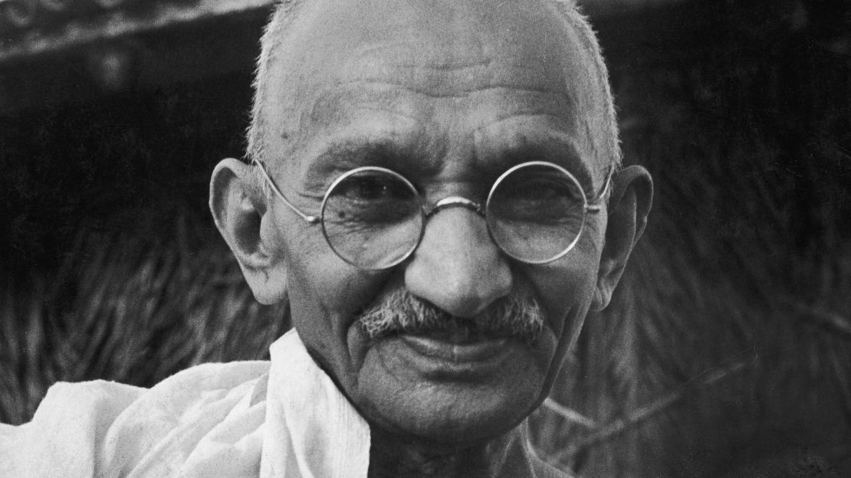
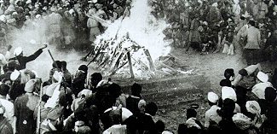

Slide 11
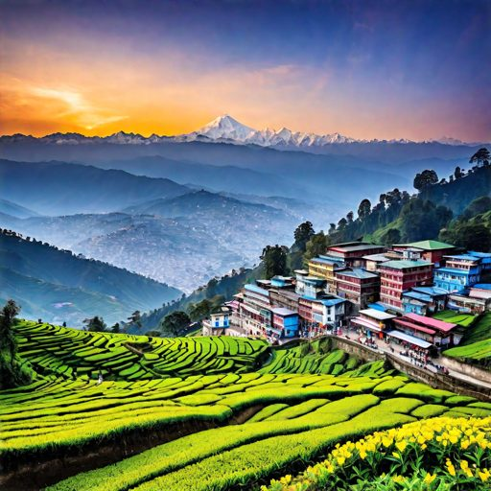
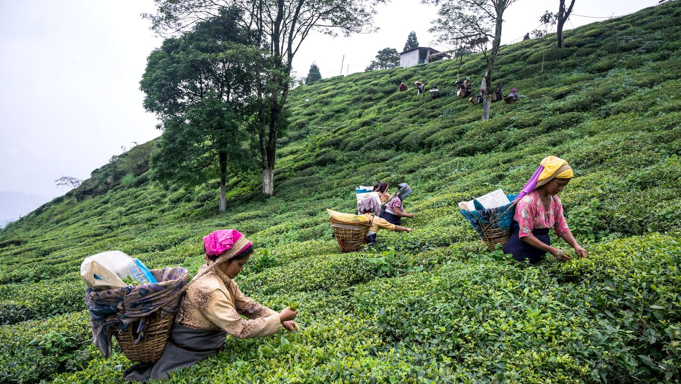
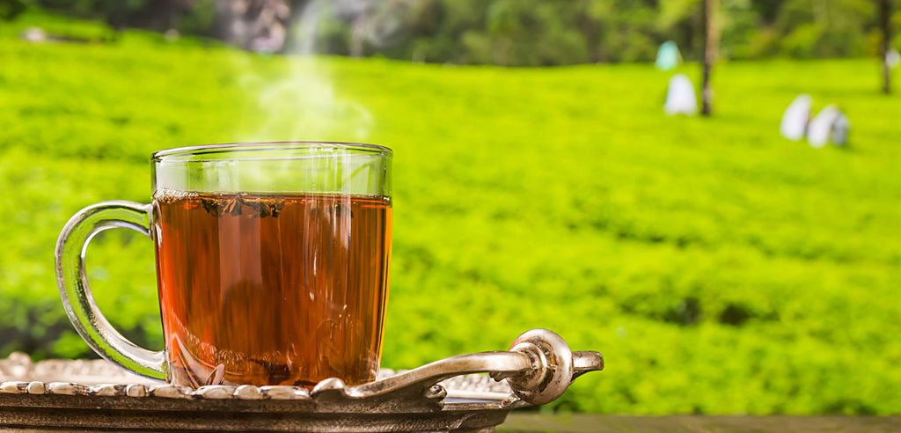

Slide 12
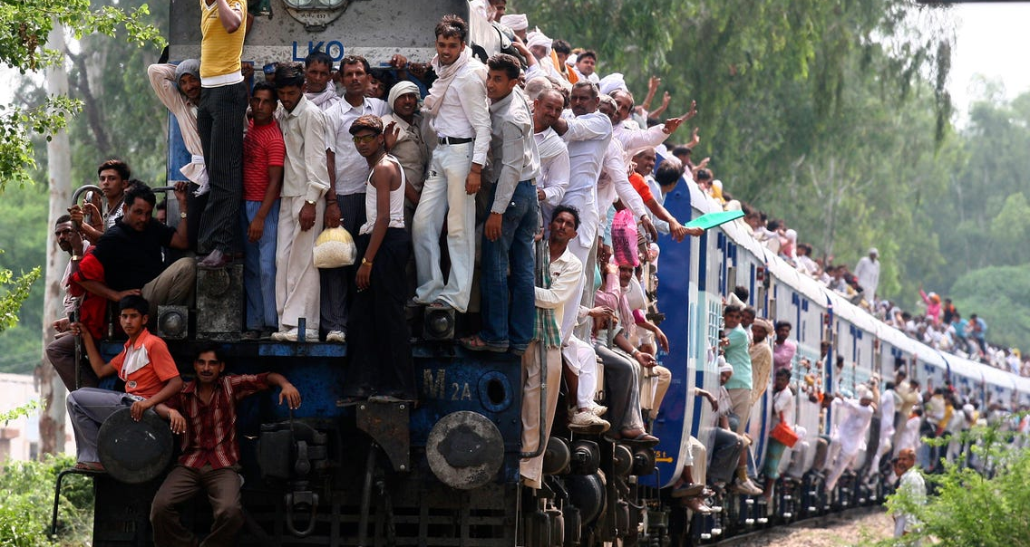
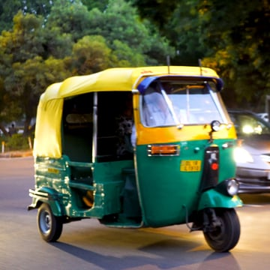
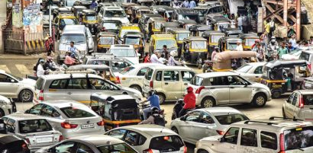
Notes:
Show Top Gear driving in India… after video explain road hierarchy: humans>bikes>tuk tuks>cars>trucks>cows

Slide 13
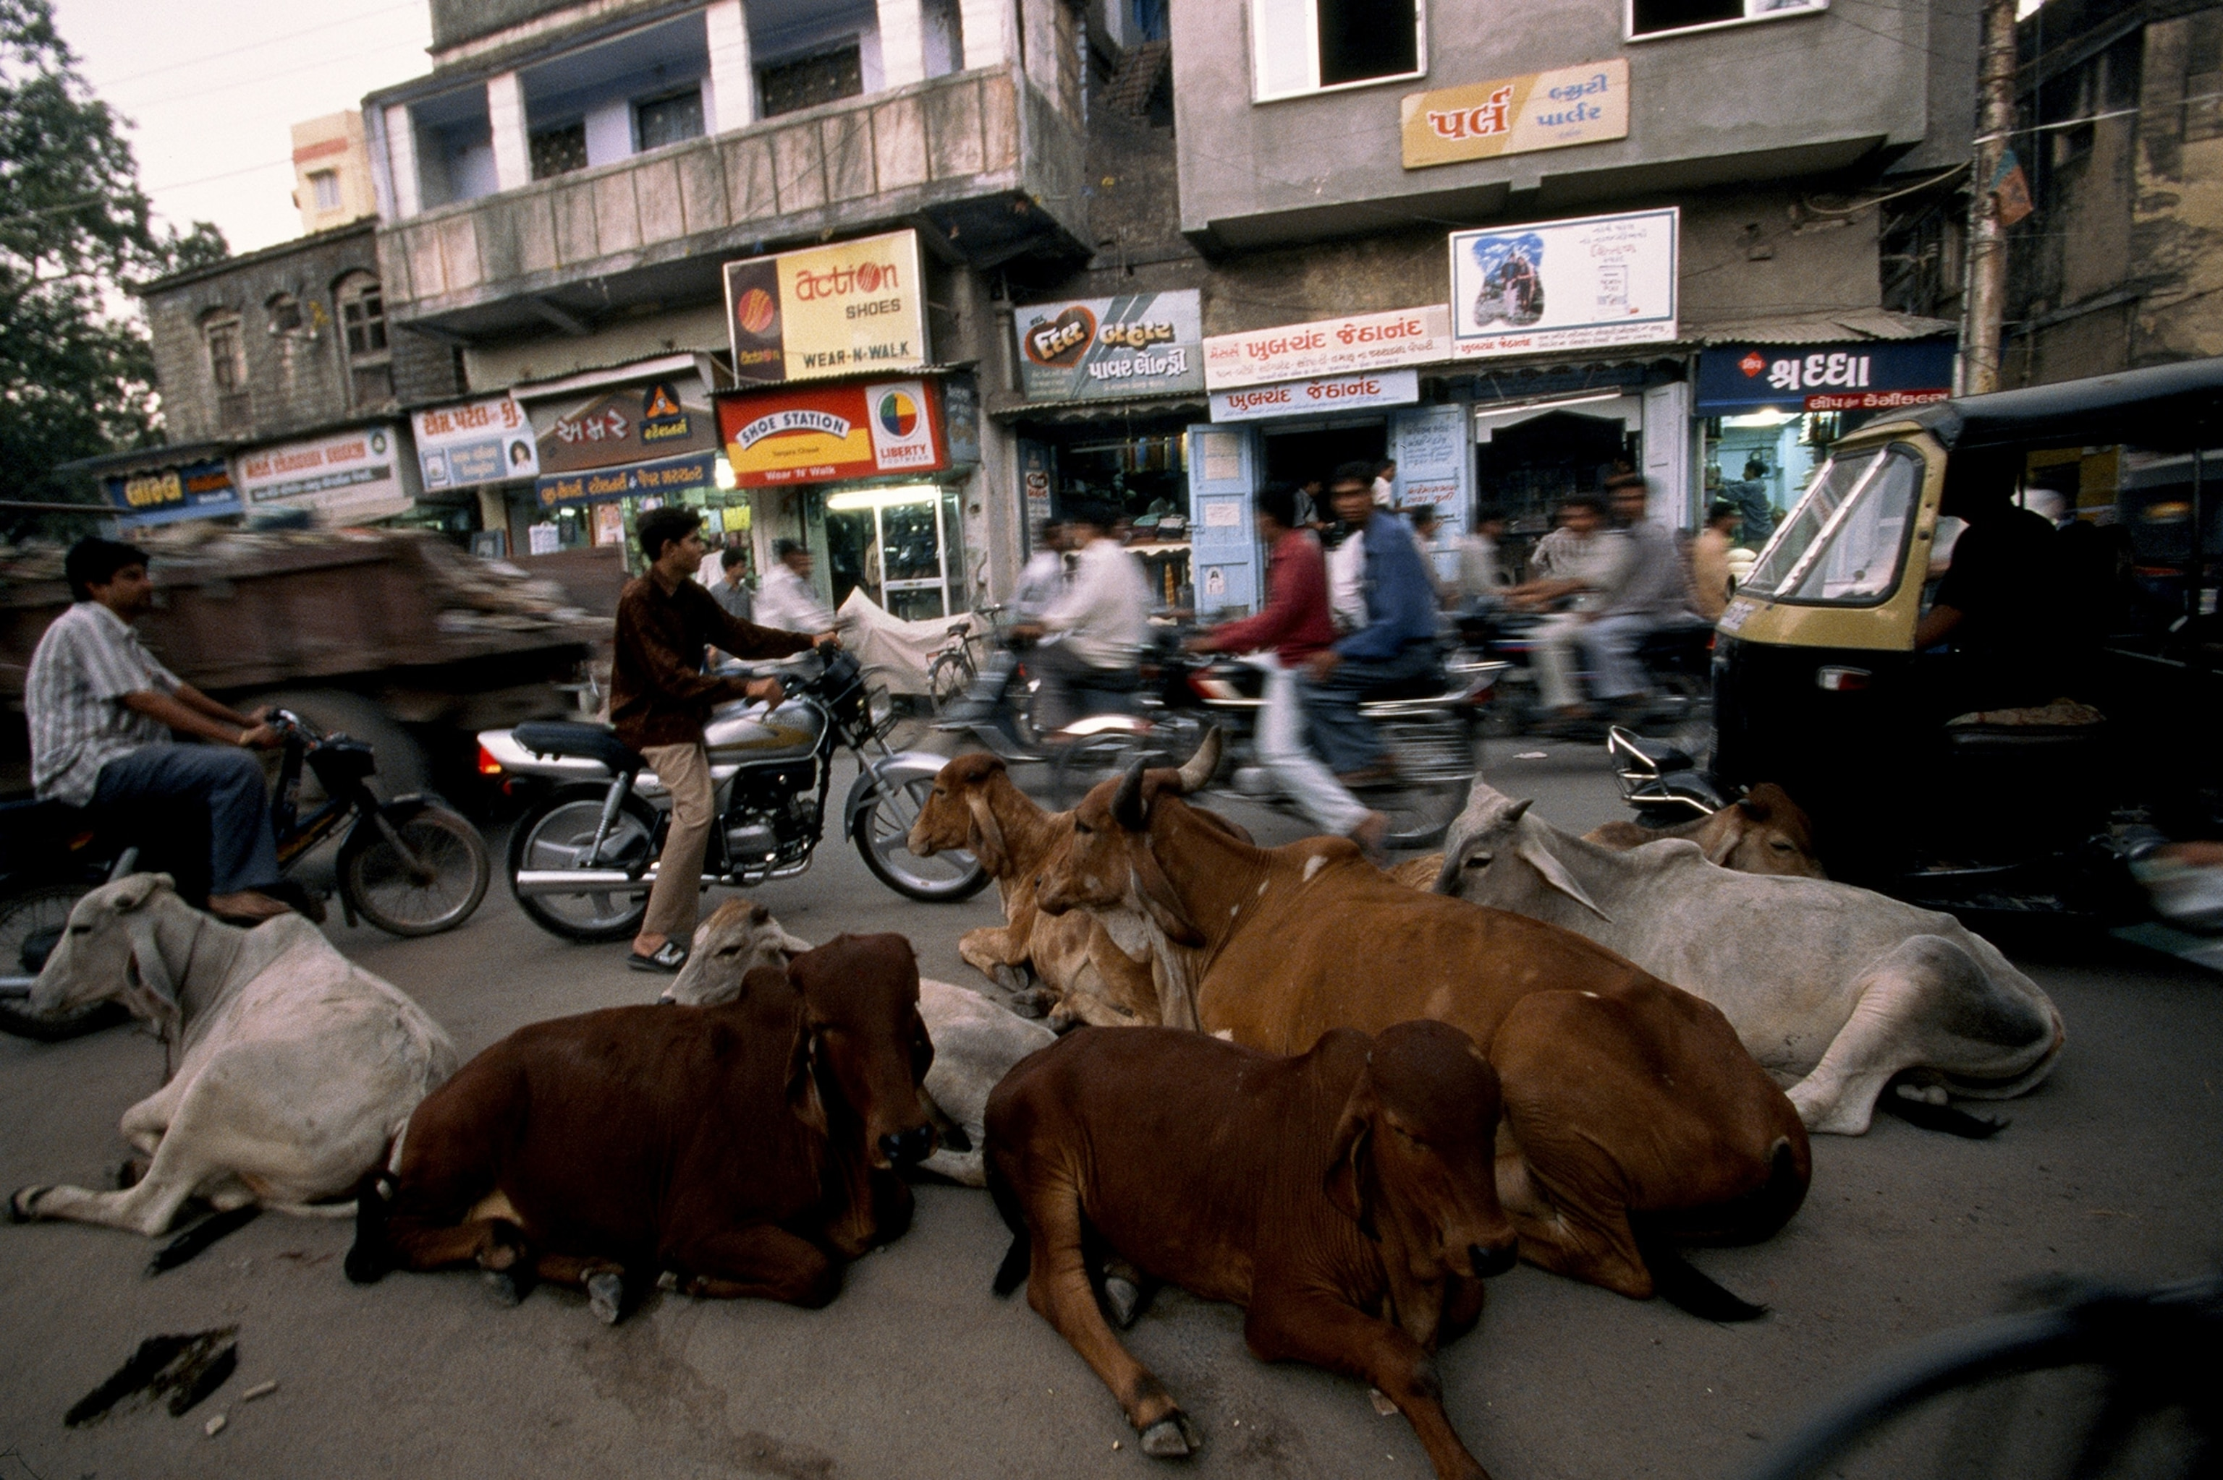
Notes:
Cows are sacred. There are around 5 million stray cows in the country. It is believed cows contain 33 gods and goddesses inside. Eating cows is strictly against the Hindu faith, however it is believed that their milk is also sacred and life sustaining. A survey found that 37% of Indians drink two liters of cow milk every day. Interestingly, most Indian milk comes from buffalo.

Slide 14
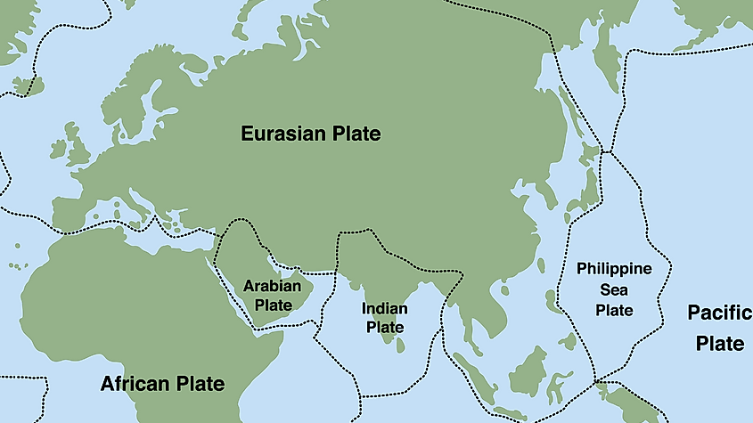

Slide 15
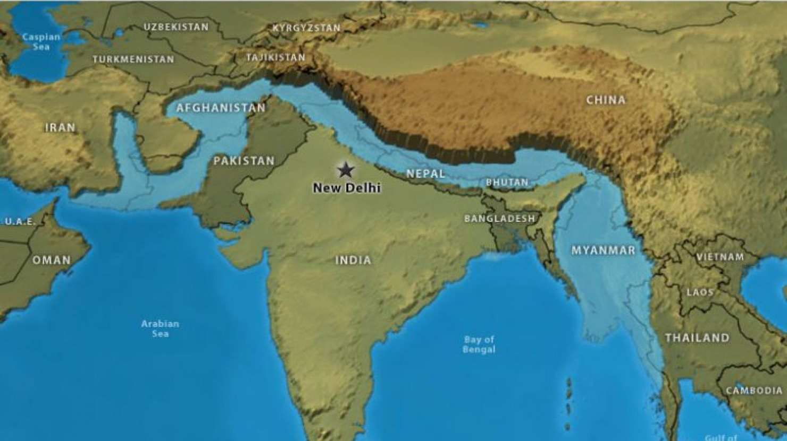

Slide 16
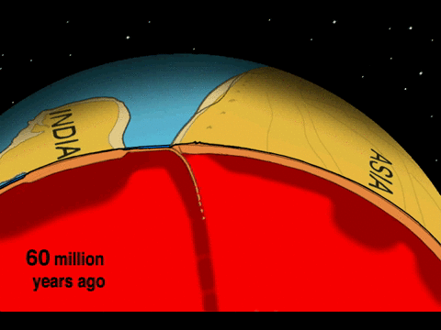

Slide 17
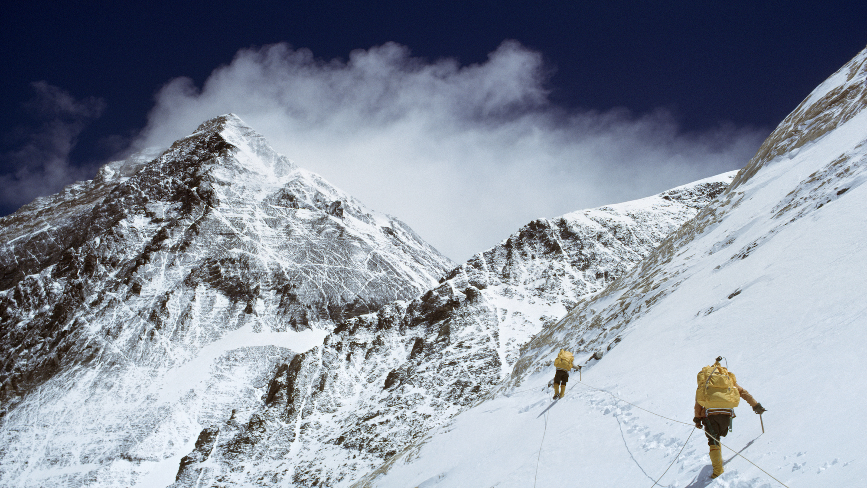

Slide 18
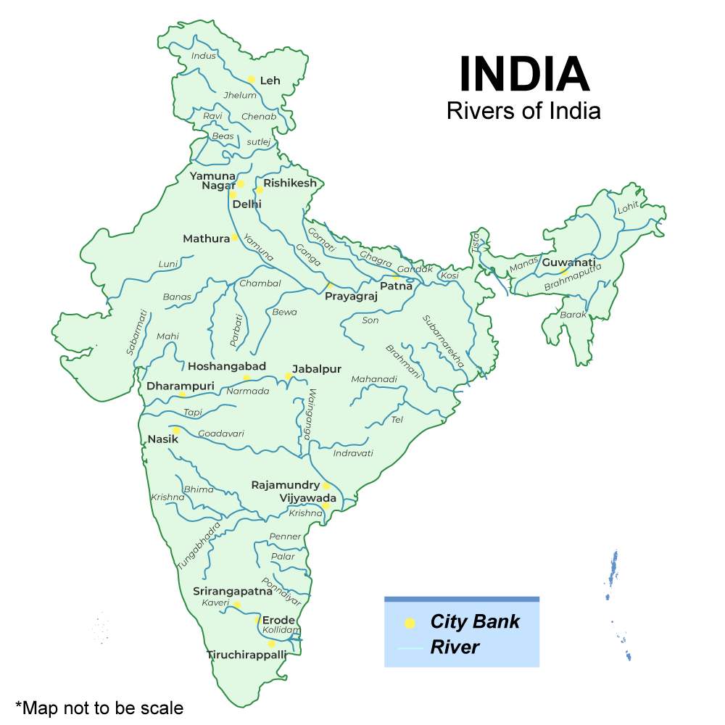

Slide 19
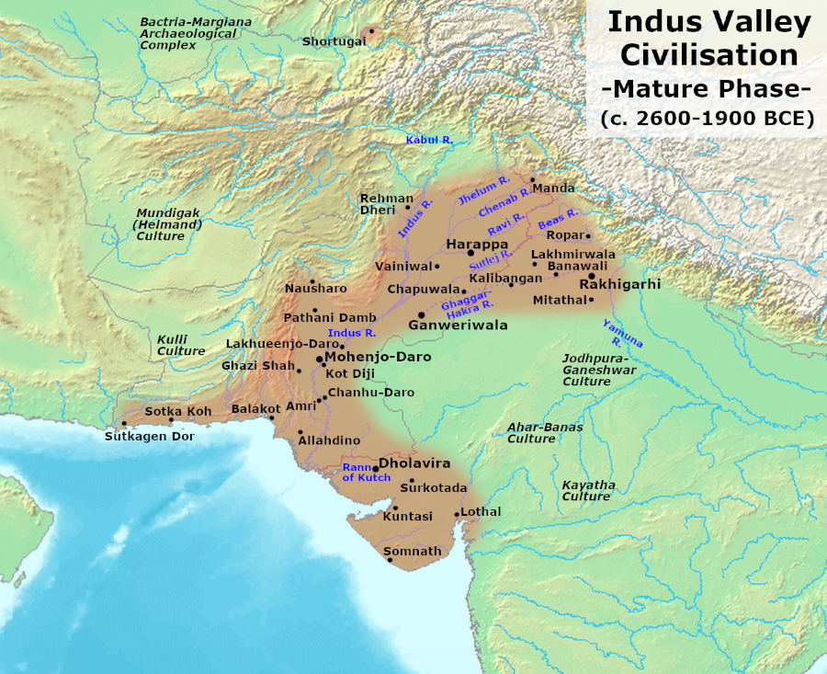

Slide 20
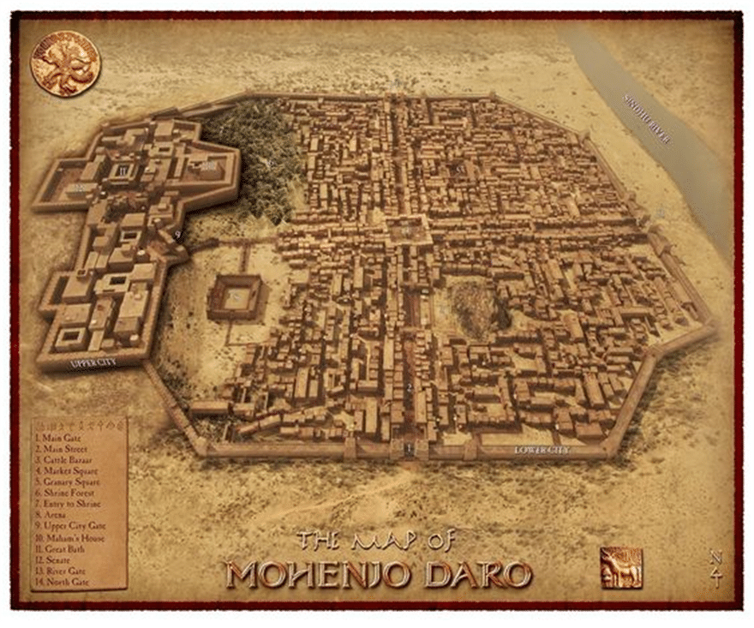

Slide 21
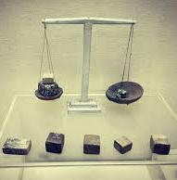
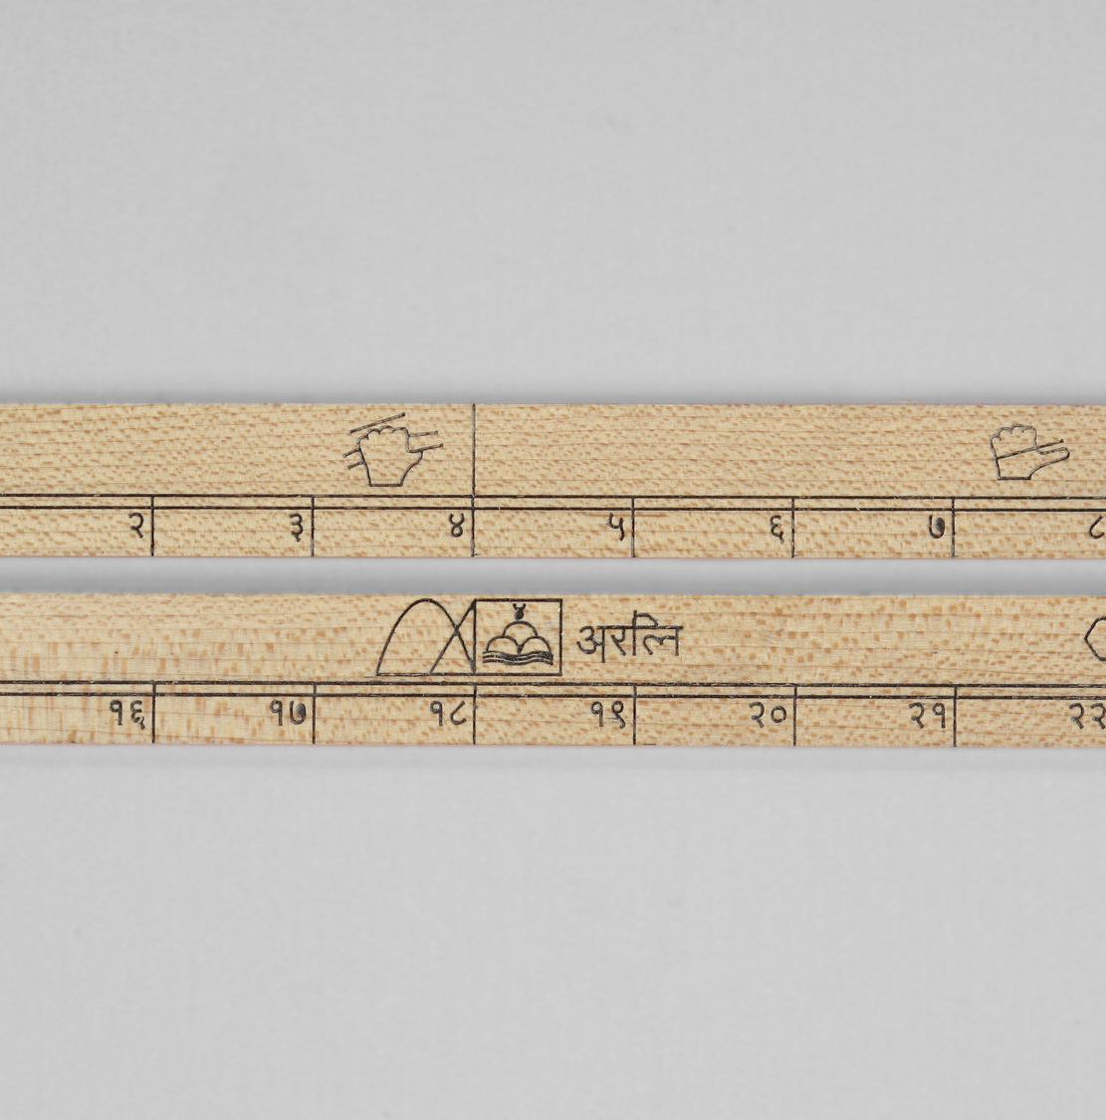

Slide 22
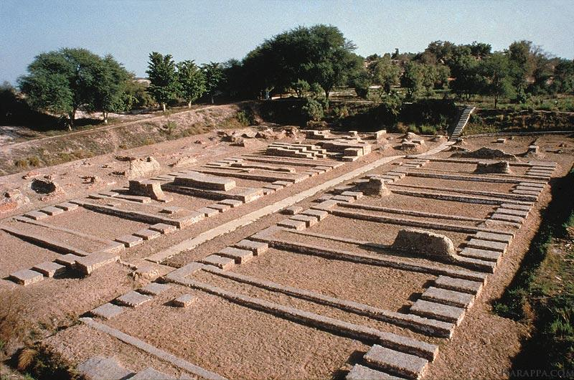
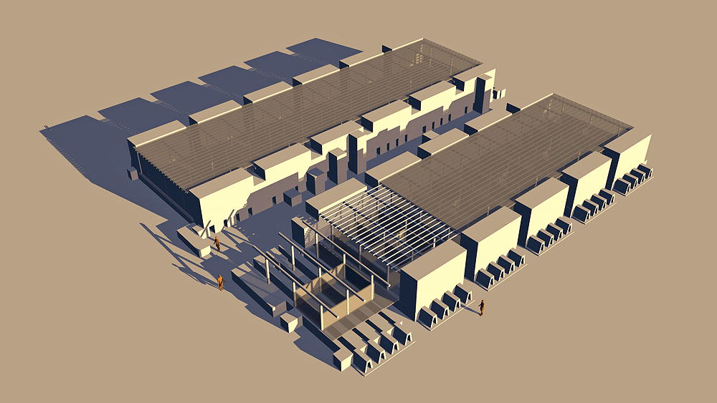

Slide 23
Table Talk (or you have to write it out for a grade)
How did the river valley civilizations get to the point where they could trade?
Meaning, what steps had to happen before trade could being?
I will get you started…
Step 1: Farms produced surplus crops…
You come up with the rest ☺

Slide 24
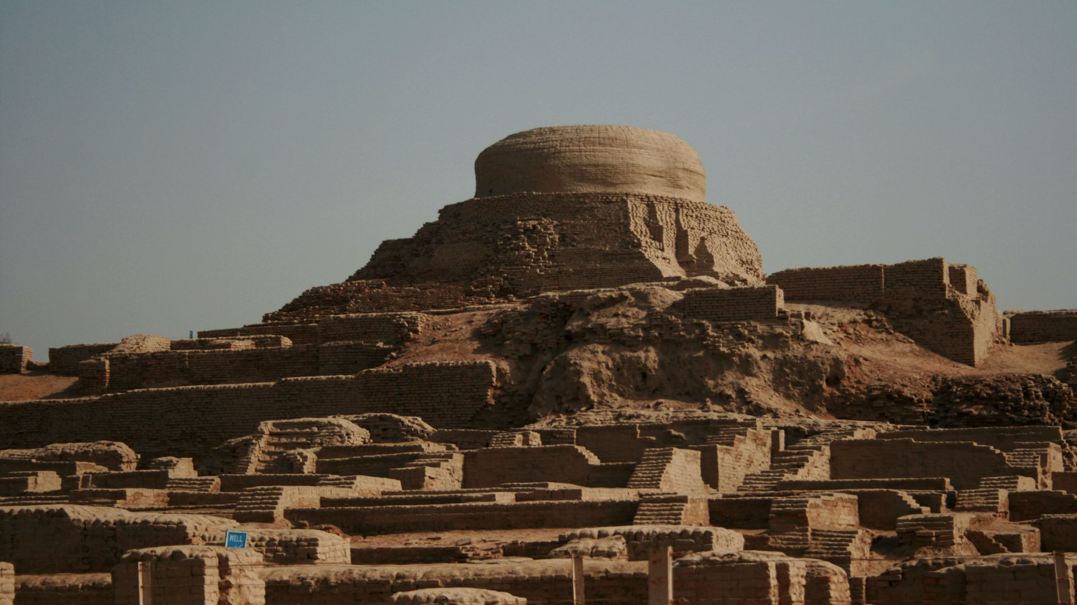

Slide 25
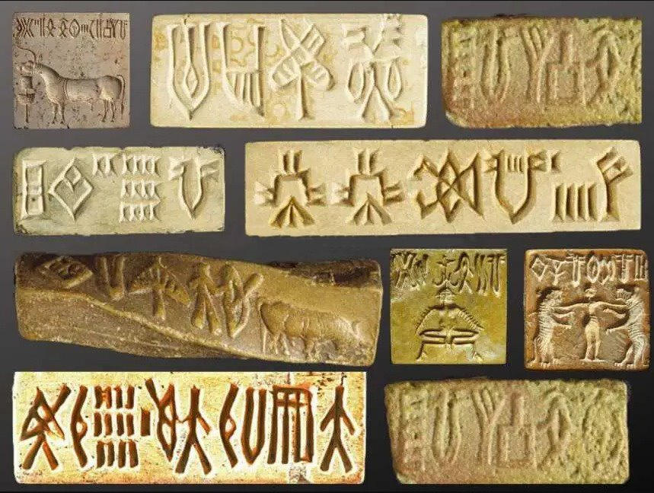

Slide 26
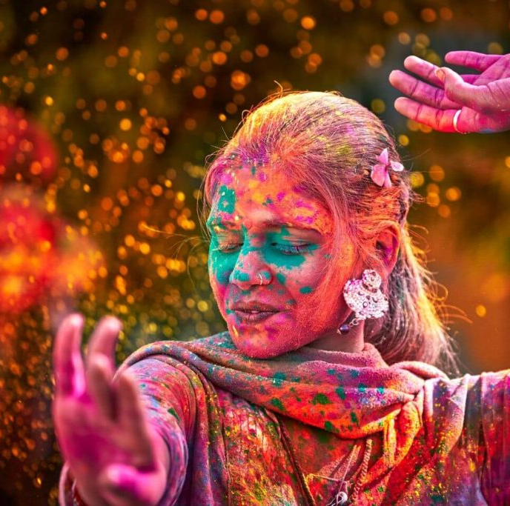
Exit Ticket
What were some of the innovations of the Indus Valley civilization?

Slide 27
Exit Ticket
What were some of the innovations of the Indus Valley civilization?
They had houses with bathrooms and trash chutes and a sewage system. They created an advanced system of weights and measures.
Notes:
Dept. of Commerce, Nat. Inst. Of Standards and Tech, Office of Weights and Management…. Experience with OWM at KYB. Great work for consumers, pain in the butt for techs.

Slide 28
Do Now
How was a granary used?

Slide 29
Do Now
How was a granary used?
A granary was used to store surplus grain until it was ready to be used or traded.

Slide 30
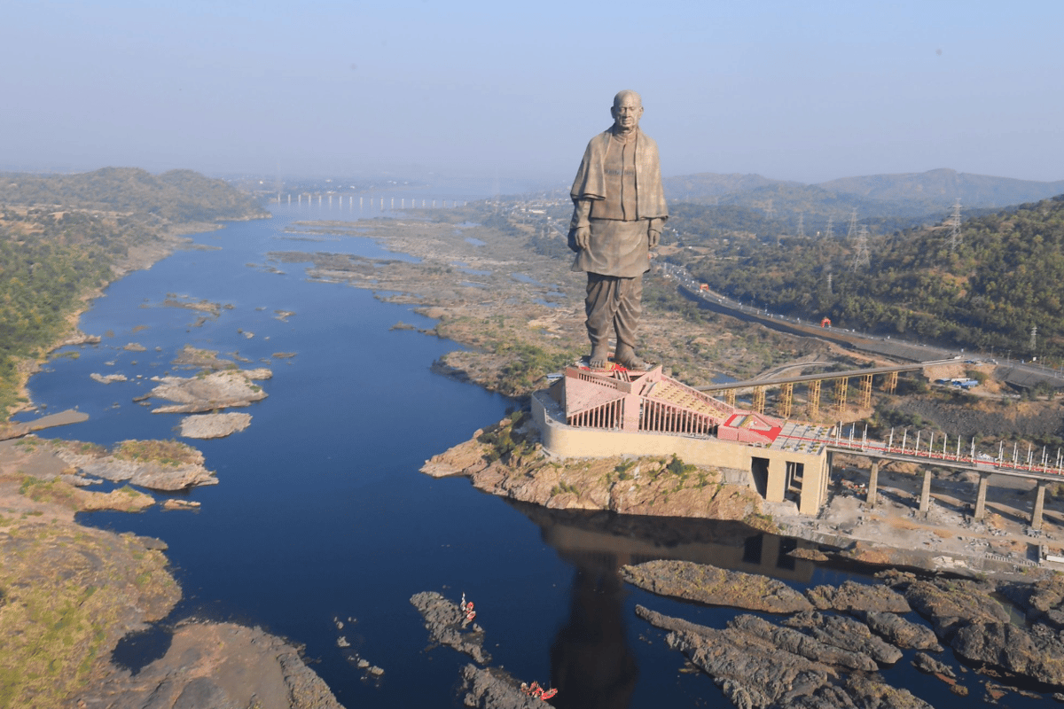
Notes:
The world's tallest statue is located in Gujarat, India. Standing almost 600 feet tall, the Statue of Unity depicts Indian freedom fighter and politician Sardar Vallabhbhai Patel, one of the most prominent leaders of the Indian independence movement, and the first Deputy Prime Minister of India.

Slide 31
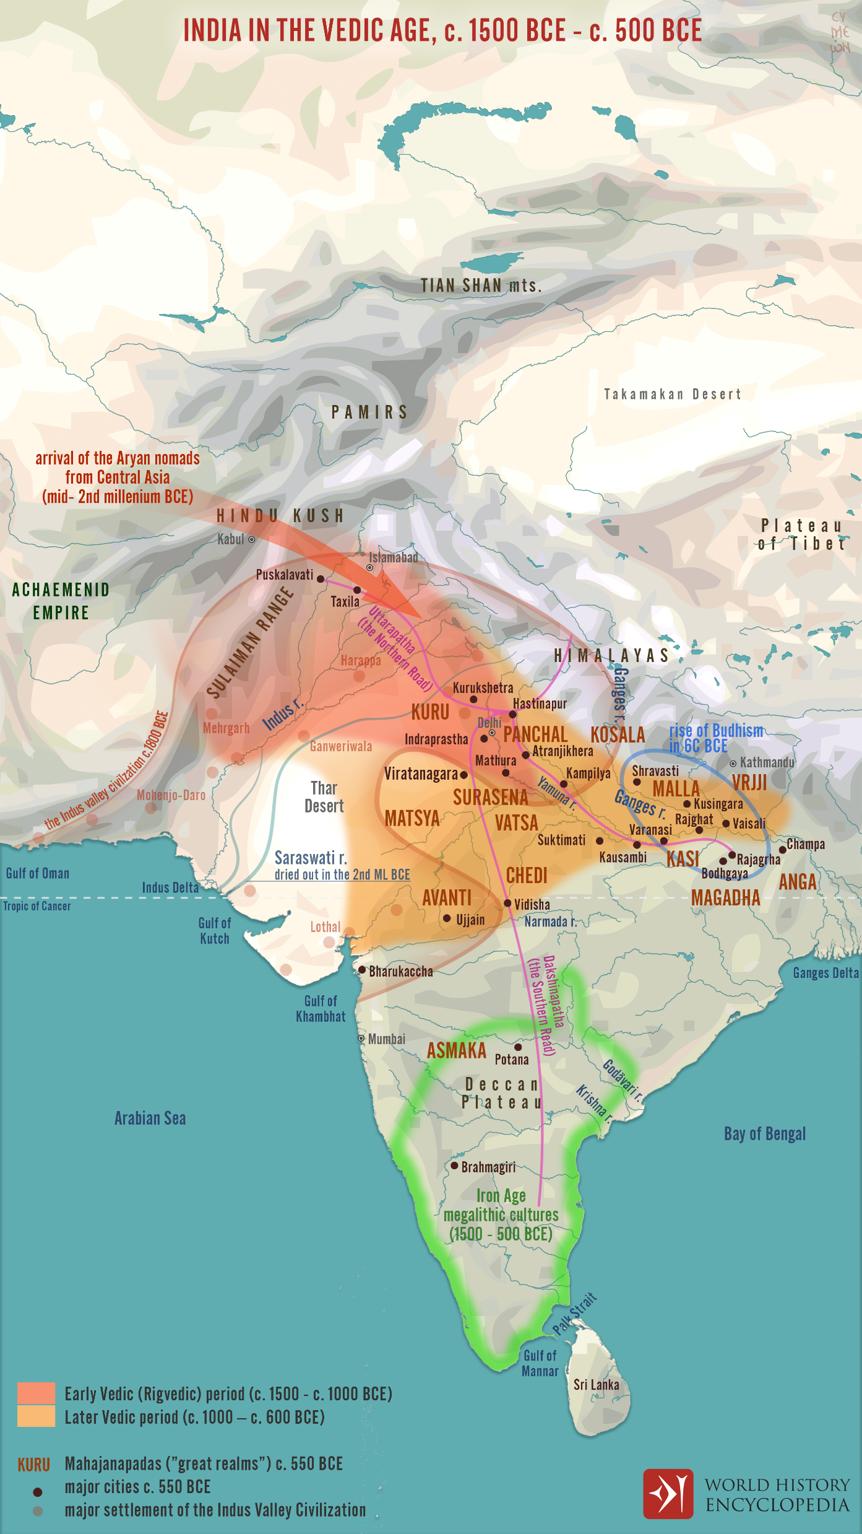
Notes:
Map of Vedic Age

Slide 32
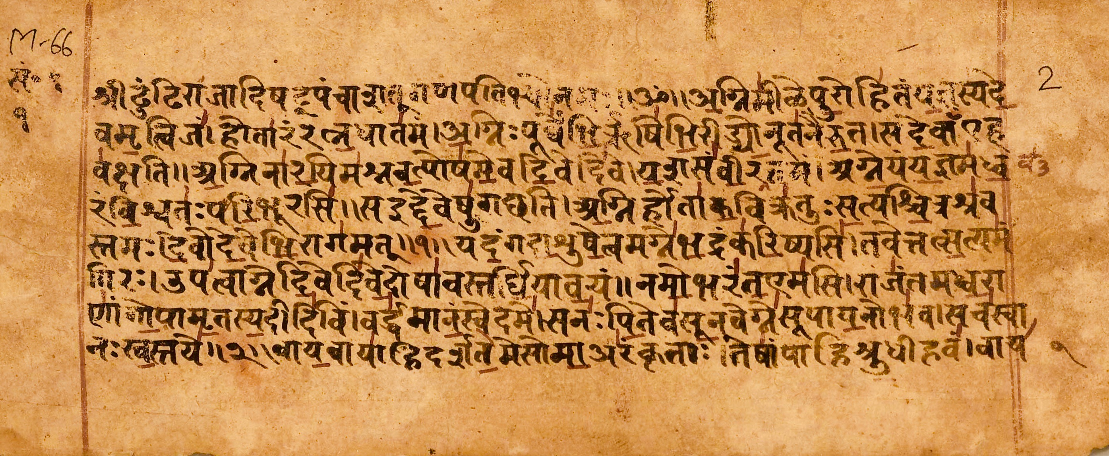
Notes:
Example of a Veda

Slide 33
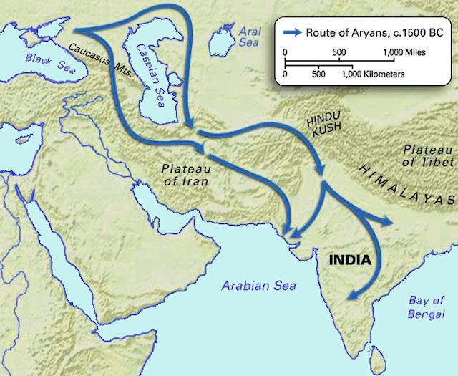
Notes:
Migration of Aryan peoples

Slide 34
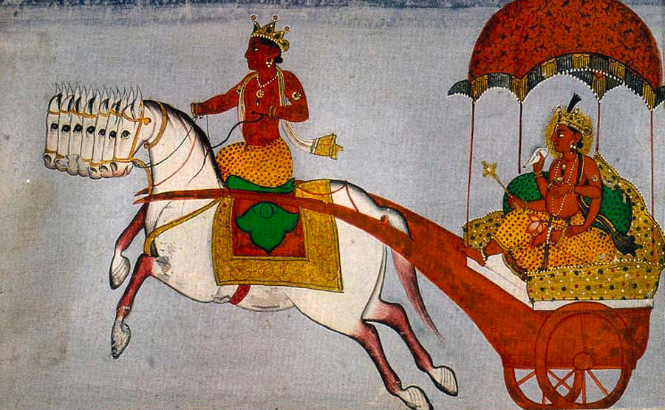
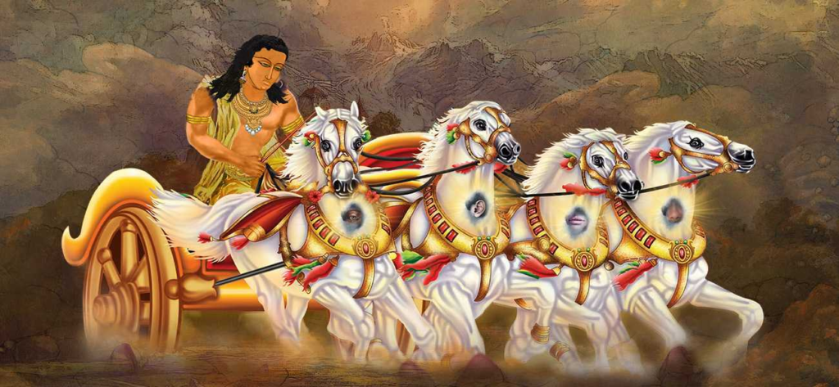

Slide 35
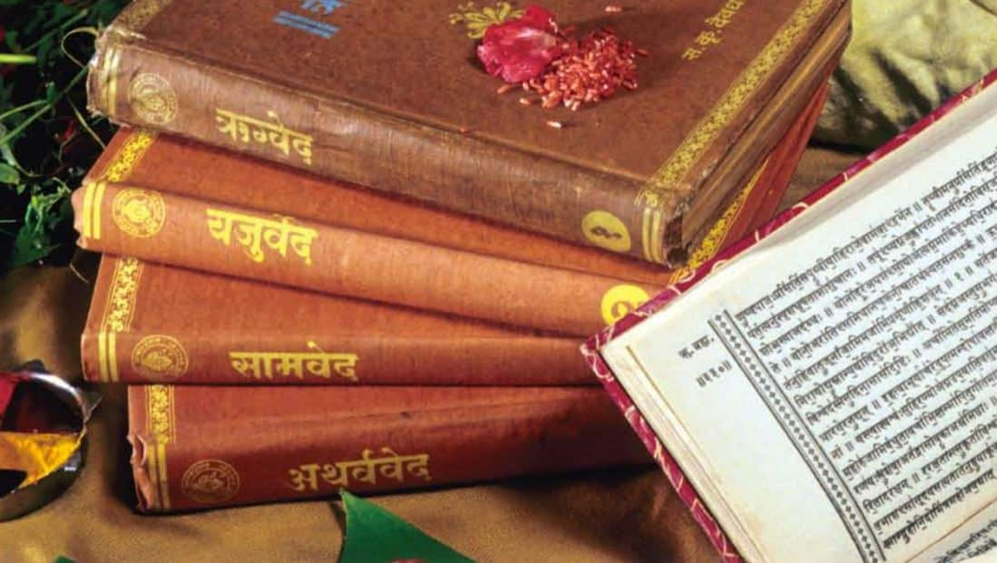

Slide 36
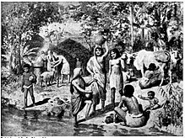
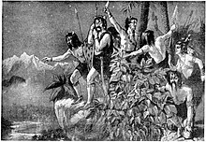
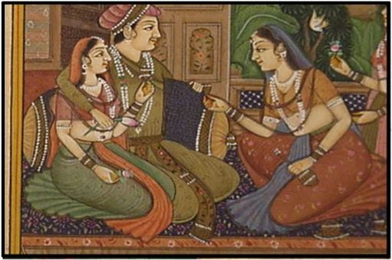

Slide 37
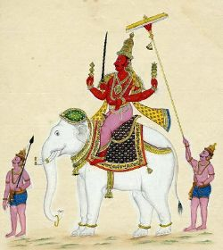
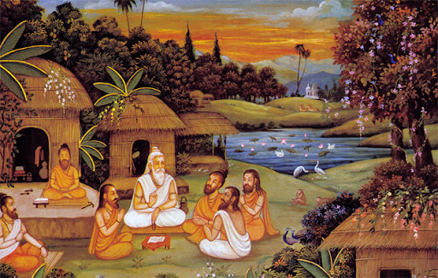

Slide 38
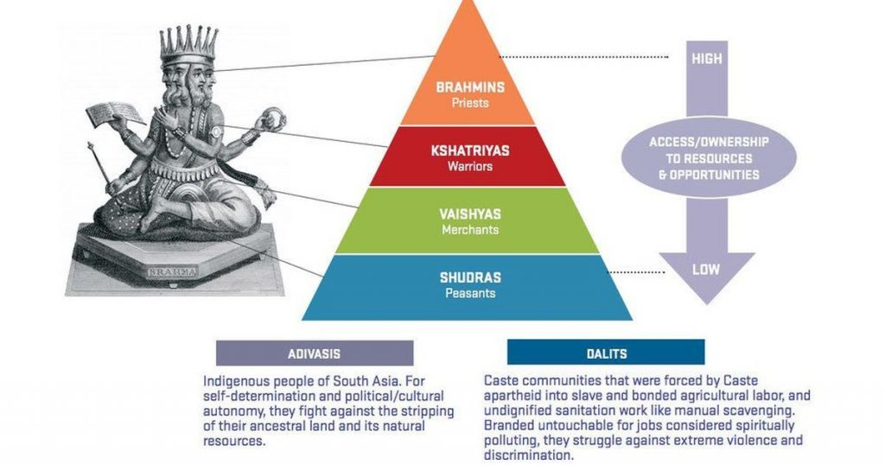

Slide 39
Desk Discussion
Why do you think priests are placed above rulers in the caste system?

Slide 40
Desk Discussion
Why do you think priests are placed above rulers in the caste system?
Priests were believed to be in contact with the gods, and gods are greater than humans.

Slide 42
Exit Ticket
Explain the meaning of the term caste in Indian history.

Slide 43
Exit Ticket
Explain the meaning of the term caste in Indian history.
It is the social class in which a person is born into.

Slide 44
Do Now
Why are the Vedas important?
They provide a record of…

Slide 45
Do Now
Why are the Vedas important?
They provide a record of Indo-Aryan life and beliefs; they are still used today.

Slide 46
North Sentinal Island/North Sentinalese

Slide 52
Notes:
Shakti, Shiva, Krishna, Vishnu, Brahman, Sarasvati

Slide 61
Exit Ticket
How did the Upanishads and the Hindu epic poems contribute to the growth of Hinduism?
Unlike the Vedas, the Upanishads…

Slide 62
Exit Ticket
How did the Upanishads and the Hindu epic poems contribute to the growth of Hinduism?
Unlike the Vedas, the Upanishads could be read and understood by everyone.

Slide 63
Do Now
What do the terms “Brahman”, “karma”, and “moksha” mean in the Hindu faith?
Brahman is…
Karma is…
Moksha is…

Slide 64
Do Now
Brahman is the supreme cosmic consciousness, spiritual force, or God
Karma is the effects of a person’s actions in this and in previous lives.
Moksha is liberation from reincarnation.

Slide 65
Notes:
Great Buddha statue in Bodh Gaya. It stands 80ft tall, with the Buddha 64ft

Slide 66
Notes:
The Great Buddha of Thailand in Ang Thong province. This Buddha stands 302ft tall. There are bigger Buddha but this is the biggest statue of THE Buddha.

Slide 75
Exit Ticket
What are Buddhism’s moral teachings, or teachings about right and wrong?
Buddhism teaches that it is wrong to…

Slide 76
Exit Ticket
What are Buddhism’s moral teachings, or teachings about right and wrong?
Buddhism teaches that it is wrong to lie, speak hurtful words, steal, or harm living things.

Slide 77
Do Now
What does “nirvana” mean in Buddhism?
Nirvana is a state of…

Slide 78
Do Now
What does “nirvana” mean in Buddhism?
Nirvana is a state of blissful peace achieved through enlightenment.

Slide 85
Class Discussion
How did Chandragupta control the empire?
What type of taxes supported Chandragupta’s government?
Why did Chandragupta put his face on money?

Slide 87
Kautilya
Education is the best friend. An educated person is respected everywhere. Education beats the beauty and the youth.
A man becomes great by his actions, not by birth.

Slide 88
Exit Ticket
How did a bureaucracy help Maurya emperors rule?
Appointed officials in each…

Slide 89
Exit Ticket
How did a bureaucracy help Maurya emperors rule?
Appointed officials in each region, province, and village carried out the emperor's orders.

Slide 90
Do Now
How did Chandragupta Maurya conquer Magadha?
He first attacked…

Slide 91
Do Now
How did Chandragupta Maurya conquer Magadha?
He first attacked its borders before attacking its capital.

Slide 93
Notes:
Live coals = hot charcoal

Slide 95
Ashoka’s Three Principles
Ahimsa
No hurting living things
Hunting outlawed
Tolerance
Respect different beliefs and customs
Well-being
Rule the people well

Slide 96
Class Discussion
What was Asoka like when he first became emperor?
Why would his experience during war cause him to preach tolerance?
What is an example of Asoka’s newfound compassion?

Slide 100
Exit Ticket
What role did the stone pillars created play in Asoka’s rule?
They enabled him to…

Slide 101
Exit Ticket
What role did the stone pillars created play in Asoka’s rule?
They enabled him to communicate with his people and promote moral law. He used the messages on the pillars to urge people to live better lives.

Slide 102
Do Now
Use the word “tolerance” to describe Asoka’s style of ruling.
Ashoka promoted tolerance of…

Slide 103
Do Now
Use the word “tolerance” to describe Asoka’s style of ruling.
Ashoka promoted tolerance of all religions, which led to peace and prosperity.

Slide 107
Class Discussion
What board game was invented in India?
What other fables do you know and what are their morals?

Slide 110
Exit Ticket
How do historians know that metal workers in the Gupta empire made great progress in metallurgy?
The Iron Pillar of Delhi was made…

Slide 111
Exit Ticket
How do historians know that metal workers in the Gupta empire made great progress in metallurgy?
The Iron Pillar of Delhi was made in Gupta times from one piece of iron and has not rusted even though it is over 1500 years old.

