Slide 1
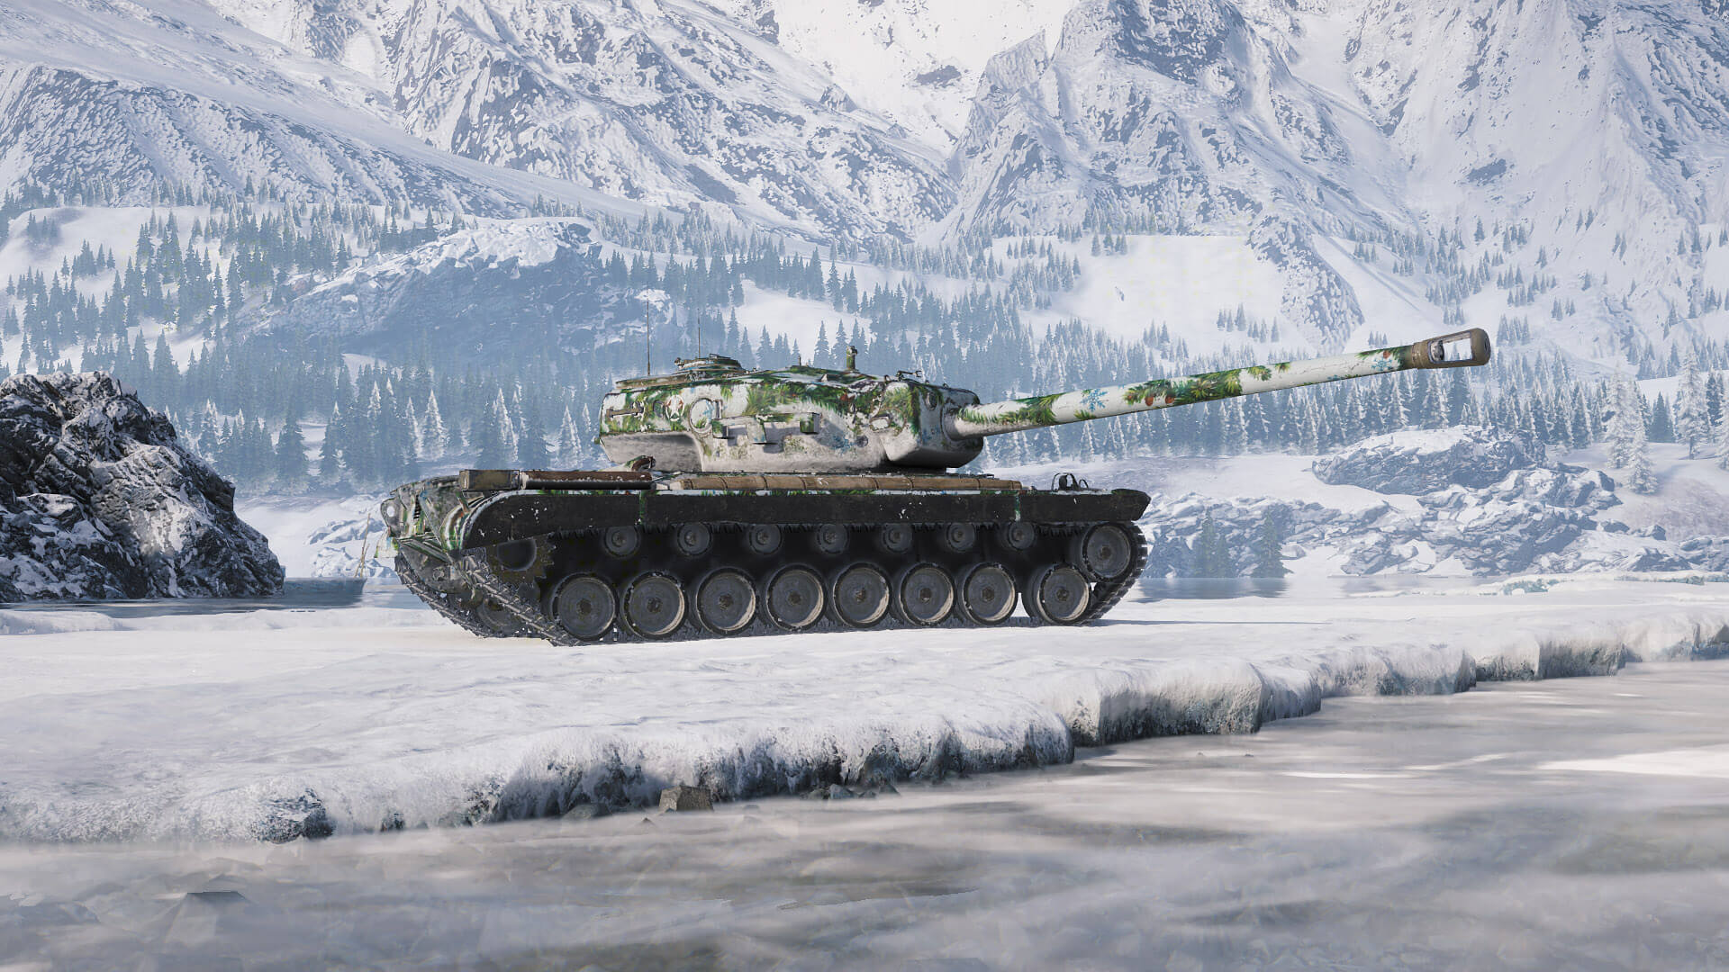
GLOBAL CONFLICT

Slide 2
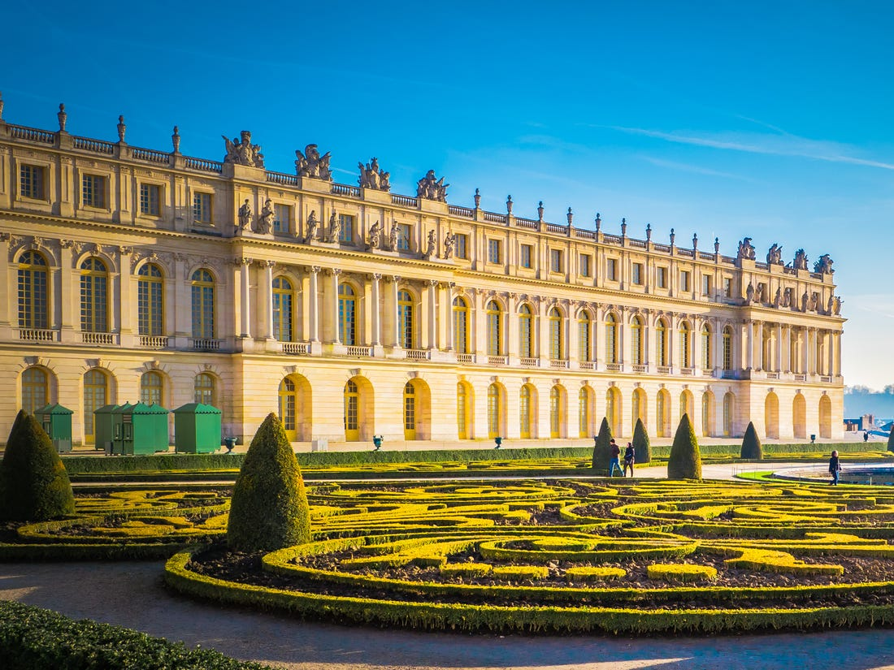
THE INTERWAR PERIOD

Slide 3
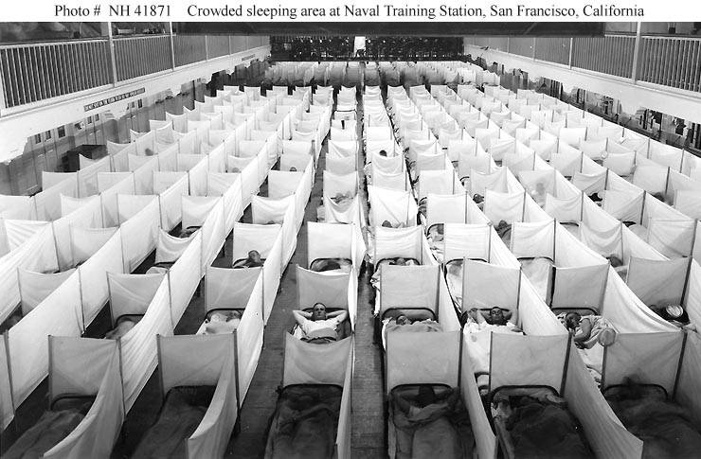
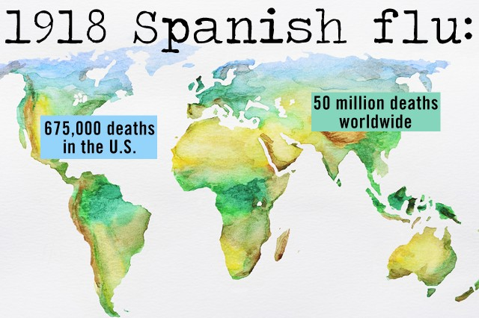
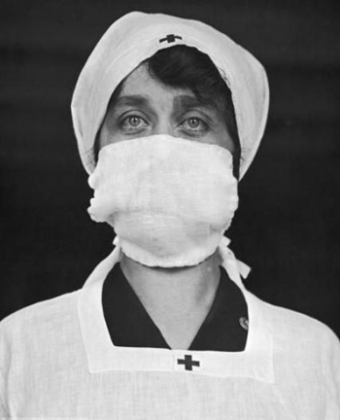
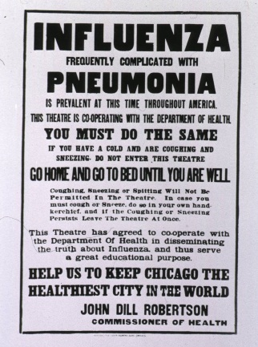
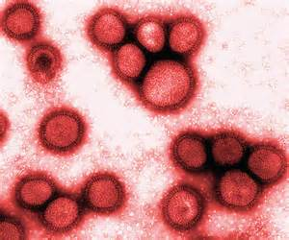
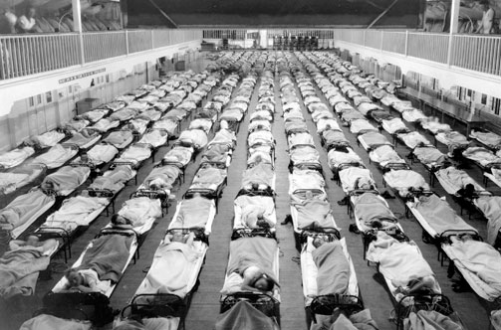
2nd greatest plague in world history hits as almost 5% of the world’s population dies in one year due to a rare strain of influenza.
*Named the Spanish Flu because Spain was one of the few nations that didn’t censor news of the illness, for 2 years about every public building was shut down (schools, theaters, sporting events, etc) & those stricken with it were put in quarantine.

Slide 4
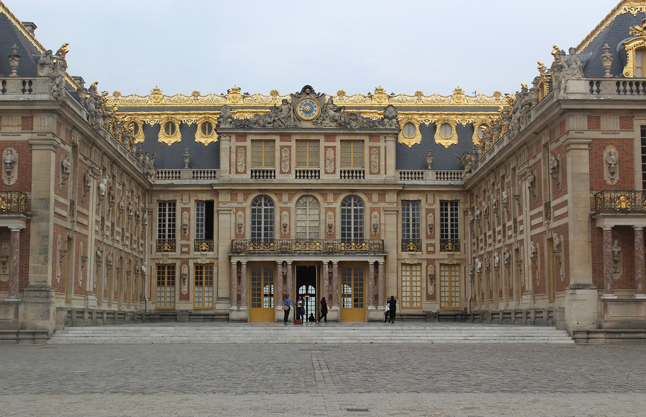
Requests from Versailles Allied victors met in france & told world they were creating a peace plan led by the big four (Britain, france, italy & usa).
USA: led by Woodrow Wilson wanted a 14 point plan to stop future wars (freedom of seas, no secret treaties, arms reductions, league of nations).
Britain & France: War retributions & colonies.
Italy: Demanded Austria as a colony as it was promised.
Japan: conquered part of northern china & wanted to keep it.
*A total of 27 nations met at Versailles and most historians look back and state that ONLY USA really had the world’s best interest at heart. The meeting lasted over a year and included delegates from Ukraine, Palestine, and other areas not yet nations.

Slide 5
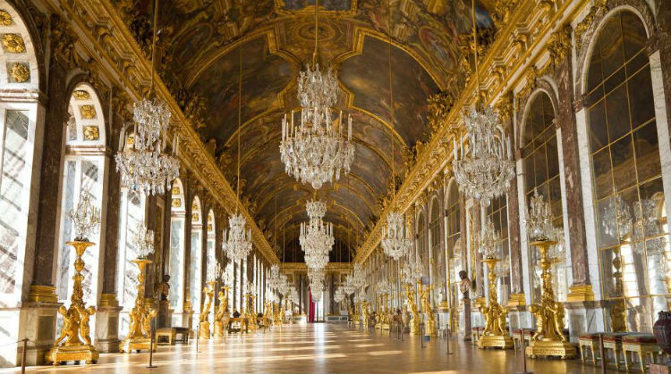
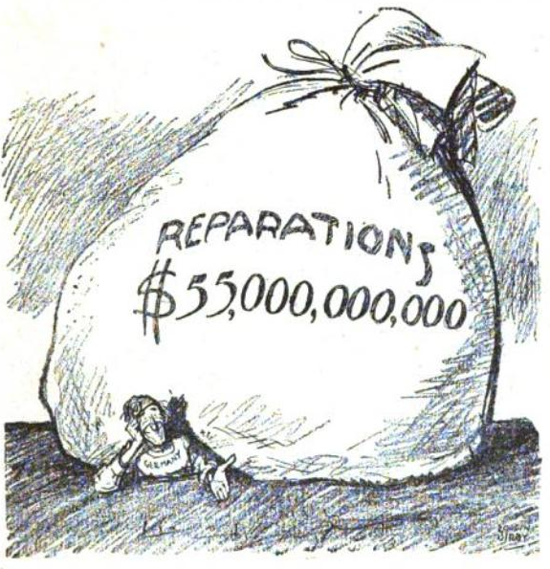
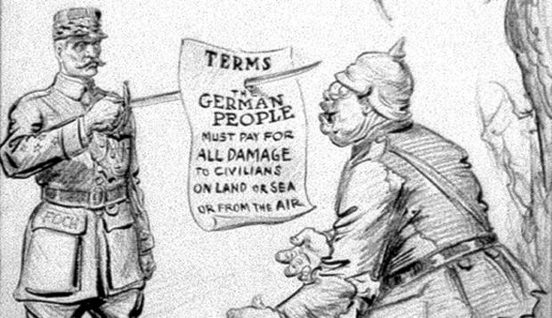
DECISIONS FROM VERSAILLES
Germany gets full blame for war: must pay back reparations, lose lands, dismantled military (german citizens will vow revenge for this treaty).
Italy does NOT get Austria (lied to by france & allies).
Japan DOES get to keep northern China (empowers their industrialization).
Ottoman Empire ends and gets carved up into modern Arab Nations.
Eastern Europe also gets carved up into 9 new nations.
USA & Wilson are ignored, only 1 of his 14 points are followed, & when he returns home the congress votes against joining league of nations.

Slide 6
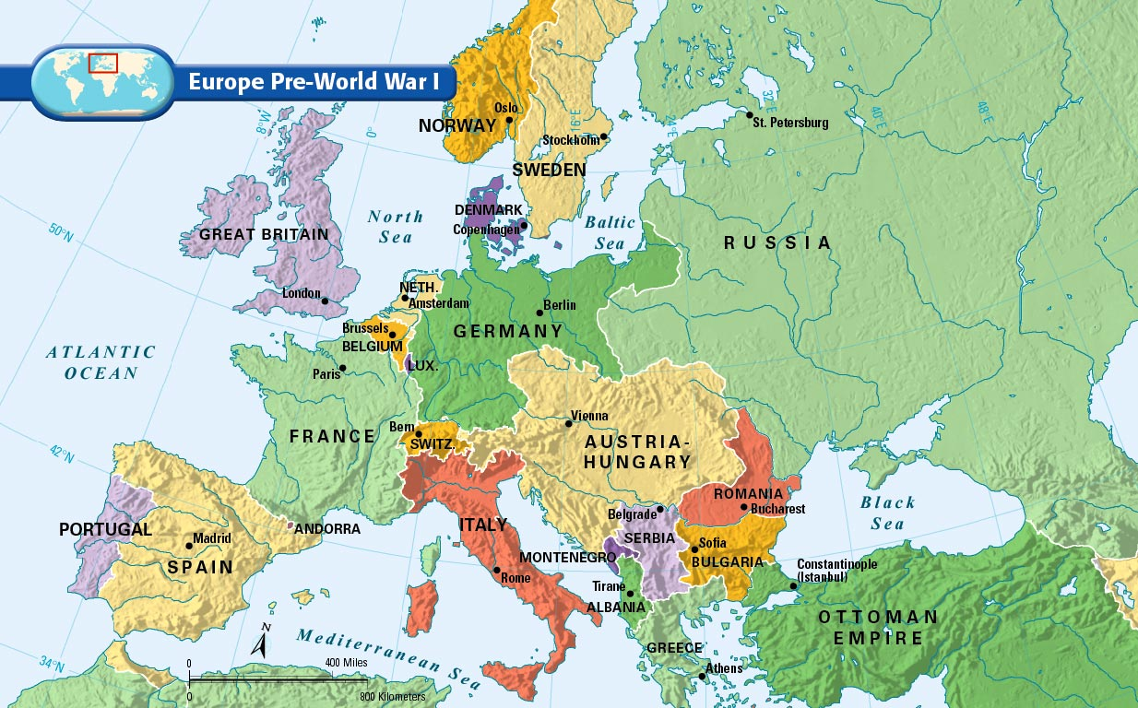

Slide 7
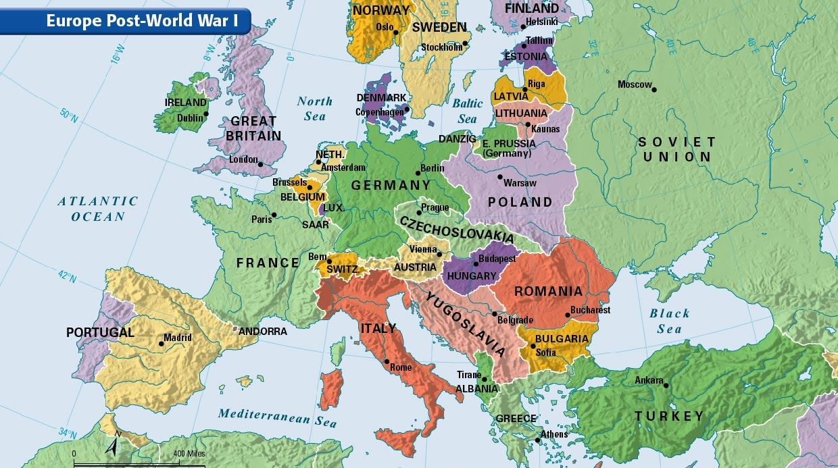

Slide 8
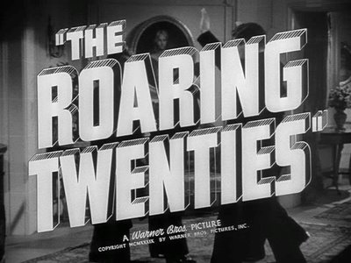
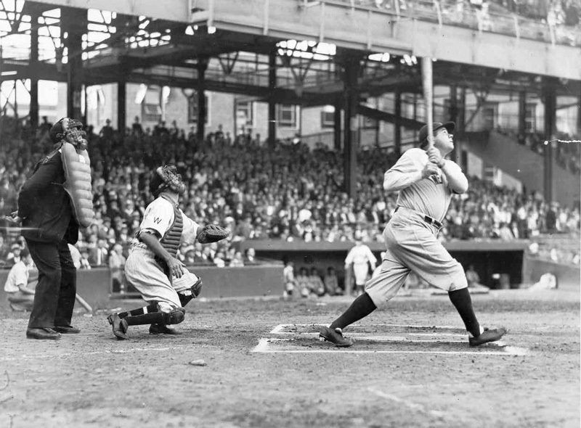
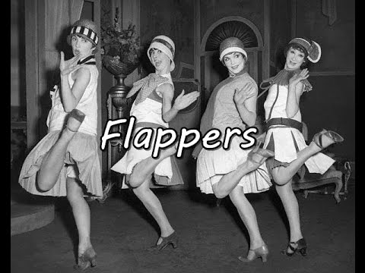
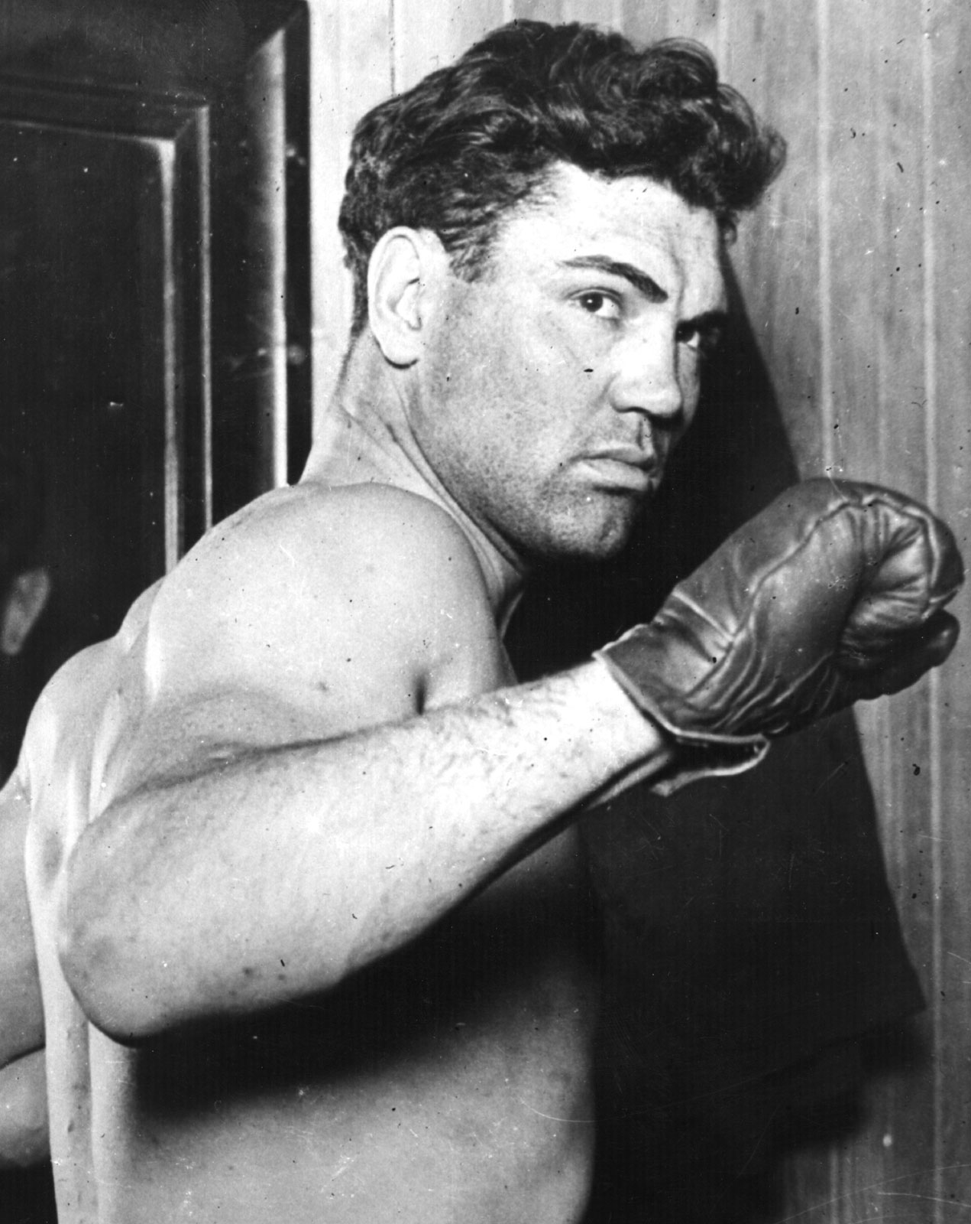
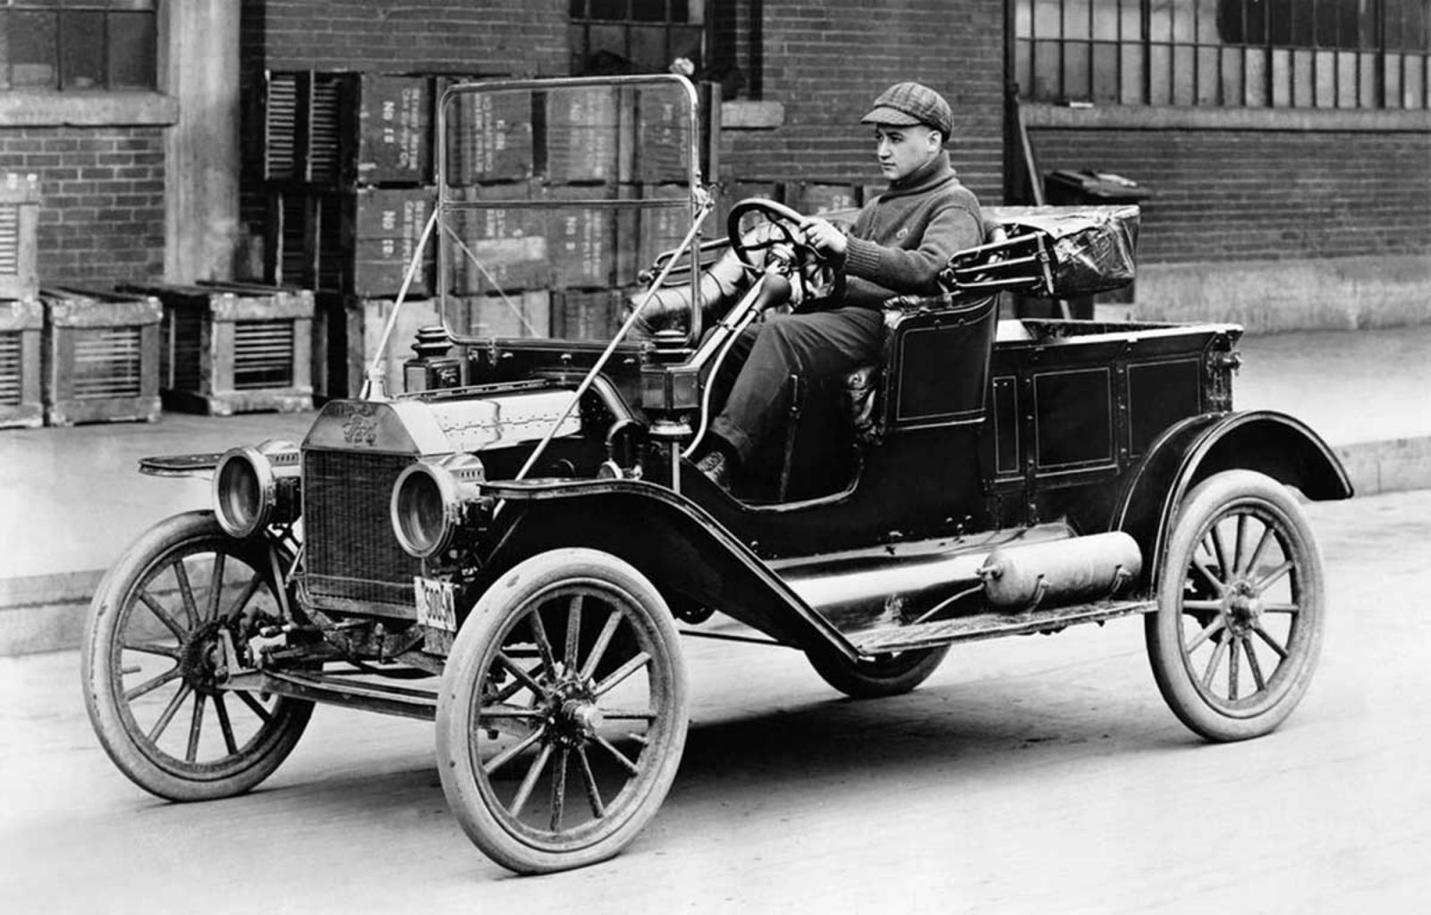
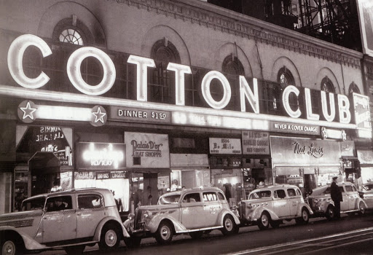
USA booms: movies, sports (baseball, boxing), radios, appliances, phonographs, cars (ford’s model t), clothes, fads & Harlem Renaissance. Americans paid for it with credit (Including stock market purchases).
Laissez-faire economics: “let do” or “do nothing.” Government did not interfere with business at all.
*Heroes like Babe Ruth in baseball, Jack Dempsey in boxing, Greta Garbo & Rudolph Valentino in Hollywood, Charles Lindbergh flies across the Atlantic.
*Hidden inside this decade Americans love to celebrate is massive racism like Chicago Riots, the KKK comes back, minorities like Italians are persecuted.

Slide 9
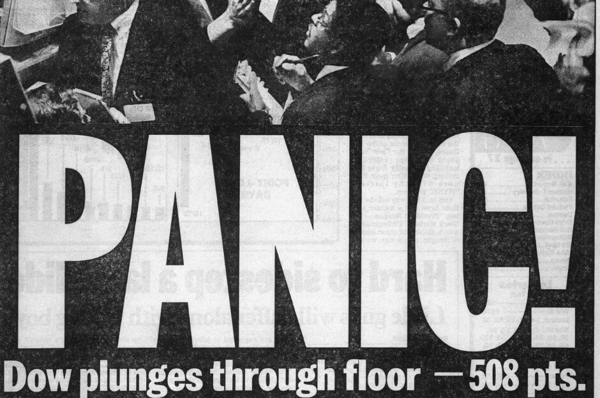
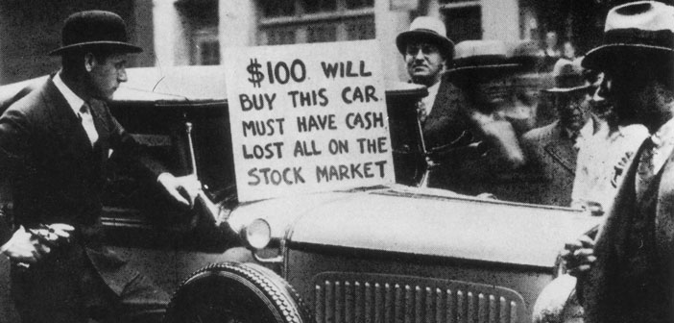
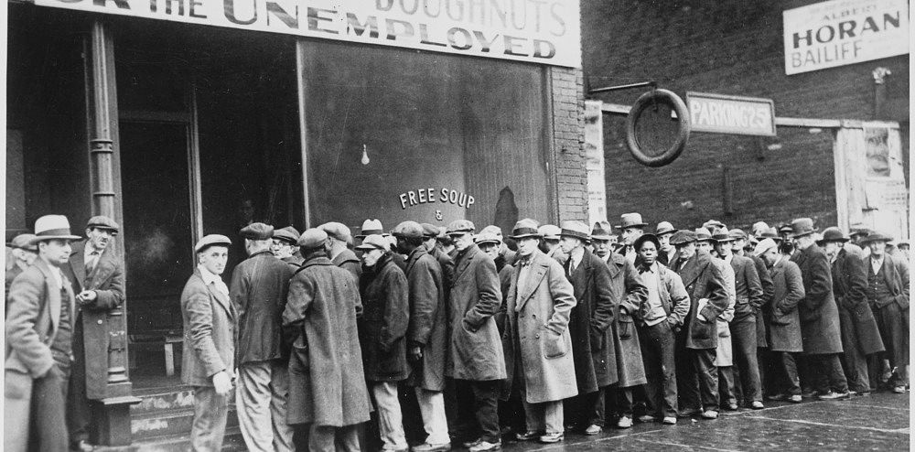
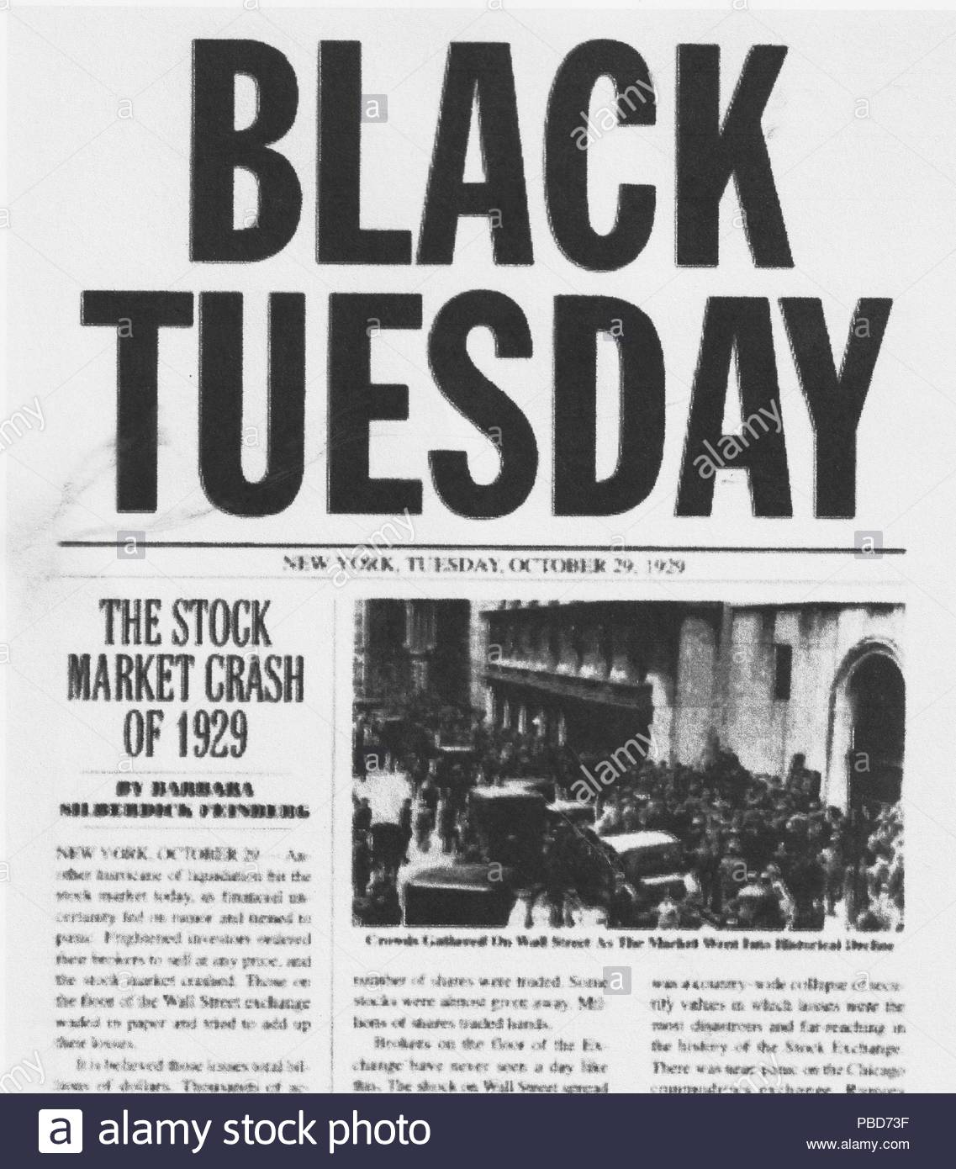
STOCK MARKET CRASH
Wall Street drops to record lows as stocks are sold at a $14B loss in one day in 1929 (stocks continue to plummet until $30B is lost that week).
*GM ($73 a share down to $8), US Steel ($262 to $22), Montgomery Ward ($138 to $4). This four year drop continues until 89% of the money is gone (about $750B in today’s $$$).
*30,000 businesses fail per year, 40% of banks closed, family income drops 33% nationally, 400,000 farms are lost. 50% of children were unnourished. Unemployment went from 5% to 25% (Chicago hits 50%, Cleveland 80%). AA workers were the last hired & the first fired.

Slide 10
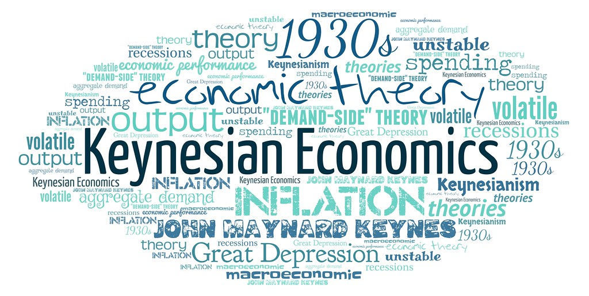
Great depression
USA turns to Keynesian Economics (Government deficit spends to stimulate economic growth) thru New Deal Programs to help end crisis. Money brought relief, recovery & reform.
*Stock market crash→ loss of homes→ closed business → loss of jobs → closure of banks → world collapse.
*As USA collapses economically any hope Germany had is gone, USA bank loans were Germany’s recovery hope.
*Billions of dollars were earned by workers through gov’t jobs but nothing seemed to end the unemployment. Hope was restored but technically WWII officially ends GD.

Slide 11
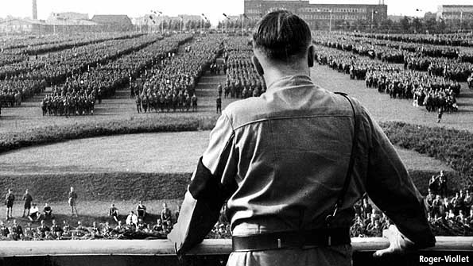
CAUSES OF WWII

Slide 12
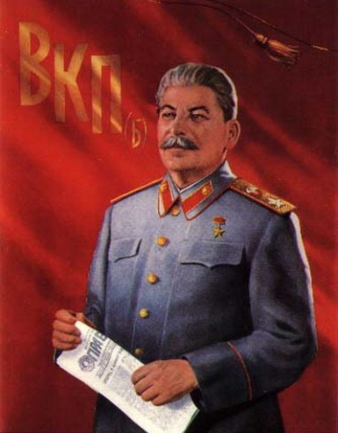
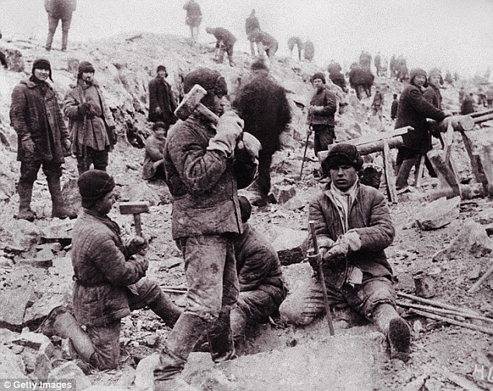
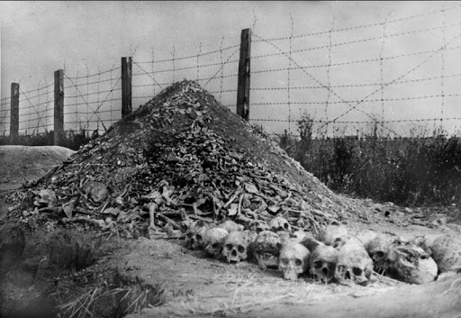
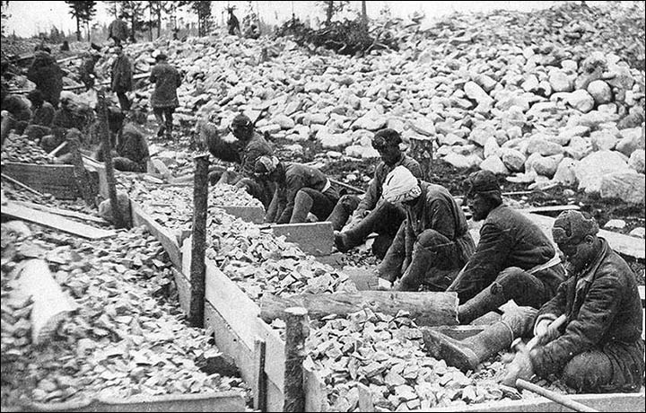
SOVIET UNION
Soviet Union transfers communist power from Vladimir Lenin to (believe it or not) an even worse murderer named Joseph Stalin. Stalin will kill 20M (millions went to gulags) while industrializing (2nd greatest killer in world history).
*Death totals could be 40M. 10M died in Ukraine region as Great Purge forced farmers to work at factories. There’s a lot to it, but essentially USSR profited by exporting food in exchange for industrial supplies as people starved to death.

Slide 13
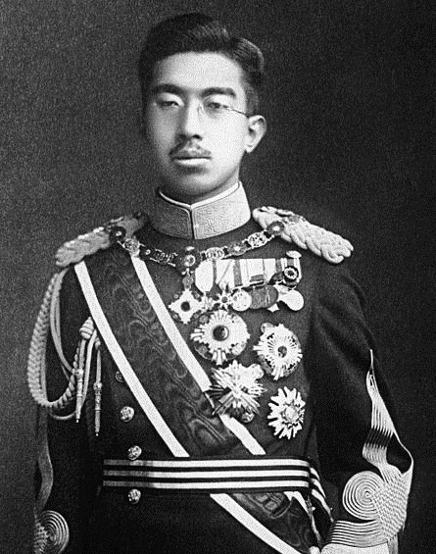
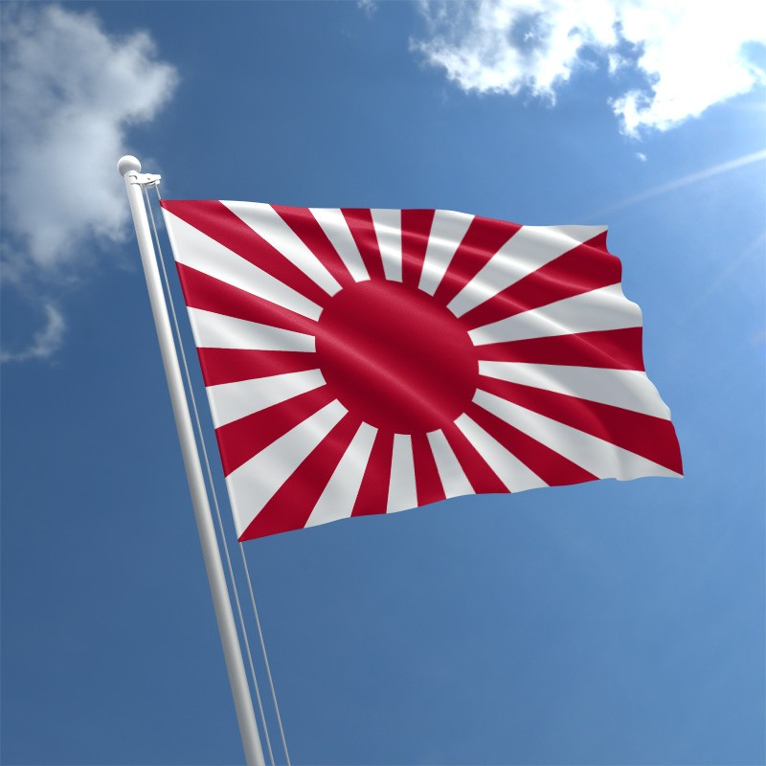
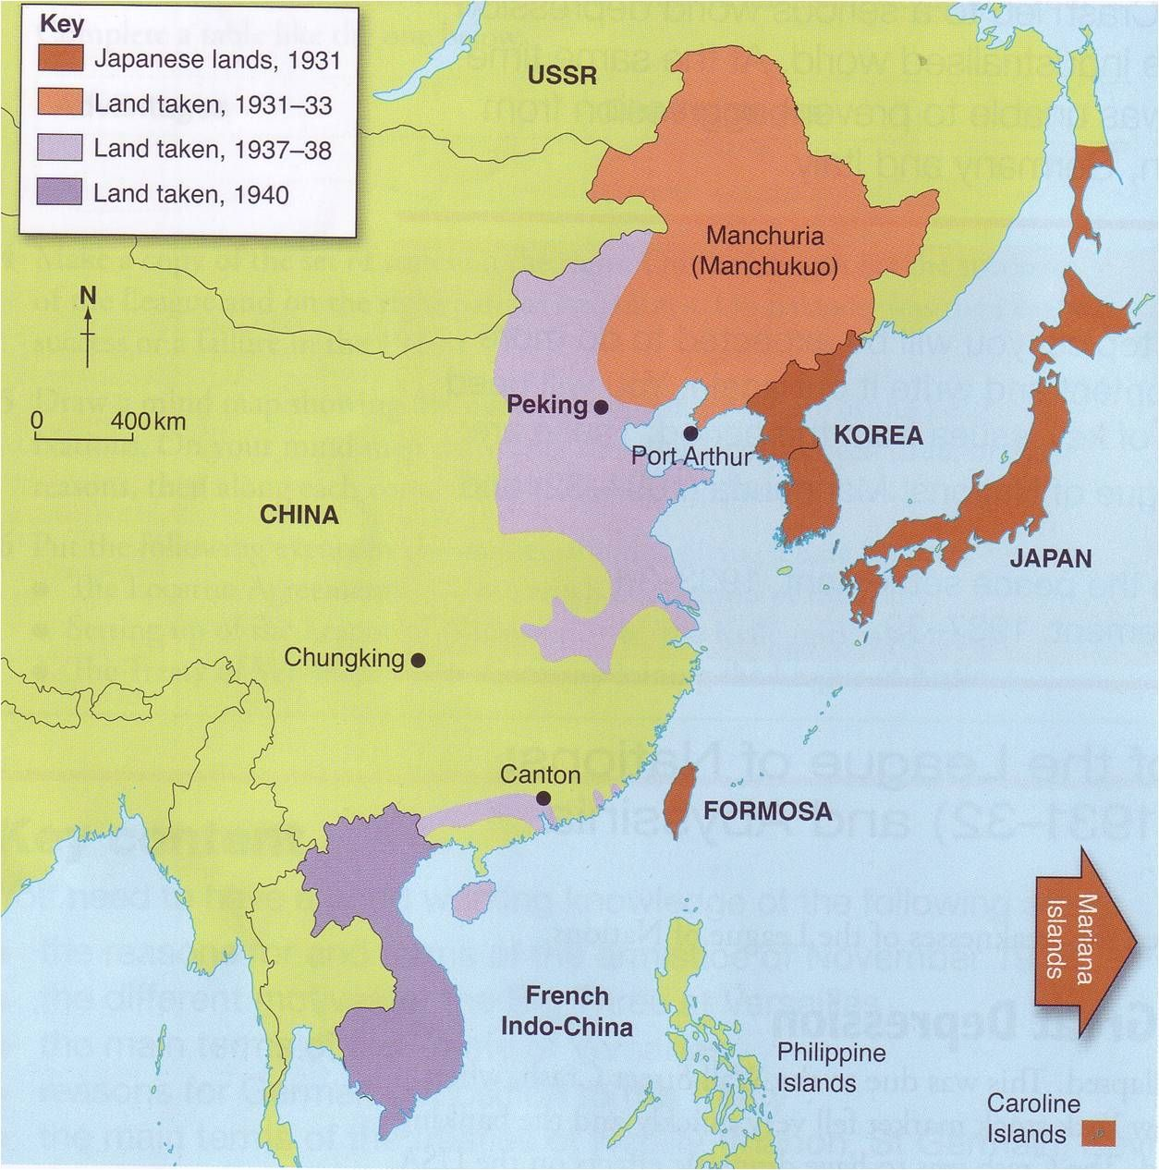
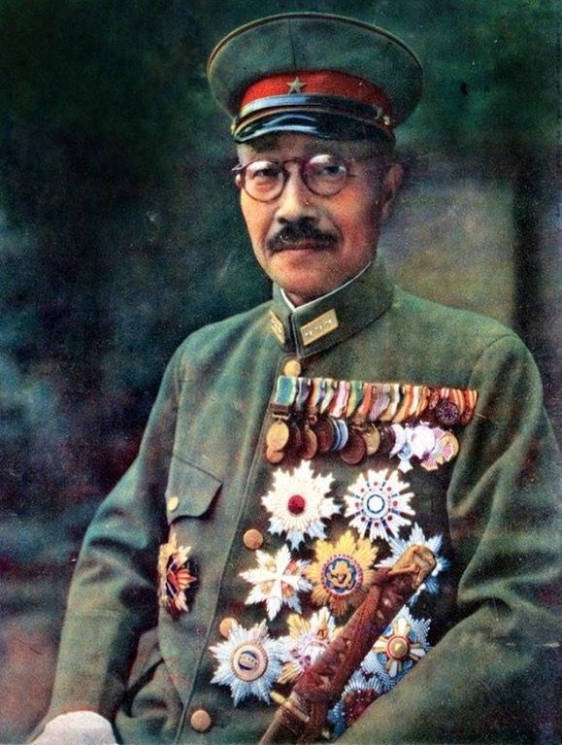
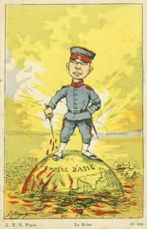
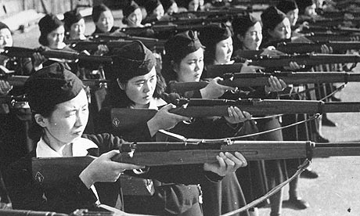
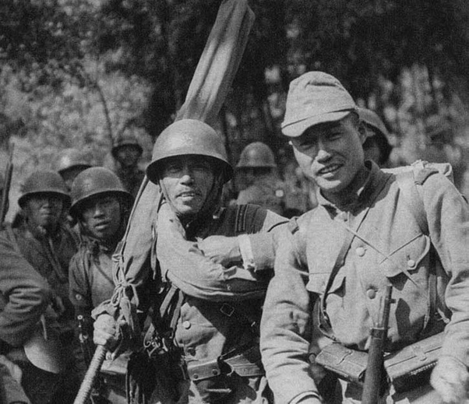
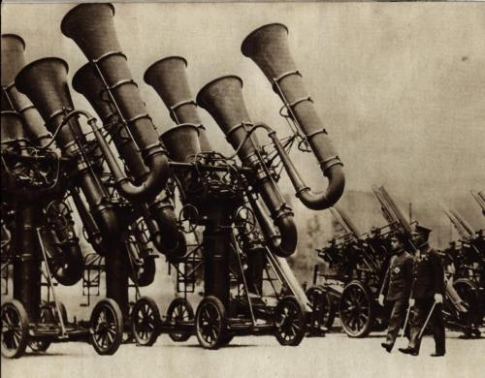
JAPAN
Military takes over leadership over Emperor Hirohito as Hideki Tojo gives orders, Japan continues to build military and conquer Northern parts of China.

Slide 14
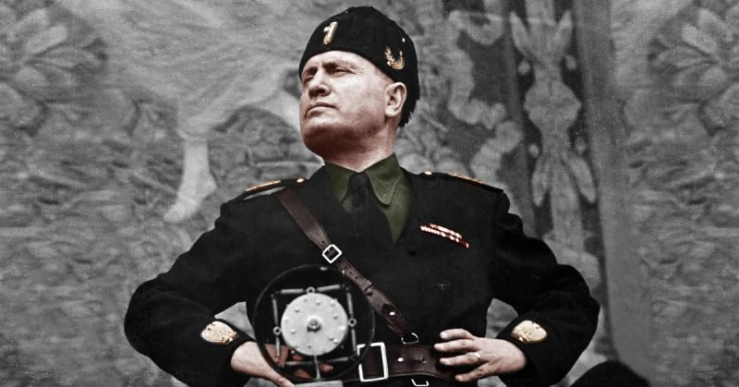
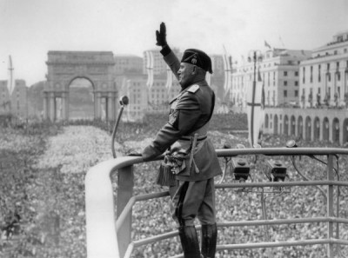
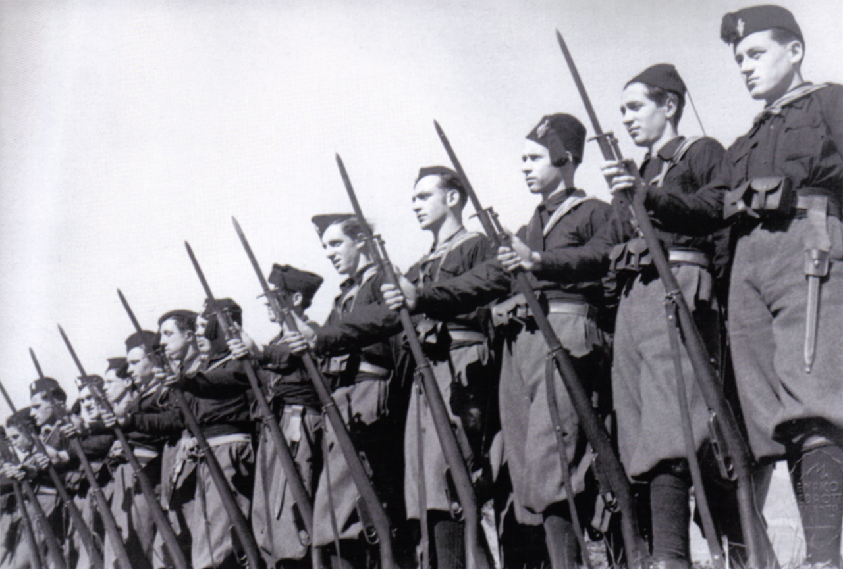
ITALY
Angry at being lied to, Italians turn to Fascism led by Benito Mussolini. Re-education begins as hyper-nationalism occurs.
Military moves into Ethiopia to avenge previous loss, league of nations classifies this as illegal.
*Italy can’t quite claim to be a world power after loss to Ethiopia (Abyssinia) so using machine guns/poison gas/ tanks to guarantee victory made sense to Italy.
*The thought was once the League made a ruling and war would stop. Italy’s response was “illegal…so what?” With no military backing League of Nations is a major failure.
*Fascism is coined by Mussolini, involves corporatism: unions, employers, state officials are organs of the state.

Slide 15
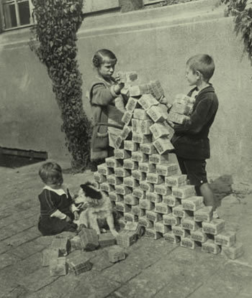
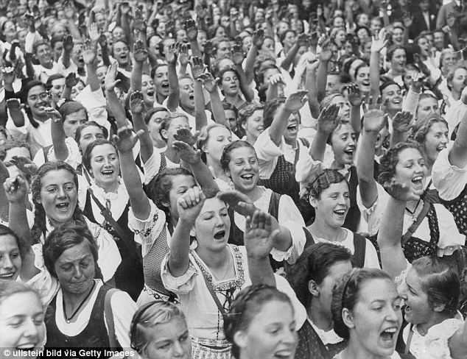
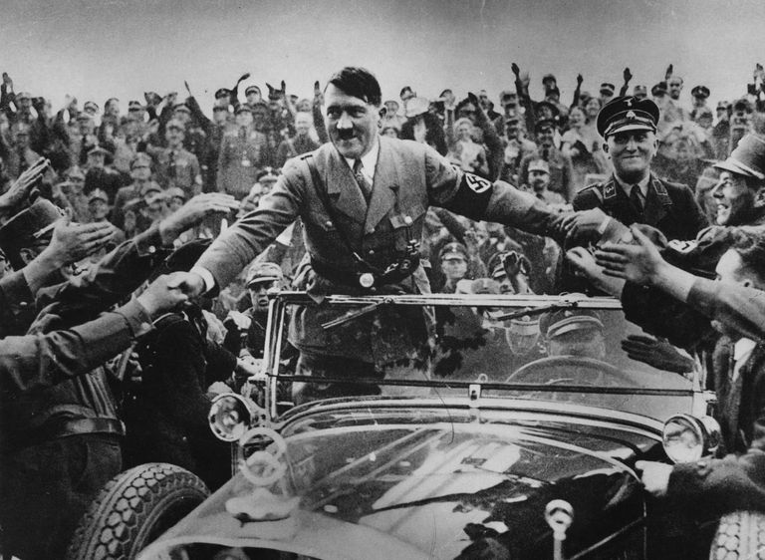
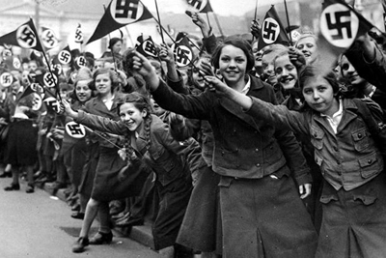
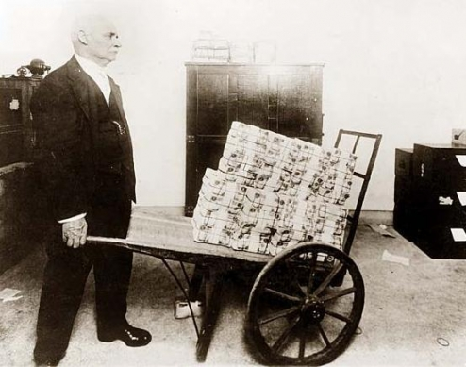
GERMANY
Hitler fails to take over Weimar Republic in a Beer Hall Putsch but gains popularity after publication of Mein Kampf. After Nazi party did well in 1932 elections, Hitler becomes president after leader dies.
Nazis burn down parliament building in Reichstag Fire & blame communists, Germans go nuts.
*Hitler was a war hero who vowed to NOT pay back Treaty of Versailles, he also promised to keep communists out of power so he was loved—not just by Germany but by the world.
*His plan to kill Jews was clear from the beginning, German citizens either did not believe he was serious, OR did not care if Jews were killed (Jewish Banking Conspiracy Theory).

Slide 16
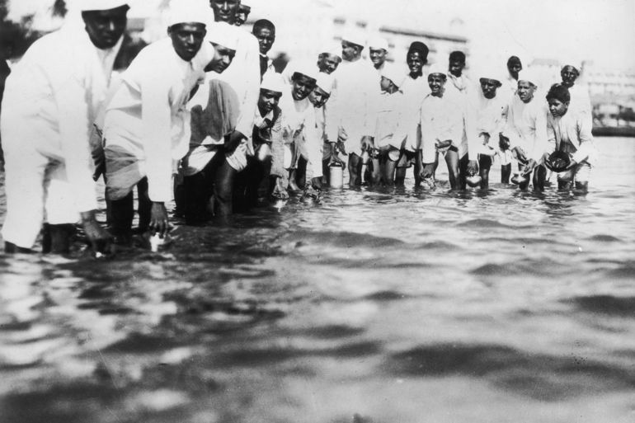
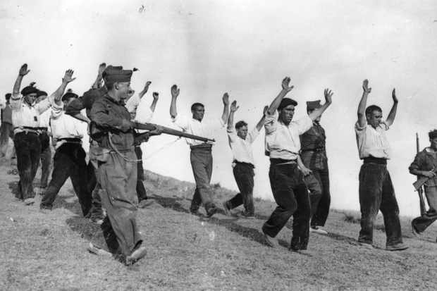
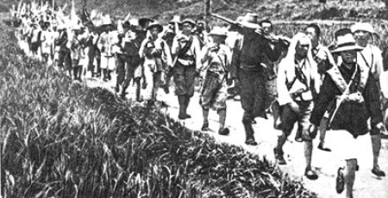
INTERNATIONAL ISSUES
India: To protest Britain, Mahatma Gandhi uses civil disobedience resisting authorities (salt march, 1000s walked to ocean to pick up a few grains).
Spain: Civil war breaks out as fascists battle democracy. Oddly, only communist Russia sends help as Germany & Italy turn Spain to fascism.
China: Communist protest poverty & go on a long march over years (Communists gain sympathy from population, sets tone for future fight).

Slide 17
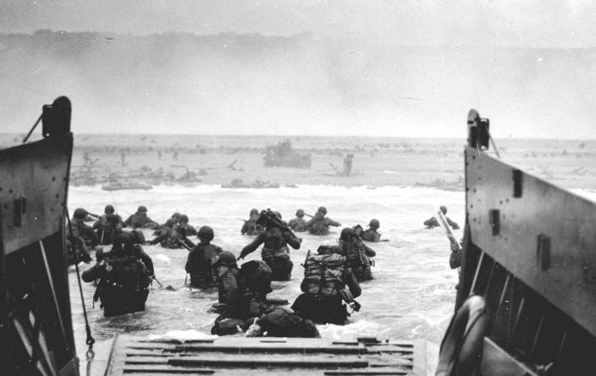
WORLD WAR II

Slide 18
appeasement
Hitler demanded Sudetenland returned to them & other issues to be repealed from tov France & Britain leadership met w/ hitler & agreed to his demands, thus Germany was legally given authority to take it in Munich Pact.
*Appeasement means to give in to demands of a leader hoping no more demands would come. Ironically, Czechoslovakia (who owned Sudetenland) was not even invited to the meeting. GB leader Neville Chamberlain was given a heroes parade for this agreement.

Slide 19
NONAGGRESSION PACT
Communists & Nazis hate each other. But Hitler & Stalin put aside those feelings & promised NOT to Fight each other for 10 Years. The result is every nation located between them will be destroyed.
*Most historians believe both sides planned to turn on the other. Regardless, the world was correct to be in fear as two superpowers who had plans for world domination were now working together. *GB & France still failed to recognize the threat as both nations were hoping to diplomatically stop war from happening.

Slide 20
BLITZKRIEG
*Blitzkrieg is an intense, swift attack by using every available resource at one time (planes, tanks, trucks, guns, etc).
*Soviets take over Estonia, Lithuania, Latvia, Finland in the Batlics, Germany takes Czechoslovakia, Hungary, Romania, Denmark, Poland, etc.
*WWII does not have an official start. Some say Germany invasion of Poland 1939. But, Japan into Manchuria 1931, OR Italy into Ethiopia, OR Pearl Harbor OR Treaty of Versailles OR whatever.
Germany & Soviets conquer every nation between them, Germany used blitzkrieg (lightning war) strategy of taking out Poland & others quickly.

Slide 21
INVASION OF FRANCE
France thought they were safe behind maginot line (underground fortress designed to win trench war) but airplane bombers destroyed it easily.
Hitler does make a major mistake by letting 350K troops to escape in Dunkirk Rescue. French set up a new pro-Nazi government in Vichy, France led by WWI war hero.

Slide 22
Against the advice of his generals, Hitler orders air raid attack called a blitz. Prime Minister Winston Churchill will call this the Finest Hour in defending Britain as civilians are bombed nightly for months.
*Ultimately Britain will win despite inferior air numbers because of incredible pilots & the new technology of radar. It is estimated that GB lost 1000 planes and had very few left in Germany’s Operation Sea Lion which ultimately failed. Royal Air Force beats Lutwaffe.

Slide 23
USA isolationism
USA citizen wished desired isolation from the war so FDR had to be creative in helping GB:
Destroyers for Bases Trade: Gave GB 50 older ships they needed for 8 unnecessary bases.
Lend-lease Act: gave war supplies for free.
*WHY? USA just saved the world during WWI & then was unappreciated & NOT paid back for our loans. In fact, many European nations had people stating USA help was NOT necessary for war was going to be over with soon anyway. So, USA was like, “fine, don’t appreciate us, then we’re not helping you again, not sorry.”

Slide 24
INVASION OF RUSSIA
*The German attack was awesome: 2500 aircraft, 3000 tanks, 600K trucks, 600K horses & 3M soldiers to smash Soviets, largest invasion in the history of the world.
*At issue was food & resources. German farms were small so massive land would be required to feed the population.
Hitler turns east & breaks pact w/ soviets, wants to eliminate communism & re-establish the lands for german Lebensraum (Living Space). Soviets respond by using Scorched Earth Policy (burning everything & retreat).
*The Germans obviously ignored Napoleon’s mistakes. But also, they attacked as conquerors instead of liberators. The Soviet people hated Stalin, if the Germans had come in to grant freedom they would have been celebrated. But instead they had to fight Slavic civilian populations which we evaluate later ends badly for the Germans when winter hits.

Slide 26
PEARL HARBOR
December 7, 1941, Japan launches surprise attack on naval base hoping to weaken USA so they can take over their greater east asia co-prosperity sphere. 8 battleships were damaged, 200 planes hit.
*Japan had practiced this attack until they had an 80% hit rate then went forward w/ attack on Sunday morning shocking soldiers.
*Japan carried out 2 waves, the 1st targeting Battleship Row & 2nd the airfields, decided to NOT carry out 3rd wave (lost surprise).
*Japan thought that after they crushed USA military that USA would desire isolationism so badly that USA would beg for a settlement just like weak Britain & France did with Hitler.
*1100 of the 2471 Americans killed were aboard the USS Arizona.

Slide 27
Japanese occupation of the philippines
10 hours after pearl harbor, japan invades Philippines to wipe USA out of pacific. Once captured, Japanese torture americans on bataan death march (16K die on jungle trek).
*Japan takes out Dutch East Indies, British Malaya, Burma, French Indochina, Malaysia, Singapore, Wake, Guam…everything in 4500 miles of territory.
*USA concern of an invasion of California was very real to people living back then.

Slide 29
American HOMEFRONT
USA labor force was awesome as women went to factories to make tons of weapons. USA military saw 15M people serve including 1m African-americans, 350K Hispanics, & 350K women.
*Factories produced 250,000 planes, 100,000 armored cars, 75,000 tanks, & millions of tons of bombs & shells. The contrast of this to Germany who relied on forced concentration camps can go overlooked. Japan, who had told their people thousands of lies during the war, decided NOT to use women in any aspect but instead to have women keep traditional roles.

Slide 30
EUROPEAN THEATER
Allied Troops led by GB & USA stop Germany’s African advance at the Battle of Alamein when Allies beat “Desert Fox” Erwin Rommel.
Then Allies entered Europe after the Invasion of Italy which ended in the surrender and conviction of Benito Mussolini.
Generals Eisenhower & Patton lead victory.

Slide 31
BATTLE OF STALINGRAD
*Over 1M civilian casualties as both sides committed war crimes on the people.
*Stalin gave orders that any captured soldiers returned to USSR would be executed, & made No One Step Backward law, Soviet women served.
*Germans froze! Over 15K limbs were amputated due to frostbite on top of deaths.
On Eastern Front, Soviet Union used Scorched Earth Policy (destroying everything during retreat, like Napoleon). Soviets won After months of frozen fighting (Battle of Kursk is largest Tank Battle in history).

Slide 32
D-DAY Invasion of Normandy
June 6, 1944 Eisenhower leads amphibious invasion of Nazi occupied France with 5300 ships & 176K soldiers. After 3 weeks, 1M Allied soldiers were heading to Berlin.
Germany tries one last effort to win at the Battle of the Bulge but nazi troops were pinched off by Patton. USA & GB coming from West, USSR from east.
*There were 5 beaches targeted for attack, USA 2, GB 2, & Canada 1. Omaha Beach saw the most difficult fighting & highest death toll. This Operation Overlord also had tons of airborne soldiers parachuted in. Allies arranged a phantom army to attack in a different location in hopes Germany would send reinforcements to the wrong place. Nazi’s planted around 4M land mines on the French beaches in anticipation of the upcoming attack. AA combat medic Waverly Woodson saved over 200 lives by providing care, he also saved 4 men from drowning.

Slide 34
PACIFIC THEATER
Navy stopped Japan in Battle of the Coral Sea, then crushed them at the Battle of Midway (sunk 4 Aircraft carriers).
*Midway was a miracle victory for USA, still recovering from Pearl Harbor & outnumbered & Japan had not lost a navy battle in 50 years.

Slide 35
ISLAND HOPPING
Under General Douglas MacArthur USA won major offensive at Guadalcanal & used a strategy called island hopping, with the plans to get close to launch an invasion. Major battles were Iwo Jima & Okinawa.

Slide 36
V-E DAY
May 8, 1945 Germany signs Unconditional Surrender as war in Europe Ends.
*Sadly, FDR has passed already so it’s Harry S. Truman (from Missouri) who gets to celebrate.
*Seeing Allies coming, Hitler orders people into subways for “protection,” then begins gassing own people.
*Hitler cowardly commits suicide prior to the takeover of Berlin (along w/ his mistress Eva Braun).
*Russians beat USA to Berlin and order the civilian population to be raped, estimates are about 90,000.
*Though Allied mood is festive, Patton refuses to celebrate w/ Russians & tells them they’re next (after Japan).

Slide 37
HIROSHIMA & Nagasaki
USA spent $2B on the Manhattan Project: plan to create an atomic weapon. After a practice drop at Alamogordo (NM), Truman warned Japan to surrender or face “prompt & utter destruction.” After no response, Truman ordered Little Boy to be dropped on Hiroshima (100K dead) and Fat Man to be dropped 3 days later (70K dead) on Nagasaki.

Slide 38
hiroshima

Slide 39
V-J DAY
Sept 2, 1945 Japan signs Unconditional Surrender & WWII Ends.
*Though USA didn’t have any more atomic bombs made, the threat of dropping dozens more scared Japan.Thankfully, the original plan of dropping atomic bomb on beach prior to invasion didn’t come to pass.
*AFTER Hiroshima is when Russia officially declares war against Japan, thanks for nothing. USA was secretly hoping to scare Stalin too.
*The Kamikaze plans of the Japanese was far more successful than USA led us all to believe. Pilots actually participated in their own pre-flight burial.
*USA leaves General Douglas MacArthur over in Japan as he re-organizes government into a democracy.Though world brings German war criminals to justice, Japan’s atrocities get swept under the table.
*In 1972, a Japanese soldier emerges from a cave to attack some vacationers—he hadn’t heard war was over.

Slide 40
MASS ATROCITIES

Slide 41
Nuremberg Laws
Hitler enacted anti-Semitic laws designed to separate Jews from German society. Led by Heinrich Himmler many were moved to ghettos as concentration camps were created. On Kristallnacht (Night of the Broken Glass) Jews were de-classified & openly attacked.
*Marriage was prohibited between the races, and Jewish females were to be fired. Jewish stores closed—no sales. Violence occurred at the end of the 1936 Olympics held in Berlin.
*Hitler, believed in Zionist Occupation Conspiracy, which stated that the Jews are taking over world banking system.
*These laws also targeted other races considered inferior to the “Aryans.”

Slide 42
HOLOCAUST (FINAL SOLUTION)
6M Jews & 11M Total (Russians, Romanians, Poles, etc) were killed in hundreds of death camps (Aushwitz, Treblinka, Dachau). Others not immediately gassed & burned were put in work camps to further war effort.
*The numbers indicate 6M out of 9M Jews in Europe were killed & other countries did not help any escape (even USA turned away a ship of Jews coming to USA).
*Some put the death camp numbers as high as 17M, there was also sexual slavery and odd medical experiments practiced on kids especially twins. Josef Mengele was nicknamed Angel of Death for these experiments.

Slide 43
RAPE OF NANKING
while controlling China, Japanese also used Genocide slaughtering 250K thru sadistic tactics & continued to kill 6M (including other Asian groups) in their “Asia for the Asiatics” policy.
*This Asian Holocaust went unpunished at the end of the war as war crime trials did not occur as they did in Europe for Nazis. Japan has issued an apology but the other political party in Japan denies it happening and labels those who committed these atrocities as war heroes.

Slide 44
SUFFERING & FAMINE
Ukraine: Citizens destroyed their own crops rather than let Stalin/Soviets have them, result is 10M dead thru intentional starvation.
*USA: fearful of an invasion, rounded 120K Japanese-Americans & placed them into internment camps (also firebombed Germany).
*Bosnians: Attacked by Serbians in 1990s who tried Ethnic Cleansing to eliminate their race.
*Sudan: In 2003, Arab Muslim Gov’t unleashed Janjaweeds to kill 200K near Darfur Region.

Slide 45
COLD WAR

Slide 46
YALTA CONFERENCE
Big Three met at Yalta before Germany was taken over to discuss post-war issues including: what to do with Germany, Nations taken by Soviets, war criminals, United Nations, etc. After War the sides met again at Potsdam only to later find out Stalin lied which leads to worldwide Cold War vs. Communism
*Allies great desire was for free elections in nations under Soviet control, something the Soviets promised to give. Also, Allies wanted SU to attack Japan since the two were close but not fighting yet.
*Soviets wanted “safety,” since they had been crushed 2X in last 130 years. They wanted control of Eastern Europe. By definition, communism cannot be limited to one nation, it must grow to survive.
*YALTA TO MALTA is a phrase given to this Cold War which lasts 1945 to 1989 (1991) as Democracy vs. Communism fights around world.

Slide 47
Iron curtain
*Romania, Poland, Czechoslovakia, hungary, Bulgaria, Yugoslavia, & east Germany are conquered.

Slide 48
containment
USA foreign policy changes to contain communism. President Truman makes the Truman Doctrine promising to defend all free nations. Marshall Plan authorizes $15B in aid to rebuild nations after World War II to prevent their collapse (out of fear becoming communist).
*Truman makes a lot of great decisions while in office. He “Brings the Boys Home” immediately after WWII, he provided GI Bill of Rights giving soldiers college, encourages the creation of Israel to save the Jews, and he desegregates the military (many hated him for these decisions but history proves him to be correct).

Slide 49
Berlin blockade & airlift
Soviet union advances on berlin in Germany holding 2m citizens hostage. Instead of going to war, Truman drops 2m tons of food/supplies in over 11 months & soviets back down. truman saves berlin.
*Most thought Truman had 2 options: go to war OR let Berlin fall to communism. The decision to drop in supplies avoided both of those terrible scenarios. NATO is created.

Slide 50
CREATION OF ISRAEL
Because of Zionism Movement, Jews had been moving to middle east, especially after WWII.
United Nations orders Israel to be Created as Arabs led by Palestine attack immediately… get crushed. Later attacks lead to Israel taking even more land.
*World is torn on this issue. Arabs deny Israel’s right to exist and Zionists claim this has been Jewish land going back to Moses taking the promised land.
*A lot of people seem to feel WWIII is going to start here since neither side will agree to Two State solution.

Slide 51
China led by mao Zedong falls to communism which leads to 20 years of tortures and purges as mao kills 40m of his own people (worst killer in history, stalin will be 2nd).
china
*Tortures include the sedan chair, toad drinking water, monkey pulling reigns, etc.
*China remains communist today & Mao must be praised by the people who care about their own lives (though active in trade).

Slide 52
Where are we in history?
WE HAVE NOW STUDIED 1250-1950 A.D.

