Slide 2
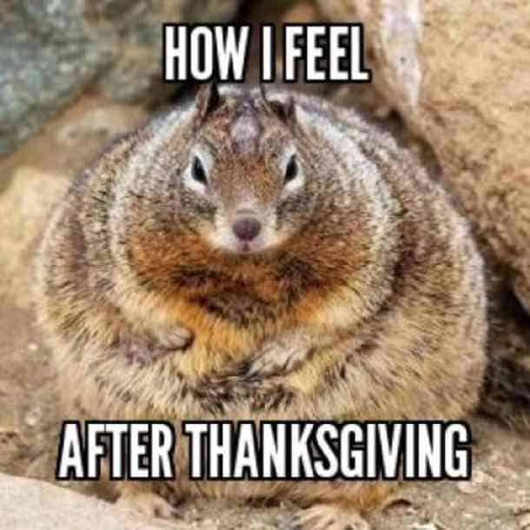
Do Now
How was your break?
Tell me one thing you did (make it a full sentence).

Slide 4
How did the first “Americans” arrive?
Clovis-first
The Clovis peoples crossed Beringia (Bearing Land Bridge)
This connected Russia with Alaska
Kelp Highway
Unnamed peoples rode the coastline before to the Clovis peoples crossing
Snacked on kelp and critters during their journey

Slide 5
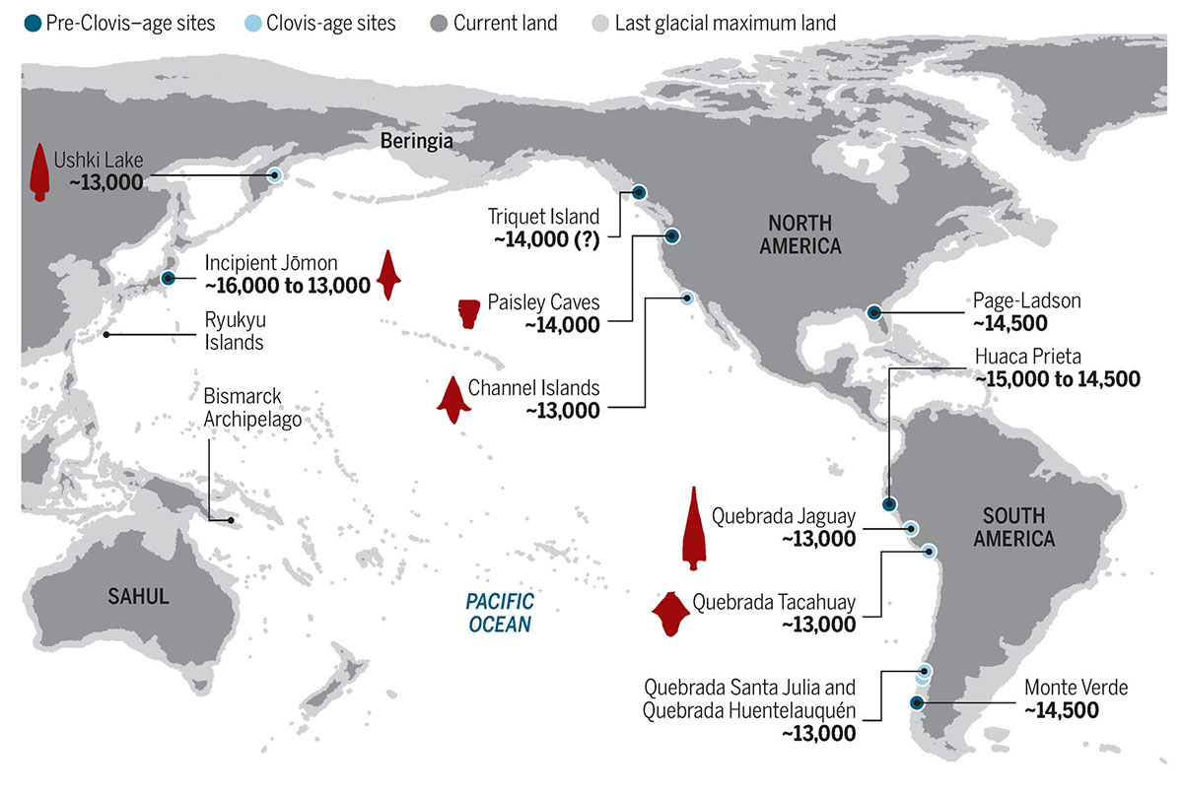
Notes:
Go to Google Earth to show topography after this slide. Show mountains, rivers, and plains. Finish showing Veracruz, Mexico to transition to Olmec civilization.

Slide 6
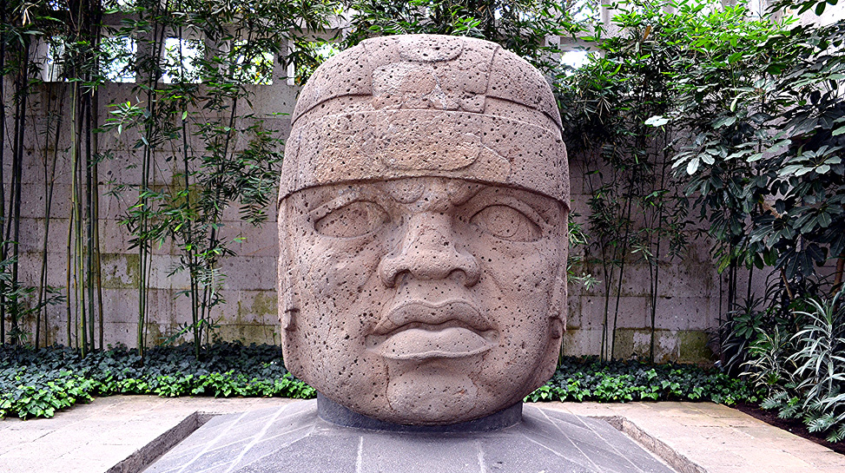
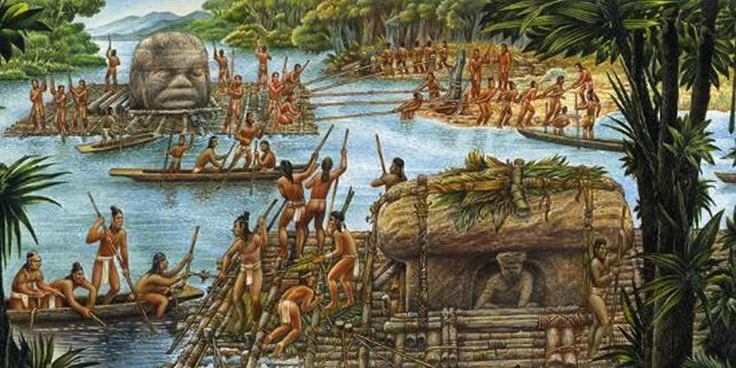

Slide 7
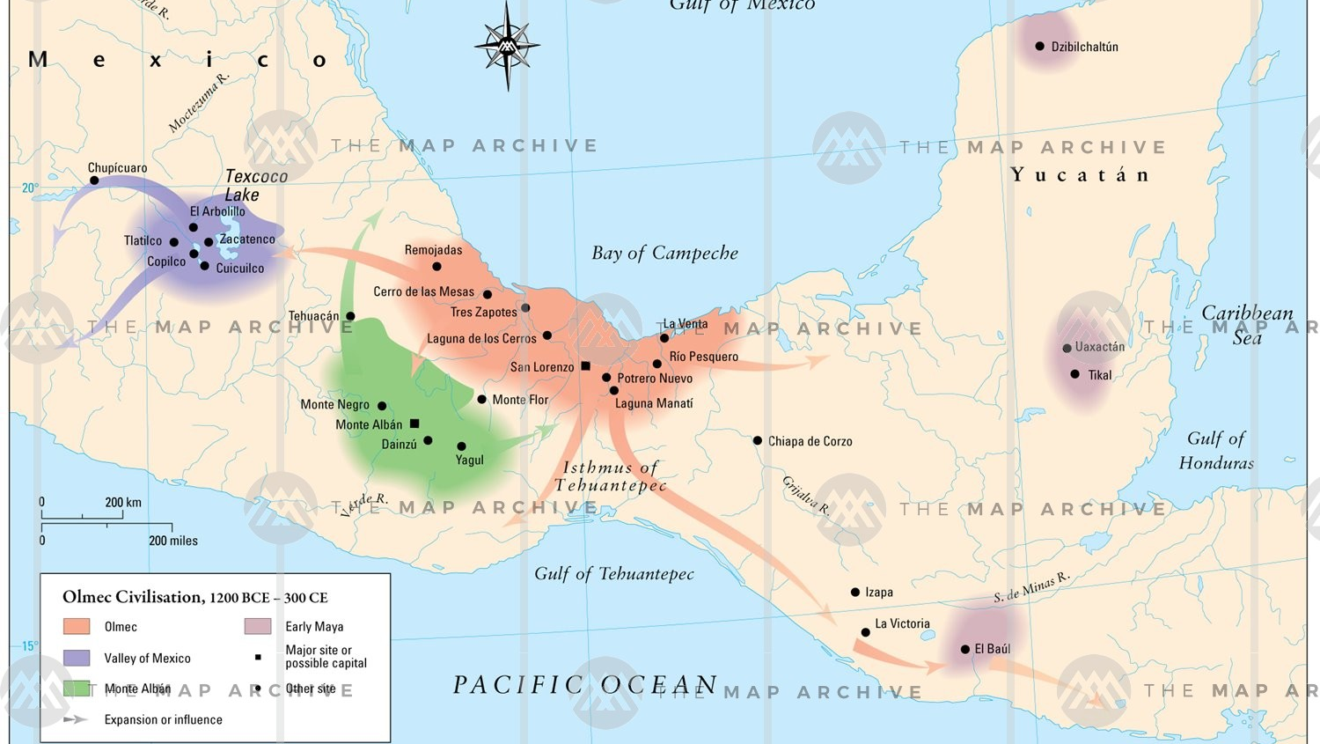

Slide 8
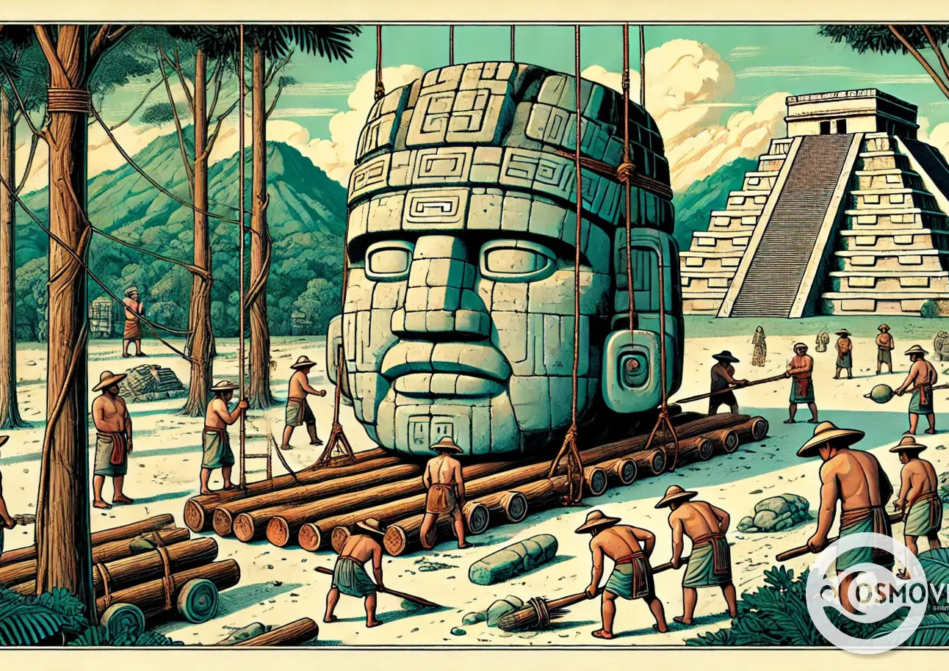
Olmec Civilization
“Olmec”= “Rubber People”
Learned how to make natural rubber
Farming and trade on the Coatzacoalcos River
“Slash-and-burn” farming
Burn the old land and trees, and the ash will fertilize the soil
Big surpluses of food
Traded for jade, obsidian, feathers, and other goods
Influenced the Zapotecs
They invented to first writing system in the Americas
Notes:
“kow-aat-zah-kow-al-kowz”
Show slash and burn farming from Maine
“Disappeared”: Likely due to earthquakes and/or water pollution

Slide 9
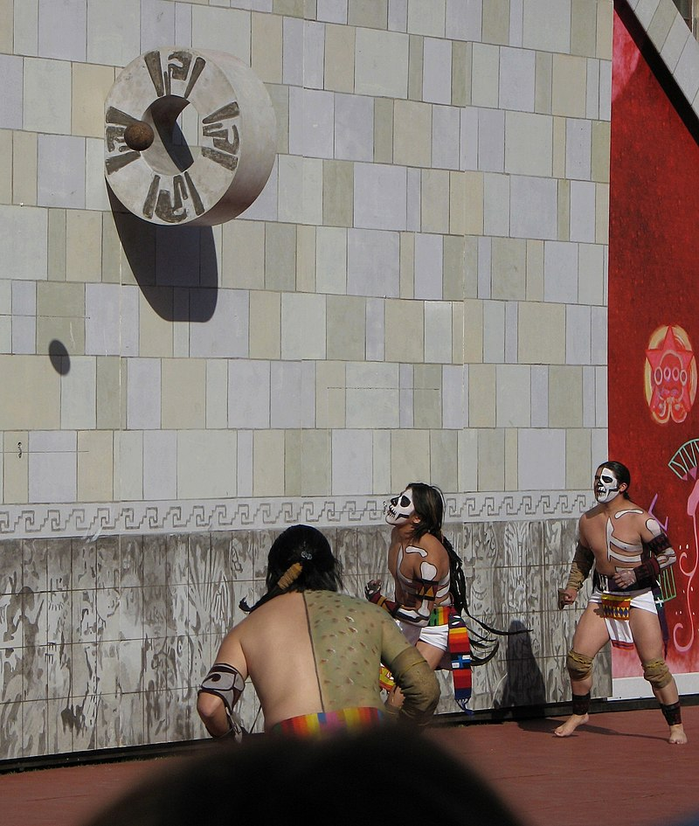
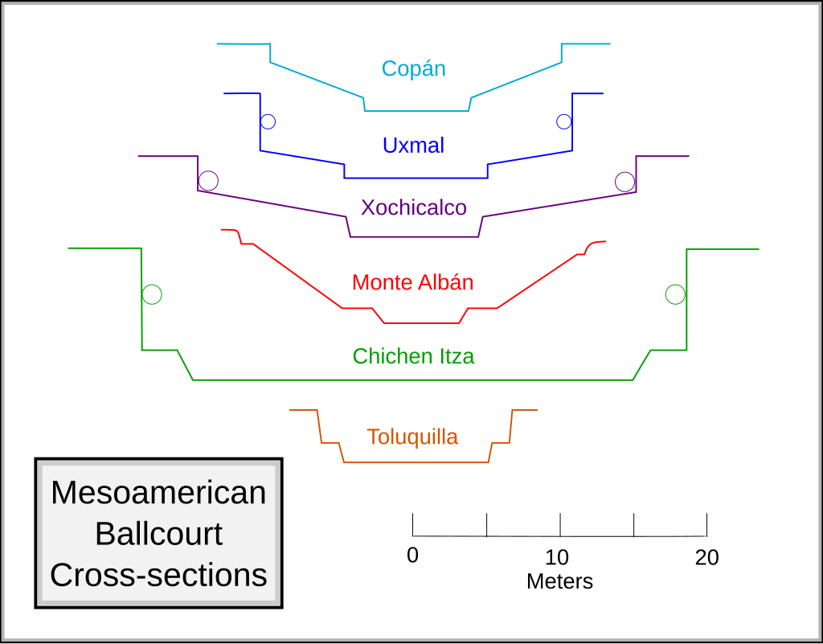
Notes:
Pok ta Pok: Mesoamerican ballgame. Believed to be invented by the Olmecs. Rules not fully understood. Rubber ball weighed 9 pounds. Important dates = important games. Winners are sacrificed.

Slide 10
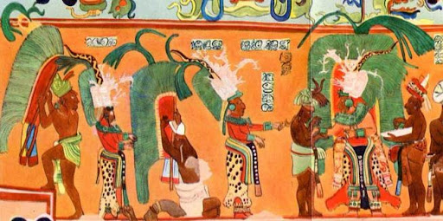
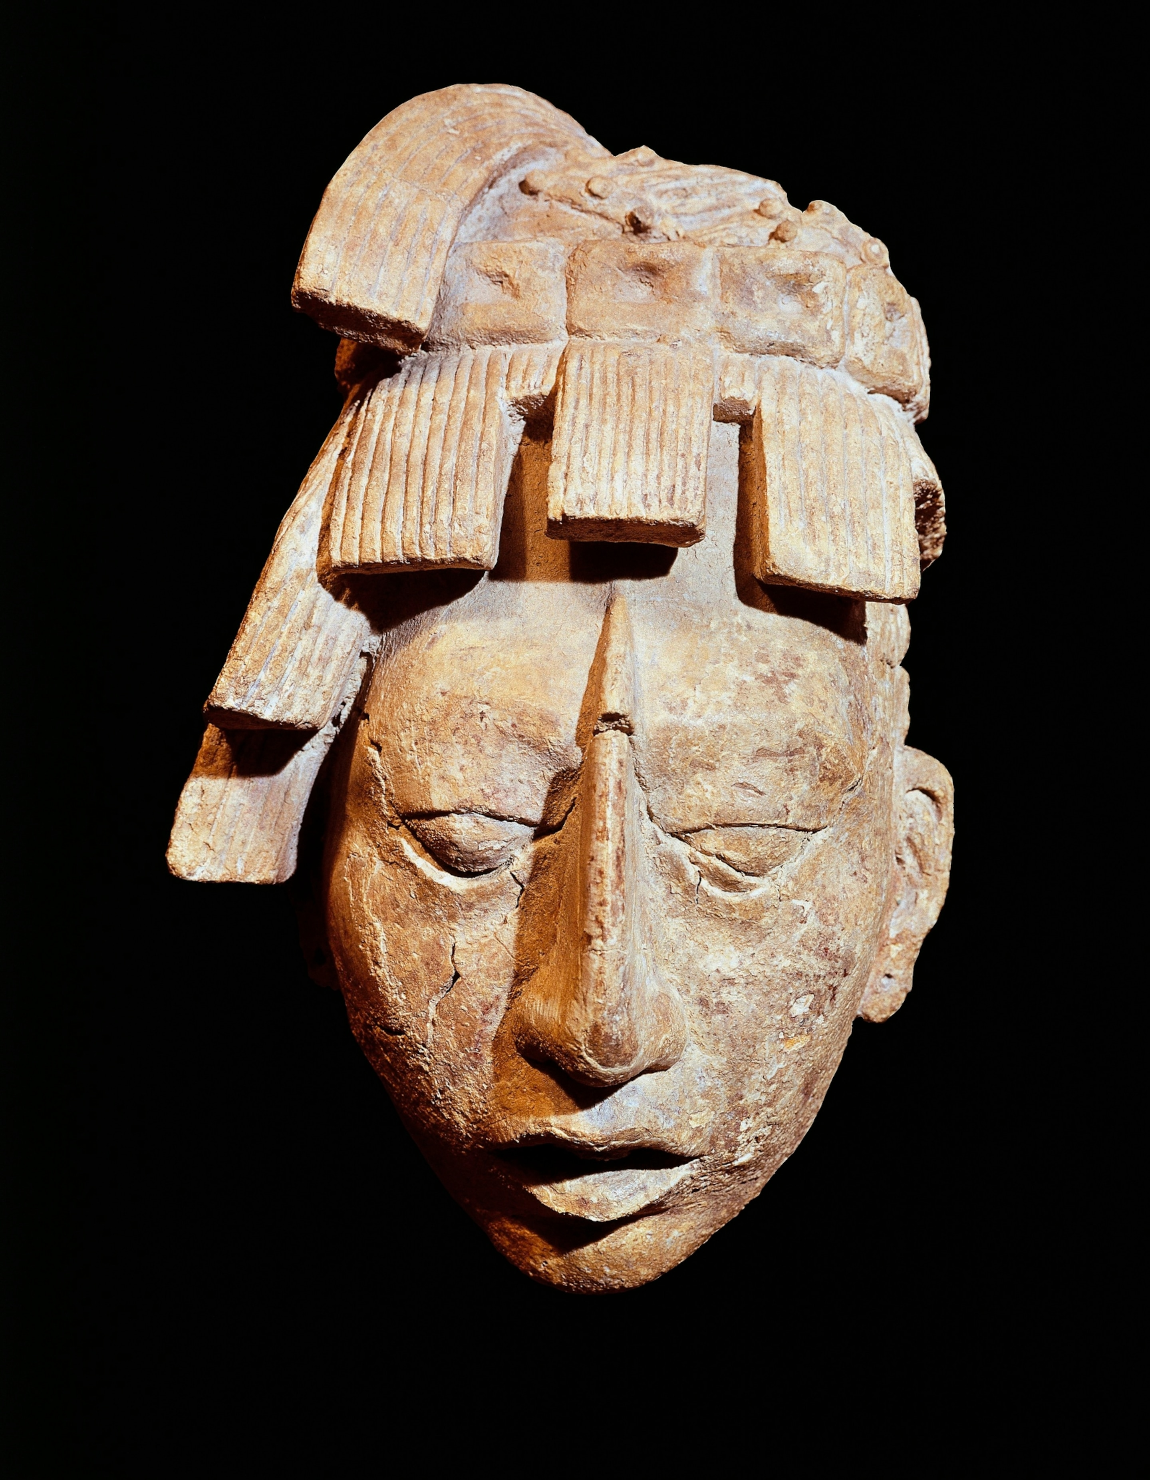
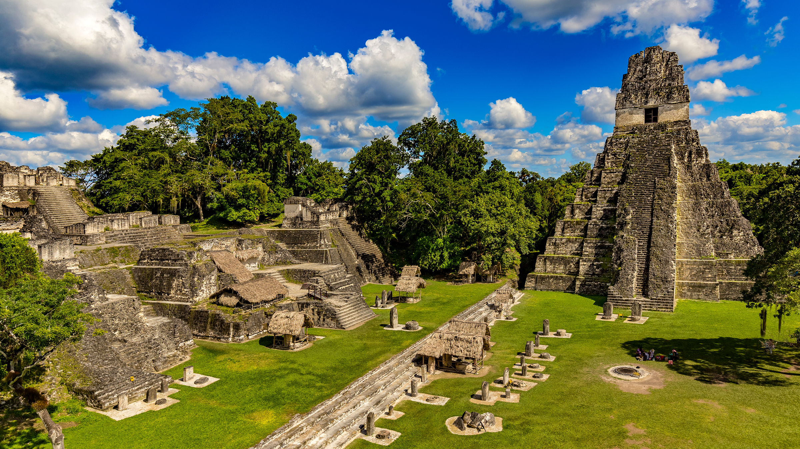
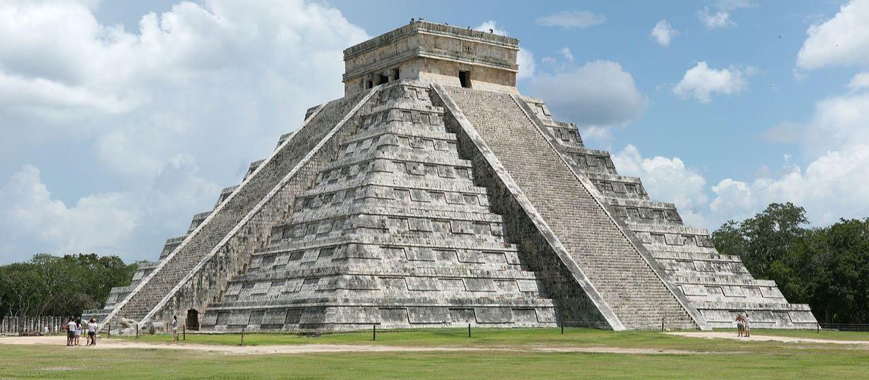

Slide 11
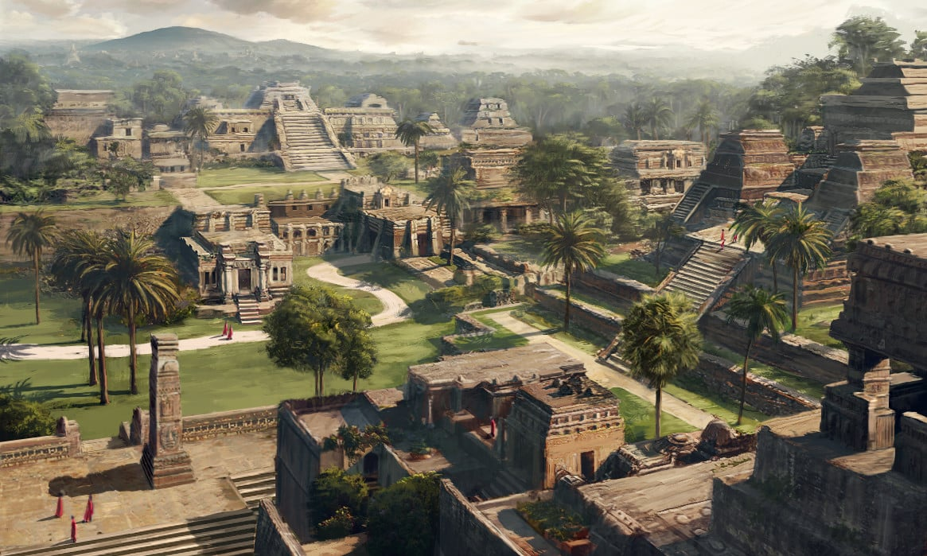

Slide 12
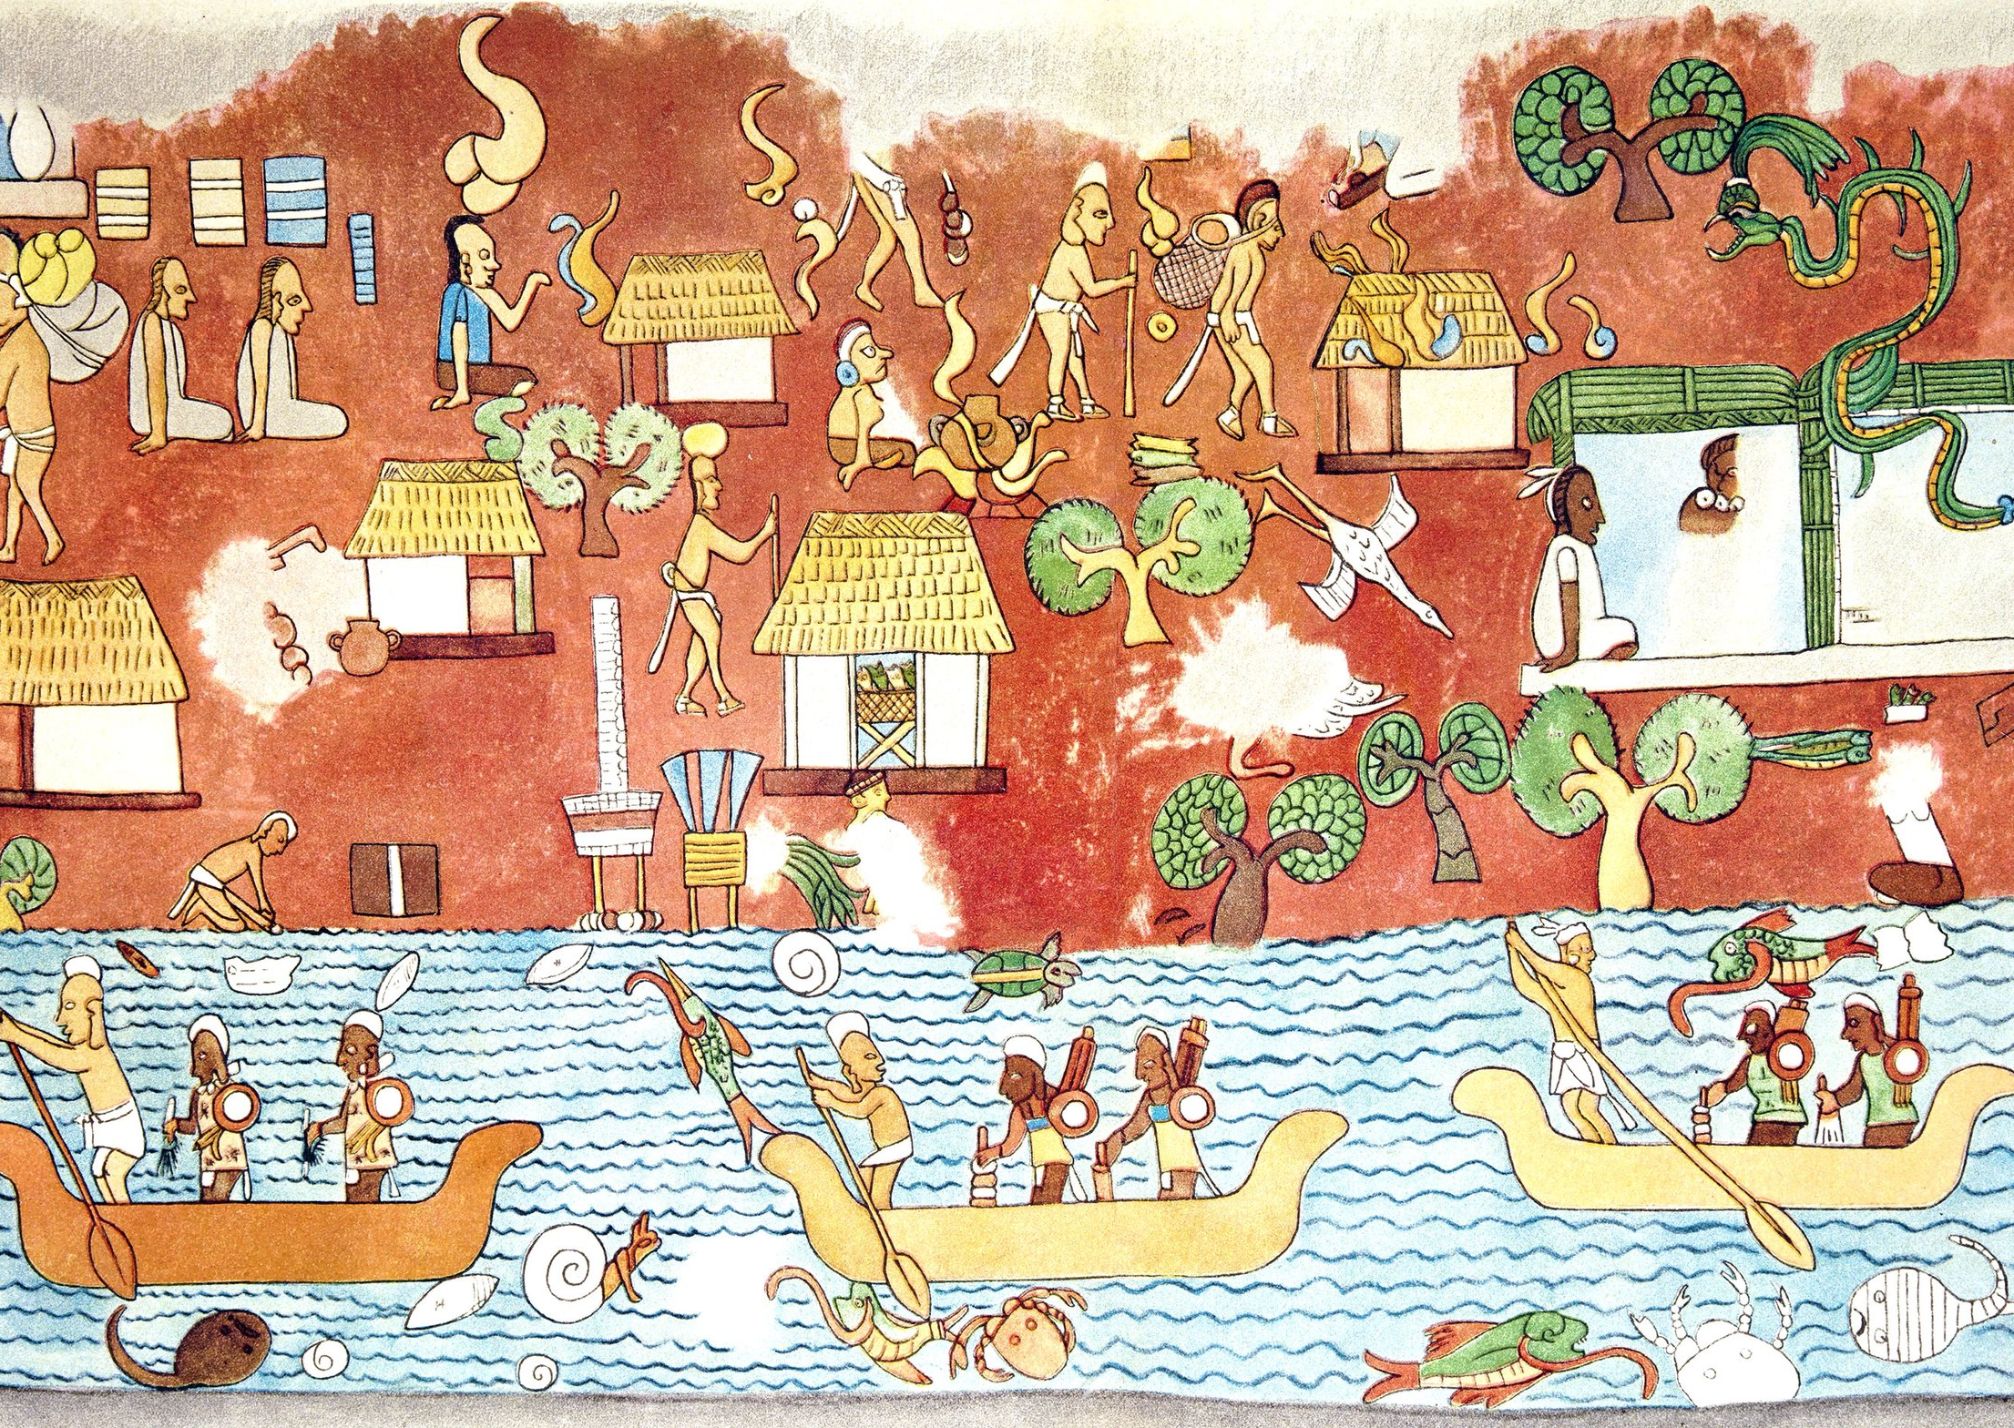
Mayan Empire
Cities were scattered and in fertile places
More room to grow, fewer mouths to feed
Cities were huge: pyramids, temples, buildings…
Most people lived on farms outside the cities
Farming was a major source of economy
Nobles controlled the large corn fields
Family grew other produce and raised ducks and turkeys
Broken up into City-States
Big city with government, and the suburbs

Slide 14
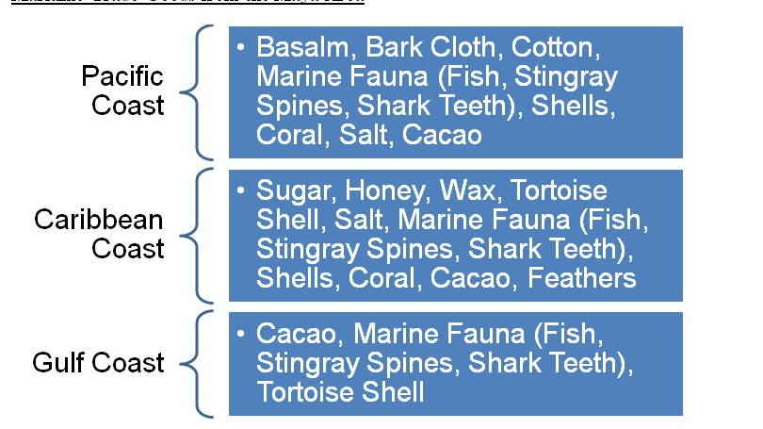

Slide 15
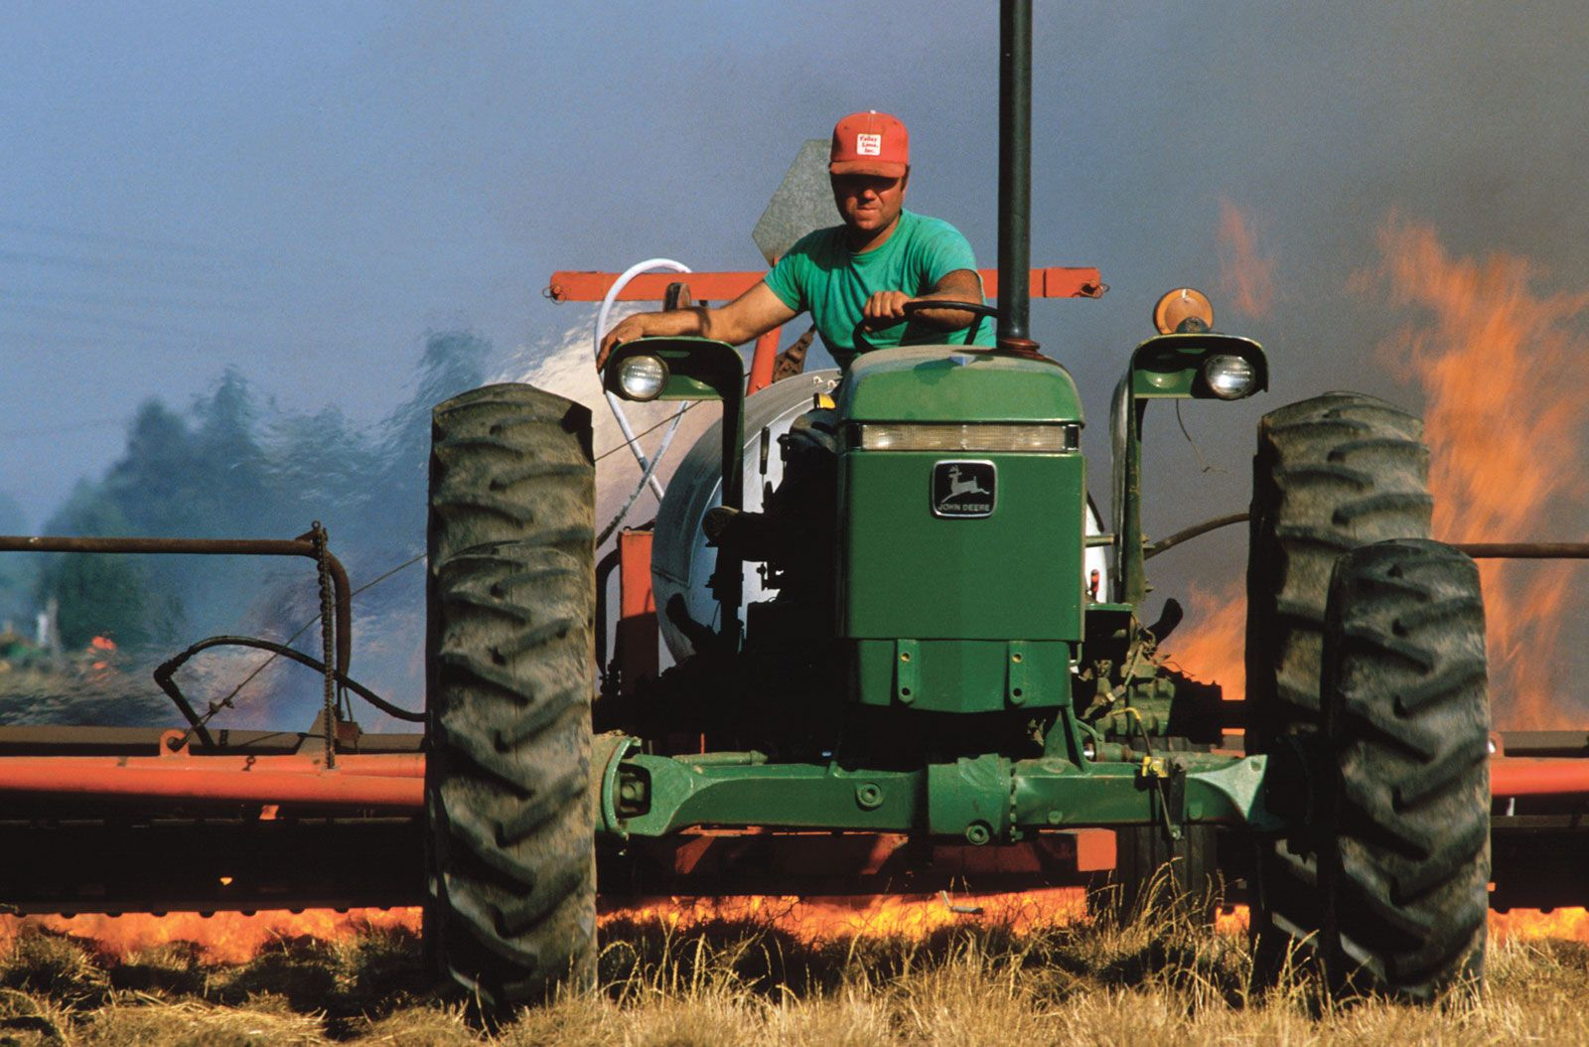
Do Now
Describe slash-and-burn agriculture.
How is it done?
Why is it done?

Slide 16
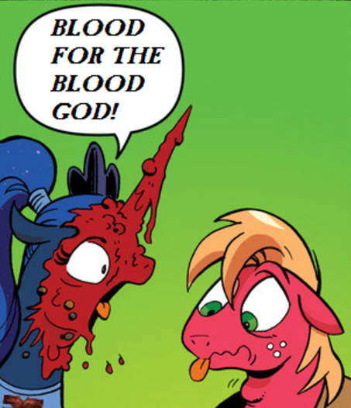
Mayan Religion
Polytheistic
Gods were forces of nature (rain, lightning, etc.)
Priests and Kings could communicate with the gods
A lot of kings were priests first
Pyramids
Pyramids were built tall to be closer to the gods
Temples were at the top of the pyramid
Sacrifice and Bloodletting
POWs, slaves, and children were sacrificed
Mayans bled themselves
This was to keep the gods happy and the universe in balance

Slide 17
Mayan Achievements
Writing
Hieroglyphs and books (the Spanish destroyed most of the books)
Astronomy
Predicted eclipses and other
Complex set of calendars
Math
Used zero for calculations
Art and Architecture
Pyramids, Temples, and Observatories
Pottery, jewelry, murals, and decorated buildings
Notes:
260-day religious, 365-day solar, and 394-year planning calendar

Slide 18
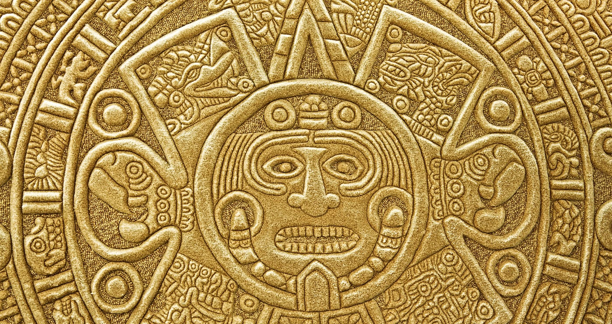
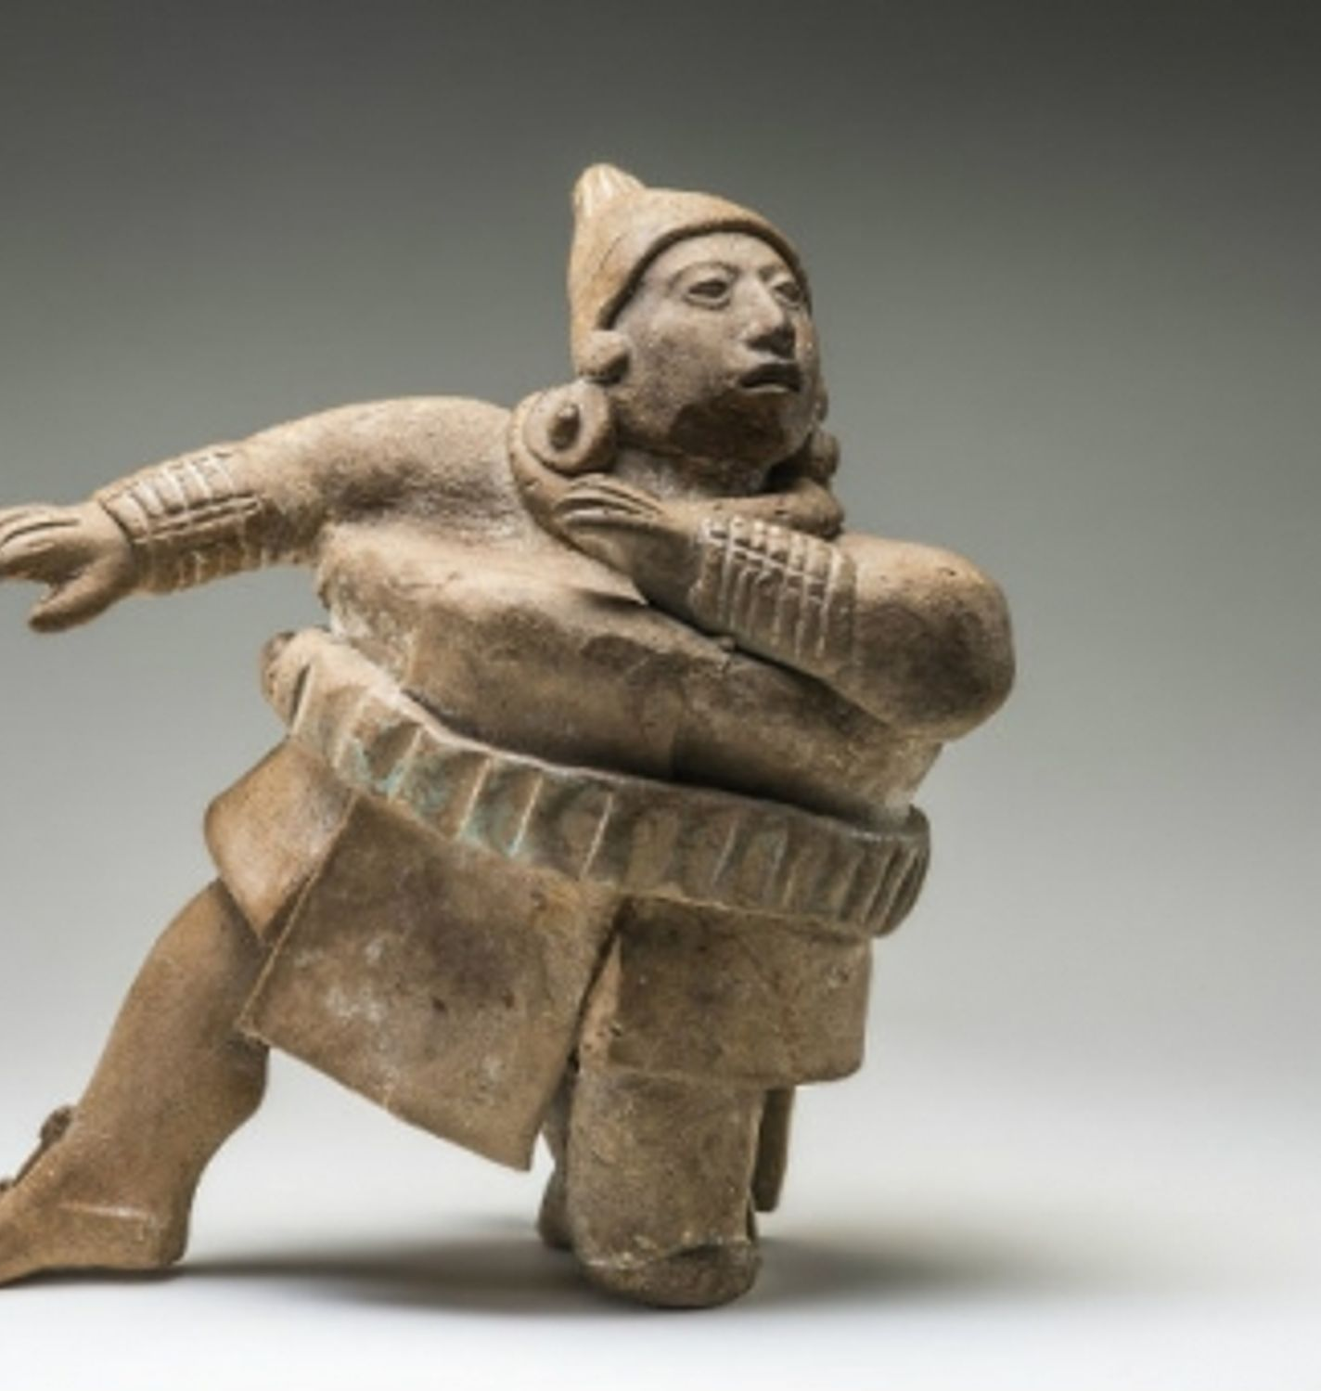
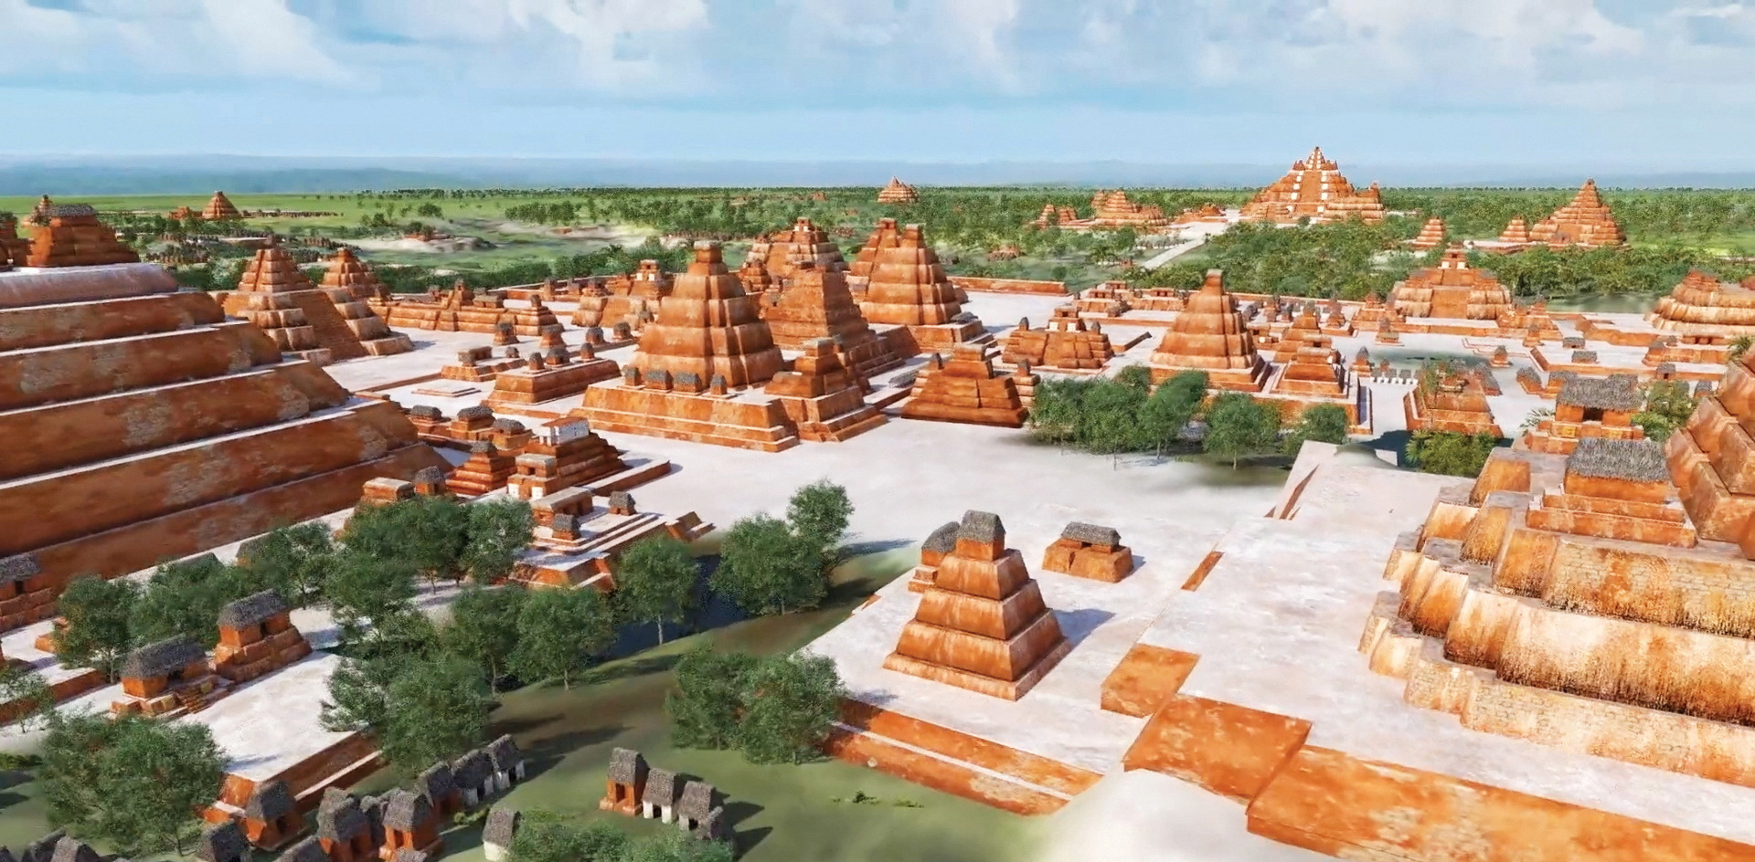

Slide 19
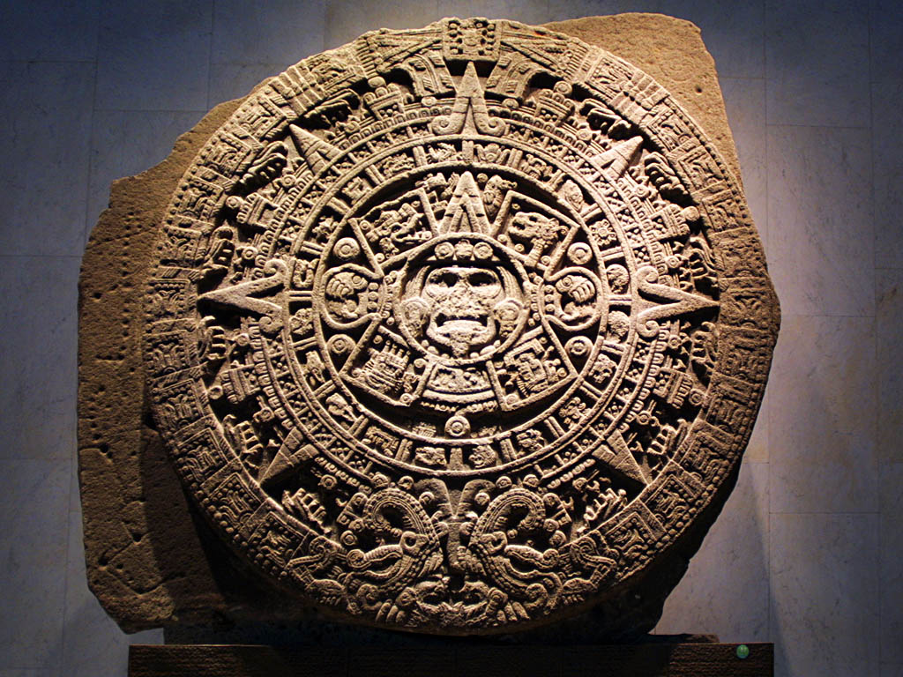
Notes:
The Mayan calendar. This caused some panic in 2012 as some believed it predicted the end of the world. More on this Thursday.

Slide 20
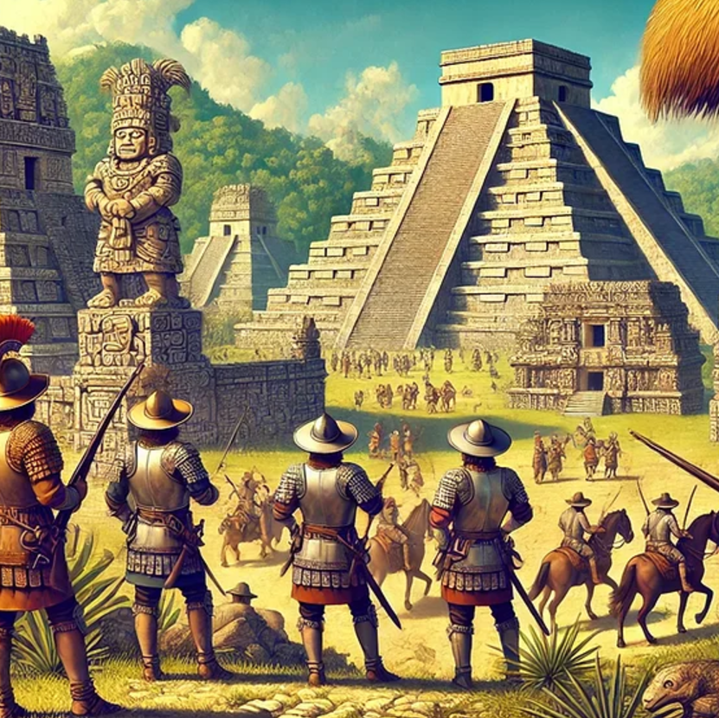
Fall of the Maya
800 – 1000 CE
Mayan cities fall apart
War and drought are the main reasons
1500s CE
The Spanish show up and conquer the rest of the Maya

Slide 21
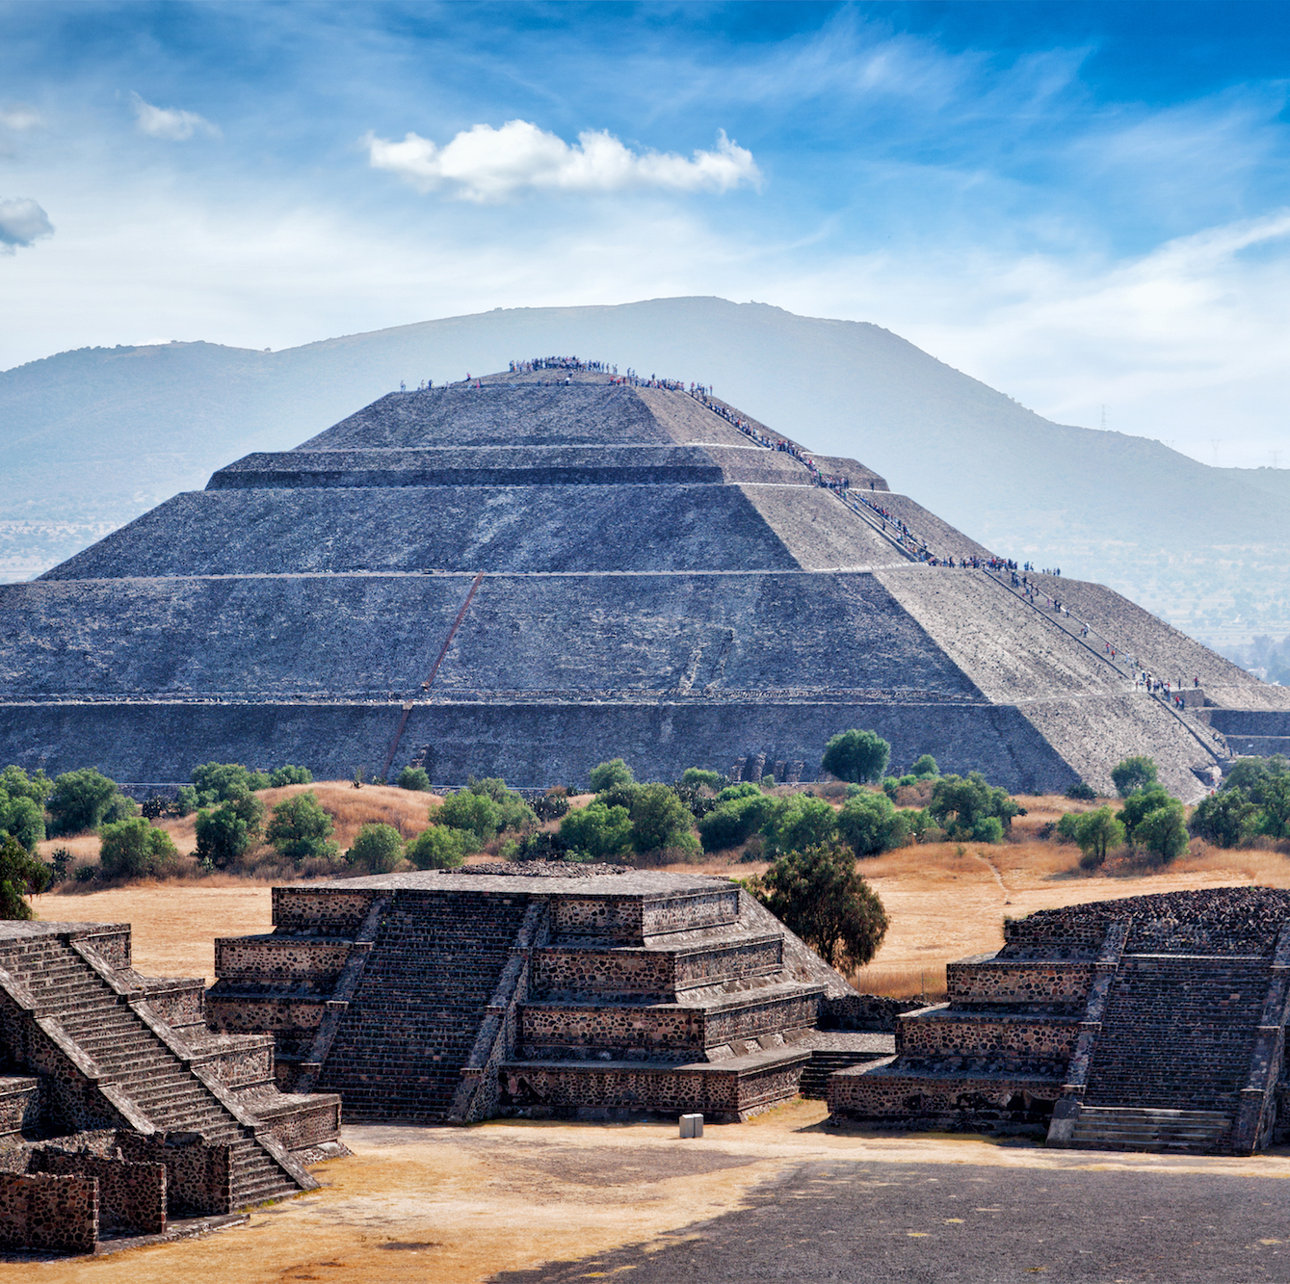
Do Now
I want you to take a moment to think about our previous lessons and answer this question:
How do empires grow?

Slide 23
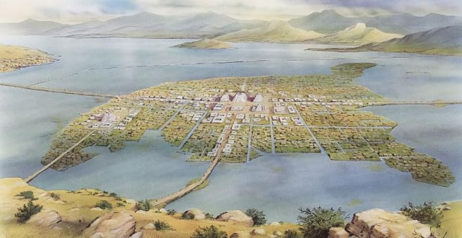
The Aztec Empire
Started a few hundred years after the Maya appeared
Tenochtitlán was their capital city
Small island in Lake Texcoco
Aztecs built causeways to connect the city to the shore
Good farmland on the shore
Easy to defend
Aztecs built chinampas for extra farmland
Man-made islands

Slide 24
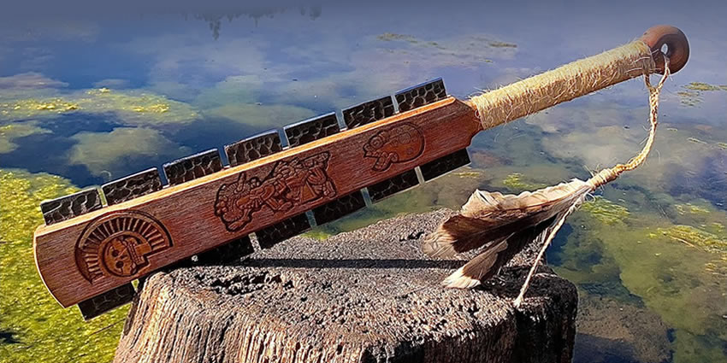
Conquering an Empire
The Aztec army was fierce and rarely lost
Started conquering their neighbors in the early 1400s
By the early 1500s, more than 10 million people lived under the Aztec
About one million at the capital
Aztec Sword
Heavy, wooden club with sharp obsidian sticking out of it
Notes:
Aztec Sword = mah-QWAH-wick

Slide 25
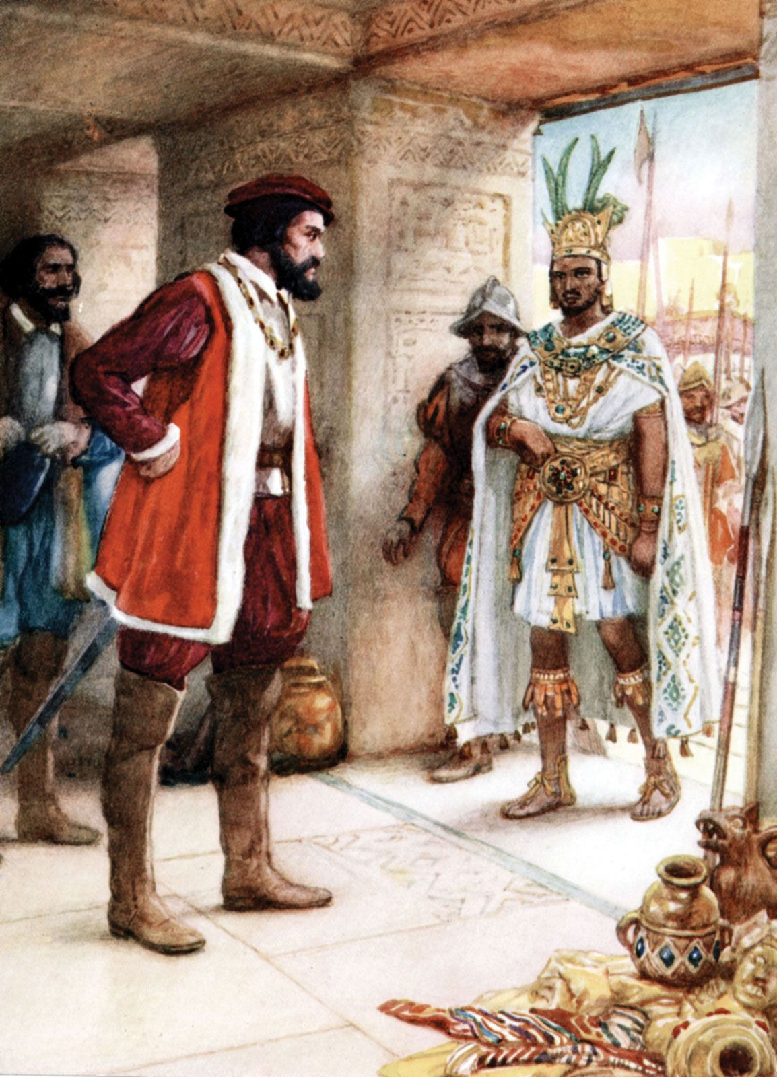
Ruling an Empire
Triple Alliance
Kings of Tenochtitlán, Texcoco, and Tlacopan ruled
King of Tenochtitlán (Aztec King) was the big boss
The Alliance demanded tribute
Payments from conquered kings to keep the peace
Absolute Monarchy
The Aztec King had all the power, and no one could question him
He had advisors but made the final decisions
Moctezuma II
Greatest and last king of the Aztecs

Slide 26
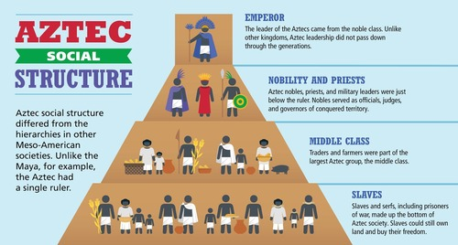

Slide 27
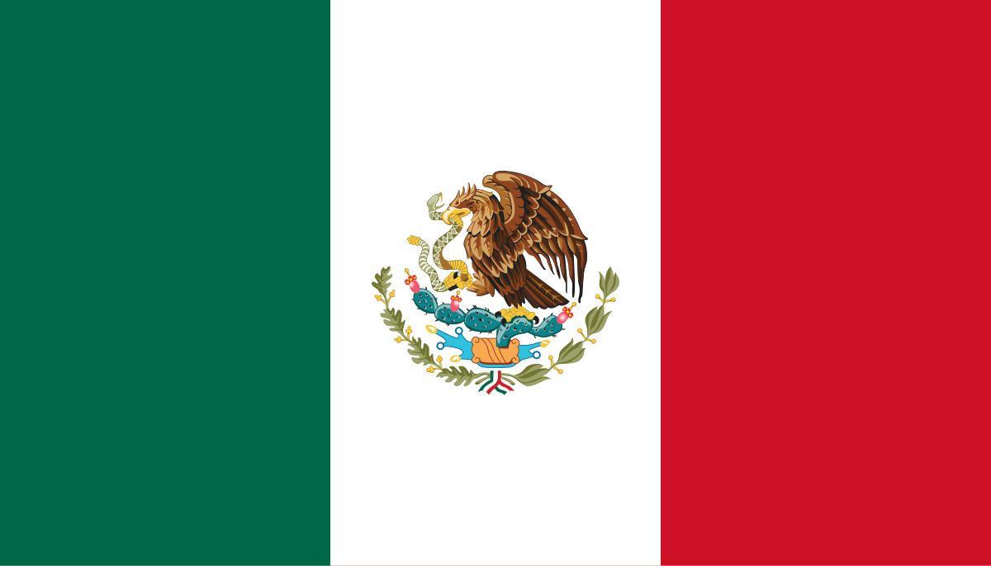
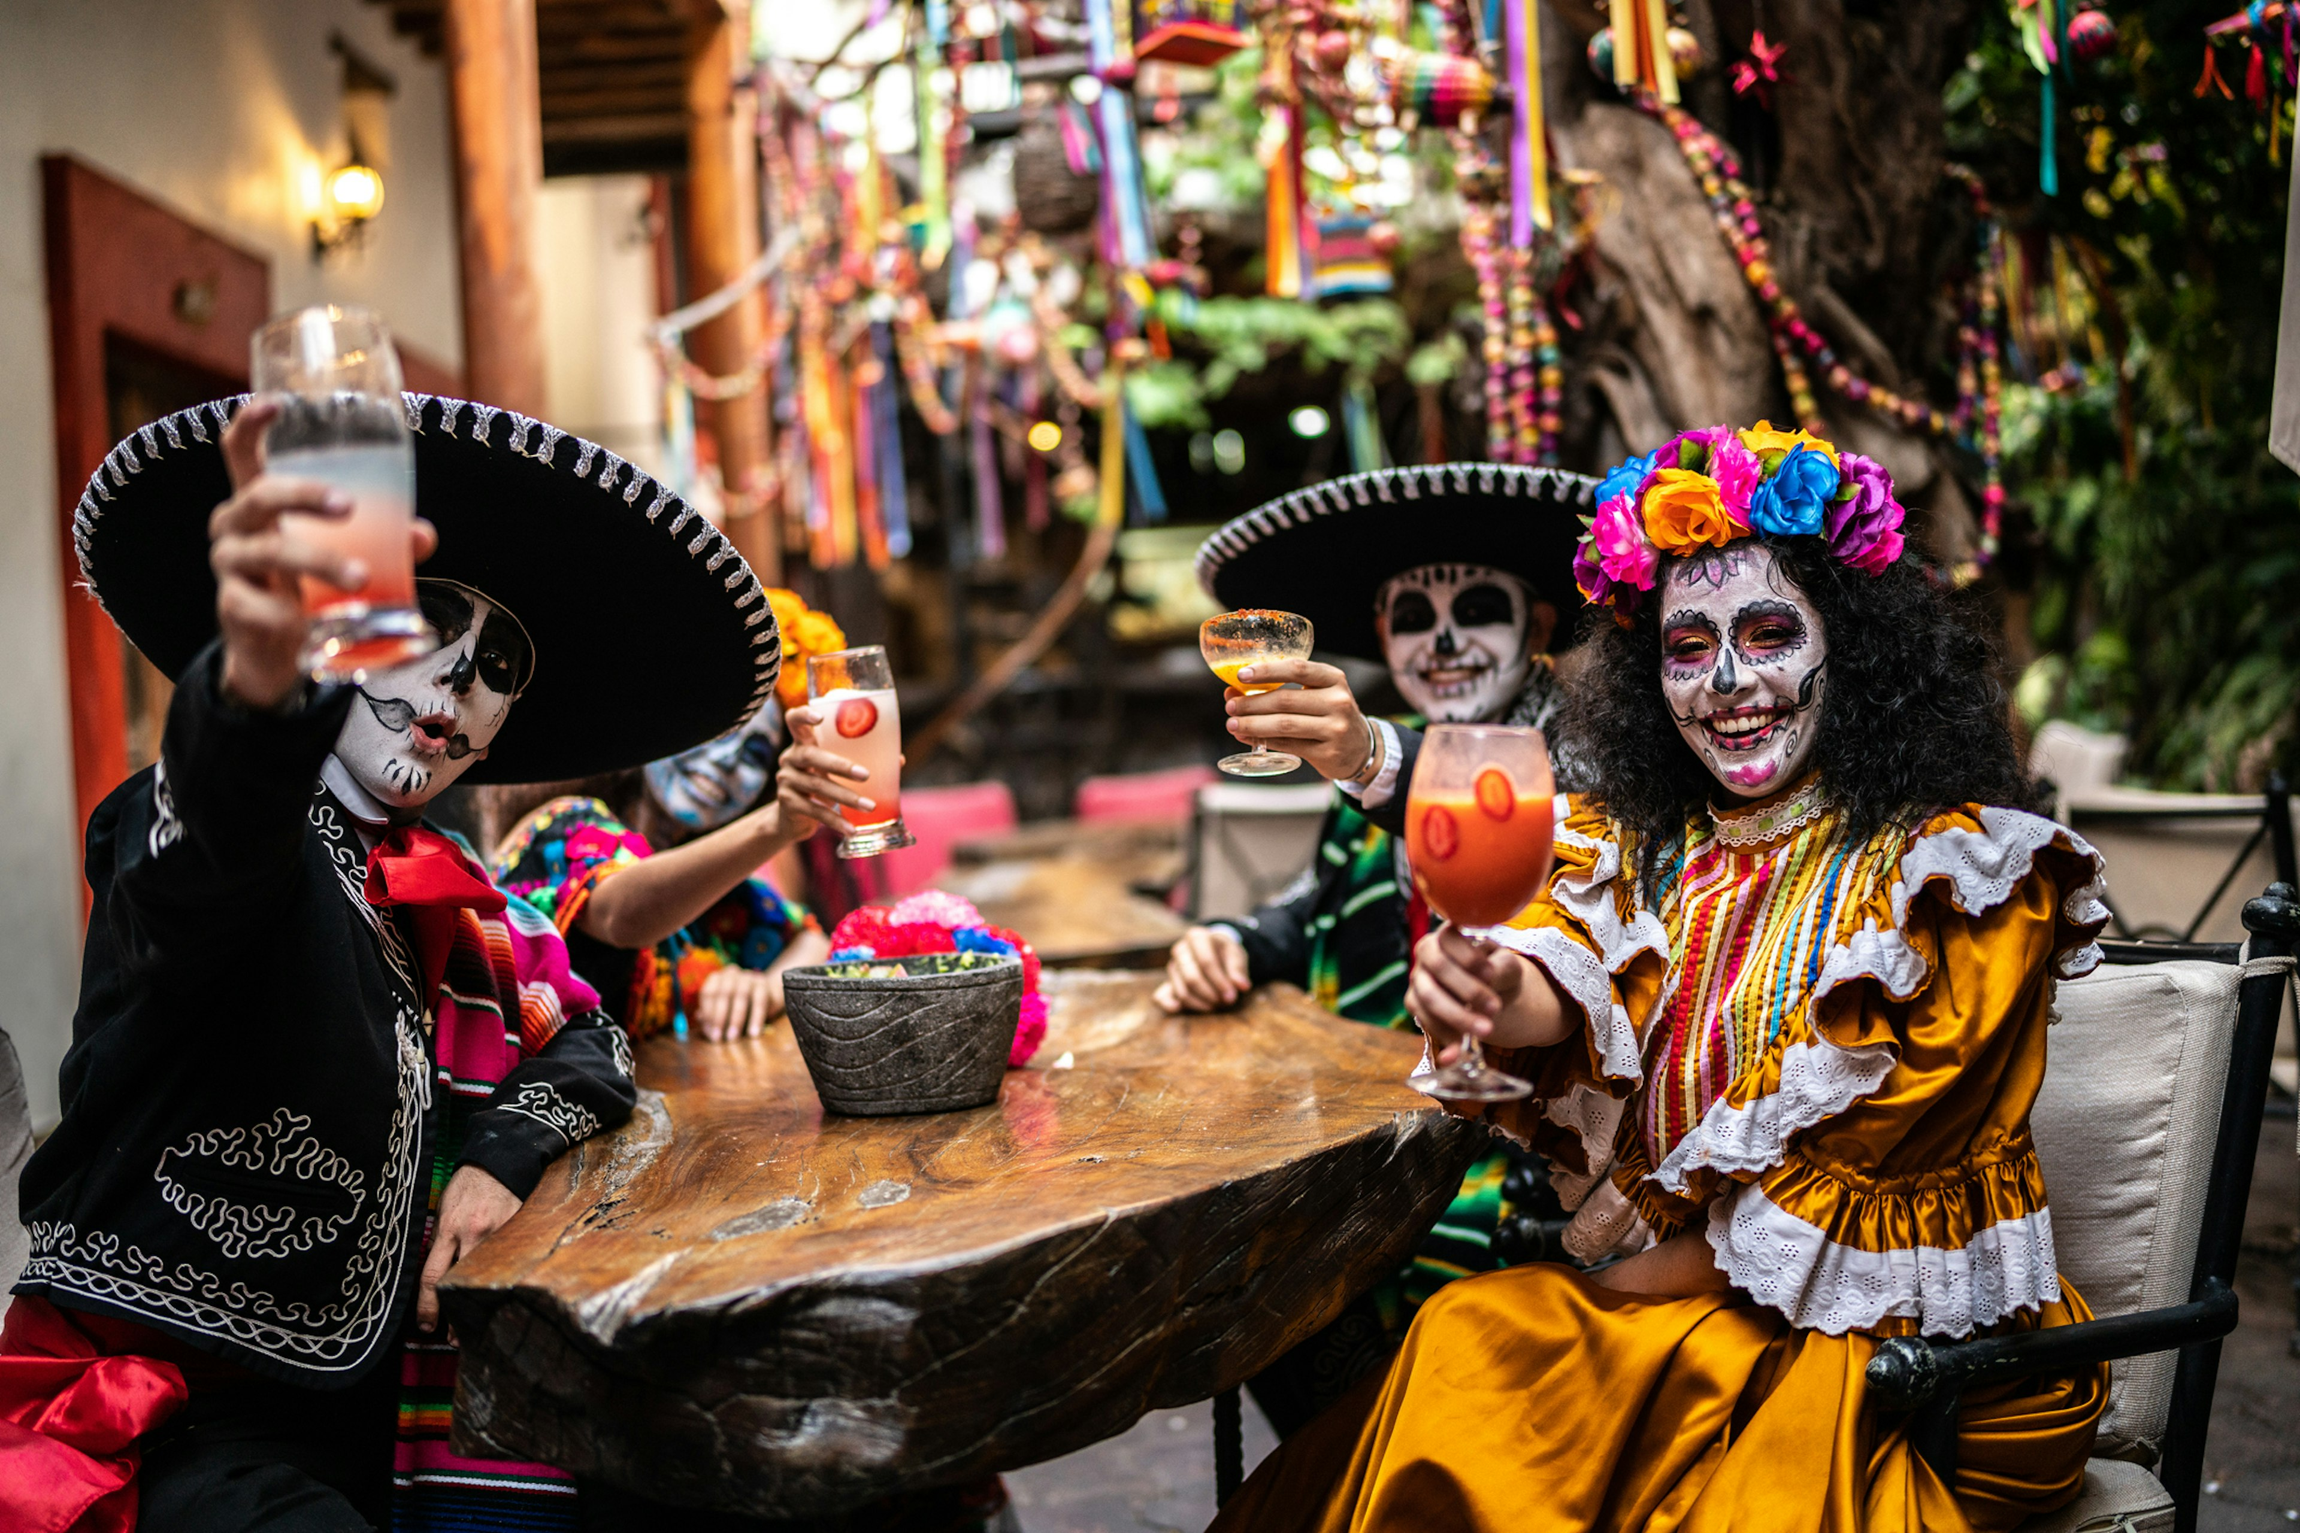
Aztec’s Lasting Impact
Cultural Influence
Traditions like the Day of the Dead trace back to Aztec rituals.
Words like chocolate, tomato, and avocado come from the Nahuatl language.
Modern Mexico
Tenochtitlán’s site is now Mexico City, Mexico’s capital.
The Mexican flag features an eagle and serpent, rooted in Aztec mythology.
Global Contributions
Introduced crops like maize and cacao, transforming diets worldwide.
Notes:
Use Google Earth to show Mexico City and where Tenochtitlan was.

Slide 28
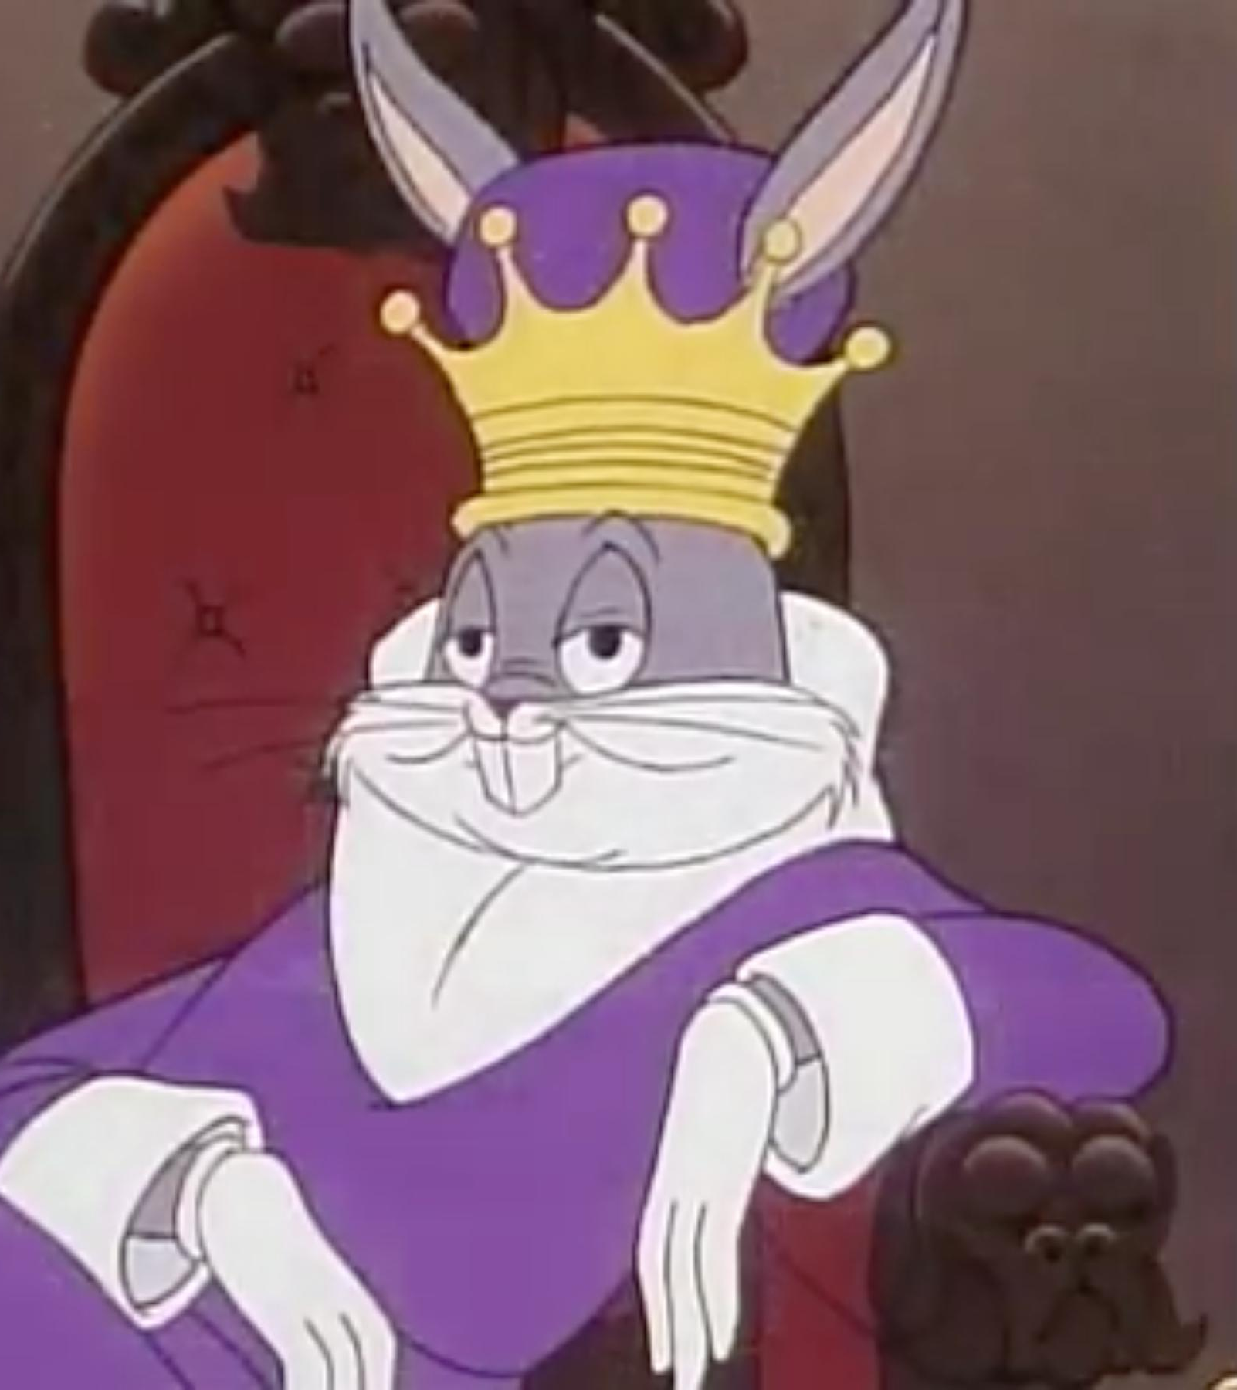
Exit Ticket
What is an Absolute Monarchy?

Slide 29
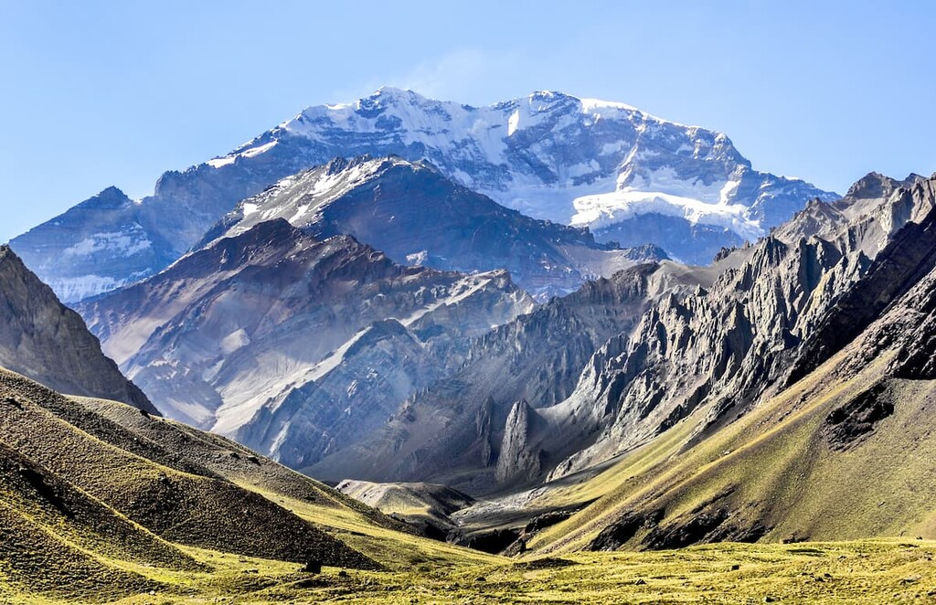
Andean Geography
Diverse Terrain
The Andes Mountains dominate, with rugged peaks and narrow valleys
Includes deserts, highland plateaus, and coastal plains.
Adaptations to the Environment
Terrace farming: Built into mountain slopes to grow crops like potatoes, maize, and quinoa.
Irrigation: Engineered canals and aqueducts to transport water
Challenging Climate
Extreme weather and high altitudes required street smarts to thrive.

Slide 30
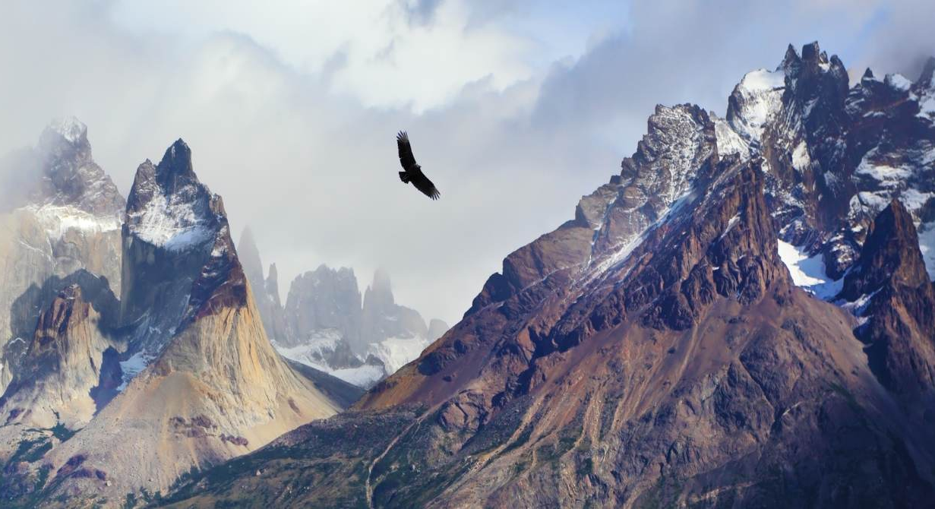
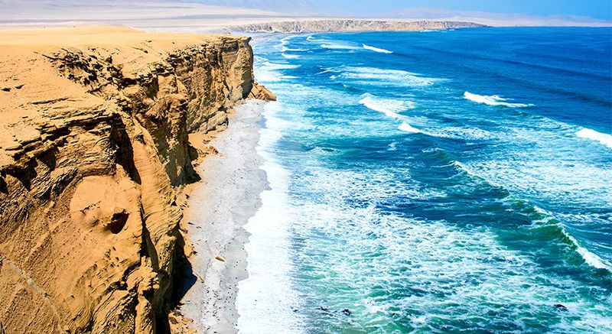
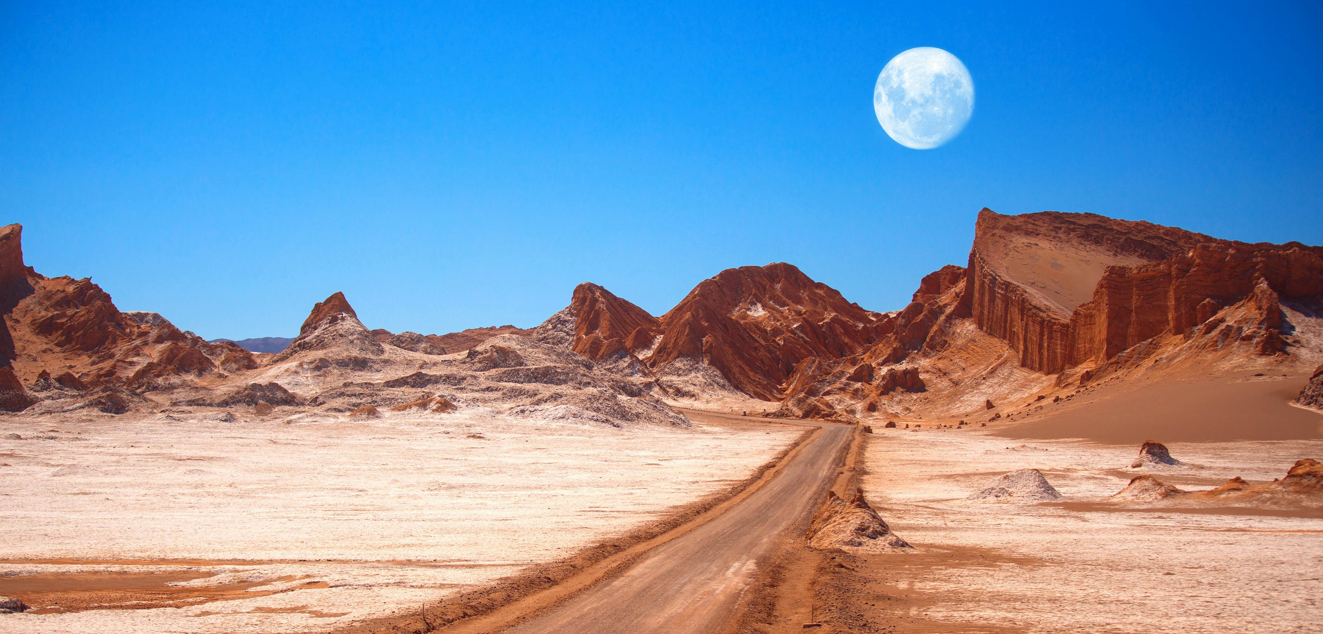
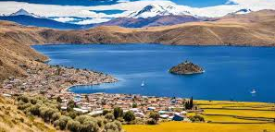
Notes:
L to R: Andes, coastline, Atacama Desert, Lake Titicaca

Slide 31
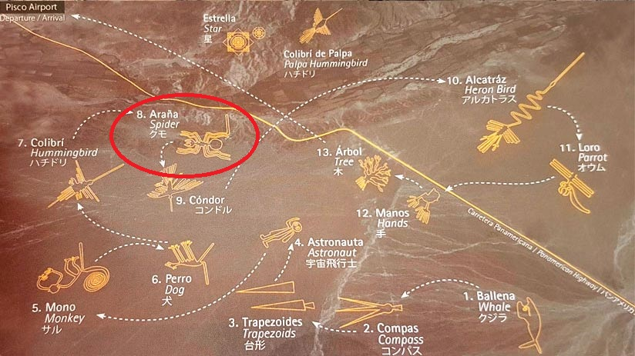
Notes:
Use Google Earth to show lines

Slide 32
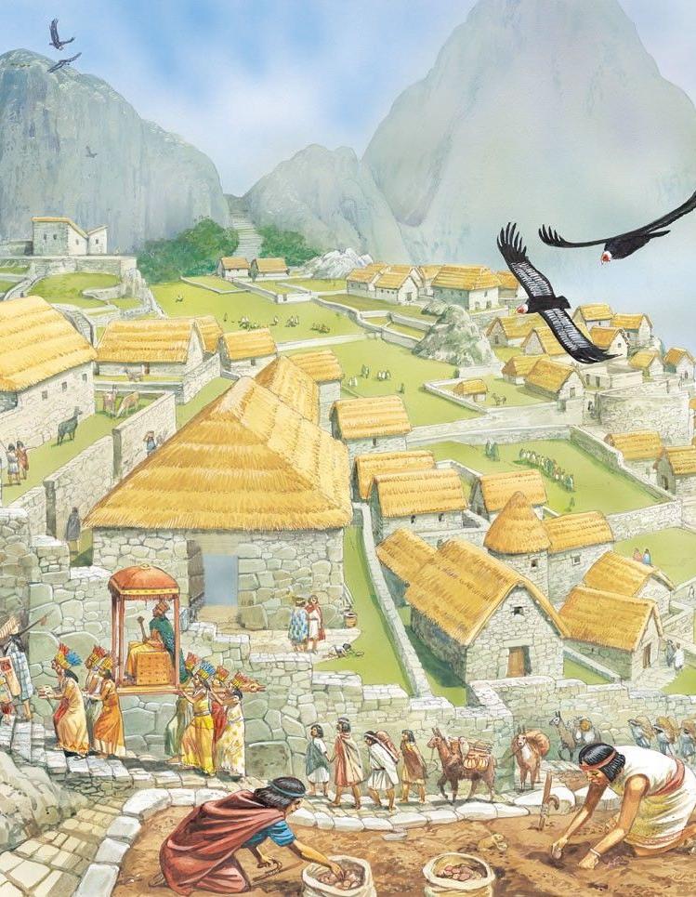
Rise and Fall of the Incan Empire
Rise:
Began in the 1200s in the Cuzco Valley, uniting smaller Andean groups.
Expanded and created the largest empire in the Americas.
Unified empire through diplomacy, military conquest, and infrastructure.
Fall:
Civil war weakened the empire
Francisco Pizarro in 1532 and the Spanish conquest marked its collapse.
Disease (smallpox) and superior weapons gave the Spanish an advantage.

Slide 33
Incan Achievements
Engineering
Road system: Over 25,000 miles of roads connected the empire, featuring suspension bridges.
Built cities like Machu Picchu, showcasing advanced stonework without mortar.
Agriculture
Innovated terrace farming and freeze-drying (chuño) for food preservation.
Communication
Quipu: A system of knotted cords used for record-keeping and communication.
Medicine
Performed successful skull surgeries and used herbal remedies.

Slide 34
Incan Society
Community Structure
Organized into ayllus (family groups) that shared land and responsibilities.
Collective farming supported local and imperial needs.
Religion
Worshiped gods like Inti, the sun god, and practiced rituals like animal sacrifices.
Built grand temples, including the Temple of the Sun in Cuzco.

Slide 35
Vocab Words to Know
Ayllu
A group of related families
Grouped resources together to meet people’s needs
Mita System
Incans did not have money
They “paid” their taxes through labor for the government
Farms were divided into three part
One for the government
One for the gods and priests
One for the people

Slide 36
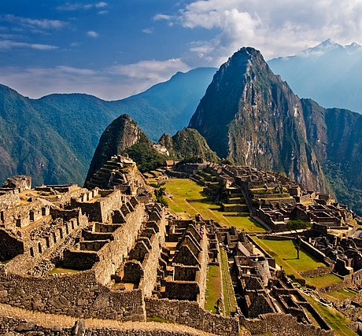
Exit Ticket
What was the mita system, and how did it affect the lives of Incan commoners?

Slide 37
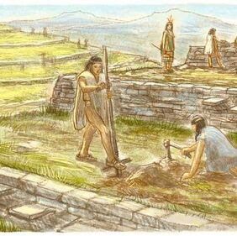
Do Now
What is an ayllu?

Slide 38
North America’s Geographic Diversity
Diverse Regions
Ranges from Arctic tundra to Great Plains grasslands, Southwestern deserts, and Pacific Northwest forests.
Geography influenced how different groups adapted and thrived.
Resource Use
Depended on available materials: wood, stone, animal hides, and plants.
Diverse food sources included agriculture, hunting, fishing, and foraging.

Slide 39
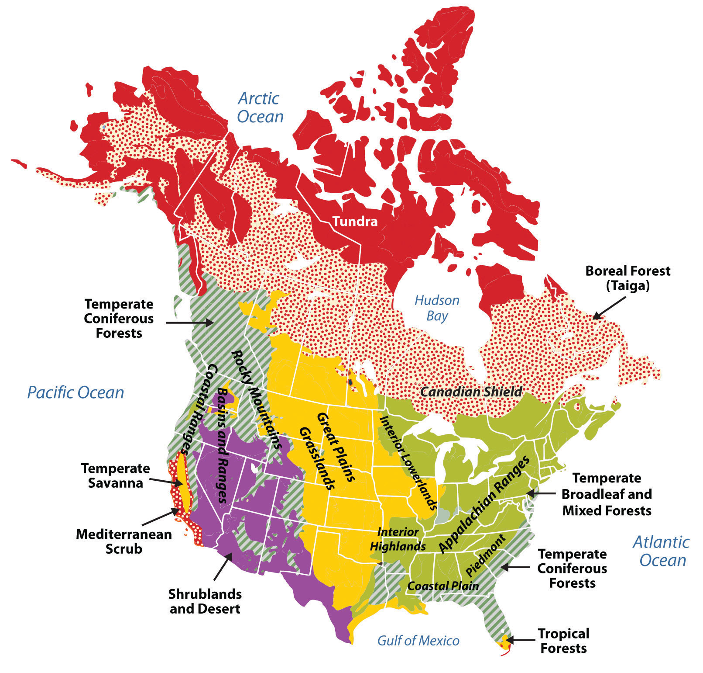

Slide 40
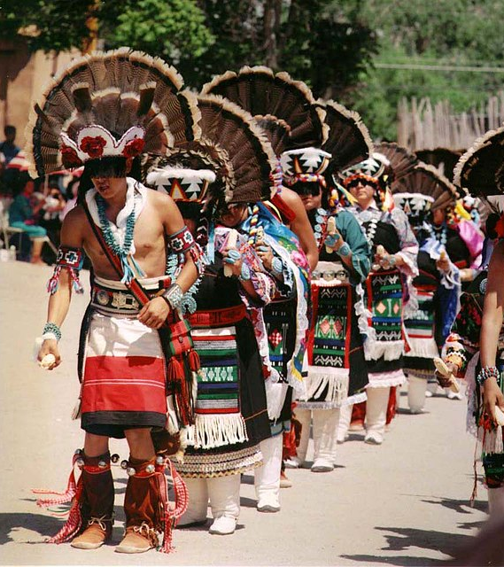
Pueblo and Southwestern Cultures
Pueblo (Southwest)
Built adobe dwellings in cliffs and mesas for protection.
Practiced dry farming and irrigation to grow maize, beans, and squash.
Developed kivas for religious ceremonies and community gatherings.
Other Southwestern Groups
Navajo and Apache adapted to desert environments through trade and herding.

Slide 41
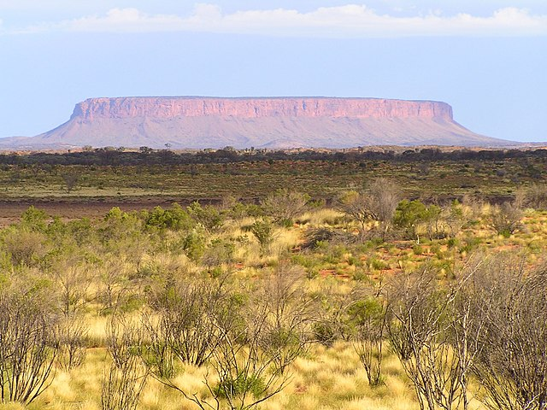
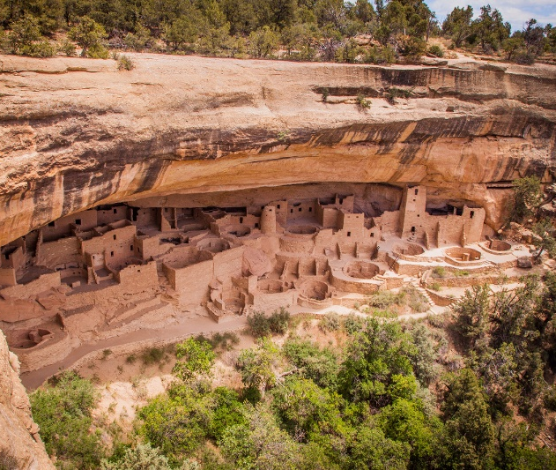
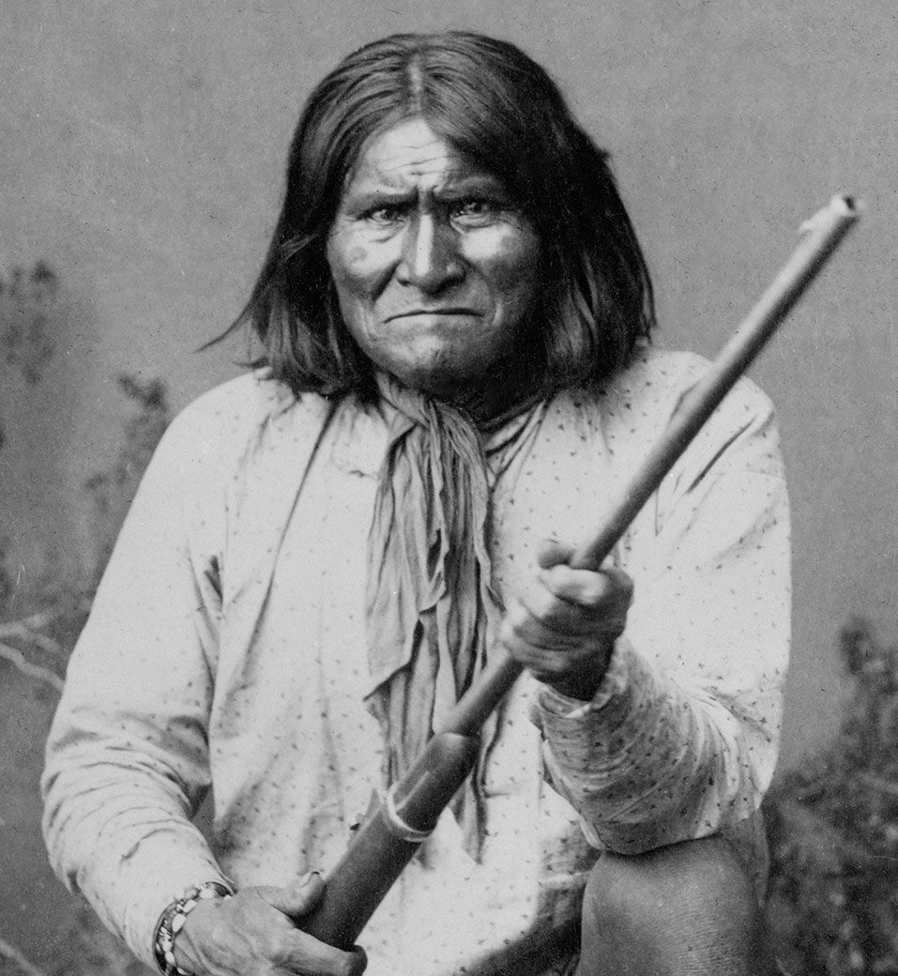
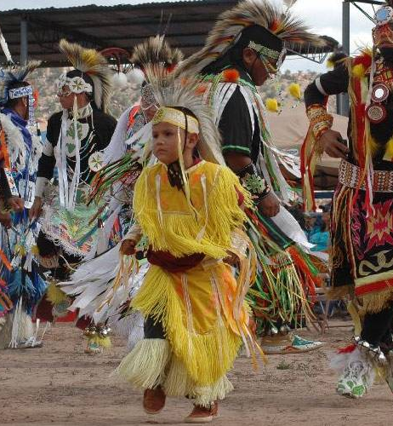

Slide 42
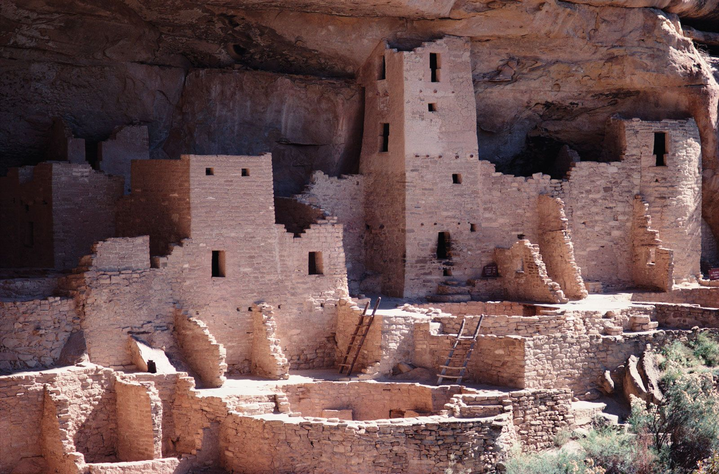
Do Now
Where did the Pueblo build their homes and why?
Notes:
Have the students write this down in their notebooks. I ran out of Do Now sheets. If they say they do not know this, it should be in their notes from yesterday’s lesson. If they say they do not have it, please emphasize the importance of notetaking. All test questions come from their notes.

Slide 43
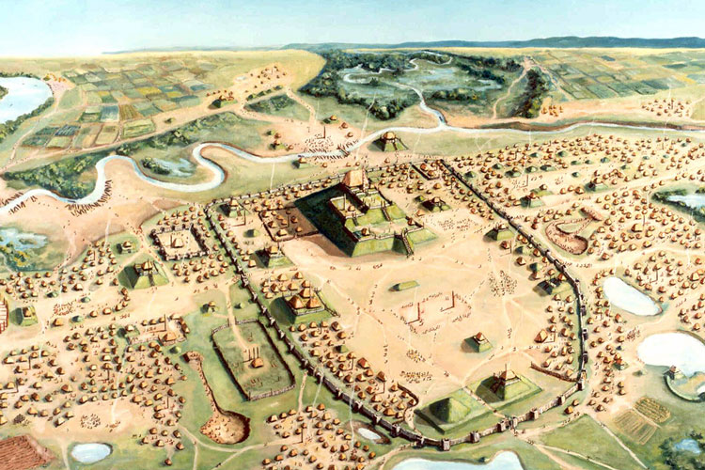
Mississippian Cultures
Centers of Civilization
Built large earthen mounds, such as at Cahokia near present-day St. Louis.
Cities served as religious and political hubs.
Economy and Society
Practiced advanced agriculture, cultivating maize and squash.
Society led by chiefs; strong religious traditions linked to the sun and seasons.

Slide 44
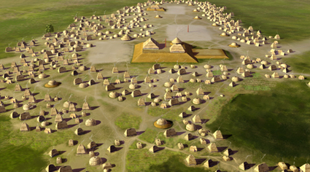
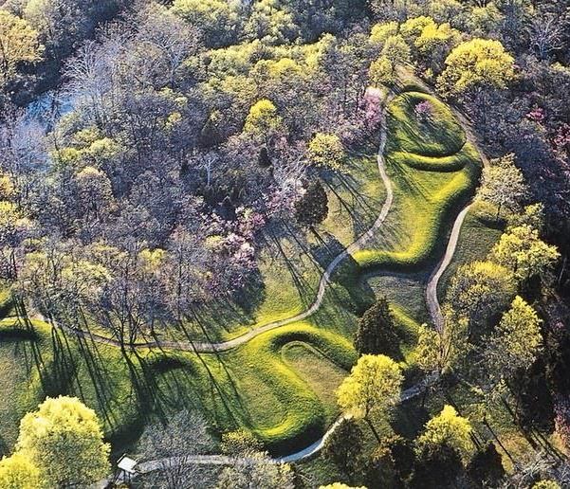
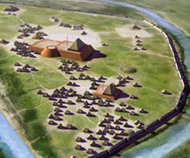
Notes:
Emerald Mounds (Cahokia suburb in St. Claire County), Angel Mounds (tribe unknown (pre-contact) in Evansville, IN), and Serpent Mound (Adena Peoples in Pebbles, OH)

Slide 45
Great Plains People
Nomadic and Settled
Nomads hunted buffalo and used every part of the animal for tools, food, and clothing.
Farmers along rivers grew maize, beans, and squash.
Adaptations
Developed teepees for mobility.
Used travois to transport goods and relied on communal hunting methods.

Slide 46
Notes:
Discuss the various uses for buffalo by the Great Plains people. The animal was sacred to them and it was an insult to the spirits and to the animal to not use every part of it.

Slide 47
Northwest and Arctic Cultures
Northwest
Rich in resources like salmon, cedar, and game.
Built plank houses and crafted totem poles to tell family and spiritual stories.
Arctic
Inuit and Aleut adapted to harsh conditions, hunting seals, whales, and caribou.
Built igloos and used kayaks for travel and hunting.

Slide 48
Notes:
L to R: Plank House, Totem Poles, Igloo outside, Igloo interior

Slide 49
Eastern Woodlands
Alliance of Five Nations
Mohawk, Oneida, Onondaga, Cayuga, and Seneca; later joined by the Tuscarora.
Established a Great Law of Peace to settle disputes and govern collectively.
Innovations
Lived in longhouses, with extended families under matrilineal leadership.
Their confederation inspired principles of representative democracy.

Slide 50
Notes:
Longhouse exterior and interior, map of the Iroquois Confederacy

Slide 51
Totem Poles
Indigenous tribes in the Northwest used totem poles to symbolize or honor ancestors, cultural beliefs, or notable events. The poles may also serve as functional architectural features, welcome signs for village visitors, among other things. Use the rest of class to design your own and explain its meaning.

