Slide 1
Native American Cultures and European Colonization in North America

Slide 2
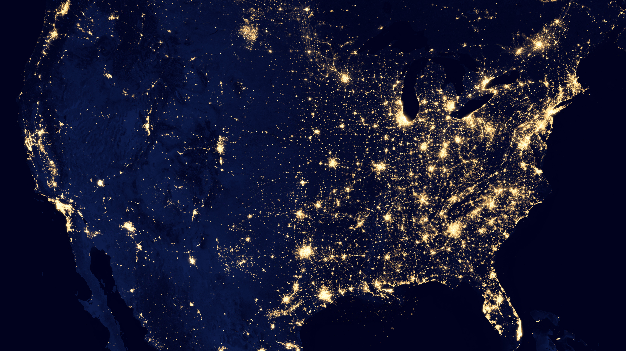

Slide 3
How Geography Shapes Our Lives
Geography affects where people live
Influences what food they can grow
Determines what materials they have for building
Impacts how they travel
Examples from your life: local weather, nearby water sources

Slide 4
Native American Culture Regions Map
Plains Region: Vast grasslands
Southwest Region: Desert areas
Northeast Region: Forests and coastline
Southeast Region: Warm climate, rivers
Northwest Region: Mountains and forests
Arctic Region: Cold tundra

Slide 5
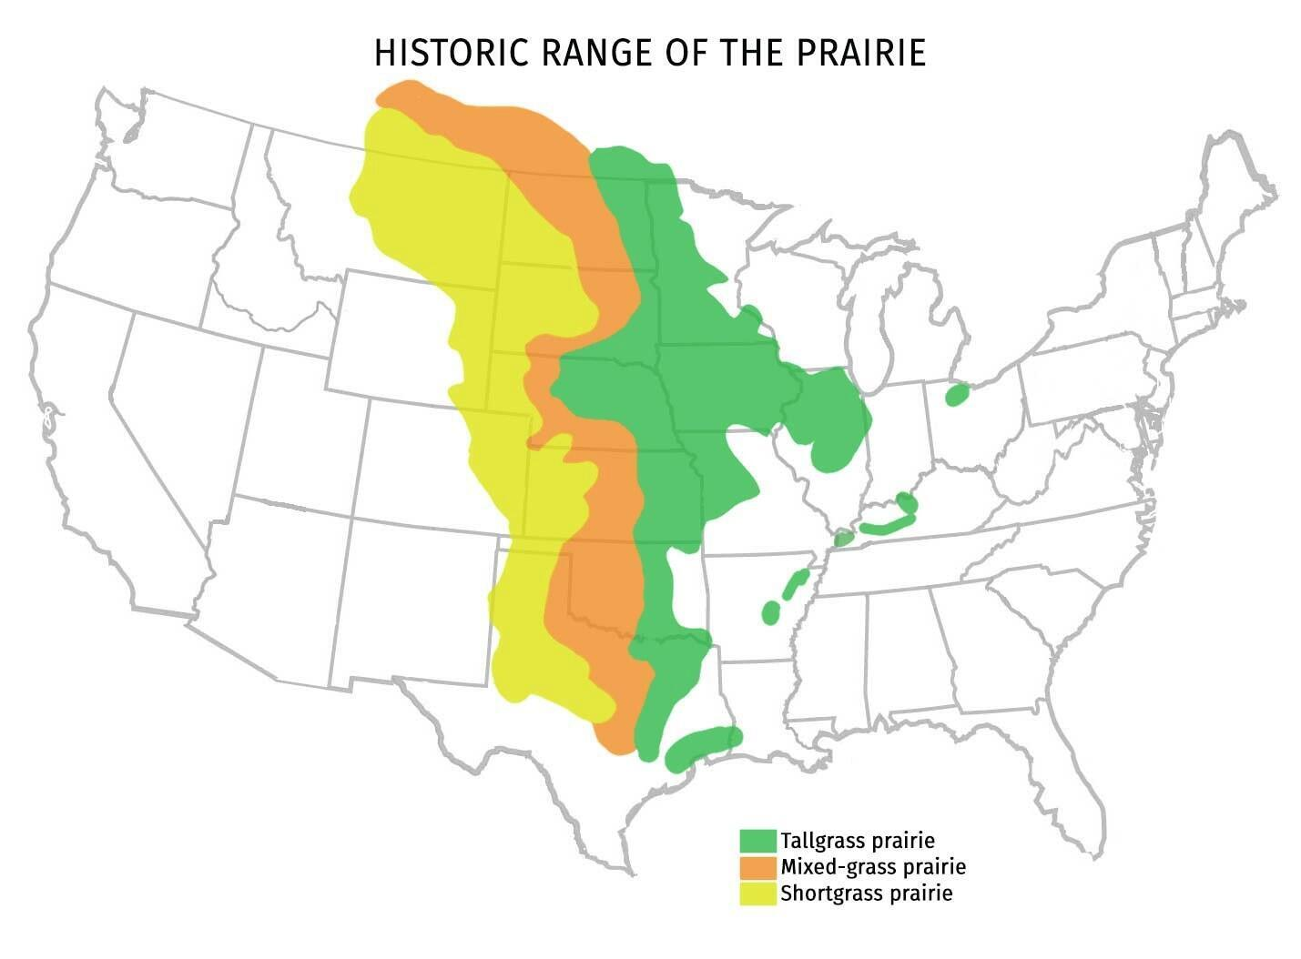

Slide 6
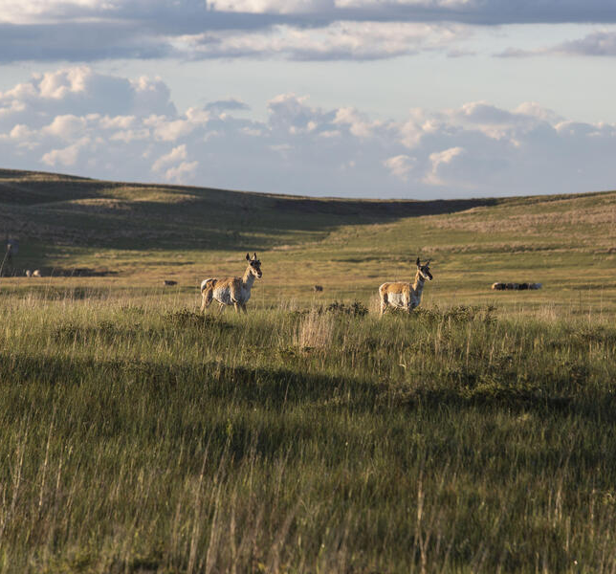
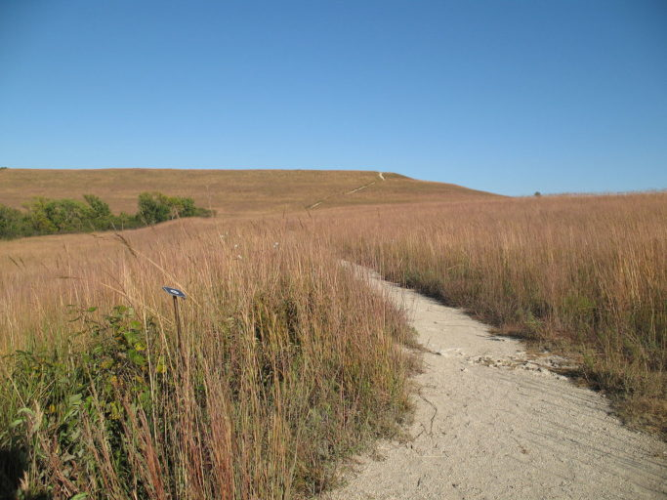
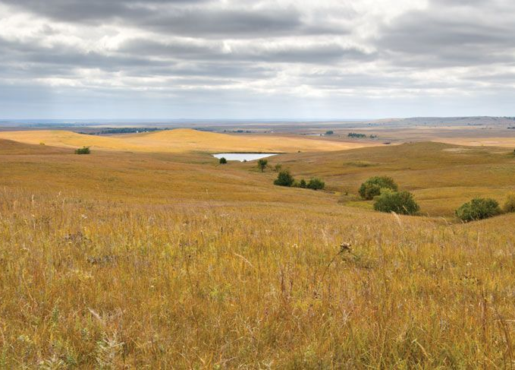

Slide 7
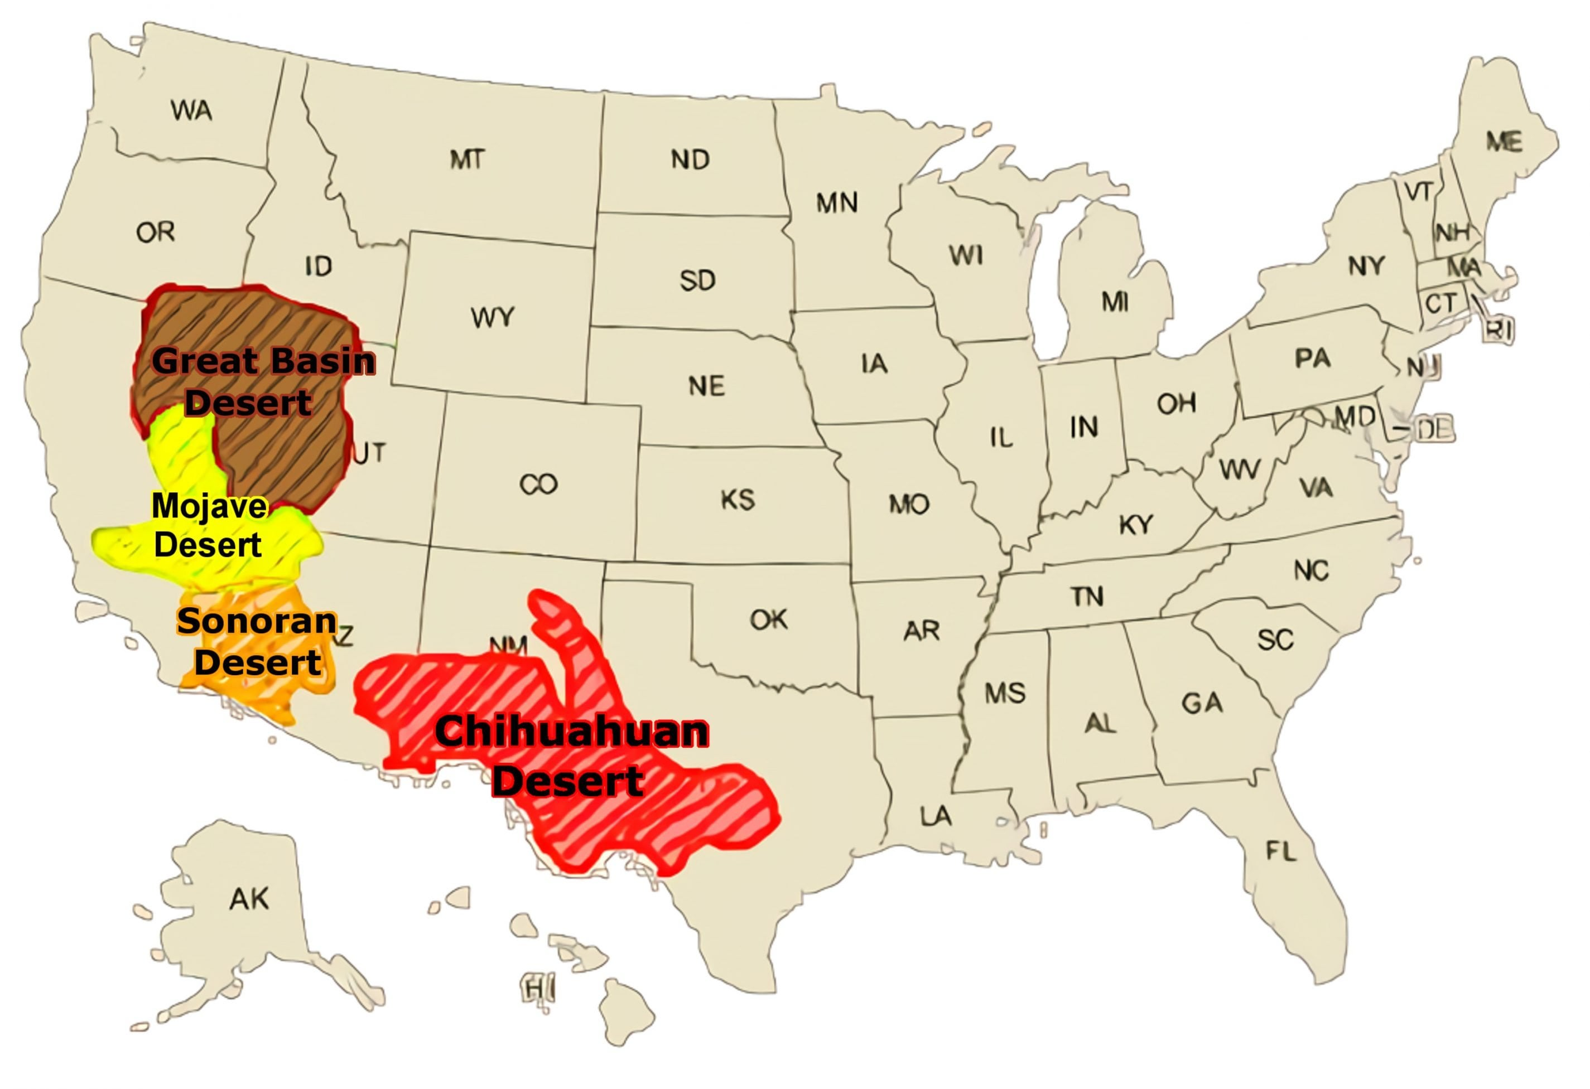

Slide 8
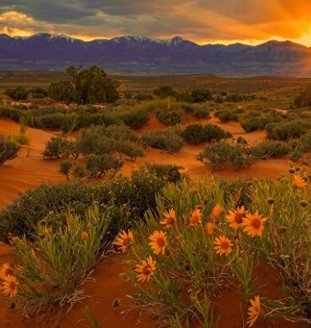
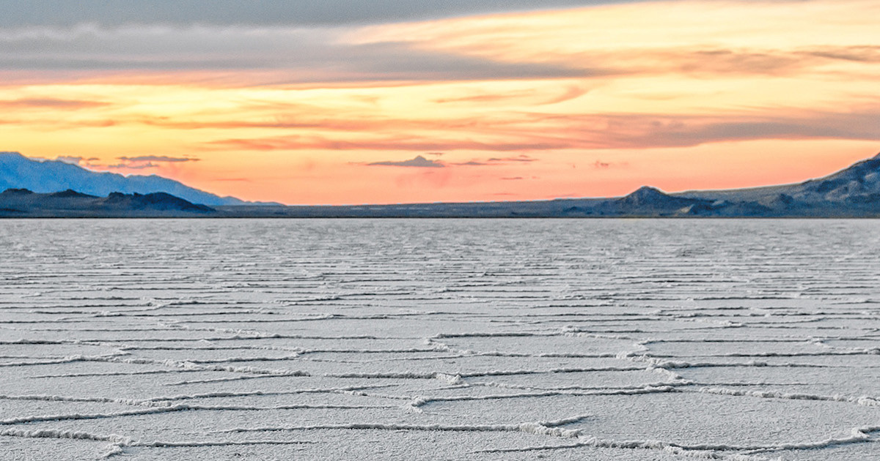

Slide 9
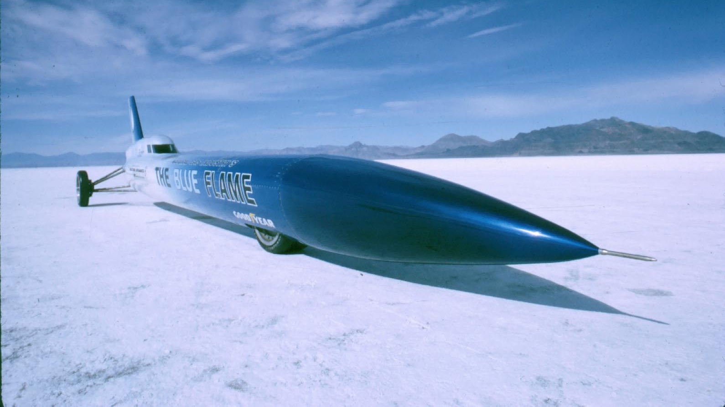

Slide 10
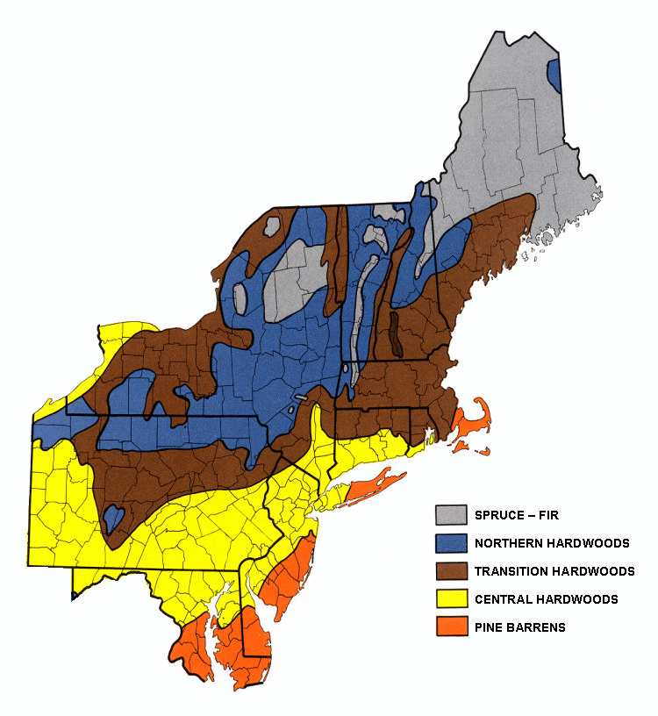

Slide 11
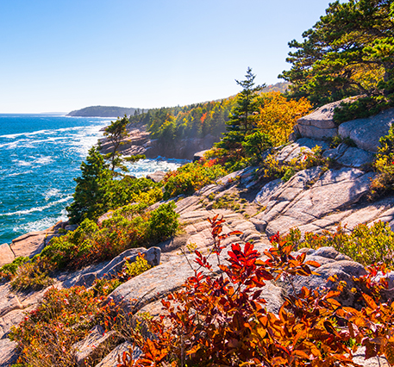
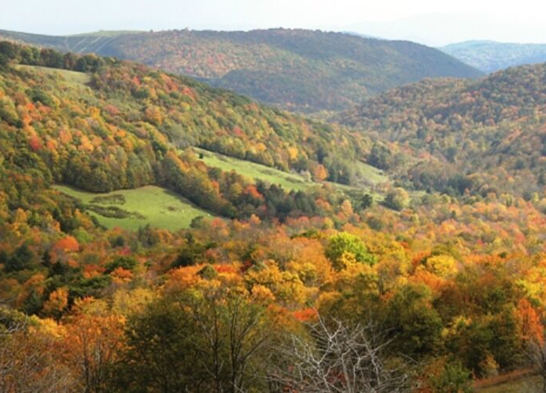
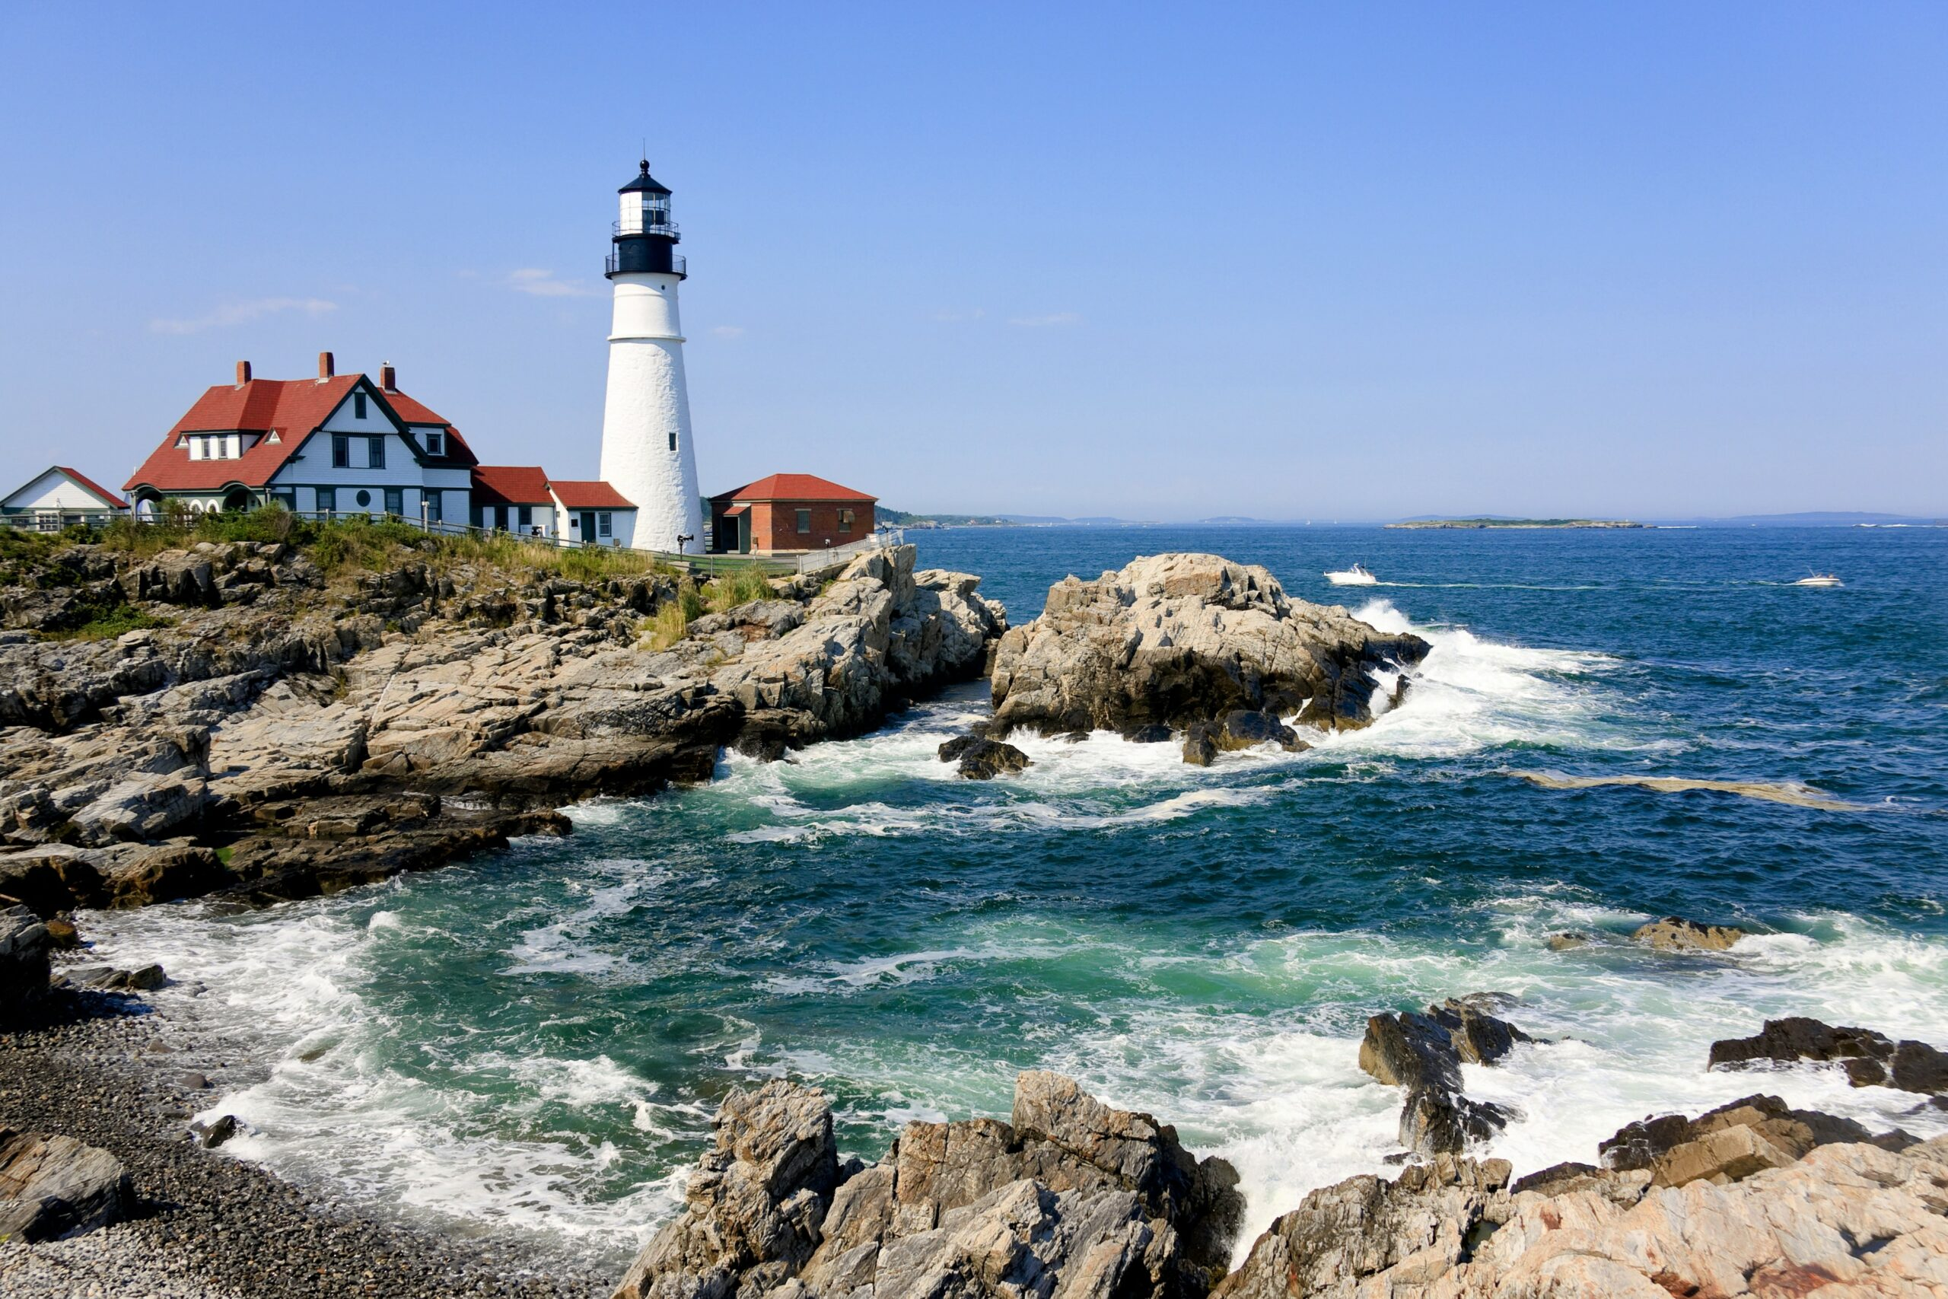

Slide 12
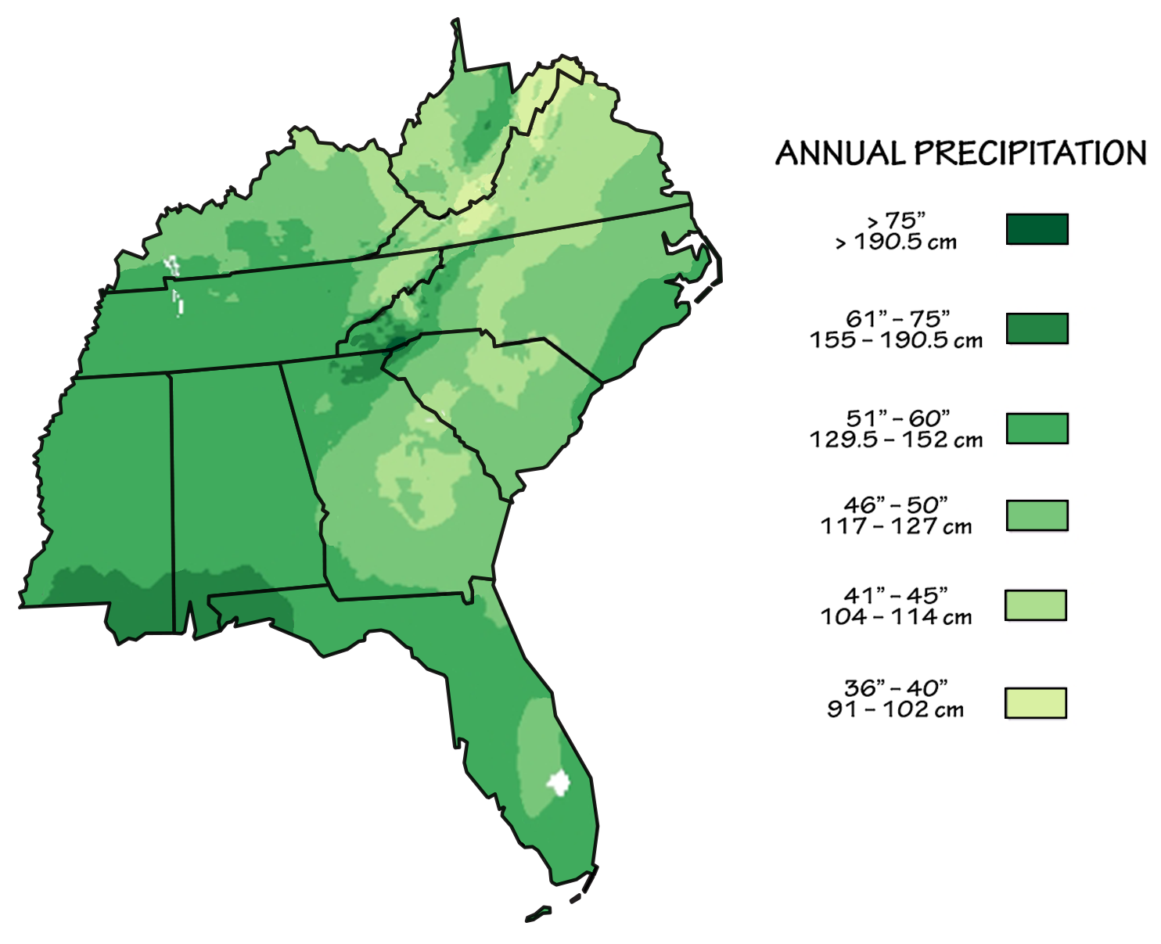

Slide 13
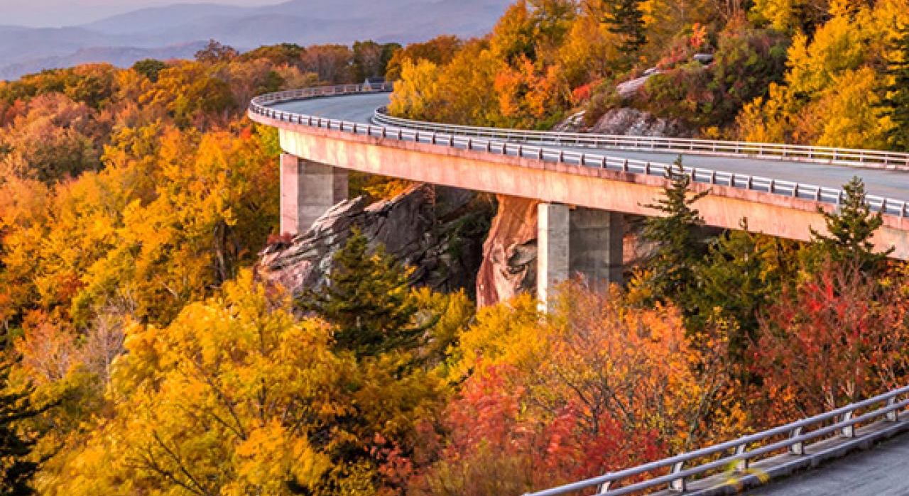
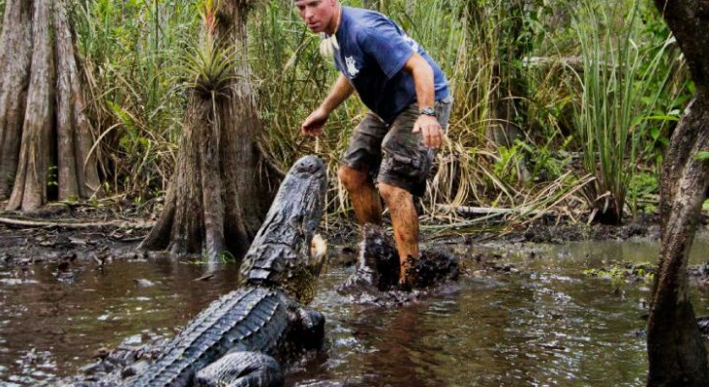
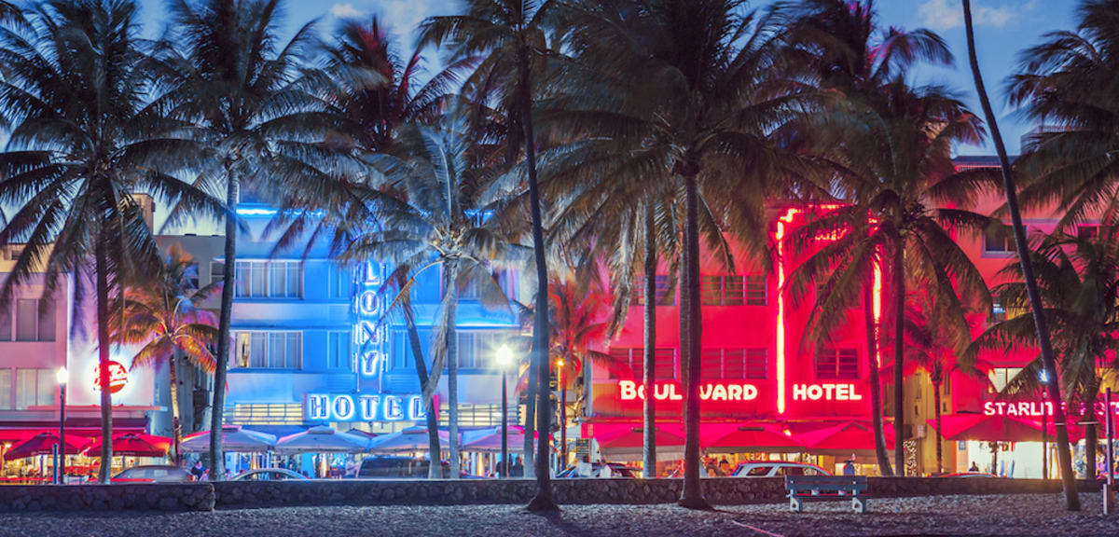
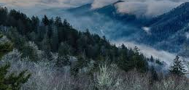

Slide 14
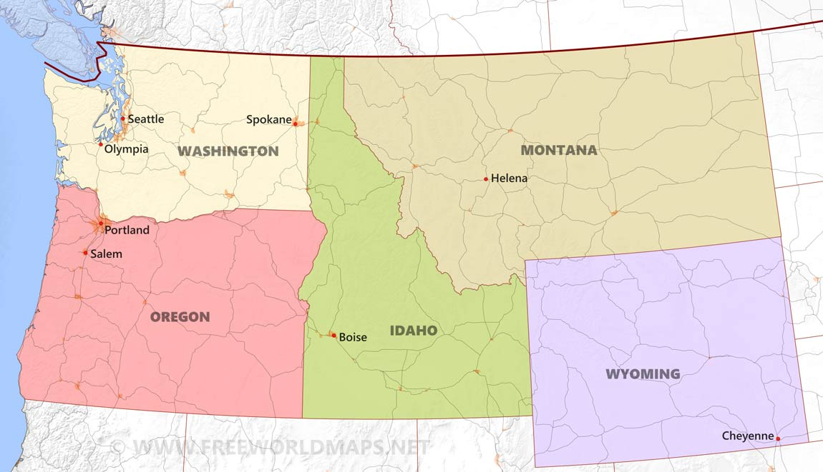

Slide 15
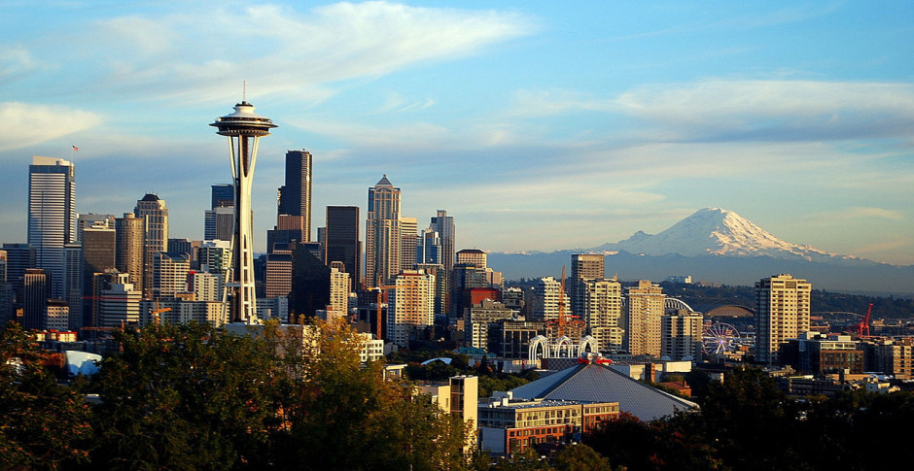
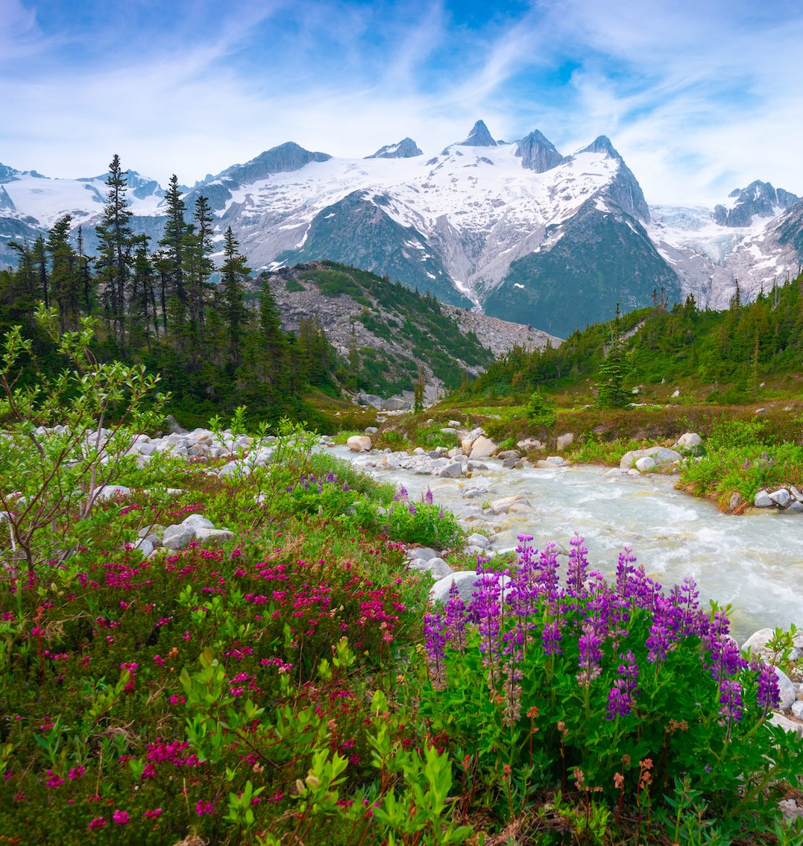
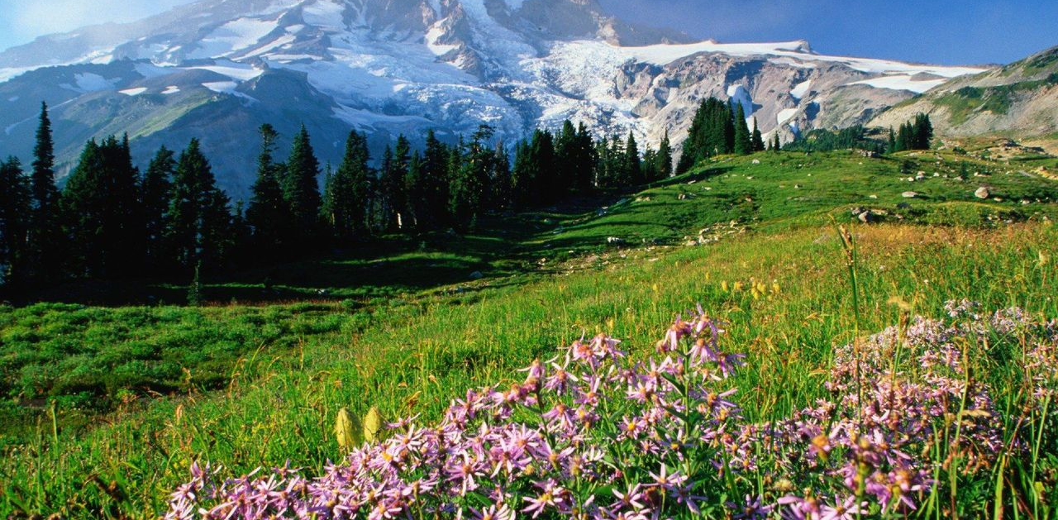

Slide 16
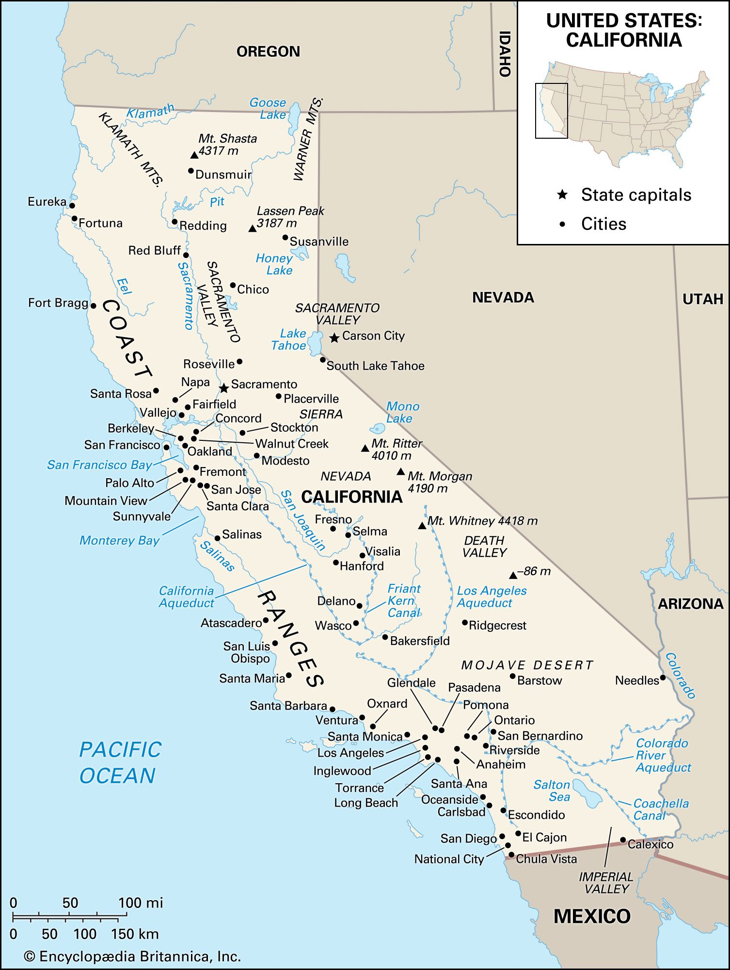

Slide 17
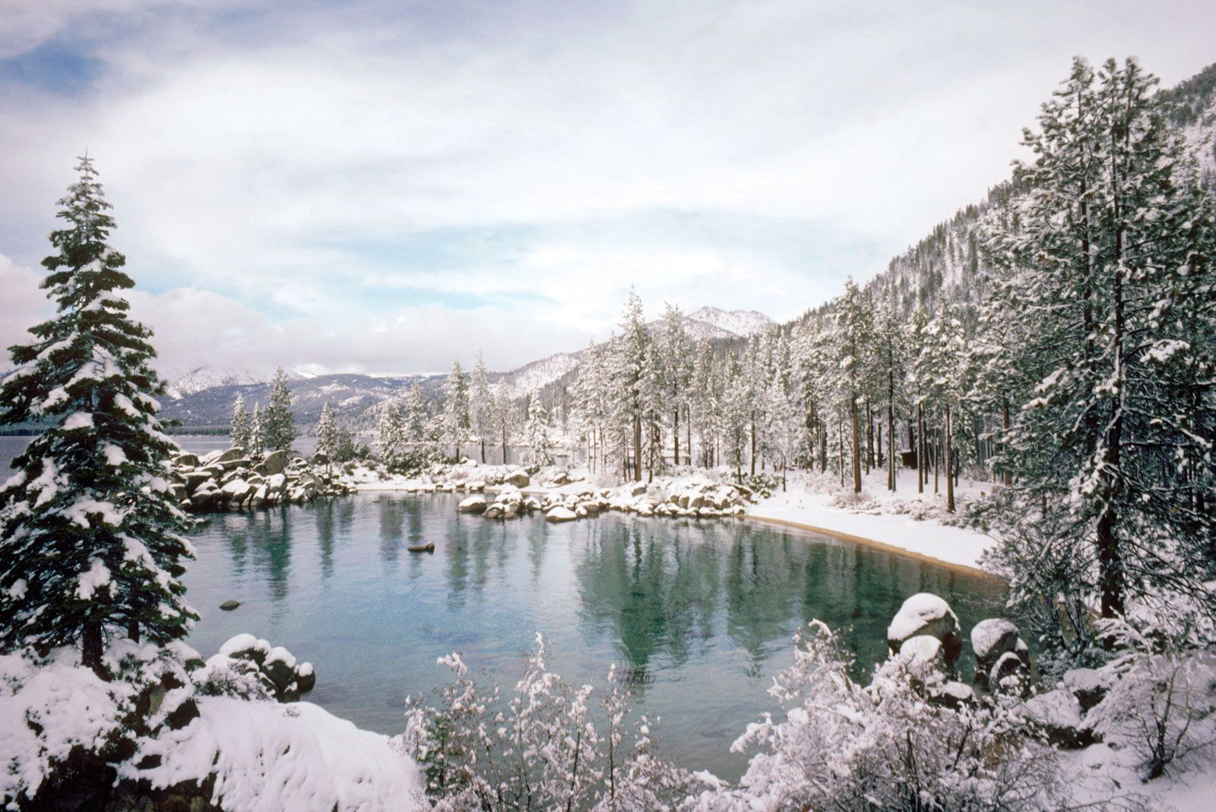
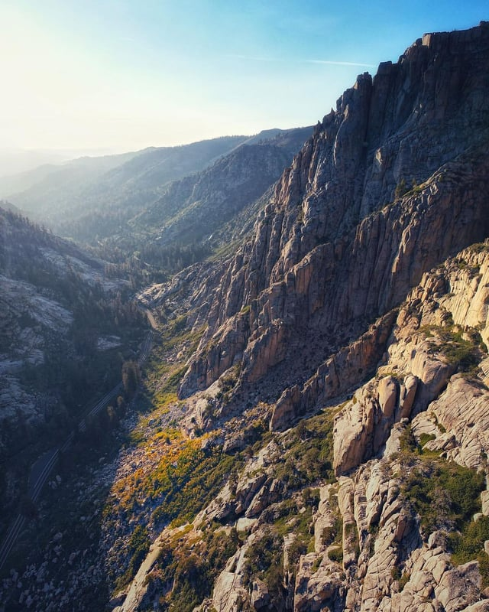

Slide 18
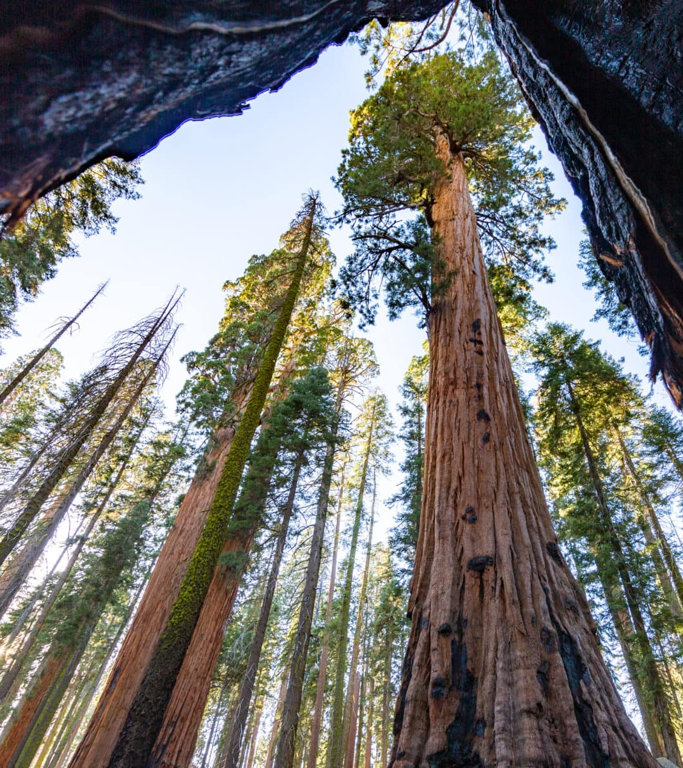
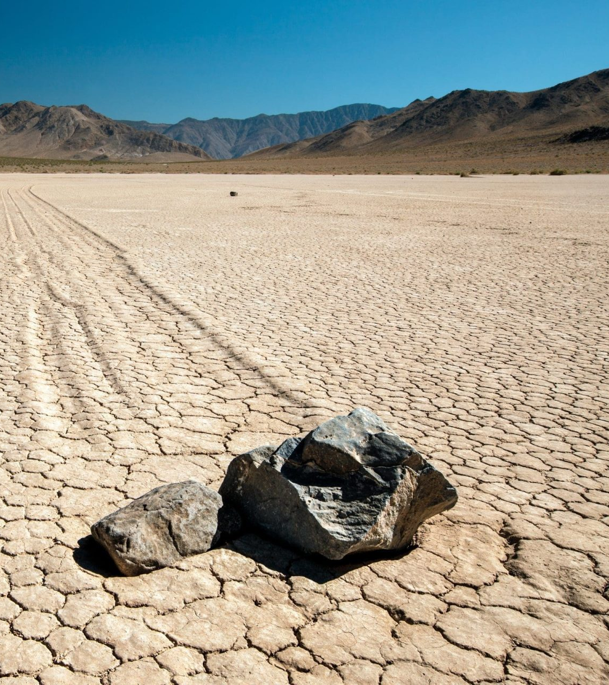

Slide 19
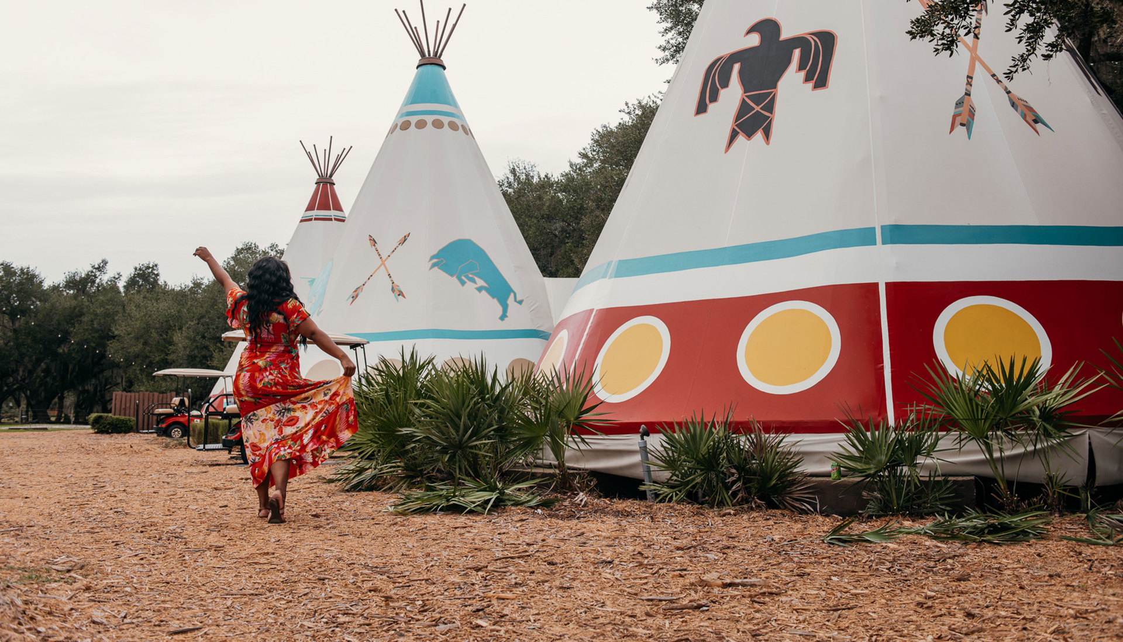
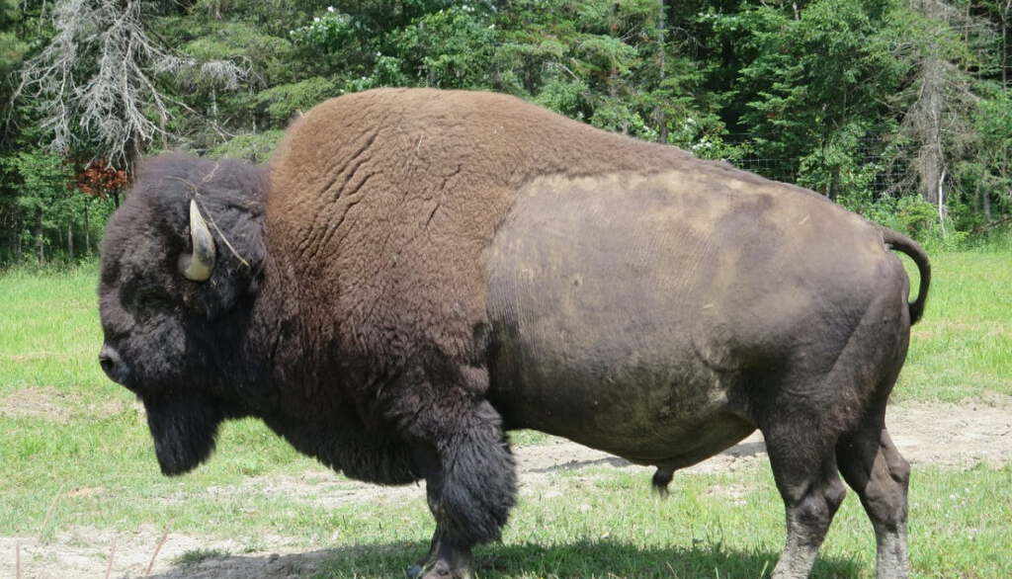
Plains Region Native Americans
Lived in the Great Plains
Buffalo (bison) were very important
Used tepees for homes
Tribes included:
Lakota
Cheyenne
Blackfeet
Horses were important for hunting

Slide 20
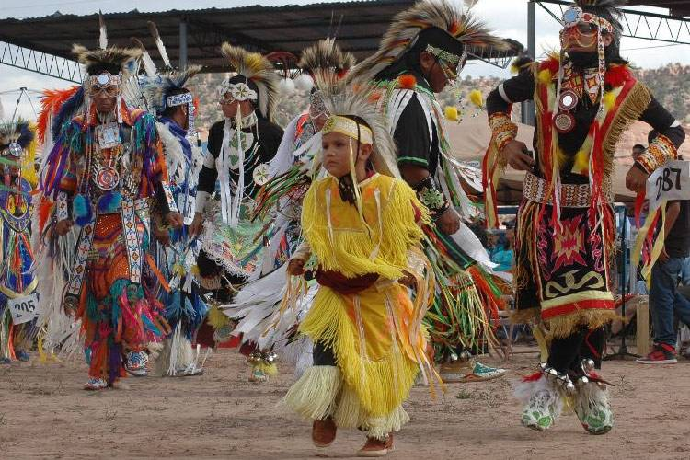
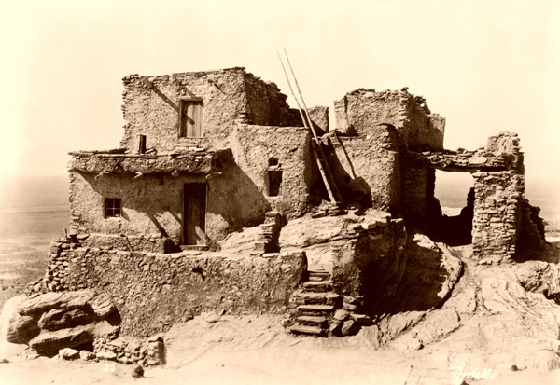
Southwest Region Native Americans
Lived in hot, dry areas
Built pueblo homes from clay
Farmed corn, beans, and squash
Used irrigation systems
Made beautiful pottery
Tribes included Hopi and Navajo

Slide 21
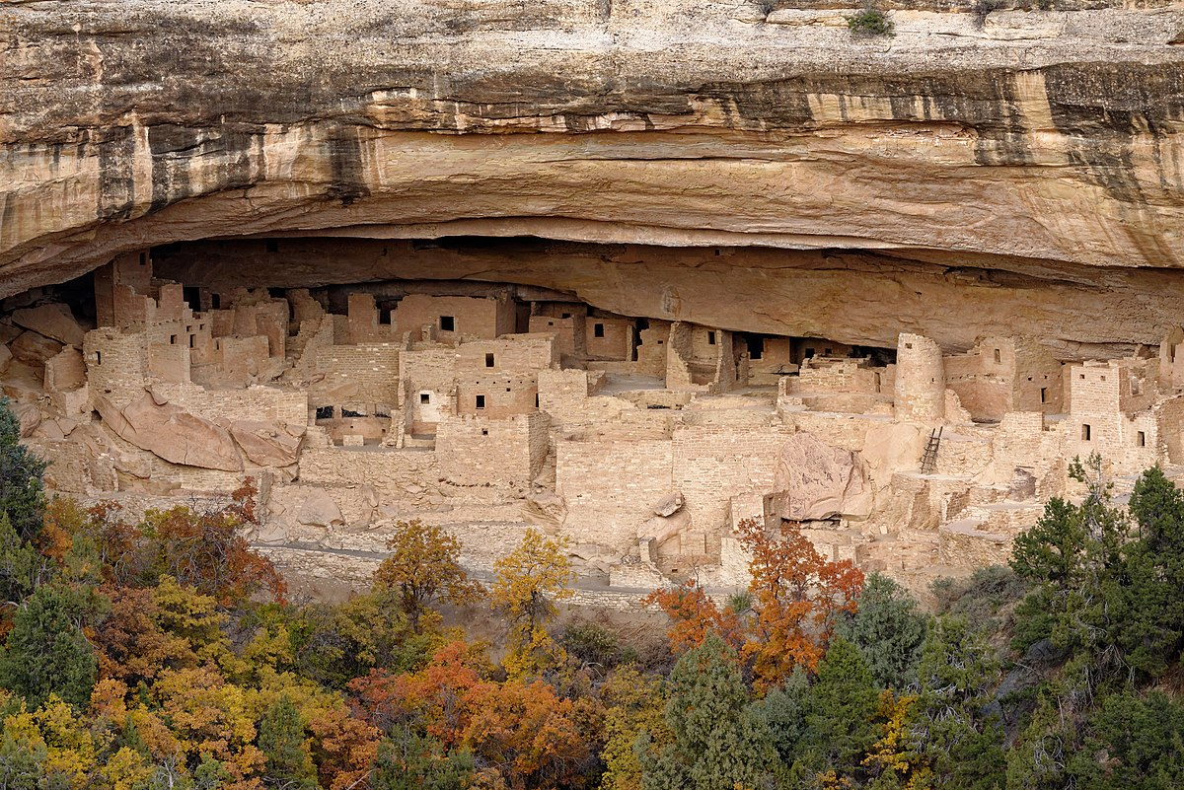
The Pueblo People
Built multi-story homes
Used adobe (mud and straw)
Farmed in dry climate
Made colorful blankets
Created special rain dances
Still live in Southwest today

Slide 22
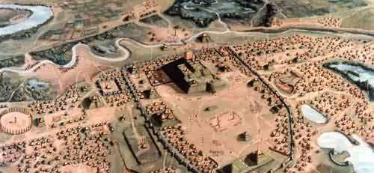
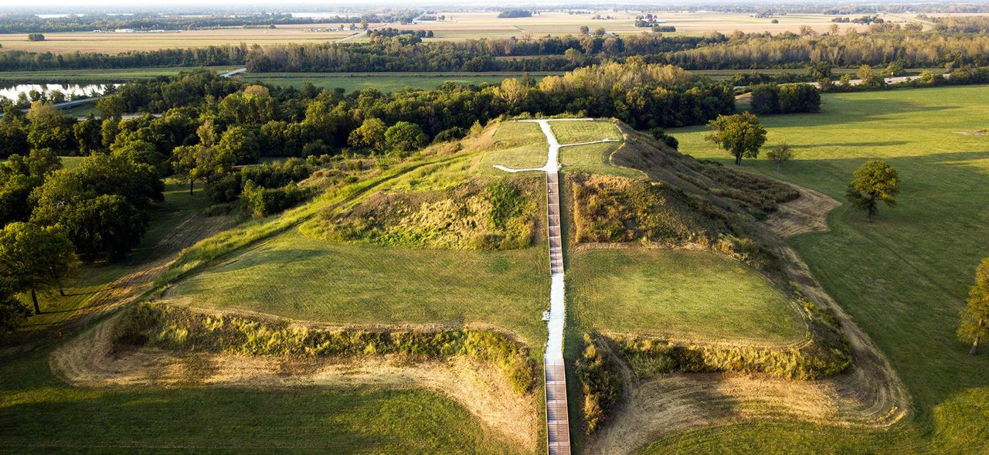
The Mississippian Culture
Built large earth mounds
Lived near Mississippi River
Were skilled farmers
Had big cities
Traded with other tribes
Built Cahokia (biggest city)

Slide 23
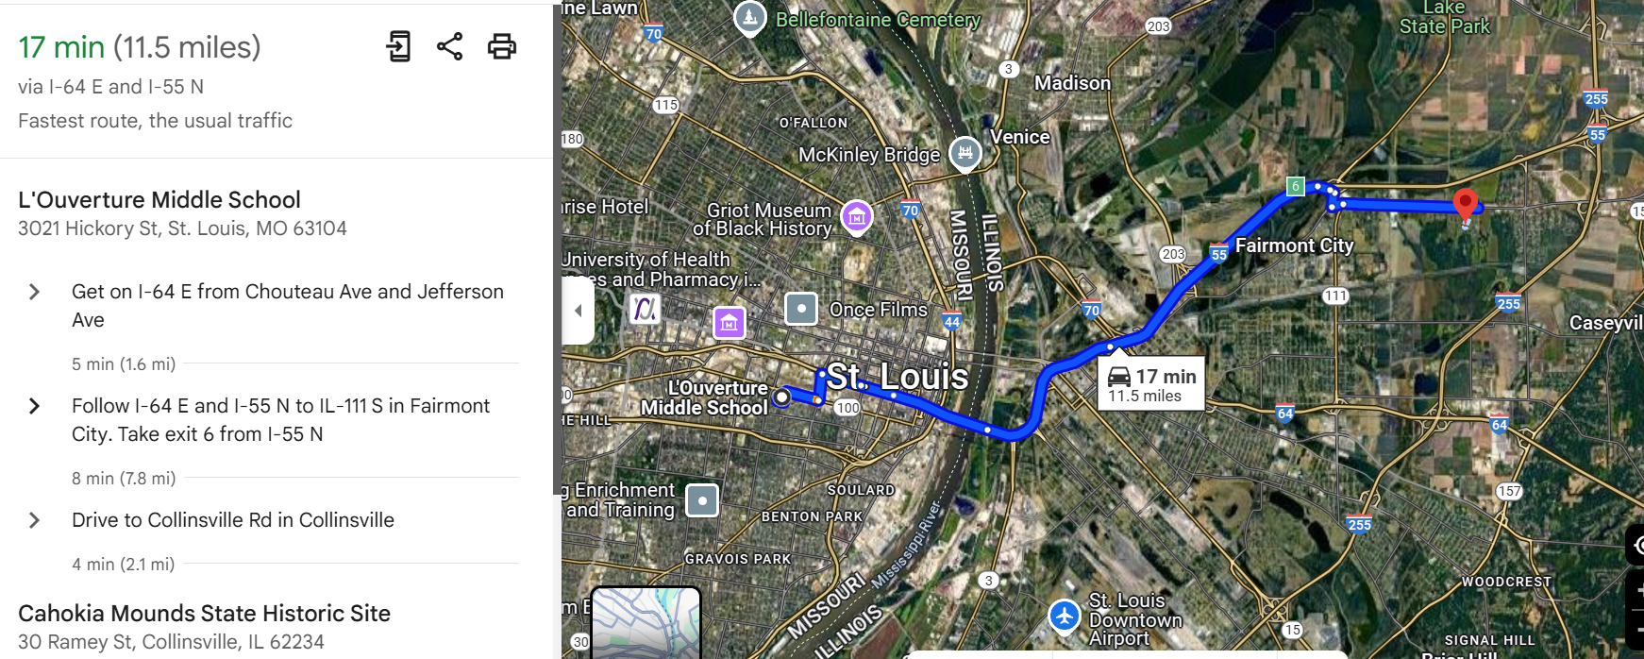

Slide 24
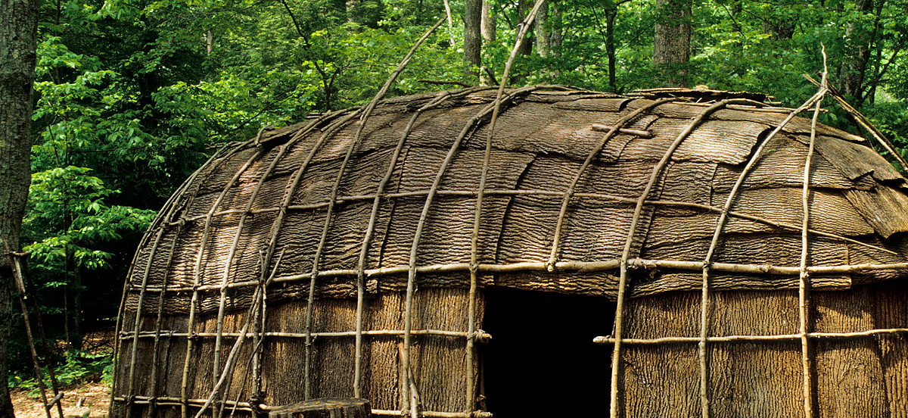
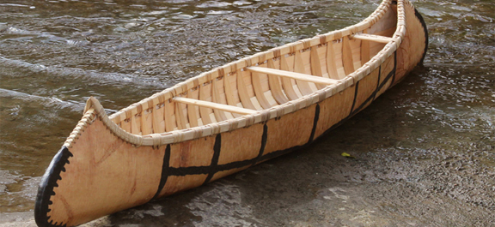
Northeast Region Native Americans
Lived in wooden longhouses
Hunted in forests
Fished in rivers and ocean
Grew "Three Sisters": corn, beans, squash
Made canoes from birch bark
Iroquois lived here

Slide 25
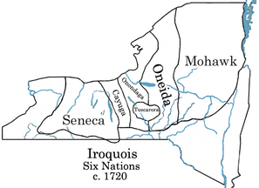
The Iroquois Nations
Five tribes joined together
Created a peace agreement
Had a democratic government
Women chose the leaders
Lived in New York area
Called "Haudenosaunee"

Slide 26
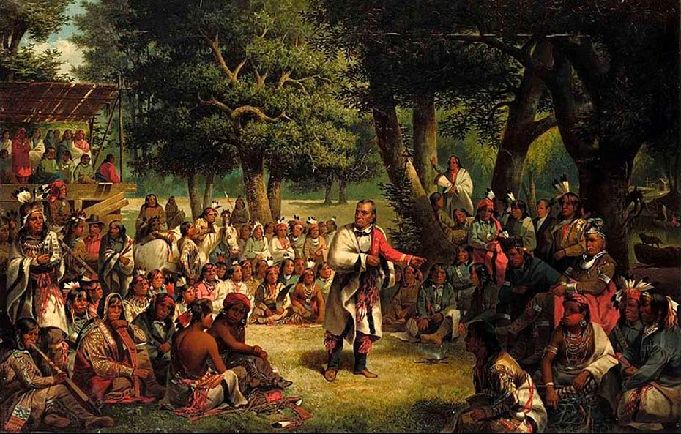
The Iroquois League
Like the United Nations today
Made decisions together
Had written constitution
Helped inspire U.S. government
Solved problems peacefully
Still exists today

Slide 27
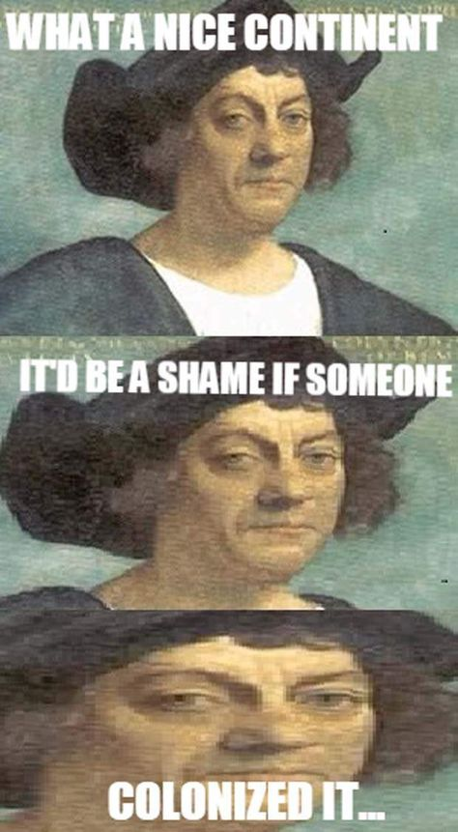
European Exploration Begins
Europeans wanted:
Gold and silver
New trade routes
Land for farming
Religious freedom
Started in late 1400s
Changed Native American life forever

Slide 28
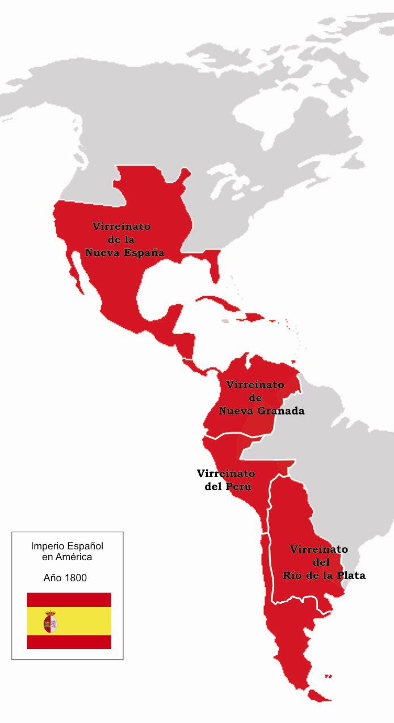
Spanish Colonization
First Europeans to settle
Came looking for gold
Built missions
Settled in Florida and Southwest
Brought horses to America

Slide 29
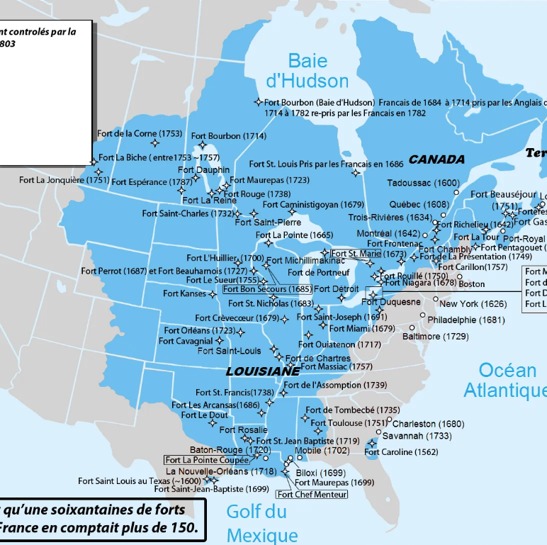
French Colonization
Settled in Canada first
Traded fur with Natives
Built along rivers
Were friendly with tribes
Had fewer settlers
Called "New France"

Slide 30
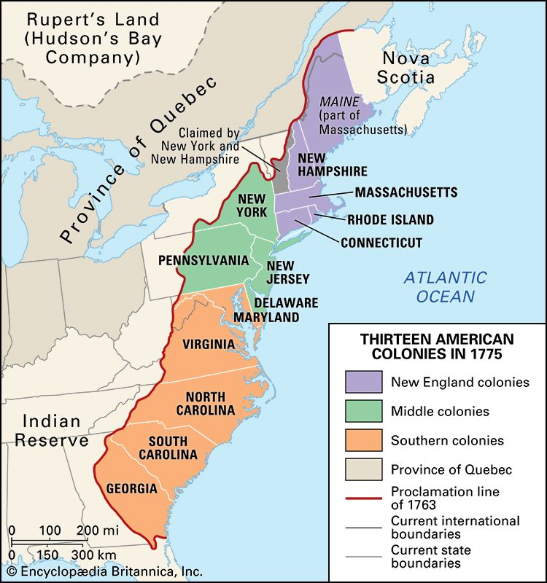
British Colonization
Built 13 colonies
Wanted farmland
Settled along coast
Had most settlers
Sometimes fought with Natives
Changed Native lands the most

Slide 31
Timeline of Colonization
1492: Columbus arrives (in the West Indies, Caribbean)
1565: Spanish settle St. Augustine (Florida)
1607: Jamestown founded (Virginia)
1620: Pilgrims arrive (Plymouth, Massachusetts)
1682: French claim Mississippi
1733: Georgia colony founded

Slide 32
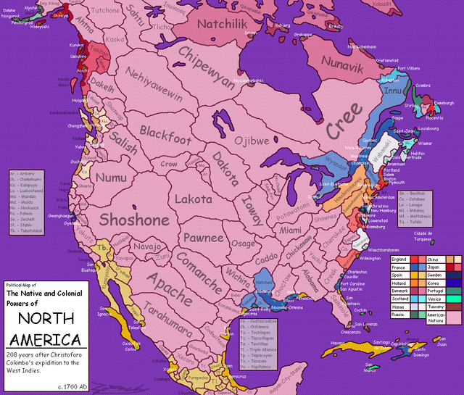
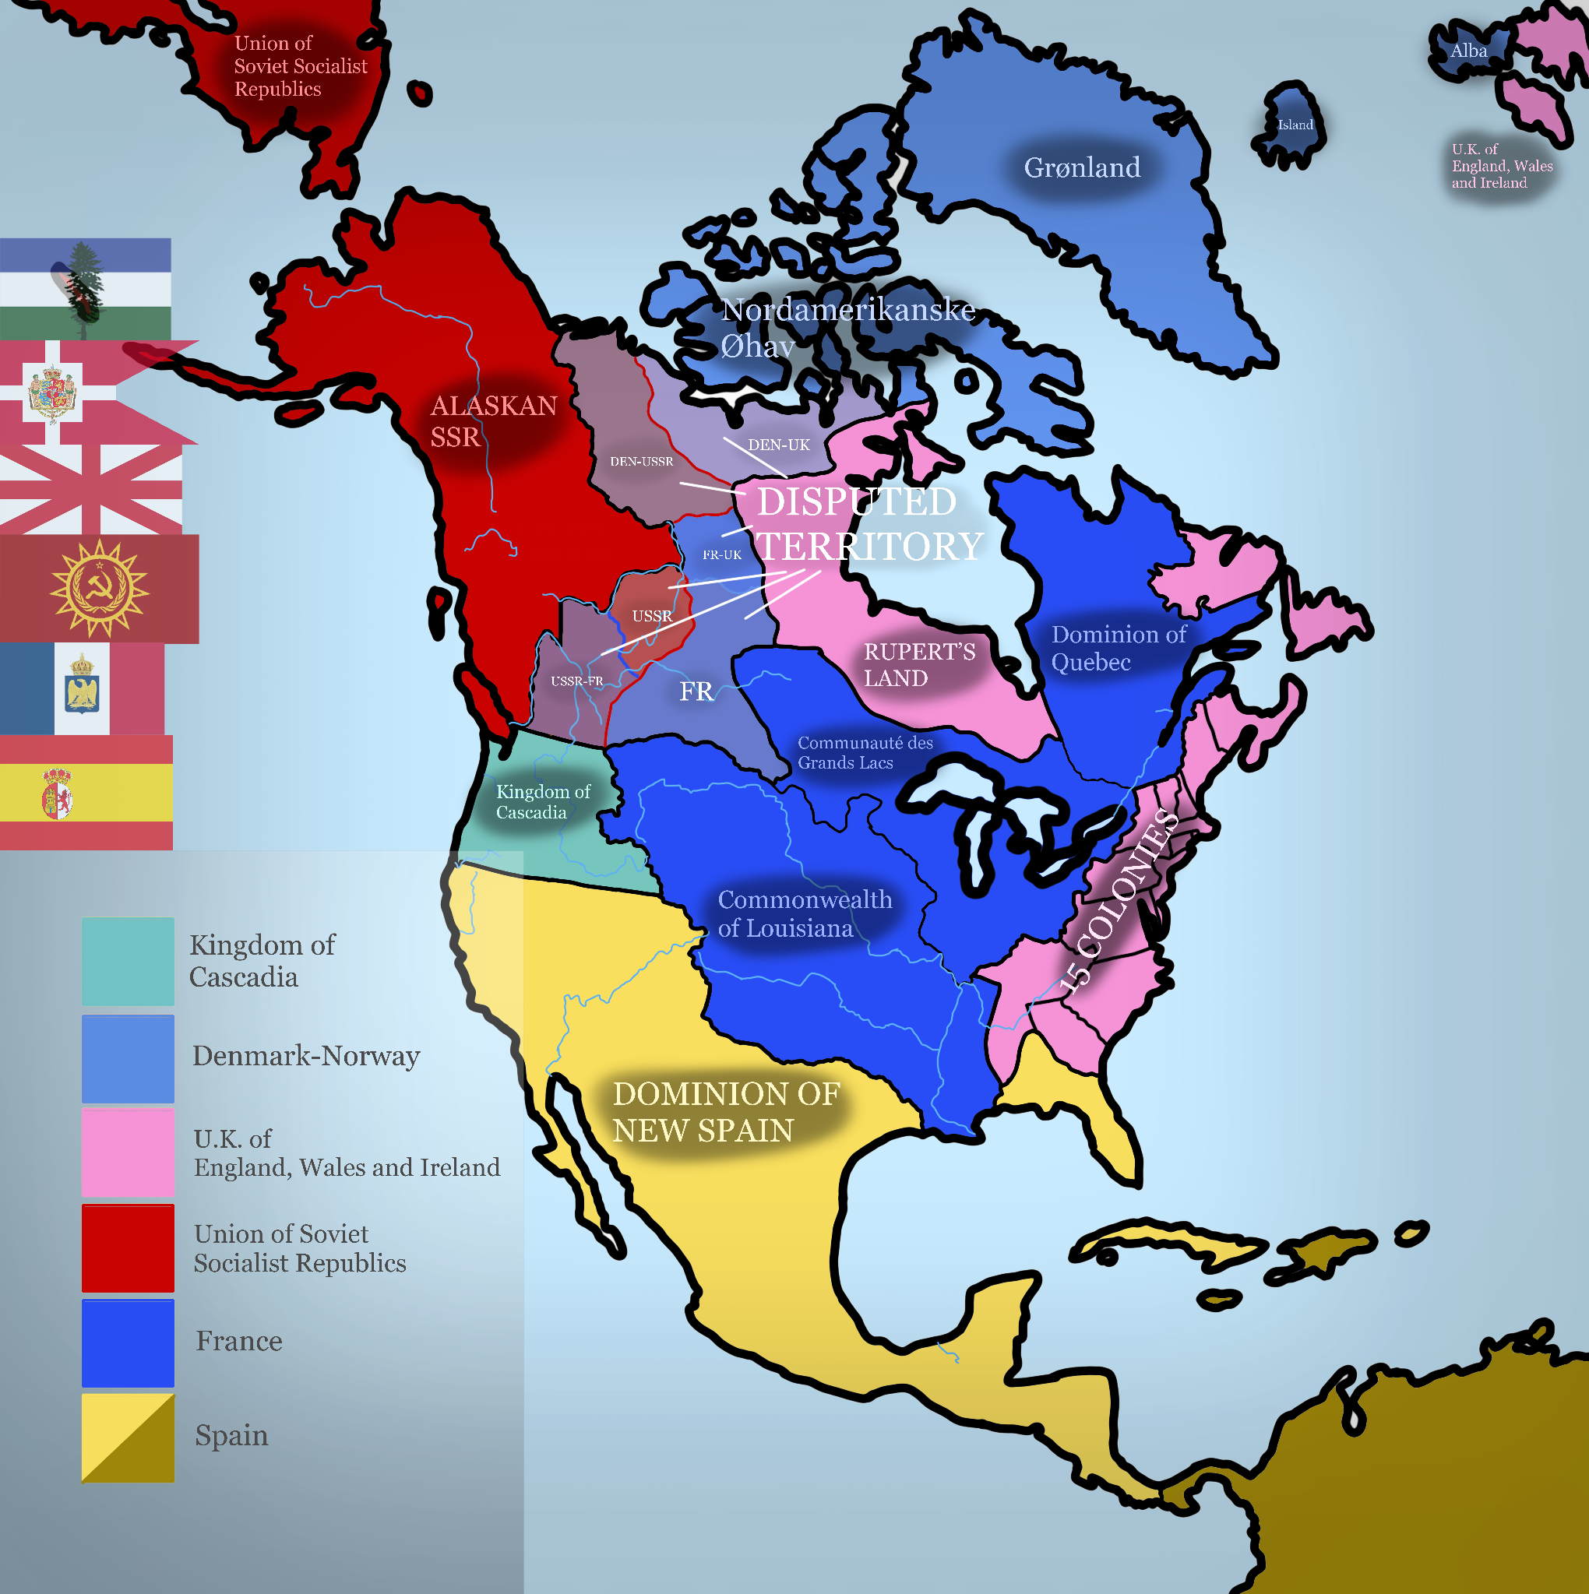

Slide 33
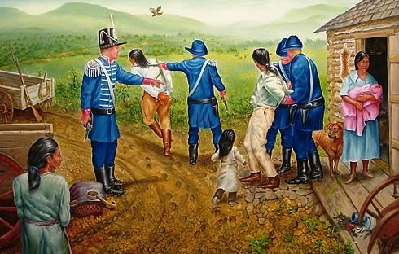
Changes for Native Americans
New diseases arrived
Lost their lands
New tools and weapons
Different ways of trading
New foods introduced
Population decreased

Slide 34
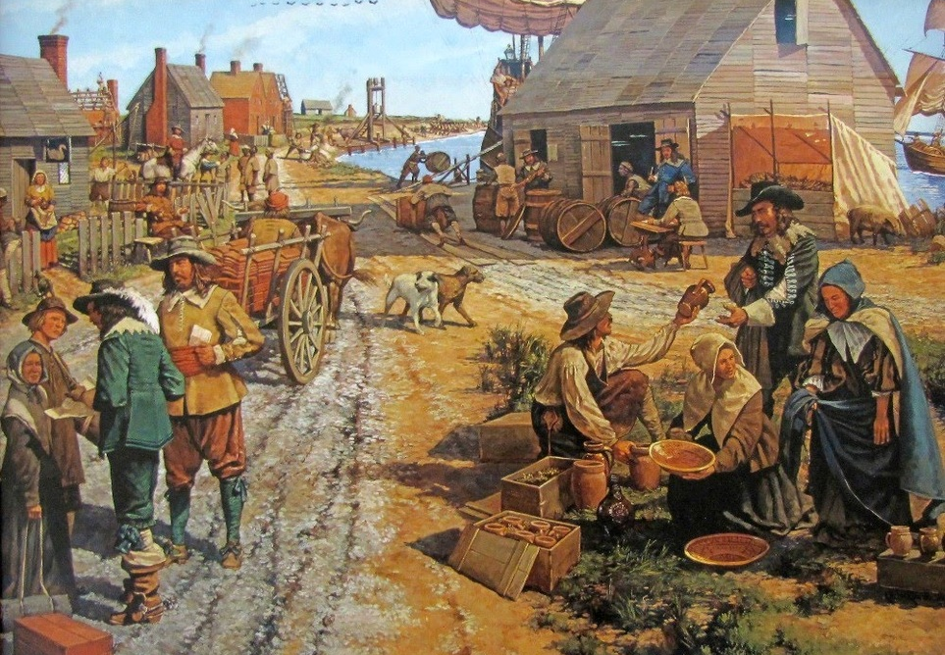
Colony Life
Built wooden homes
Farmed European crops
Created new towns
Made their own rules
Traded with Europe
Mixed different cultures

Slide 35
Important Words to Know
Colony: New settlement
Culture: Way of life
Region: Area of land
Colonization: Taking over land
Indigenous: Original people
Migration: Moving to new places

Slide 36
Review Questions
How did geography affect Native Americans?
What made the Iroquois special?
Why did Europeans come to America?
How did colonization change Native life?
Which Native region interests you most?

Slide 37
Think About It
How does where you live affect your life?
What can we learn from Native Americans?
Why is it important to understand different cultures?
How can different groups of people live together?
What would you want to know more about?

Slide 38
North American Culture and Economy: Understanding Our Diverse Neighbors

Slide 39
What is Culture?
Culture includes the customs, arts, beliefs, and ways of life of different groups
Examples we see every day:
Food we eat
Clothes we wear
Languages we speak
Celebrations we have
Think: What parts of your culture are important to you?

Slide 40
Multiculturalism in North America
Many different cultures living together
People from all over the world
Different languages spoken:
USA: English, Spanish, Chinese, and many more
Canada: English, French, and others
Both countries welcome immigrants (well… sort of)
Each group adds to the cultural mix

Slide 41
Cultural Similarities: USA and Canada
Both value freedom and democracy
Share many holidays
Similar food choices
Love of sports
Similar entertainment
Both have Indigenous peoples' cultures

Slide 42
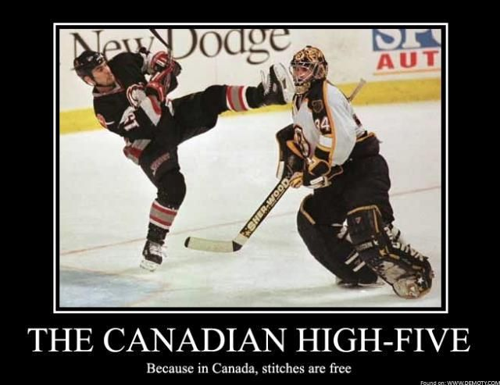
Cultural Differences: USA and Canada
Language differences:
Canada: French and English official languages
USA: No official language at federal level
Different holidays:
Canada Day vs. Independence Day
Different sports favorites:
Hockey more popular in Canada
Baseball/football more popular in USA

Slide 43
Creating a Cultural Fact Sheet
What to include:
Traditional foods
Popular celebrations
Common languages
Important traditions
Famous cultural symbols
Traditional clothing
Popular customs

Slide 44
Cultural Traditions in North America
Examples:
Thanksgiving celebrations
Fourth of July (USA)
Canada Day celebrations
Indigenous powwows
Cultural festivals
Regional food traditions
Local community events

Slide 45
North American Diversity
What makes North America diverse:
Different ethnic groups
Various religions
Multiple languages
Different traditions
Various food cultures
Different music styles
Different art forms

Slide 46
Important Industries
Major economic drivers:
Technology
Agriculture
Manufacturing
Healthcare
Education
Entertainment
Tourism

Slide 47
USA Major Industries
Key industries:
Technology (Silicon Valley)
Entertainment (Hollywood)
Car manufacturing (Sort of… ask me about Detroit)
Agriculture
Healthcare
Financial services
Construction

Slide 48
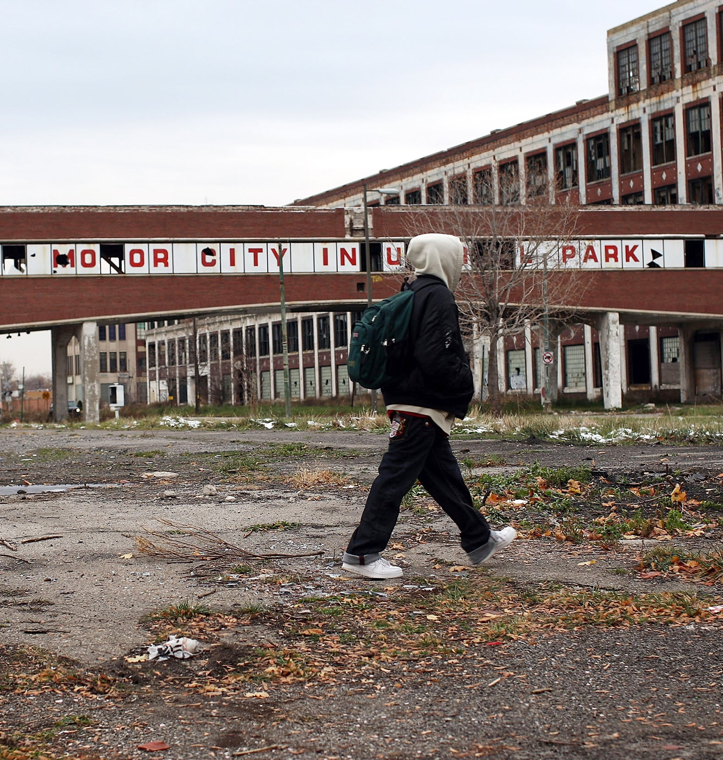
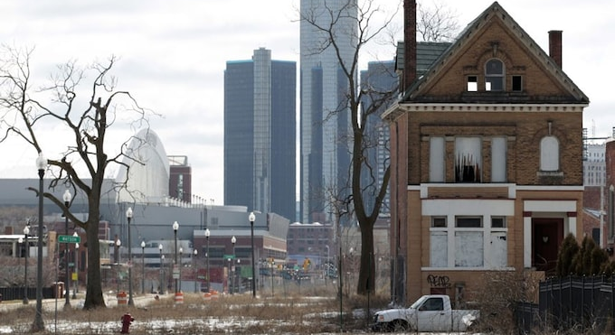

Slide 49
Canadian Major Industries
Key industries:
Natural resources
Forestry
Mining
Oil and gas
Agriculture
Manufacturing
Technology

Slide 50
Job Markets
Common jobs in both countries:
Teachers
Doctors and nurses
Construction workers
Store workers
Office workers
Factory workers
Truck drivers

Slide 51
Economic Differences
USA vs. Canada:
Different minimum wages ($7.25 vs $12.09)
Different healthcare systems (Private vs Single-Payer)
Different education costs ($20-50k vs $8-21k)
Different tax systems (Complicated: Canadians pay more but get more for their money)
Different social programs (Healthcare is the big one)
Different retirement systems (Social Security = Canadian Pension Plan)

Slide 52
Understanding Economic Trends
Basic concepts:
Jobs that are growing (Medical Industry especially geriatrics)
Jobs that are changing (autonomous labor is changing the game)
New types of work
Important skills needed (reading, writing, researching)
Future job opportunities (shortage of lawyers ¯\_(ツ)_/¯)
Technology's impact (AI)

Slide 53
Review: Key Points
Remember:
Both countries are very diverse
Many cultures live together
Different industries are important
Jobs are similar in both countries
Both economies are strong
Both value multiculturalism
Both offer many opportunities

