Slide 1
Sophocles’ Oedipus the King
IB Literature
Fall 2015
Stan Misler
<latrotox@gmail.com

Slide 2
A. Classical Athenian Theater in Age of Pericles (defeat of Persia, 480, to defeat of Athens in Peloponissan Wars, 410)
1. Oldest extant body of theatrical work in Western literature.
(a) Arose from choral festival celebration of Dionysis (= god of wine, fertility and drama). Grows into main cultural event of year: communal or civic affair (social and moral experience for society), rather than (i) personal entertainment / intellectual challenge of modern drama or (ii) unchanging ritual of a religious service. Attendance a social duty.
(b) Works place special emphasis on powers of speech and debate which all citizens are expected to master.
2. Theatric presentation:
(a) theater = amphitheatre, a semicircular sloping structure, built in to hillside near top of hill (acropolis) and seating up to 17,000 spectators. Consists of: orchestra, a flat playing space; skene, stage house behind and higher than orchestra and housing props and waiting actors; and sloped seating. Unobstructed sight lines and excellent acoustics.
(b) actors = protagonist and subsidiary 1-2 actors each wearing mask for easy identification and performed by male using gestures and tone with little movement;
(c) choral singing, dancing accompanied by flute, drum and harp;
(d) audience votes on best tragedy out 12-15 performed at each yearly festival;
(e) finances: committee chooses a rich patron to sponsor play including choosing a playwright, admission charges but poor get subsidy

Slide 3
Only extant musical fragment: Stasimon (or static) Chorus of Euripides’ Orestes You wild goddesses who dart across the skies seeking vengeance for murder, we beg you to free Agamemnon's son from his raging fury We grieve for this boy. Happiness is brief among mortals. Sorrow and anguish sweep down on it
3. Theater of tragedy explores the underpinnings of an orderly and largely secular society based on human dignity and brilliance of intellect. However balance in character or dike can be destroyed by exaggerated pride & arrogance (or hubris) and errors of judgment (or hamartia ) which then can lead to social catastrophe
4. Tragedy considered highest art:
(a) imitation of life experience that is serious, important and complete in itself (unity of time, place and purpose) with no comic relief. Evokes pity that action has occurred, fear that action could happen to them, and ends in resolution with new understanding of world.
(b) Plots are well known from myth or legends about familiar figures in Mycenean civilization almost a millenium before (Agamemnon, Ajax and Achilles of Trojan war; Oedipus of Thebes; Theseus of Athens). Value of play judged by its dramatic skill, character delineation and poetic excellence.
(c) Comedies spoofing Gods or leaders performed at end of 3-4 daily tragedies

Slide 4
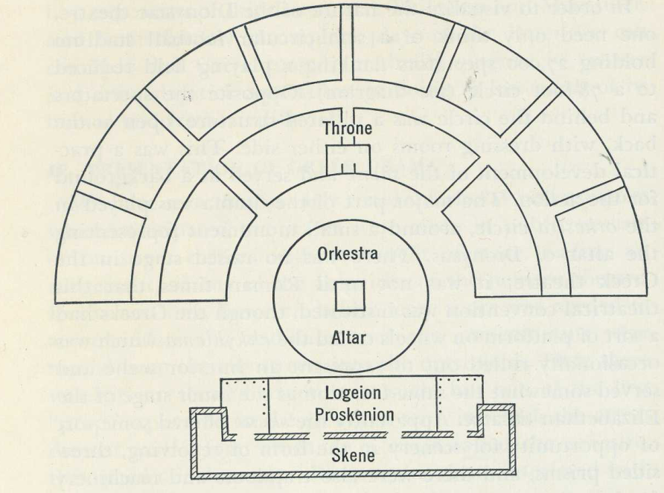
Roman Theatre in Caesarea, north of Tel Aviv, modeled after Greek

Slide 5
5. Age of Pericles is one of greatest flowering of other arts and rational philosophy
(a) sculpture (lifelike forms with articulation of movement); architecture with proportion and balance;
(b) rational philosophy encourages personal development of brainpower and body (arête = personal excellence in all things)
6. City-state Politics
(a) Small city-state 1000 square miles containing 300,000 people. Citizenship and participation in democracy (legislative bodies and juries) awarded to the 45,000 males over age 21 and of Athenian parents. Tolerable treatment for all including 115,000 humanely treated slaves forming clerical workers, police
(b) encouragement of continuing education and huge construction program (temples, ships, warehouses) financed by high taxes on satellite states.
7. Principles of theater carried into Hellenism and Roman Empire (Greco-Roman civilization) and but then merged with Hebreo-Christian ideas. In the latter individual brilliance was denigrated, man was thought of as child of God, the loving father, and objective of life was to humbly serve God. Return to theatre in 13-14 ^{th} centuries ACE consisting of mystery plays of based on stories of Bible with strict moral of plot and obvious lessons to be learned

Slide 6
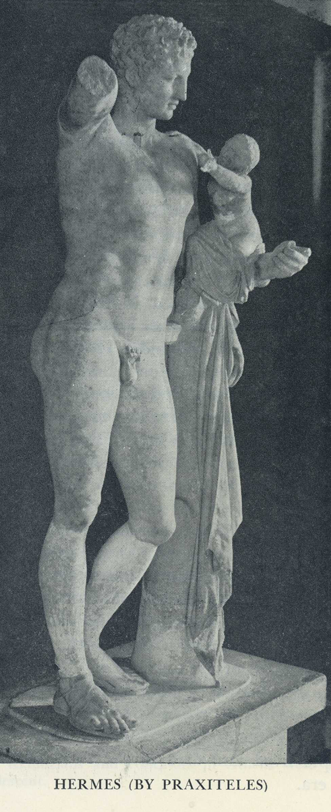
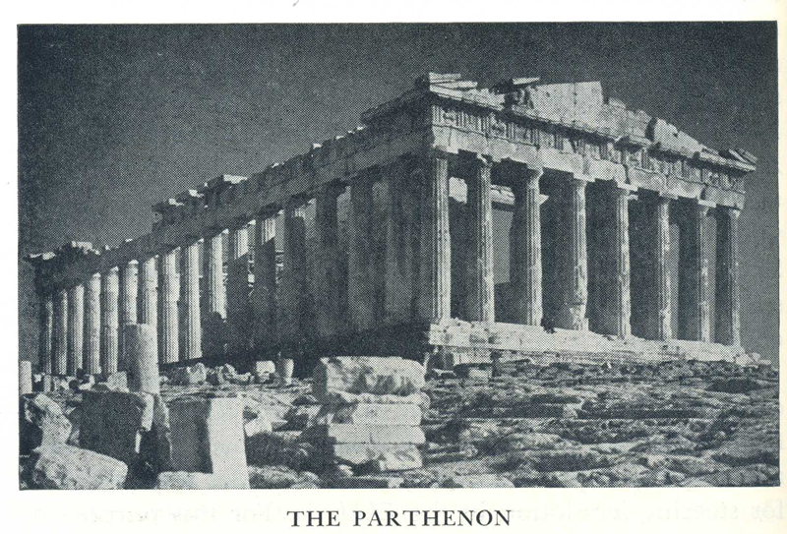

Slide 7
8. The Age of Pericles and a “modern” Zeitgeist (spirit of times)
(a) Defeat of Persians at Marathon (480 BC) -> two generations of free inquiry, individual initiative, democratic openness and cultural vitality -> wealth, intellectual and artistic flourishing, rebuilding of Athens as powerful and beautiful imperial city (with Parthenon on Acropolis and Theatre of Dionysis on descending hill)
(b) New Rational Philosophies :
(1) Anaxagorus: all life explained by physical processes and interaction of material substances. Disease as imbalance of organ function; human body as ideal of beauty as portrayed in sculpture of man in motion. Man has dominion over earth and its creatures; religion as invention of human mind as a way of maintaining social order.
(2) Protagorus: “man is measure of all things”; no objective knowledge as to whether gods exist. In opposition to older ideas of world balance set up by gods whom man should revere though they are not always just by human standards
(c) Beginning 431 BC Athens is defeated in Peleponesian wars with Sparta and is hit by a series of disease plagues. This resulting in populous turning away from personal and social exuberance towards helplessness, religiosity and superstition. Return to older wisdom of oracle at Delphos: “Know thyself” and “do nothing in excess” and to exercise “sophsyne” = caution, temperance and self control (like Creon)
(iii) Sophocles’ Oedipus (420sBC) embodies Periclean and post-Periclean ideas but is humanistic; “much is awesome but nothing is more awesome than man”

Slide 8
B. Dramatic Genres 1. Tragedy
General usage of word: disaster happening inexplicably to “good” person
Literary genre started by Greeks with basic features extending to modern times. Character, often of person of high station in society, converges with events so that a change of fortune (peripetia) results in man destroying himself in spite of his best qualities. Protagonist accepts struggle and suffering of mental or spiritual anguish that makes him heroic. Often unclear how much of struggle and suffering is (i) preordained (destiny of conflict with overpowering force, gods) or (ii) due to character “flaw” or error in judgment (“A man’s character is his fate”). Often there is concomitant collapse of social or natural order around protagonist and he may be pushed to insanity.
As the result of encounter with unfortunate situation protagonist usually recognizes some basic truth about himself or the order around him (anagnorisis). By participating vicariously in the suffering, expressed in elevated language, the audience is purged (catharsis) of pity and fear (as after a good cry) and is uplifted by seeing the protagonist retain dignity in adversity and even death (“protagonist’s pain in defiance of destiny is transmuted to viewer’s exhilaration”)

Slide 9
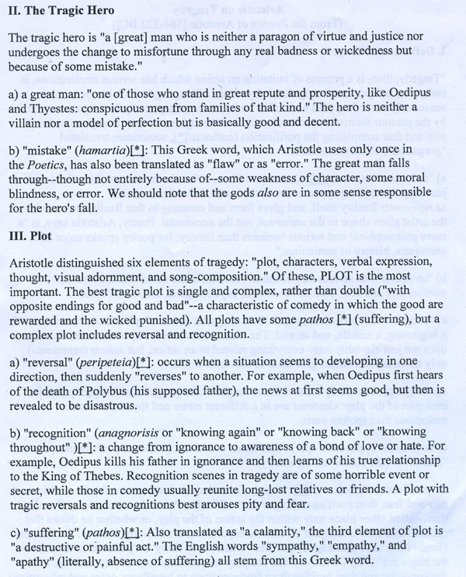
Unity of time (24 hrs), place, person purpose.

Slide 10
2. Comedy
General usage: humorous and laughter-inducing events
Literary genre of many forms but commonality of beginning in laughter and ending in judgment or reproof of the character provoking the laughter
Forms
Conflict of powerless society of youth (i.e., young lovers) vs. society of age with set conventions. Young need to perform ruses to overcome elders
Satire: portrait of persons or social institutions as ridiculous or corrupt
Romantic comedy: portrayal of foibles of those falling in love
Screwball comedy: bizarre situations or characters
Pantomime: expression via extravagant mine, slapstick and dancing
Commedia del arte: improvisation by stock characters such as foolish old man, devious servant, military officers or pedants with undeserved bravado
Comic frame: satirizes situations and people with aim to provoke thought and promote change as in politics

Slide 11
3. Romance
Hero capable of prodigious feats of courage, love, chivalry and adventure often ending in social reconciliation such a marriage
4. Melodrama
Exciting, sensational plot involving stereotypic characters with exaggerated emotions: emphasis on action, violence and thrills; little character development; magical resolution (deus ex machina) rather than cause and effect.

Slide 12
Interlude: Attic Greek as basis for medical lingo
Histo
rhino-
Laryngo-
Nephro-
Neuro-
Sarco-
Kranio-
Hepatos-
Sepsis
Podos-
Enkephalos-
Arthros-
chondros
Sphigmo-
Derma-
Odonto-
Enteron
Phlebos
Thrombo
Pneumo-
Trichos
Emesis
Oidema
Thoraco
Angion
Phrenos
Psoriasis
phagos
Spondylos
Gastro-
Pharmakon
Tomos
-lithiasis
Thermia
Hyper-; hypo-
Leuco-
Lipos
Cardios
Melanos
Myelos
Osteon
Gerontos; thanatos
Brady; Tachos
Necros
Stenos
iatros
-ology
-graphy
-pathy
-itis
-scopy
-sclerosis
-dynia
-oma
-clastos

Slide 13
C. Oedipus: Points for discussion
Poetic genre of play: tragedy, comedy, romance or melodrama?
Treating the play as a puzzle, what pieces of puzzle do Creon, Teiresius, Jocasta, Oedipus, Messenger from Corinth and Herdsman contribute?
How does Oedipus fit into mythology?
What does oracle at Delphos tell Oedipus? Is this a prediction or preordainment?
What is the Sphinx, why is she dangerous and what is the solution to her riddle? What is the reward Thebes offers for correct answer?
What happens at meeting of 3 roads? Is it murder or provoked manslaughter?
Propose some examples of where we must suspend disbelief
What does Oedipus learn from his experience in the play? What does chorus learn? What do we learn?

Slide 14
1. Oedipus the King: Tragic Overview
a. Tragedy of revelation of destiny and personal identity of Oedipus: self-discovery through suffering. Poses question of justice of universe in face of suffering.
(i) Tragic irony = we know more than characters who are immersed in stream of events
b. Oedipus’ world turned topsy-turvy from greatness, wisdom and kingly service to city to intense suffering due to his unceasing inquiry into the murder of former King Laius. The inquiry develops into a great detective story and investigation of his own identity. By forcing reticent characters to speak Oedipus learns that he is polluter of his plague-ridden city Thebes through his murder of Laius (his true father) and incest with Jocasta (his true mother). Reacts by self-blinding and exile
c. Process of discovery: Oedipus needs to put together pieces presented “randomly” and in flash backs until full picture emerges.
d. Oedipus is clear sighted and quick thinking when it come to discrete issues but is blind to larger truths.
e. Emphasis for audience is how pieces of “truth” get assembled

Slide 15
2.

Slide 16
3. How does Oedipus fit into mythology?
Myth about powerful young man on road to self discovery, encountering challenges and inquiring of the gods about his identity before going to new land where he is crowned king
In Oedipus : Young man challenged about birth in home town of Corinth -> undertaking a journey to discover identity -> inquiry at Delphos results in answer that he is fated to kill father -> onset of journey to strange land. On the road Oedipus meets older regal figure blocking way -> combat and death of opponent and regal train-> ventures to try his luck on riddle of Sphinx which he solves -> venture to Thebes where is crowned king and given Jocasta as queen

Slide 17
4. Is oracle a flexible prediction or preordainment?
Oracle states the way things are or should be but humans bring about events through their actions (Oedipus: “It was Apollo that brought this bitterness but the hand that struck me was my own. Why should I see whose vision showed me nothing sweet to see ?”)

Slide 18
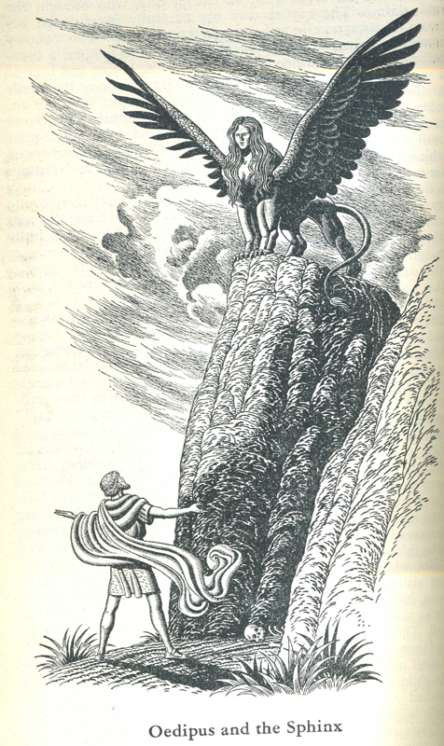
5. Riddle of Sphinx: dangerous half bird / half women (wings, claws and human face) lures young men, particularly Thebans, during their travels, to try to solve her riddle and then kills them when they can’t. Thebes is thus in permanent state of siege. Oedipus, despairing of finding fellowship, tries to solves riddle, succeeds and Sphinx kills herself
Riddle: What speaks with one voice but goes on four feet in morning, 2 feet at mid-day and 3 feet in evening and goes more slowly on four feet than two? Oedipus or man
How does this fit Oedipus? Infant put out to die, headstrong adult; groping blind old man

Slide 19
6. Flaws of incredulity in play…… or when we must suspend disbelief
Oedipus never mentioned encounter at cross-roads
No one ever investigated Laius killing before. Preoccupied by other matters ?
Neither he nor Jocasta talked about scarred foot
Coincidences: Sole witness to Laius slaying = Herdsman given Oedipus at birth; Messenger from Corinth = recipient of infant from Herdsman
Sole remaining witness to killing of Laius took awfully long time to get back to Thebes and lied about slaying of Laius by band of robbers. Finally, then on seeing Oedipus as king asked to be sent out of town
Teiriesias knew all along but never said anything about Oedipus

Slide 20
7. What is learned from this tragedy?
Oedipus: (i) from nastiness, hot temper with rash accusations to humility, calmness and new clarity;
(ii) man’s vulnerability is due to ignorance or blindness about himself;
iii) man is fated, often unjustly, but is ultimately free to act: “It was Apollo that brought this bitterness but the hand that struck me was my own. Why should I see whose vision showed me nothing sweet to see?”
Audience: (i) Realization that there was no motive for Oedipus doing evil (was ignorant of situation in Thebes thus “more sinned against than sinning”);
(ii) Riddle of world: Prophesy is not preordainment (Oedipus had choice in undertaking journeys to Delphos and Thebes and marrying after oracle) (iii) What a man does and becomes results from his innate humanity: (a) self-exile from Thebes but still maintaining caring for others (especially daughters); (b) audience knows from myth that at end of life of blind wandering Oedipus will die as demi-god of Athens.
(iv) To “choose life” and bear out destiny’s burden is a victory in defeat
Chorus: “Count no mortal happy till he dies secure from pain”

