Slide 1
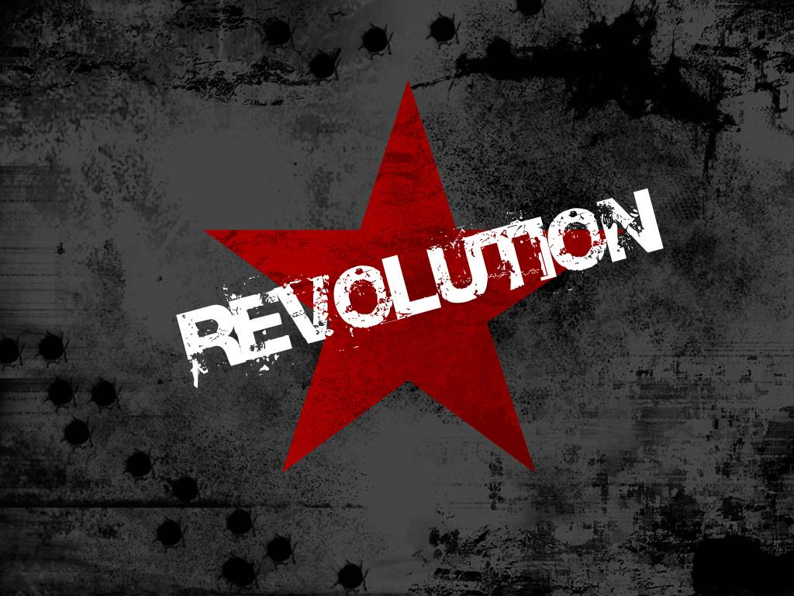
)

Slide 2
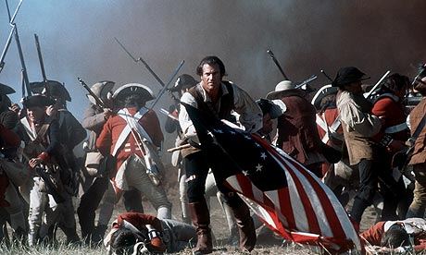
AMERICAN REVOLUTION

Slide 3
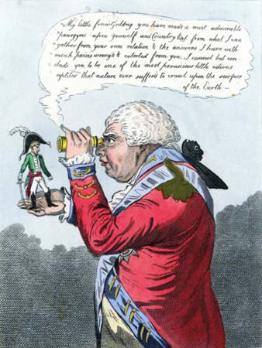
WAR OF AMERICAN INDEPENDENCE
Desperate to pay back debts caused by Seven Years War, King George III of GB begins series of taxations on the colonies. Colonists complained about having Taxation Without Representation which led to shootings such as the
Boston Massacre and then rebellions known as the Boston Tea Party.
*These taxes, the Sugar Act, Stamp Act, Quartering Act, etc were hated by the colonies. It wasn’t really about the amount, it was how random they occurred and that they had no vote or say in the process.

Slide 4
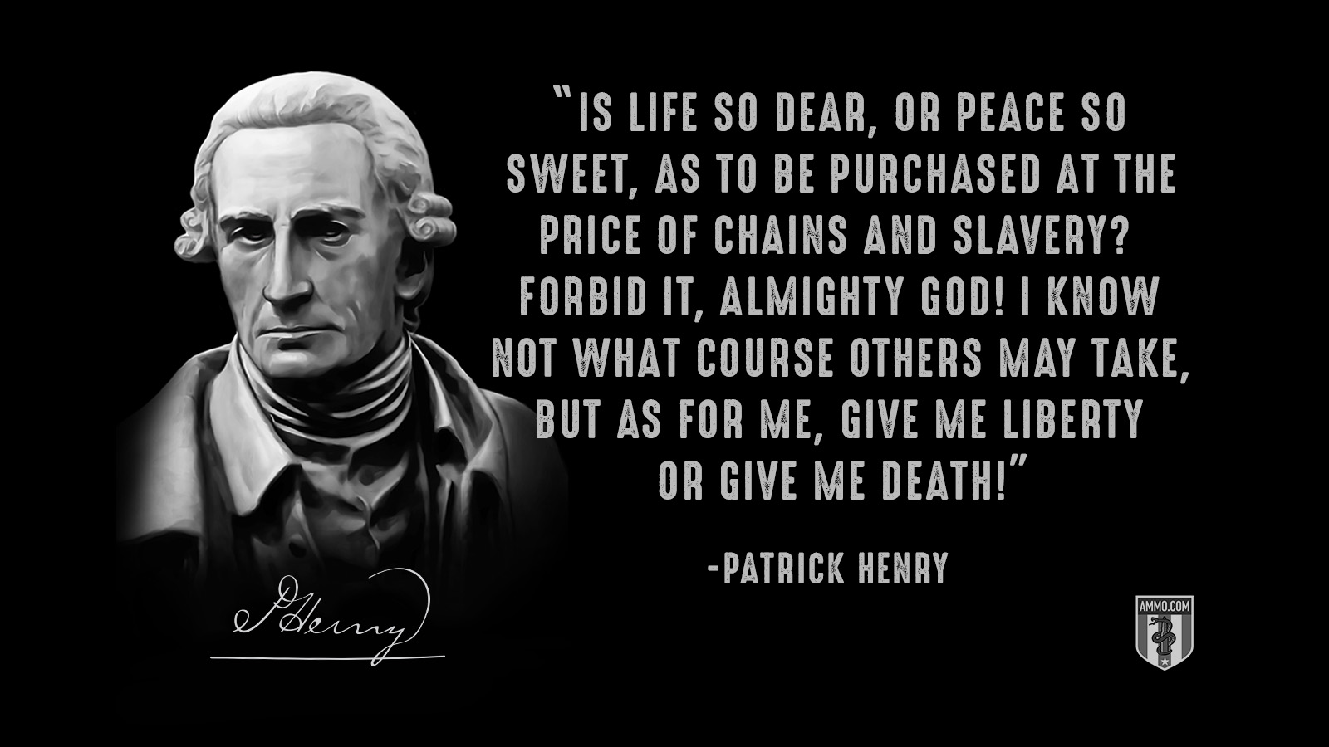
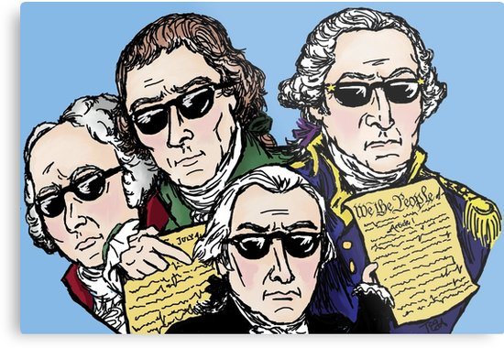
FOUNDING FATHERS
Believing strongly in Enlightenment, early American leaders begin war trying to create a nation with free speech, limited government & social contract theory. Thomas Jefferson is asked to write DOI, George Washington is asked to lead, Samuel Adams stirs up trouble, & Patrick Henry gives decisive speech to break.
*The Boston Tea Party was no small deal. Once the patriots dumped the tea, British companies demanded the British king do something about the loss of money. So GB responds with Intolerable Acts, a series of massive tax increases, arms confiscations, & freedom limitations.

Slide 5
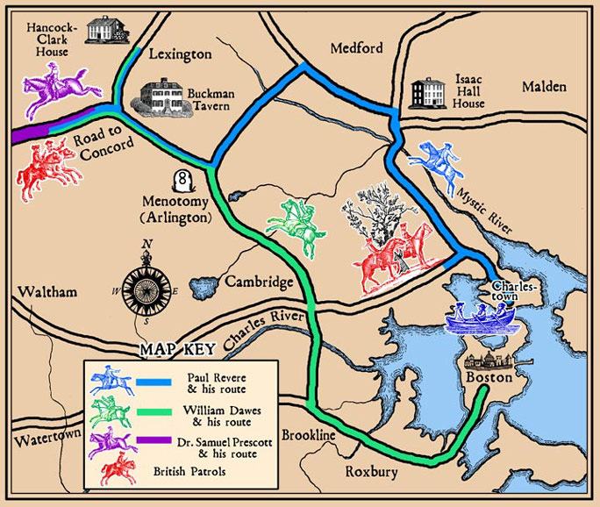
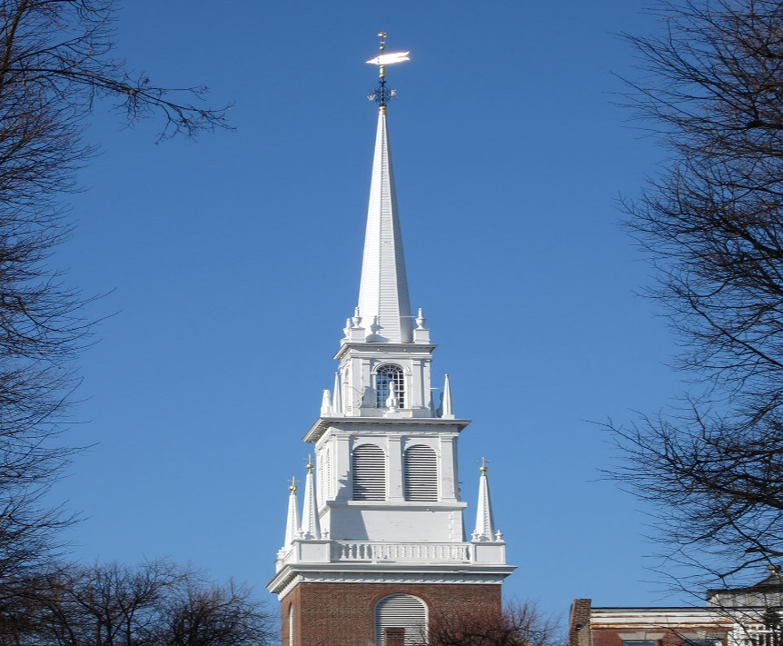
GB planned to grab weapons but colonists heard about plans. Gunshots ring out at Lexington & when GB marches to Concord they discover guns have been removed. History records this event as the start of war.
Shot Heard ‘Round the World

Slide 6
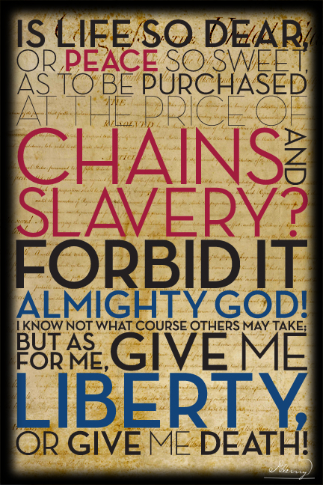
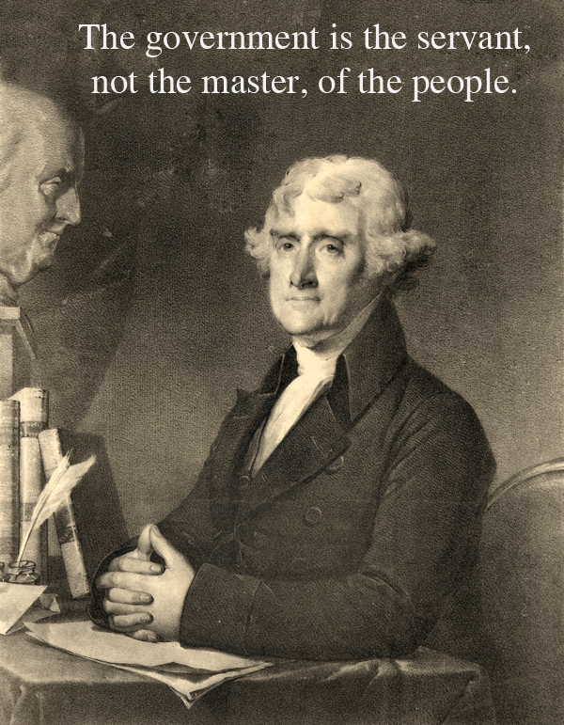
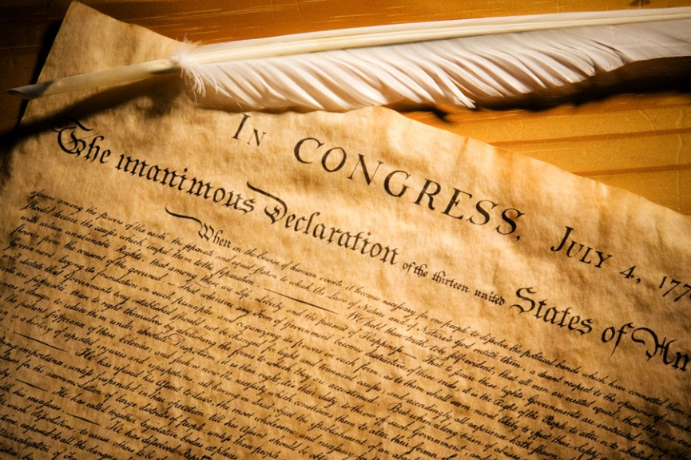
Declaration of Independence
Colonists meet at Virginia Convention & decide to officially break away from GB. Orator Patrick Henry gives his famous “Give Me Liberty or Give Me Death” Speech, Thomas Jefferson is given the task to write down the reasons for Independence, & Seven Years’ War vet George Washington is given the task to lead the troops.

Slide 7
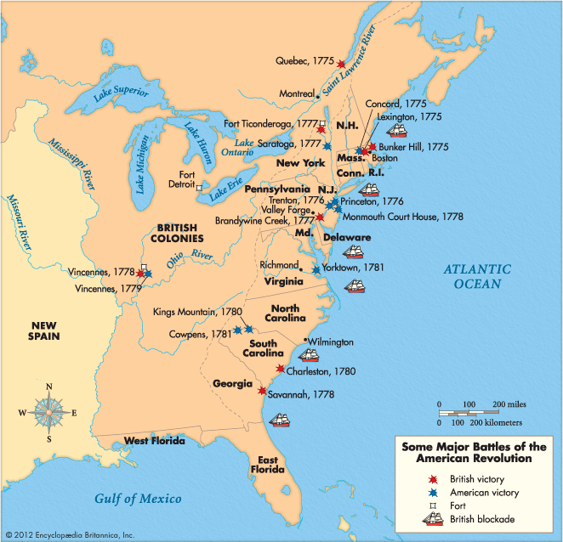
Revolutionary War
WAR HIGHLIGHTS
Bunker Hill: 1st major battle, USA is willing to fight (…whites of eyes).
Saratoga: Turning point of war: a GB general surrenders (France agrees to join in war).
Valley Forge: GW leads soldiers thru deadly cold
Yorktown: Generals trap Cornwallis at coast as FR fleet blocks escape.

Slide 8
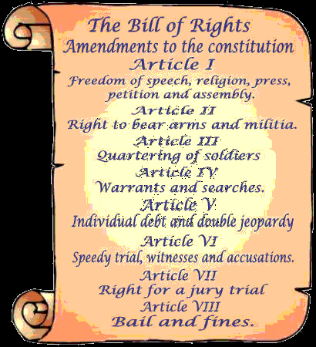
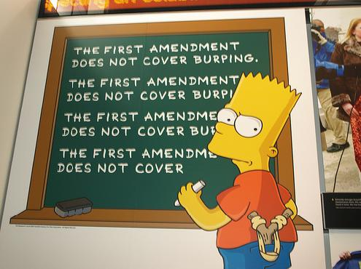
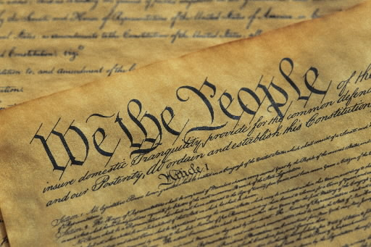
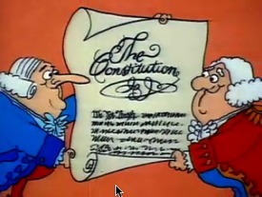
CONSTITUTION & BILL OF RIGHTS
Constitution: Legal document that separates power into 3 branches, creates a bicameral (2 house) Congress, & creates federalism (balancing national powers with state powers). Beginning is known as Preamble.
Bill of Rights: 1st Ten Amendments to the Constitution designed to limit gov’t powers (based upon the writings of John Locke). Without basic guarantees of freedom, Constitution would not have been passed.

Slide 9
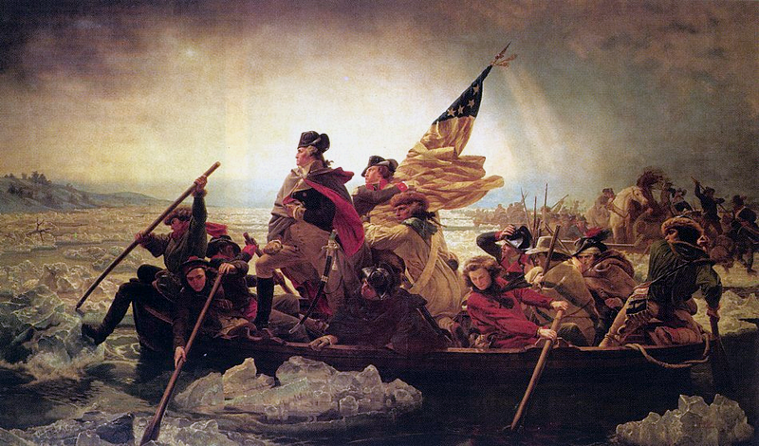
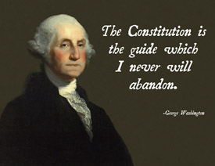
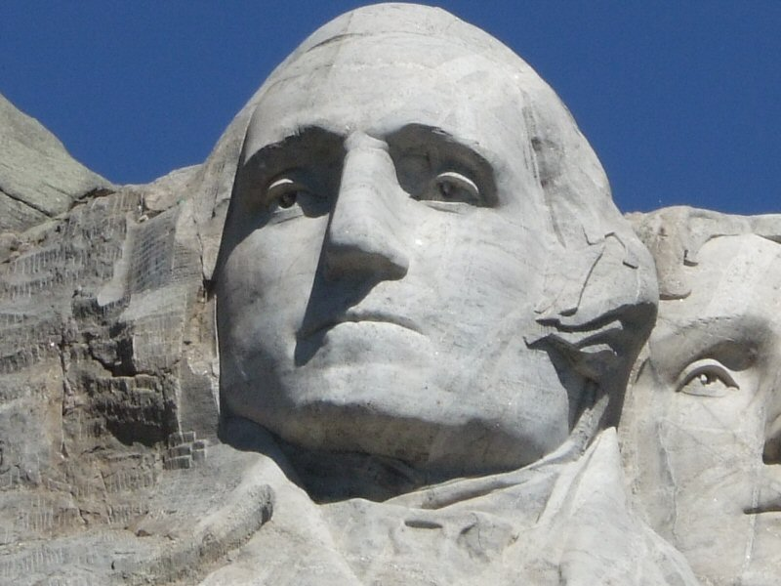
George Washington
Commander-in-Chief of the USA Continental Army who became Father of our Nation when unanimously selected to be 1st USA President. Famed for keeping morale high during war & for being an unselfish leader (would retire to his VA farm after 2 terms in office).

Slide 11
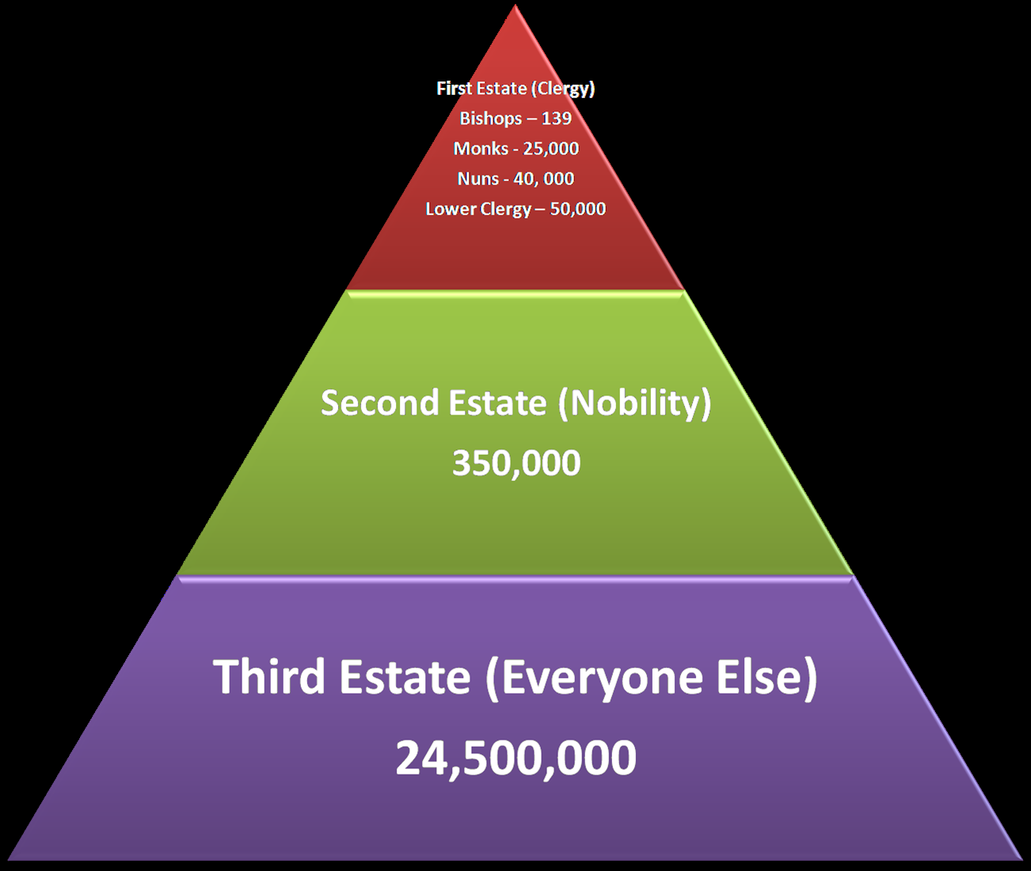
THREE ESTATES
*France was seen as the most advance nation of the 1700s, but had great unrest: taxes, bad harvests, Enlightenment ideas.
1st Estate: Had 10% of land, taxed at 2%.
2nd Estate: Rich Nobles owned 20% of land & had 0% taxes (hated enlightenment ideas).
3rd Estate: 97% of folks were in this class (though there was some bourgeoisie that had wealth), most barely survived. 50% of $$$ was taken in taxes.

Slide 12
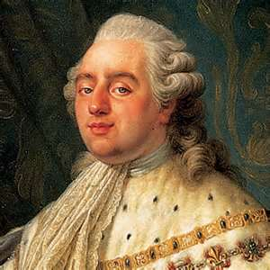
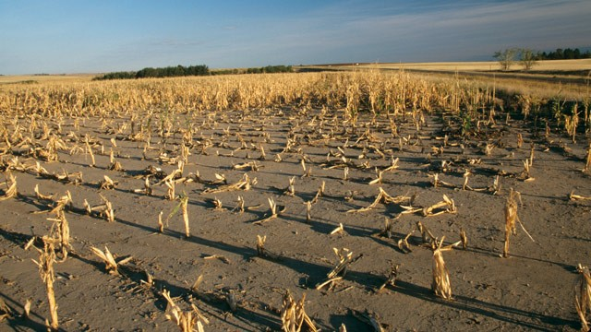
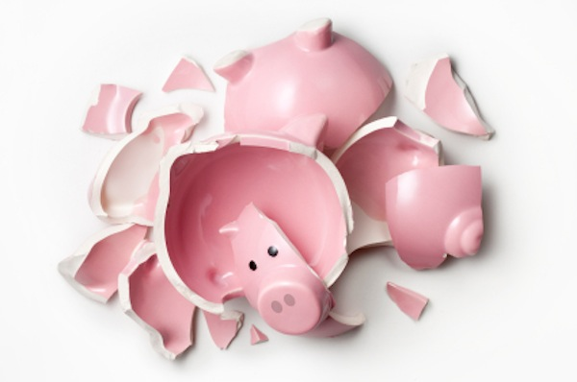
King Louis XVI
High taxes & grain failures made nation broke & hungry.
KL16 (who already had inherited a massive debt) went wild spending the rest on parties w/ his wife Marie Antoinette.
Bankers refused to lend any more money to the king.

Slide 13
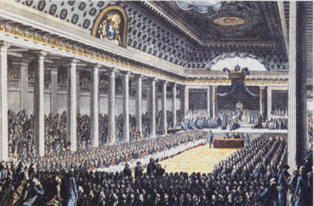
ESTATES GENERAL
*King Louis XVI wanted more money so he desired to raise taxes, but the plan to do this required a meeting of the Estates General, which is sort of like a Congress. Essentially, people from all three estates had to vote for or against the tax increase. What happened:
When King Louis XVI realized the tax increase was going to fail, he told the people the vote would take place after lunch, then locked the door & had the vote. Outraged, those locked out gathered together, making the Tennis Court Oath which promised a revolution & a Constitution.

Slide 14
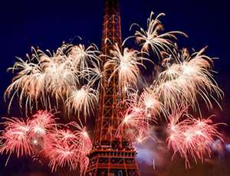
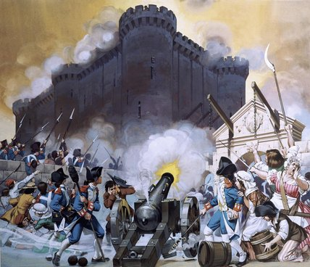
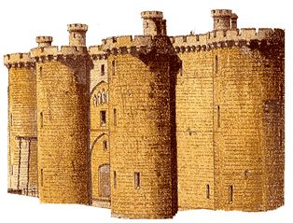
STORMING THE BASTILLE
Scared by rumors that KL16 was going to crush National Assembly, mob storms Bastille prison, kills guards, takes weapons, & paraded the streets w/ men’s heads on pikes.
*July 14th, the date of the Storming is recognized in France as a patriotic holiday, sorta like 4th of July to Americans.

Slide 15
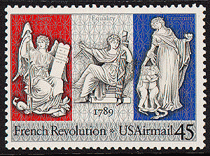
LIBERTY, EQUALITY, FRATERNITY
National Assembly adopts The Rights of Man, states “men are born and remain free and equal in rights.” Guaranteed: liberty, property, security, & resistance to oppression. Revolutionary leaders adopt the slogan “liberty, equality, fraternity” as bloodshed occurs all over the country.
*There was Great Fear throughout the countryside as farmers heard rumors that the king had hired outlaws to crush them. Before it could happen, farmers killed lords with blunt farming objects.
*Mothers heard that grain was being stored at Versailles so a Women’s March ensued in which the ladies demanded the food. This is where famous “Let Them Eat Cake” line supposedly comes from.
*Worried for his safety, KL16 tries to leave France but is stopped on the border, his decision to flee seals his fate.
*French Rev was heavily influenced by USA Rev, Thom Jefferson was a supporter, led to a political backlash in USA.
*Revolutionary leaders saw the Church as an established authority…in other words…a helper to the king & royals.
Therefore, it was open season on the church as citizens attacked leaders & stole from the church buildings.

Slide 16
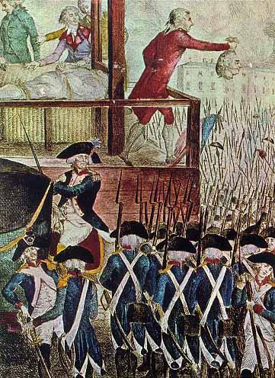
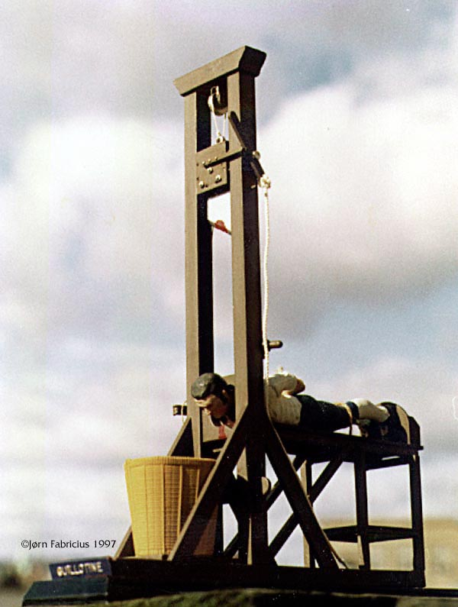
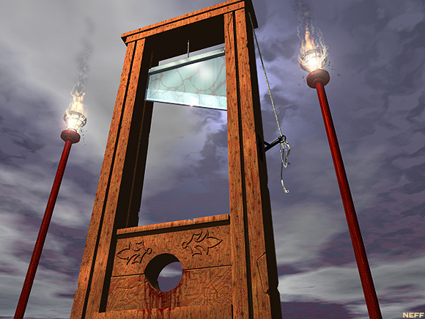
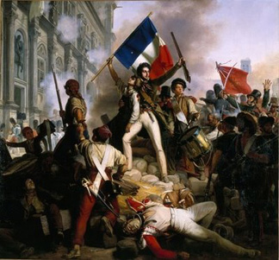
Guillotine
Guilty were driven thru the streets in a 90 min procession prior to death.
Some believed head maintained hearing/sight for 15 minutes post death.
*Ironically, despite heavy civil fighting, France was able to repel the attacks made by Prussians & Austrians.
*Britain, Holland, & Spain join in to also fight the French.
*Convention needed soldiers, so France ordered a draft.
*One Jacobin leader, Maximilian Robespierre comes to power with the goal of wiping out aristocracy

Slide 17
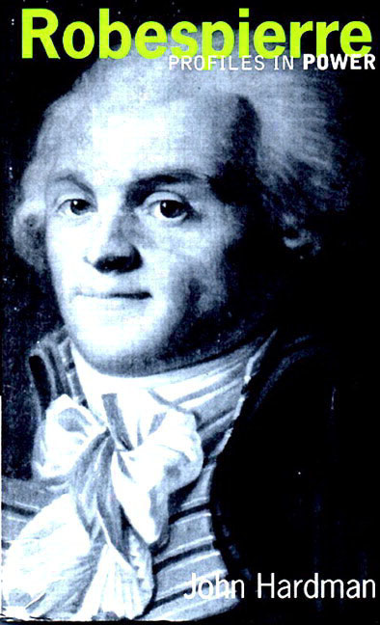
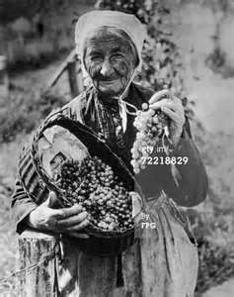
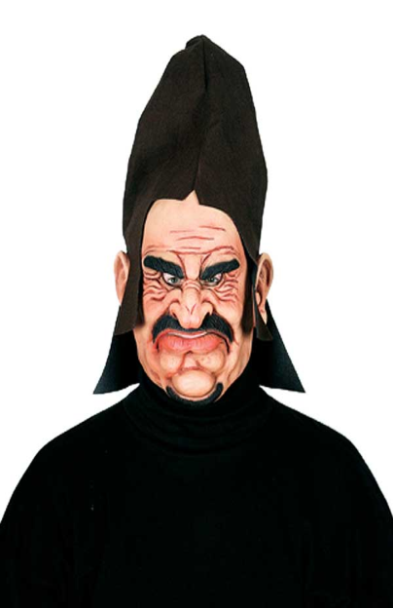
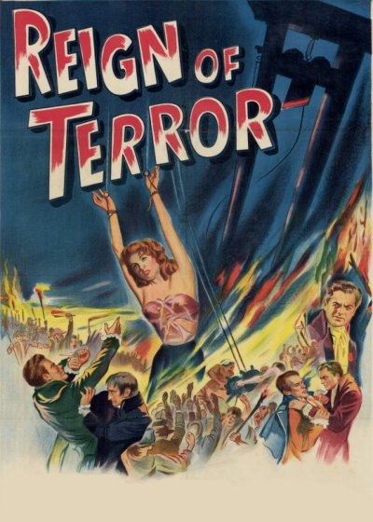
*One 18 year old was sentenced to die for cutting down a tree that had been planted as a symbol of liberty. *Despite plan to end monarchy, 85% of deaths were done to peasants.
Maximilian Robespierre built a “republic by virtue” by trying to wipe out every trace of past.
His one year long reign executed about 40K people (that’s just in Paris), anyone who challenged him was declared an “enemy.”
Anti-religious: closed churches & wiped Sunday off of calendar.

Slide 18
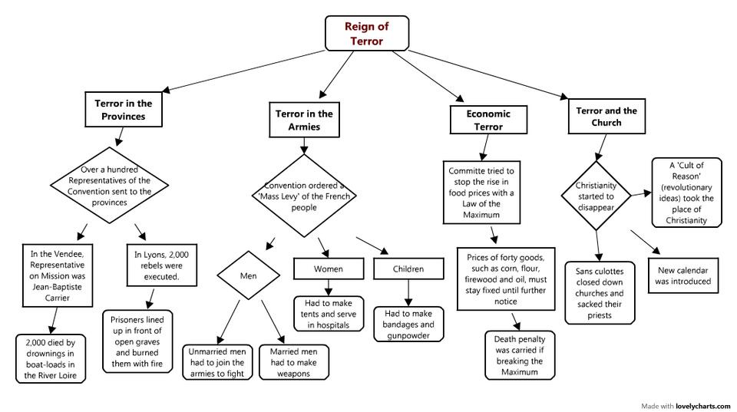

Slide 19
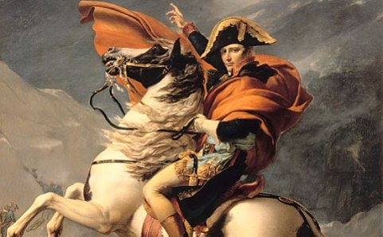
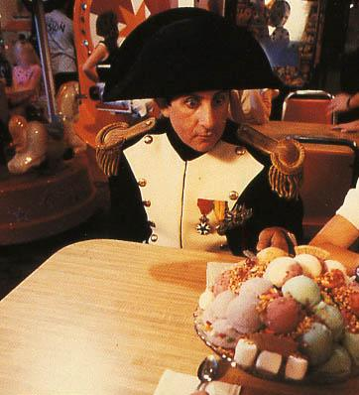
NAPOLEON BONAPARTE
After Reign of Terror ended, France picks 3rd gov’t in 5 years. War torn nation turns to epic war hero who had kept France safe from foreign invasion during war, comes to power in a Coup D’Etat.
*A lot of civil wars are as simple as Side A vs. Side B. France was way more complex in that there were as many as 5 different sides wanting power. Napoleon was perhaps the only person the majority could possibly agree on to lead.

Slide 20
COUP D’ETAT
Napoleon returns from war & ends national legislature (those left behind vote to make him dictator).
People backed decision w/ a vote.
He makes an effective tax collection system, establishes a national bank, fired corrupt officials, & set up public schools (lycees) open to all people.
He set up Napoleonic Code (fair set of laws) that promoted order. Also, allowed churches to re-open (then had the Pope crown him emperor).

Slide 21
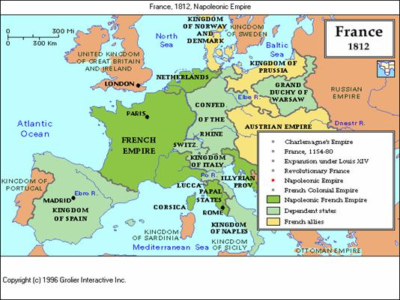
FRENCH EMPIRE
Not content to own just France, NB sold Louisiana to US for $15M & annexed a bunch of nations next to France.
Great victories gave NB control of everything in Europe except Britain, Portugal, Sweden & Ottoman Empire.
*NB at 1st wanted a world empire, but lost in a colonial war in the Caribbean.
So making the Louisiana Purchase made sense to him:
$$$ for war
USA would surely become an enemy to Britain.

Slide 22
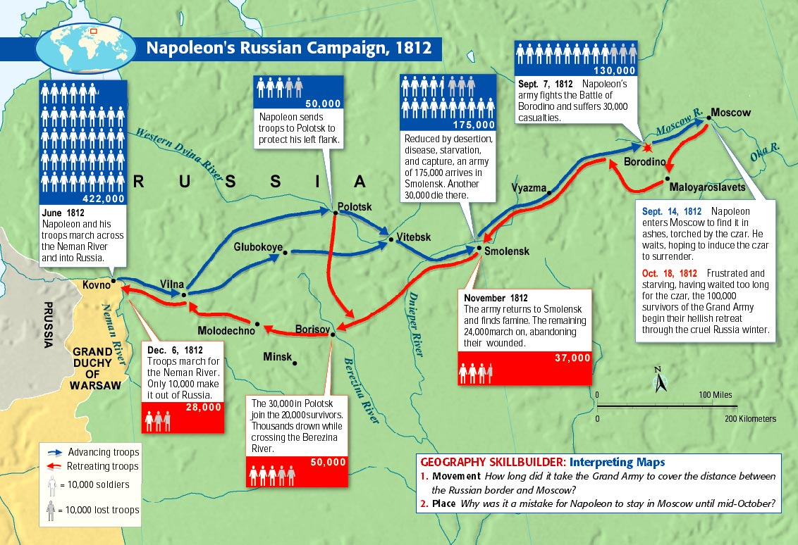
NB’s big mistake is the invasion of Russia. Russian soldiers retreat destroying all lands (scorched earth policy) which left no supplies to be gained as winter set in.

Slide 23
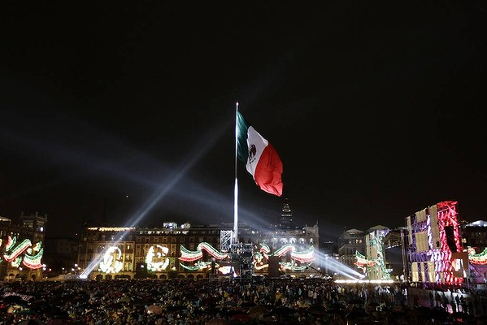
WORLD REVOLUTIONS

Slide 24
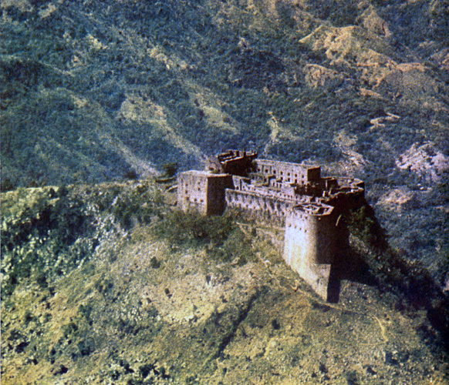
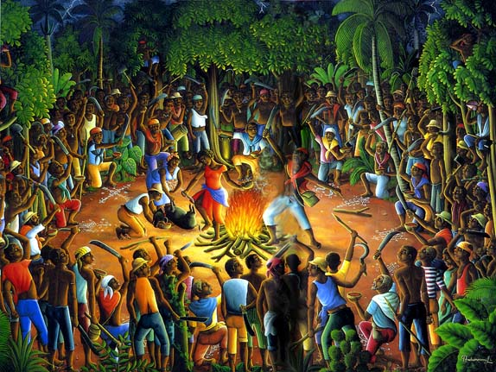
HAITI
French colony enslaved around 500K when Toussaint L’Ouverture lead an uprising (called Saint Domingue). Only slave revolution to win.
Haiti is technically where Columbus landed.
After the revolt, a pig was sacrificed & the land was dedicated to Devil/voodoo/something.
*Haiti means mountainous land.
*Haiti is where Napoleon failed & decided to sell off New World.
*Haiti is currently the poorest nation in the Western hemisphere.
*2010 earthquake killed thousands.

Slide 25
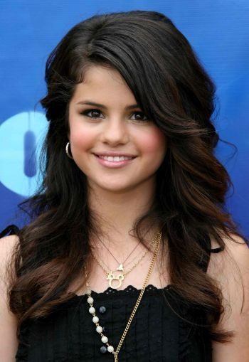
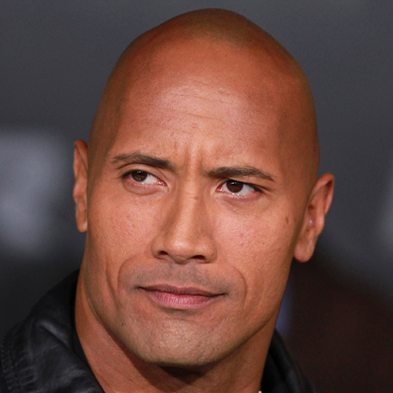
CREOLE REVOLUTIONS IN LATIN AMERICA
Central & South America had odd mix of class structure:
Peninsulares: Colonists born in Spain or Portugal.
Creoles: European ancestry born in the Americas.
Mestizos: European & Native American mix.
Mulattoes: European and African American mix.
Obviously this is not a plan for permanent economic security.

Slide 26
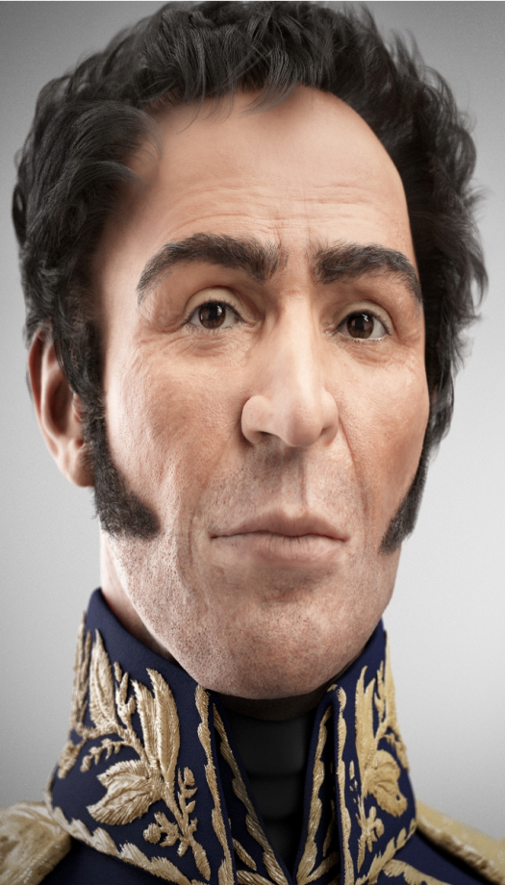
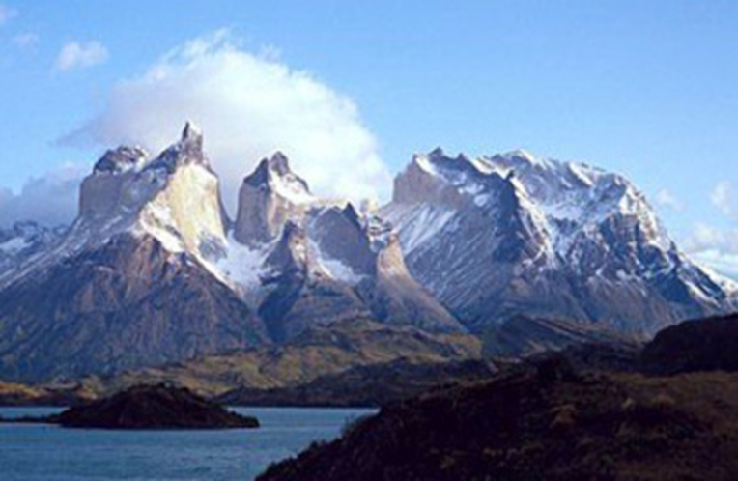
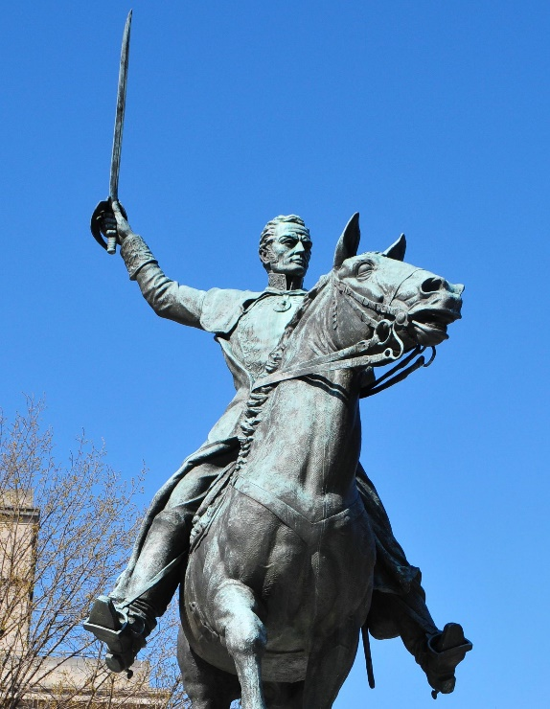
LATIN AMERICA
With Spain’s empire waning, fighter Simon Bolivar lead volunteer soldiers through mountains beating Spanish troops & winning independence, goal was to create one great nation called Gran Colombia (like USA).
*Obviously the hopes don’t come true as South America becomes many different nations. Truth is both these guys didn’t exactly get along nor did the people they helped want these two to lead them. Armies loyal to generals led to the rise of caudillos—strong local leaders with regional power. These men prevented strong central governments from gaining the necessary foothold to form a strong country.

Slide 27
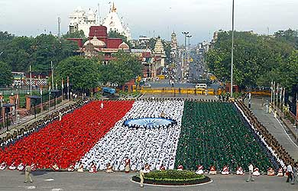
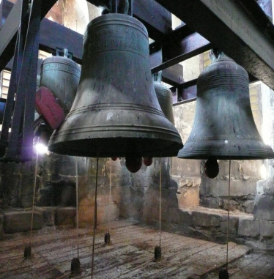
MEXICO
Father Miguel Hidalgo rang the church bells, but rather than have church, called for revolution against Spain (the Cry of Dolores). Over the course of 11 years & multiple leaders in a complex war, Mexico eventually defeats Spain and declares their freedom.

Slide 28
BRAZIL
Portugal had been taken over by Spain, but royal Portuguese family escaped to Brazil. While in Rio de Janiero, they ran nation until NB conquered Spain (then went back to Europe). Creoles living in Brazil demanded independence, which Portugal GRANTED W/OUT BLOODSHED (only peaceful rev in New World).

Slide 30
1848 REVOLTS (CENTRAL EUROPE)
Uprisings occur across Europe as citizens demand better care & more freedom. The result is royalty wins & people remain subjects to the monarchies.
Greece does win their independence from Ottoman Empire.

Slide 31
TEXAS
*From left to right, massive state of Sam Houston near Huntsville (67 feet tall), John Wayne as Davy Crockett, TX flag, The Alamo (not far from San Antonio), & convincing TX win at San Jacinto.
Unhappy with high taxes & forced conversion to Catholicism, citizens of Northern Mexico (Texas) rebel. After defeat at The Alamo (place where Davy Crockett dies), Governor Sam Houston leads Texan army to amazing victory at the Battle of San Jacinto winning independence for the Republic of Texas.

Slide 32
RUSSIA
Czar Alexander II saw the revolutionary times and made major agrarian reform by freeing all the serfs (a form of forced slavery).
*Decision was made around the time of US Civil War, A2 said “it is better to liberate the serfs from above than to wait until they win their freedom from below.” The result was massive increase in farm productivity.

Slide 33
ITALY
Modern Italy is founded as military leader Guisseppe Garibaldi & political leader Count Camillo di Cavour unite the Italian City-States into one nation.
*Region was divided among languages into city-states. Cavour (who spoke French better than Italian) was a believer in classical liberalism & believed in natural rights. Also believing that the end justifies the means, realpolitik, he manipulated people to advance the military. Once Cavour allied with the Red Shirts army led by Garibaldi, Italy unified.

Slide 35
Civil War
WAR HIGHLIGHTS
Bull Run: 1st combat, N gets blasted (underestimated S).
Antietam: Deadliest single day in USA history (22K).
Emancipation Proclamation: Lincoln orders slaves (living in S states) to be free.
Gettysburg: Turning point of war, N turns back S in PA.
Death Total: 1M casualties (2X more deadly than all other USA wars combined).

Slide 36
GERMANY
UNIFICATION HIGHLIGHTS
39 states loosely lived in a German confederation (dominated by Austria).
Otto von Bismarck expands Prussia & begins to dominate Germany, he gains a following by attacking neighboring nations and when those nations return fire, German Speaking Peoples unite.
Trying to gain control of southern Germany (shown in yellow on map), invade France. After winning easily in the Franco-Prussian War, OTB throws a party for himself at Versailles.
*Events like that aren’t forgotten easily. France will spend decades planning their revenge on Germany.

Slide 37
JAPAN
Emperor Meiji takes over in 1868 & gov’t takes great ambition in moving from feudalism to an industrialized state (code of samurais is abolished as ex-warriors enter into poverty, their rebellion fails).
*Some Japanese companies like Mitsubishi are formed in this era, & are still operational today.

Slide 40
Cottage Industry
Using cotton gained by USA slave labor, Britain has women sew cotton into clothing using their own homes.
*Effective but slow, the world demanded a faster pace so a process called the factory system would be created.

Slide 41
Industrial Revolution
Industrial Revolution refers to the greatly increased output of machine-made goods that began in England in the 1700s. IR began there because Britain had water power, coal, iron ore, rivers, harbors, & ships to sail.

Slide 42
Agricultural Revolution
Wealthy bought up villagers’ lands & put hedges up. On these enclosures (large fields), farmers tried new techniques like using a seed drill (allowed farmers to plant crops in rows as opposed to random scattering).
*Breeders learned to increase mutton (sheep meat) by using the largest livestock stud (male).
*Between 1700 & 1786 the average weight of lambs increased from 18 pounds to 50 pounds.

Slide 43
GROWTH OF TECHNOLOGY
The spinning jenny (James Hargreaves) & the water frame (Richard Arkwright) reduced the time needed to spin yarn & weave cloth as more than one thread could be spun & moving water could do it with a minimum number of people.

Slide 44
Eli Whitney’s creation of Interchangeable Parts allowed manufacturing to happen hundreds of times faster, and allowed consumers to fix broken items quicker. Original benefit was the USA military w/ weapons.
His other invention the Cotton Gin was meant to reduce the need for slaves. Instead American slavery became more profitable than at any other time in history

Slide 45
Steam Power
Robert Fulton: Felt steam could also propel boats & created the steamboat
By the mid-1800s in England, there were 4250 miles of inland channels.
James Watt: Found a way to make the steam engine energy proficient (earlier models were too expensive to use). Major use of steam engine was to power the newly created railroads.

Slide 47
RAILROADS
With Transcontinental Railroad in USA and Trans-Siberian Railroad in Russia, the entirety of the world is now connected. Human Capital (otherwise known as People) was a key factor in USA success.

Slide 48
Urbanization
Between 1800 & 1850, the number of European cities boasting populations of more than 100,000 rose from 22 to 47 cities (London being the largest: 1M).
Because of rapid growth, cities lacked adequate housing, water, schools, police protection (unpaved roads were covered in animal feces, human waste, & had heaps of garbage). Sickness was widespread as many lived in dirty slum shelters.
People worked 14 hours a day, 6 days a week, performing the same mundane tasks. Machines often injured or killed workers (no child labor laws yet).

Slide 49
RESOURCES
Coal made it possible to mass produce iron (and an alloy of iron combined w/ carbon called steel). By the mid 1800’s oil wells were drilled & later 1800’s saw power stations, street lighting & trains run by electricity.

Slide 50
Textile Industry
*1000s of women flocked to the mills, conditions were like sweat shops.
Britain made laws forbidding engineers, mechanics, & toolmakers from leaving the country (didn’t want info on how to build factories to leak out). So when Francis Cabot Lowell started his factory near Boston, it revolutionized USA.
*A textile is defined as a cloth or yarn, made of flexible woven materials of wool, flax, or cotton.
*Below is a renovated mill in Lowell MA, where FCL changed USA.
*Above is Watkins Mill, the most famous still standing mill in MO.

Slide 51
INDUSTRIALIZATION IN FAR EAST
JAPAN: Central government grows stronger, industrialization increases (bushido codes are removed), seek technology as schools/literacy become important.
CHINA: Unfortunately Qing Dynasty does not grasp industrialization so foreign nations will take advantage through opium trade & spheres of influence.

Slide 53
UNIONIZATION
To press for reforms in wages & working conditions, workers formed groups called unions & used collective bargaining (meet with owners via a large group to discuss issues). If demands were not met, a strike (refusal to work) would be threatened or acted on.

Slide 54
COMMUNISM
Karl Marx introduced a radical type of socialism called Marxism (in 23 page Communist Manifesto)
He & Friedrich Engels argued that the haves & have-nots will fight.
Solution is Communism, or the complete socialism by all means of production (mines, factories, RRs, business, & even lands).
Believed economic forces alone is the motivating factor of people (obviously wrong…religion, family, patriotism, lots motivating factors)

