Slide 1
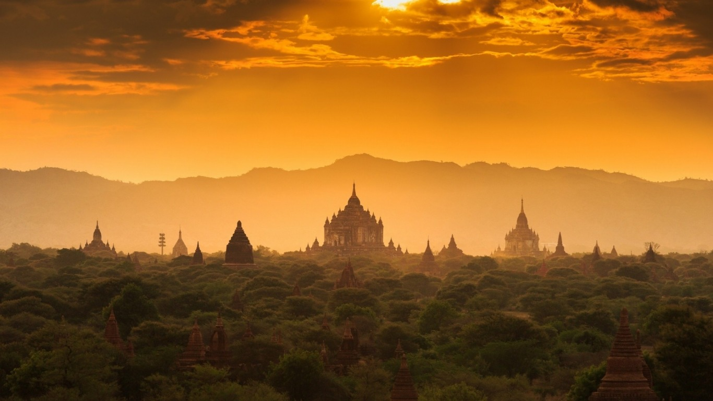
GLOBAL TAPESTRY

Slide 2
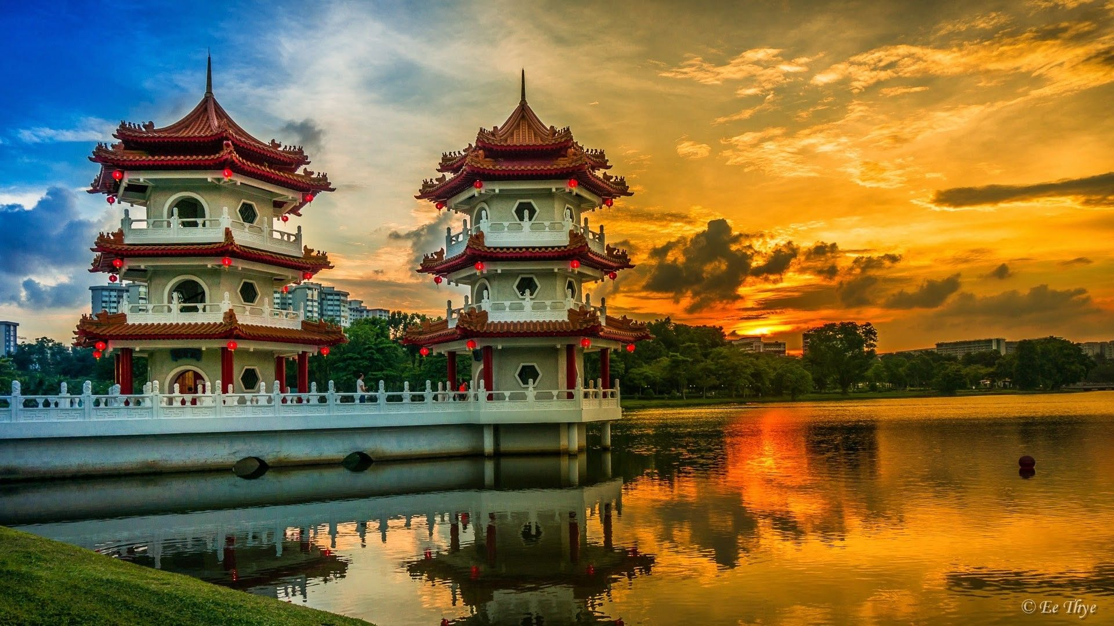
CHINA

Slide 3
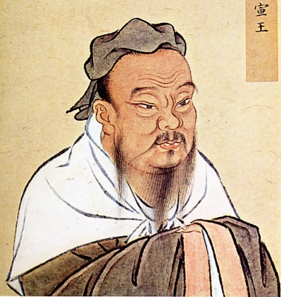
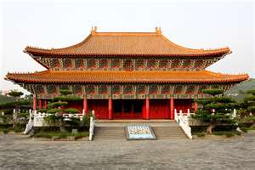
CONFUCIUS
Taught that society could be restored if built around 5 basic relationships. Philosophy/religion of Confucianism is the belief that humans are generally good, teachable, can be improved, and even reach a state of perfection.
CHINESE PROVERBS
“Before you embark on a journey to revenge, dig two graves.”
“Men’s natures are alike, it is their habits that carry them far apart.”
“I hear & I forget. I see & I remember. I do & I understand.”
“Choose a job you love, & you will never have to work a day in your life.”
“Only the wisest & stupidest men never change.”

Slide 4
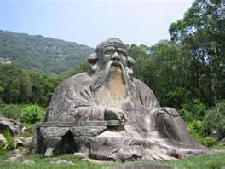
LAOZI
Laozi was carried in his mom’s womb for 62 years & was born with white hair.
Believed government should do as little as possible: stay out of way.
All nature followed “the Way” or “Dao,” except humans who had to work at it.
Daoism Religion is founded in which humans strive to live alongside nature.
Yin & Yang is the symbol representing this perfect nature of good & evil.

Slide 5
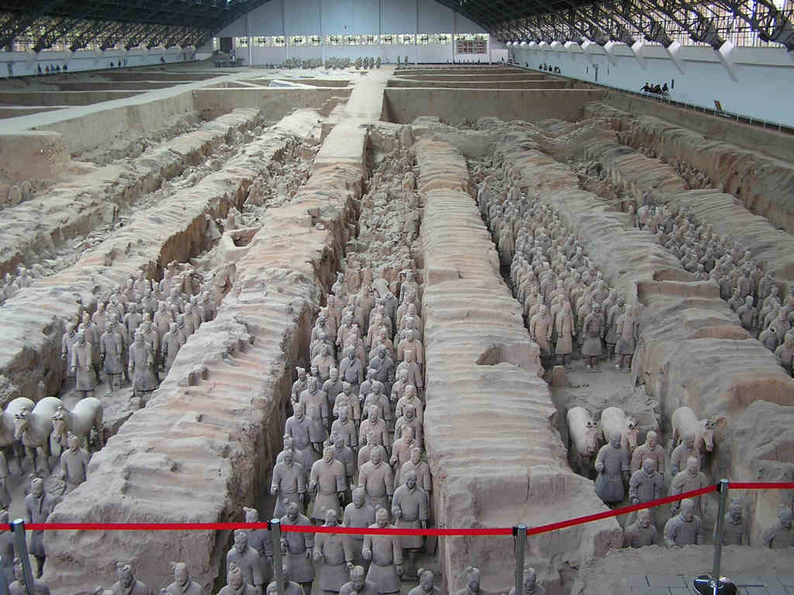
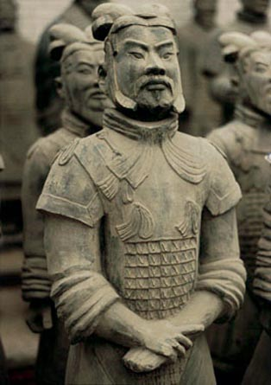
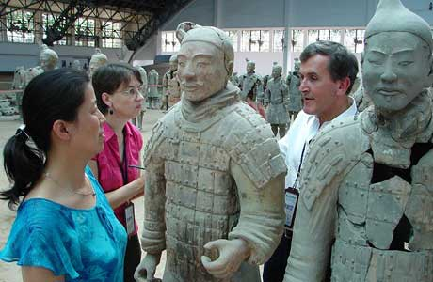
Terracotta Warriors
Discovered in 1974: around 8000 soldiers, 13o chariots, 750 horses & other non-military personnel were discovered (seemed to be made by clay molds).

Slide 6
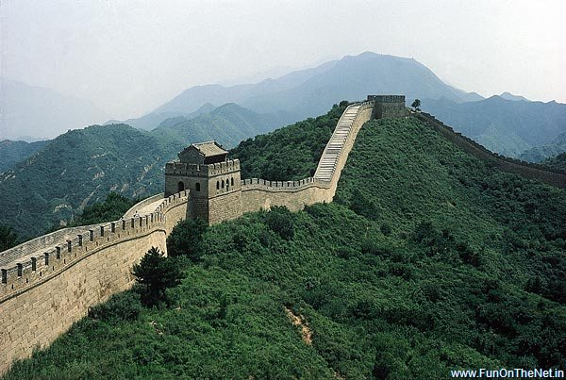
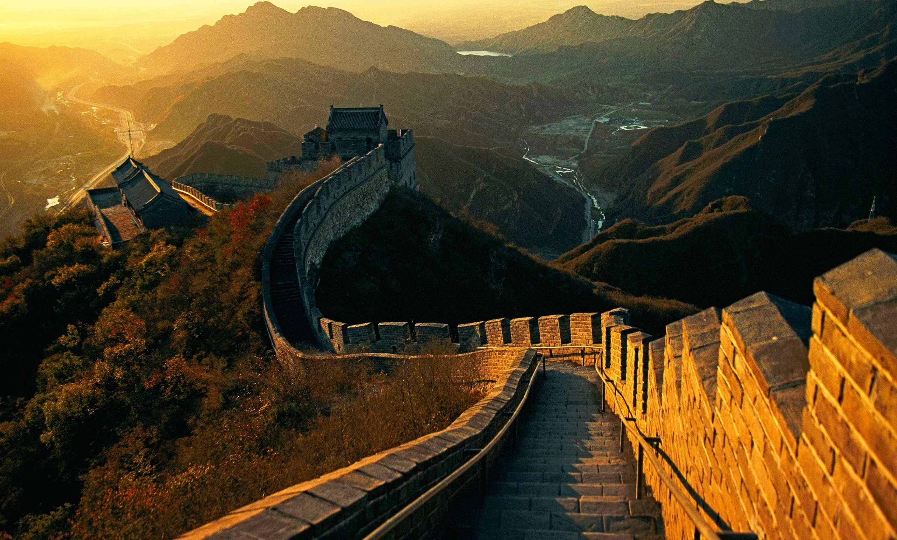
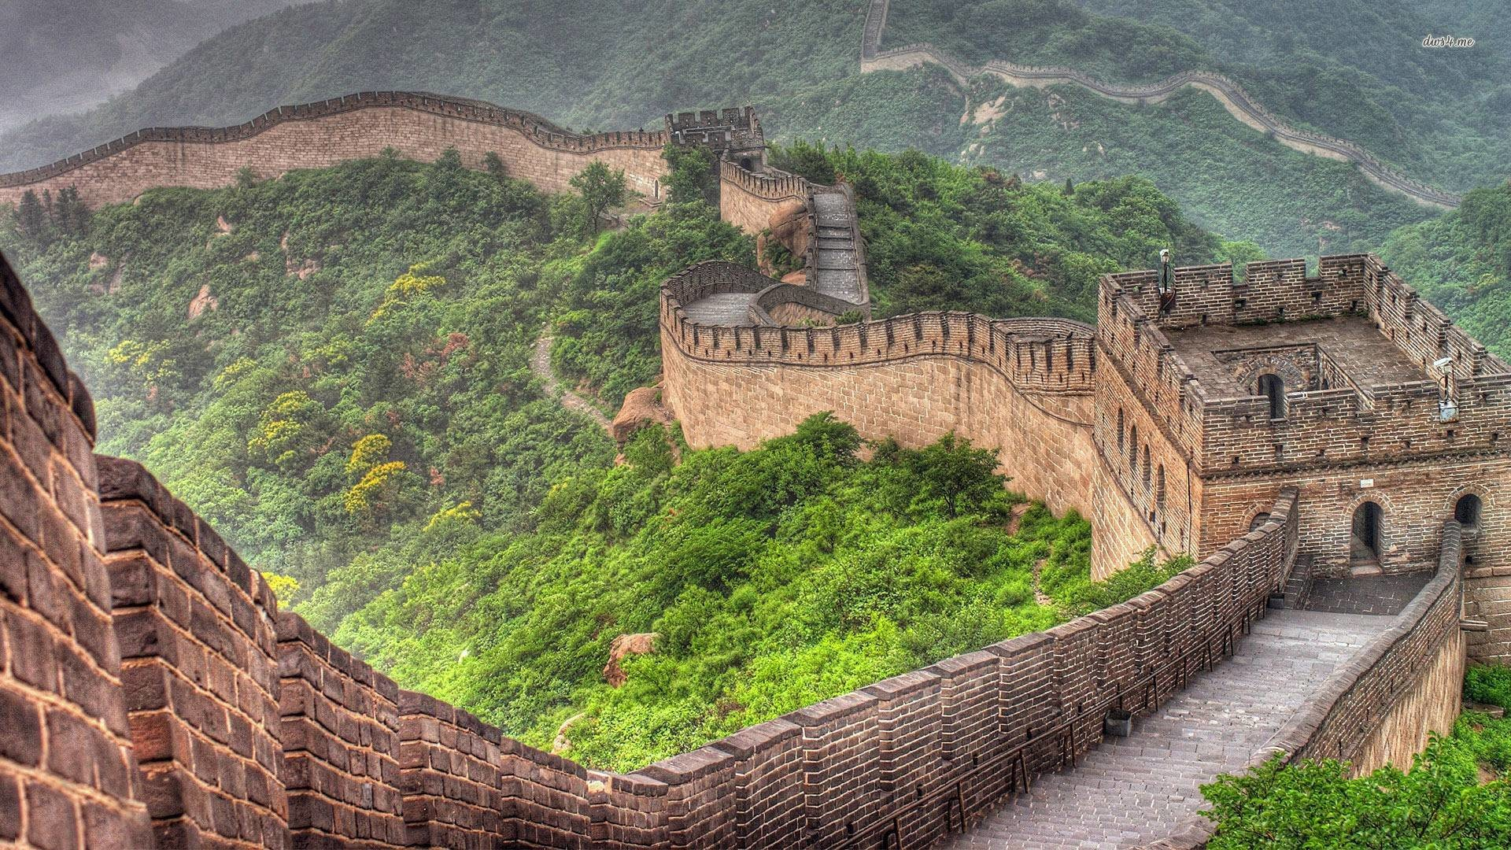
Great Wall of China
Workers were told build or die.
Original wall is gone, no details as to size of original length.
Estimated that 100,000s of workers died while building wall.
Wall is not actually one wall today, divided up into pieces.
Watchtowers were 200-300 yds. apart.

Slide 7
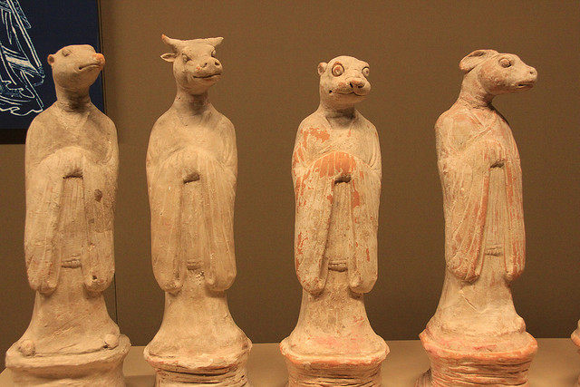
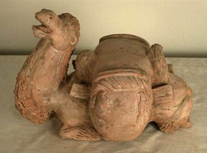
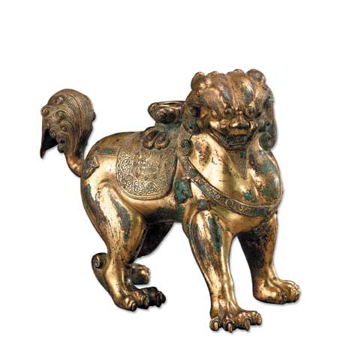
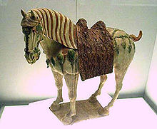
TANG & SONG EMPIRES (CHINA)
Previous to Mongol invasion, China had strong leadership & a growing society over 100 Million!
Dug the massive Grand Canal, continued Great Wall, & created a host of inventions (foot binding, ouch).

Slide 8
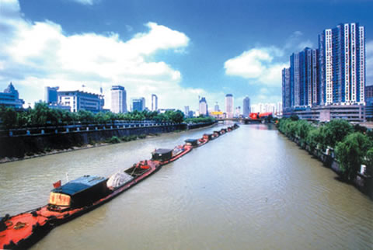
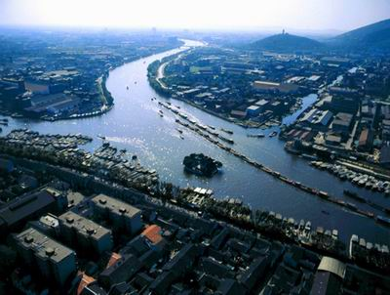
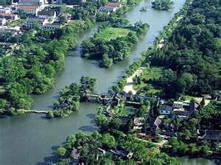
GRAND CANAL
Connected the Huang He & Chiang Jiang Rivers together.
About 1M people worked on the 1000 mile waterway for 5 years (around ½ of those who worked on the canal died digging it).

Slide 9
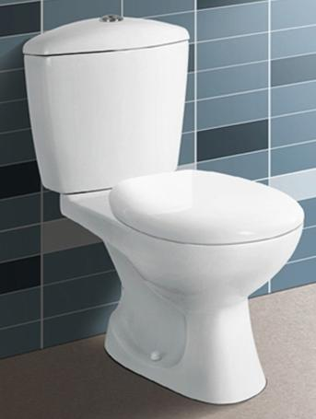
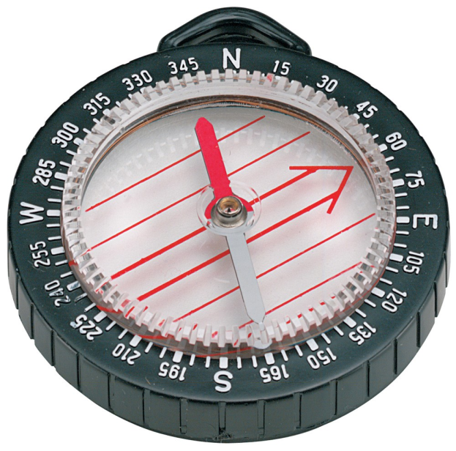
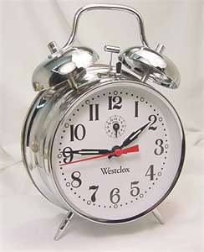
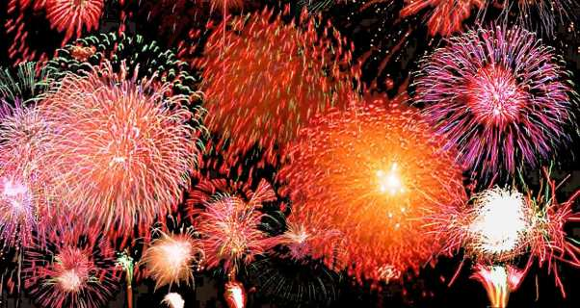
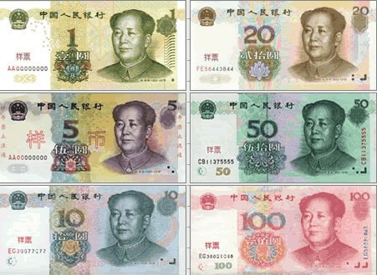
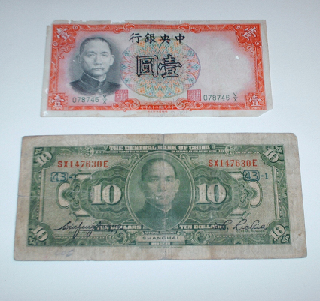
Chinese Inventions
Created Movable Type, Mechanical Clocks, Porcelain, Paper Money, Magnetic Compass, Acupuncture & Gunpowder.

Slide 10
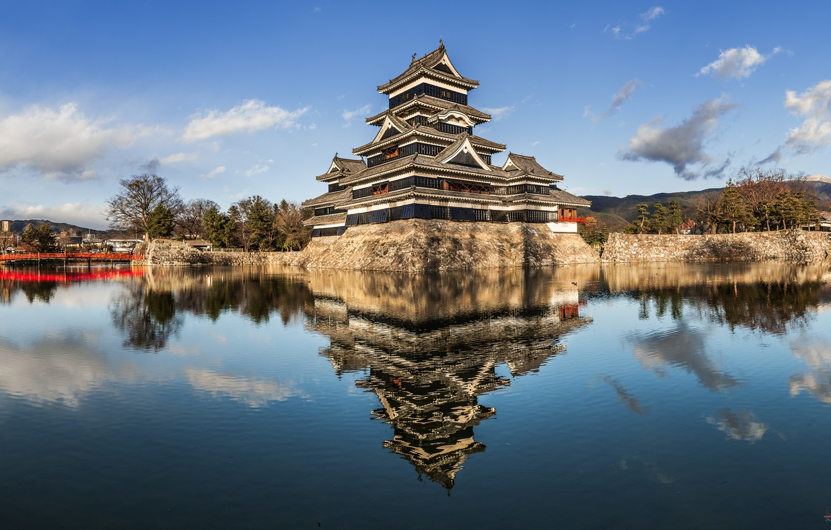
JAPAN

Slide 11
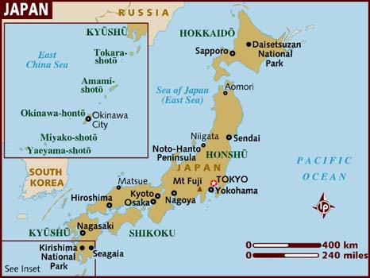
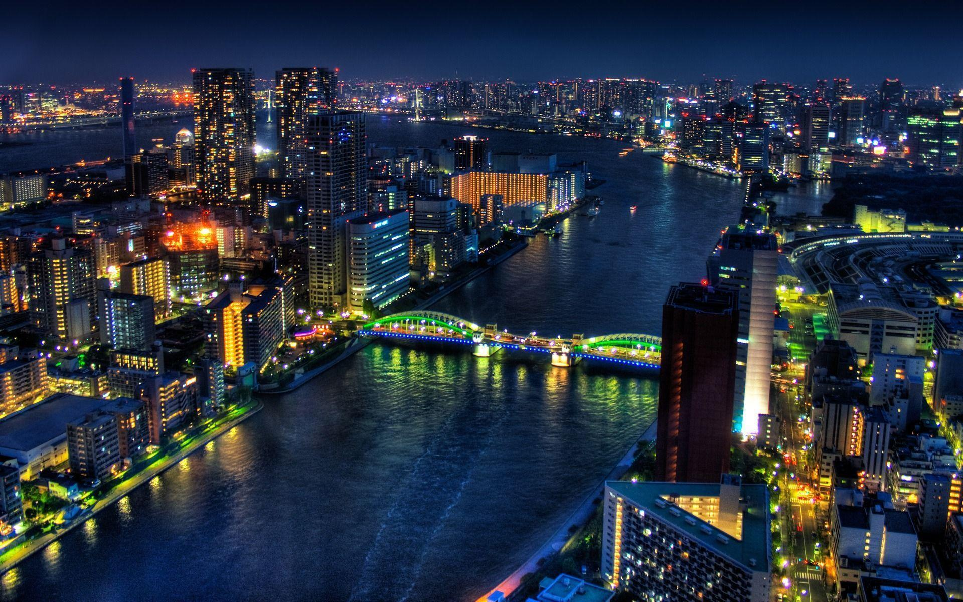
JAPAN
Geographically made up of over 4000 islands
(4 largest islands of Hokkaido, Honshu, Shikoku, Kyushu).
70% of Japan’s terrain is considered mountainous.
Located in the Pacific area called the Ring of Fire, will feature around 1500 earthquakes per year.
Today, Tokyo is a megalopolis, with around 35 million people living in the Greater Tokyo Area.

Slide 12
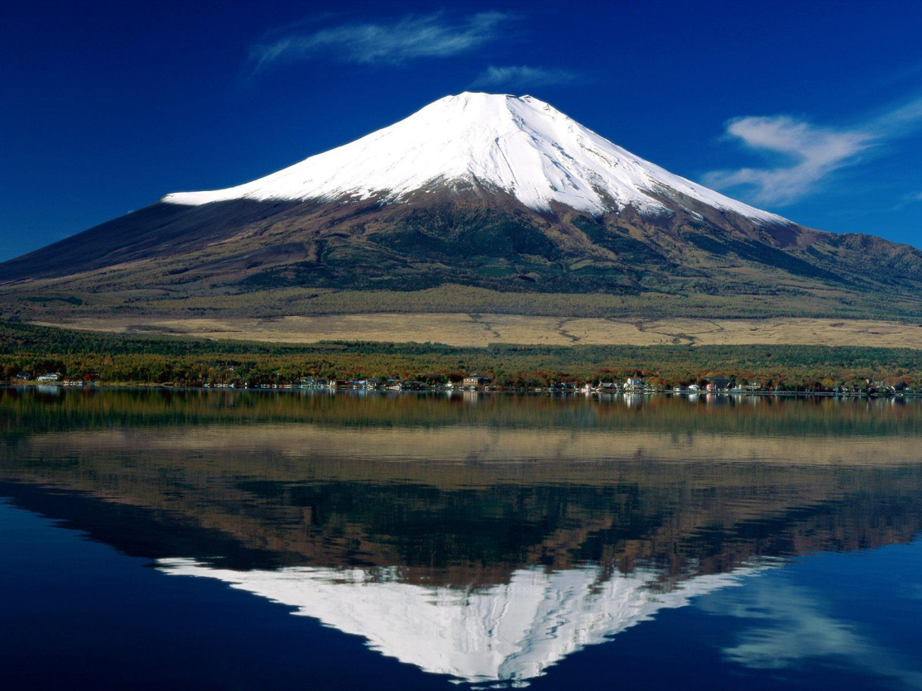
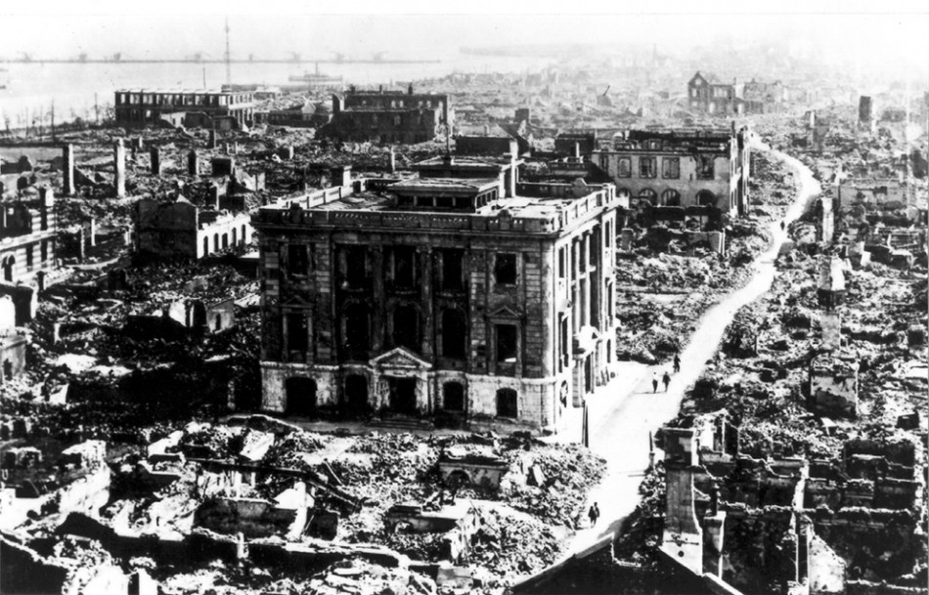
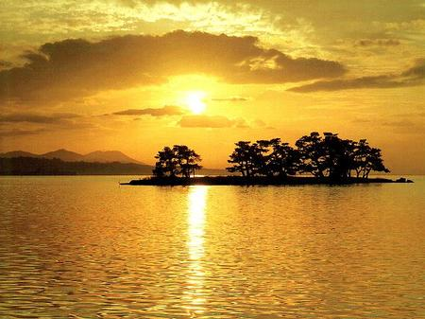
Japan Geography
Mt. Fuji is the highest point of Japan, elevation: 12K.
The 1923 Great Kanto Earthquake was a 9.0 quake that killed 140K (at lunchtime, fires ensued).

Slide 13
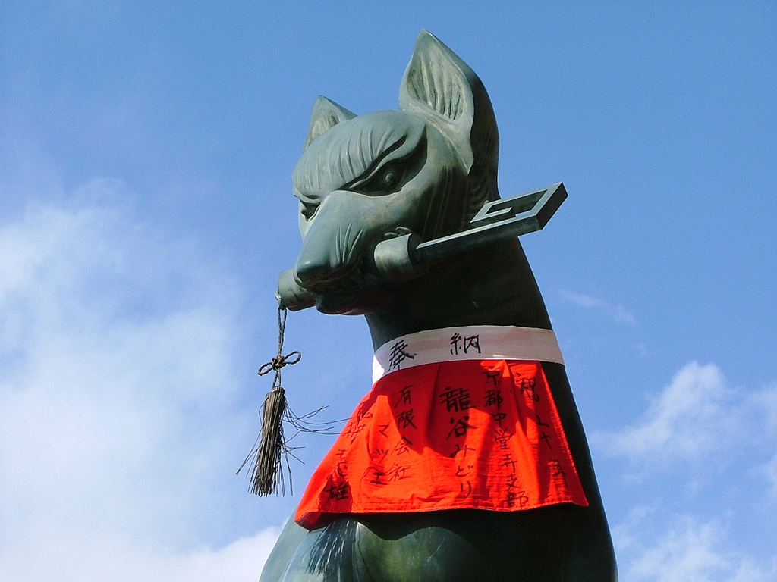
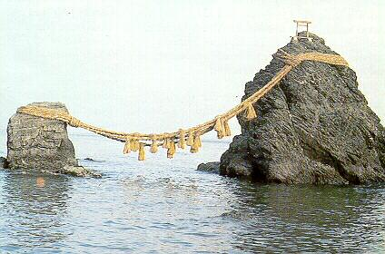
SHINTO
*Left is a statue of Kitsune, a messenger fox god.
*Below is kami resting place in which rituals are performed during New Year’s.
Based on respect for the forces of nature, worships the Kami (divine spirits that indwell in nature). Any unusual rock, tree, waterfall was thought to be a home of a Kami.
Sort of a Japan Only religion with few followers outside the islands.

Slide 14
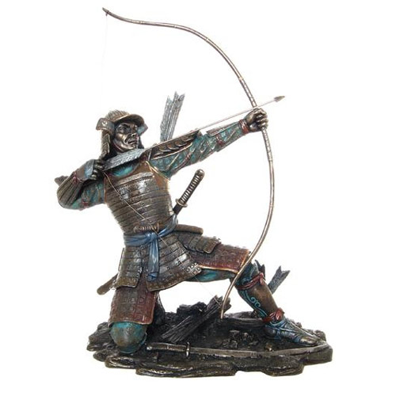
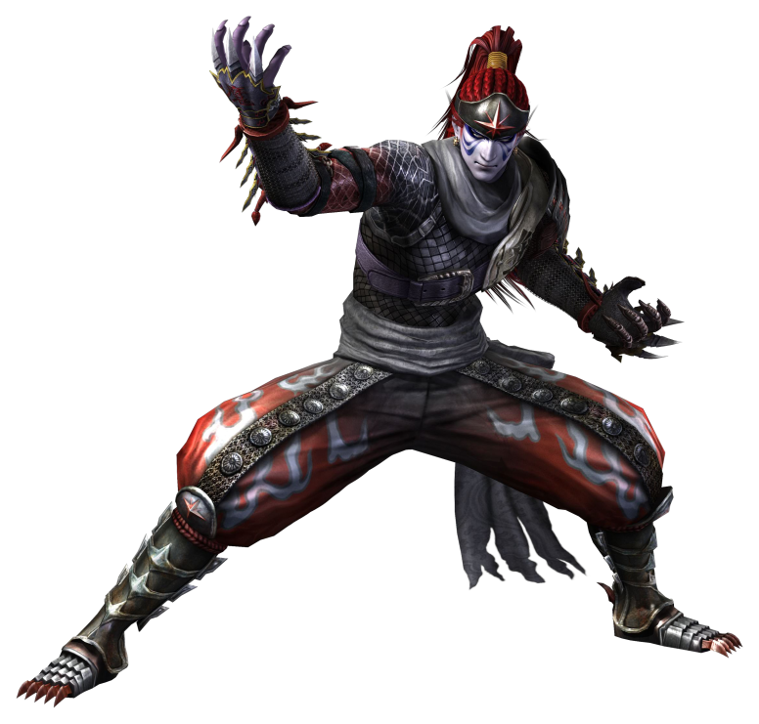
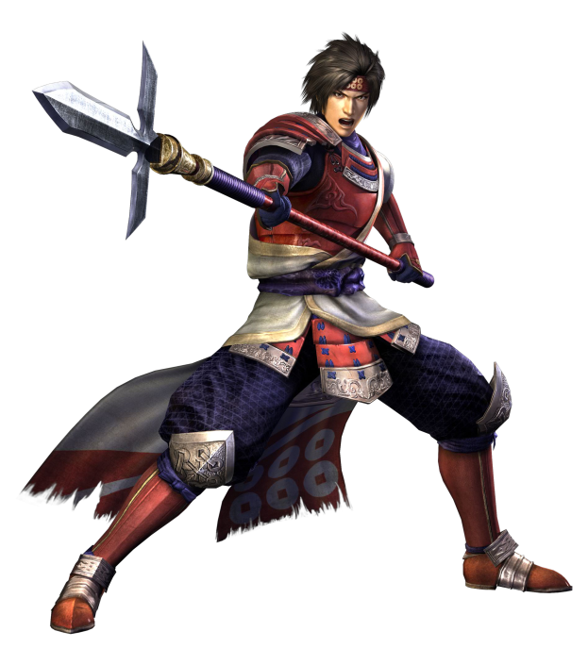
Shoguns & Samurai
Shoguns were feudal Lords who had essentially absolute power over their region. Independent in nature, strong enough to repel the armed attack of the Mongols. Samurai were their soldiers, followed their Bushido code that emphasized honor, bravery, & loyalty.

Slide 15
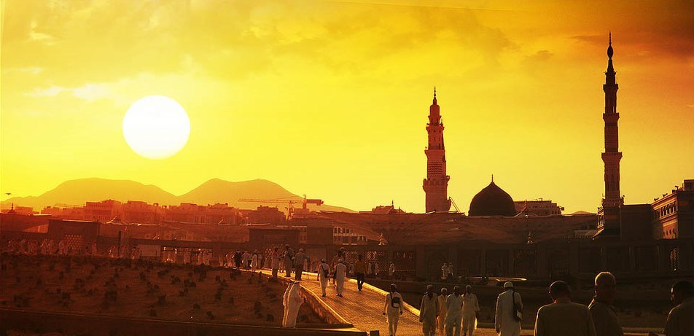
BIRTH OF DAR AL-ISLAM

Slide 16
Birth of islam
In Middle East, people took pilgrimmages to Mecca to worship at a shrine called Ka’aba (lots of deities).
Muhammad believed he heard voice from the angel Gabriel & identifies Allah as the one and only God.
After moving to nearby Medina, Muhammad returns to Mecca with 10,000 soldiers conquering it for Allah.
Teaches that the way to paradise is to follow the Five Pillars of Faith.

Slide 17
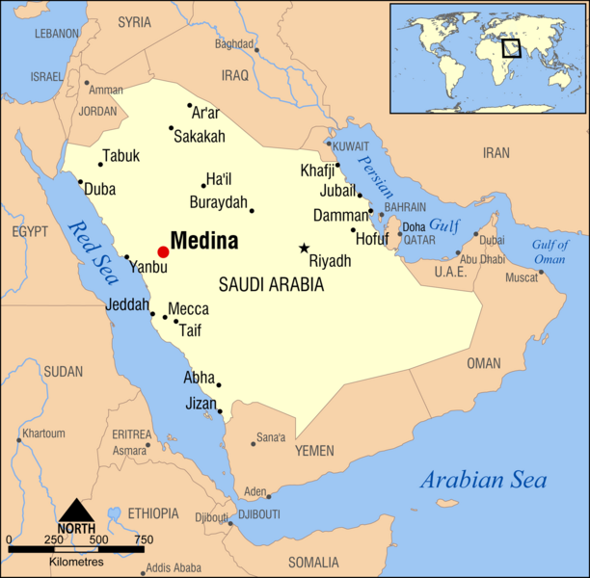
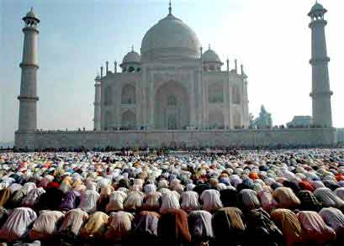
muhammad
God told Abraham he would father a chosen race (Jews claim through Isaac, Muslims claim this is fulfilled thru other son Ishmael).
Allah was worshipped in Mecca as a creator deity, then gets 100% focus (all other deities are to be destroyed). Koran will become the Islamic Holy book.
Worship takes place in a mosque

Slide 18
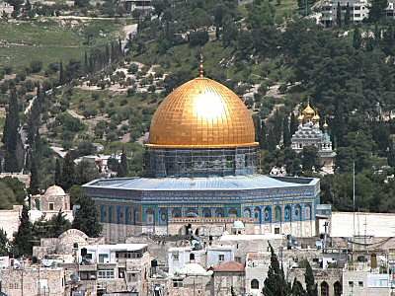
Five pillars of faith
1.Admit that “There is no God but Allah & Mohammad is the messenger of Allah.”
2.Pray 5 times a day facing Mecca.
3. Must give alms ($$$) to the poor.
4. Must fast (not eat) during the daylight hours of the month long Ramadan holiday.
5. Take Pilgrimmage to Mecca.
*If a person dies during a jihad (holy war), their soul goes directly to paradise.
*Above is the “Dome of the Rock.” It’s located in Jerusalem & is the earliest surviving Muslim monument. It’s located on the former site of Solomon’s Temple.

Slide 19
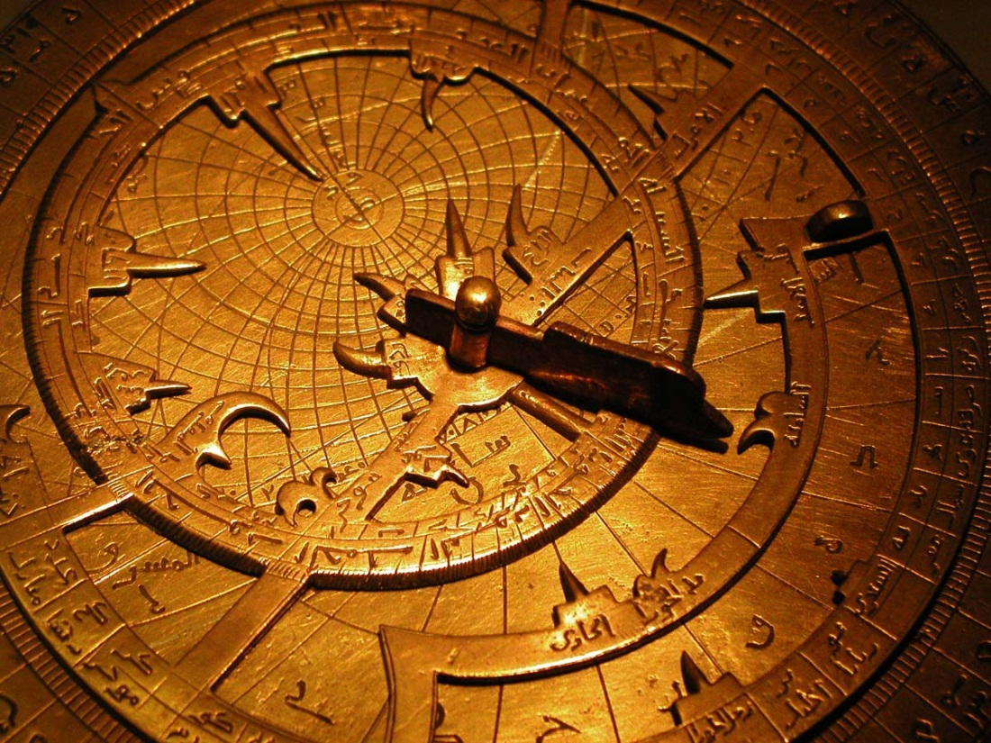
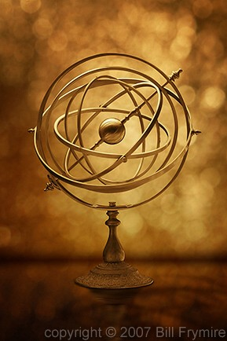
Astrolabe & armillary sphere
Muslims created astrolabe (had a plate as a map & a rotating “rete” that symbolized the rotating earth), helped them create a lunar calendar.
Armillary Sphere rotates a mock Earth while the rings carry meaningful data about the mock stars.
*Depending on how people count the numbers…
Islam is either the 1st or 2nd largest religion in the world (Christianity is the other).

Slide 20
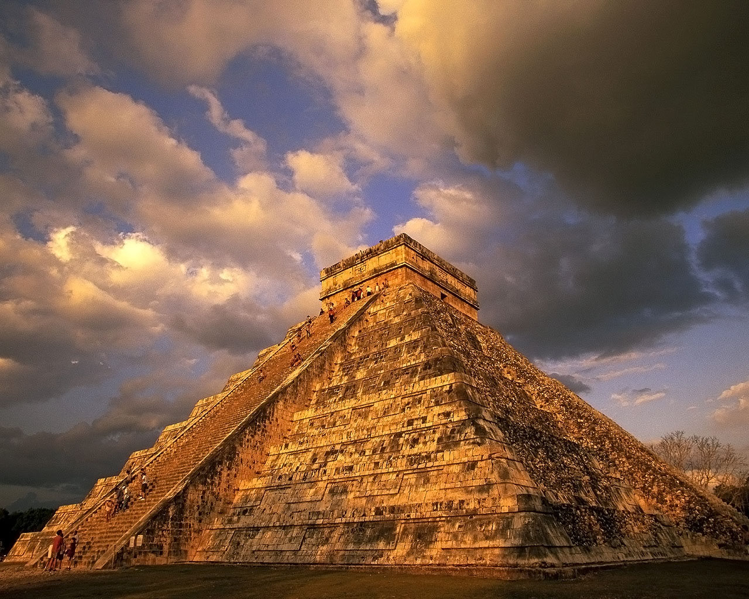
DEVELOPMENTS IN THE AMERICAS

Slide 21
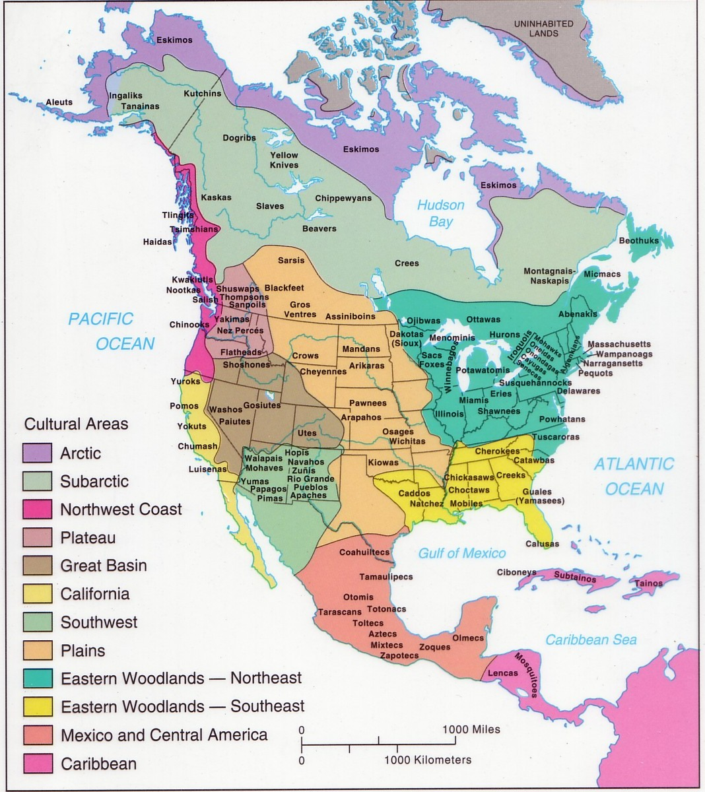
NORTH AMERICA
Pre-Columbian Indians lived throughout the regions.
Anasazi lived in the Southwest near Utah, Colorado, NM,etc
Lived in pueblos: apartment style compounds made of clay
Mississippians lived in Midwest along the river systems, known for building mounds.
Iroquois lived in Great Lakes & East (5 great tribes of NY).

Slide 22
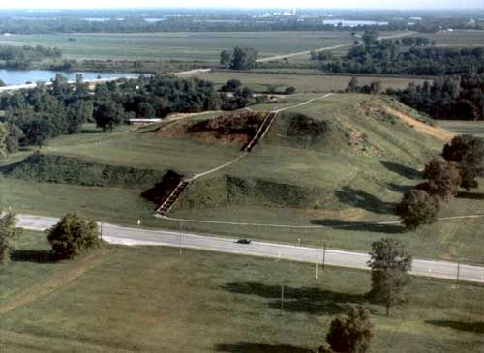
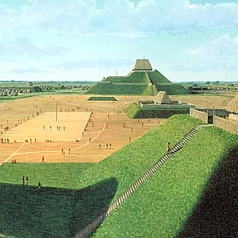
CAHOKIA
Just east of St. Louis was the main lands of the Cahokia Indians. They were led by priest-rulers & built a massive mound 100 feet high crowned with a wooden temple.

Slide 23
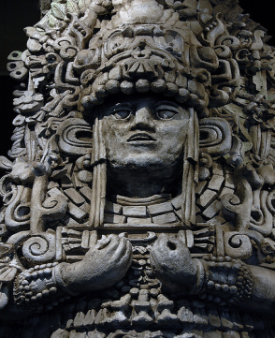
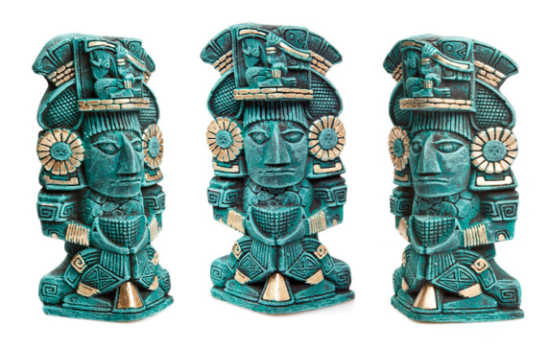
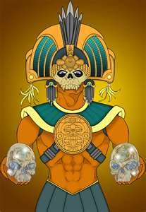
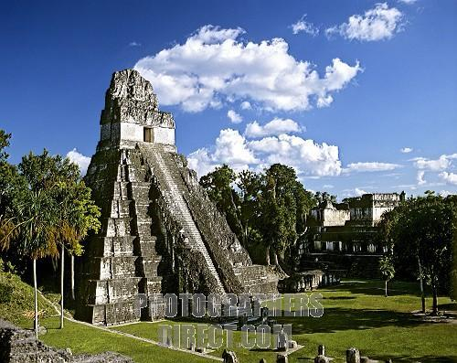
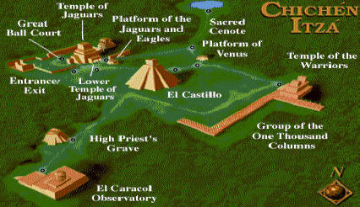
Mayans lived in Central America & had a complex writing system along with an accurate calendar.
Leader was a god-king. Other gods were of corn, death, rain, etc
Mayans built at least 50 massive sites & awesome cities at Tikal & Chichen Itza (temple was 210 ft tall).
*Mayans had a ball court with 20 foot tall hoops, thought that the losing team was beheaded.
*Though there are still Mayans, the greatness of their civilization collapsed around 900AD.

Slide 24
Aztec gods were vicious, their sun god demanded blood sacrifice (Cortez compared these sacrifices to Satanic worship).
Had the largest city in the world in its time. Tenochtitlan had 400K people & was built over the top of a lake. Pyramids were common throughout what is now modern day Mexico.
*Aztecs loved chocolate, made tons of cocoa drinks.

Slide 25
INCANS
Incans dominated South America by using diplomacy & roads to connect people together (14,000 miles of roads). Recorded their history on a quipu (a rope with a series of knots indicating events).
Macchu Picchu is an iconic village found 8000 feet above sea level (that was abandoned & discovered in 1911). Incans mummified their leaders & llamas were sacrificed for gods.

Slide 26
MACCHU PICCHU

Slide 27
AFRICA

Slide 28
Mali empire
Mali Empire was the grandest of all African empires & dominated the world in the 1200s. Known for excellent trade and epic capitol city of Timbuktu (had a library with 700K manuscripts). Started by Sundiata Keita (The Lion King), size of it was bigger than modern day Texas. Empire would last 400 years with its peak being the 1400s, Islam played a major role.
*Mali Empire was run by Mansa Musa, some argue he was the richest man to have ever lived.

Slide 29
MANSA MUSA
MM owned all the gold, copper, and salt in his region. He was so rich, on his trip to Egypt, he had 100 camels carrying 100 pounds of gold and flooded Cairo with so much wealth he actually inflated the money units and caused a decade long depression. Estimate worth is $400B.

Slide 30
SONGHAI EMPIRE
Songhai Empire rose as Mali collapsed & included Eastern Mali (though capitol was moved to Gao). It’s the largest African empire in history & a bit more violent when compared to Mali.
*Fearless leaders like Sunny Ali & Askia the Great invoked Sharia Law (Islam) and though both were great conquerors, could also fall into that “tyrant” category of ruler. African history was sung and memorized rather than written down, this leads to the great difficulty of learning and teaching it’s history.

Slide 32
VICTORIA FALLS

Slide 33
MIDDLE AGES IN EUROPE

Slide 34
COMPLEX MAP OF EUROPE DURING THE MIDDLE AGES

Slide 35
Simple map of Europe during the middle ages

Slide 36
FEUDALISM BY DEFINITION
King: Top of Feudalism pyramid.
Lord (Noble): A landowner who granted land (called a fief) to a vassal (person receiving the land).
Knights: Mounted horsemen who pledged to defend Lord’s lands in exchange for food/funds/fief.
Serfs: Peasants who received protection in exchange for their agricultural work (could not lawfully leave).

Slide 37
Medieval manor

Slide 38
knighthood
Knights wore leather saddles & stirrups, enables riders to carry heavier weapons & fall less frequently.
Served in combat about 40 days a year (trained year round). Receiving land from Lord was a huge reward.
Code of Chivalry: Demanded the Knight fight brave for 3 masters: earthly Lord, heavenly Lord, & his lady.
Path to Knighthood: Become a Page at age 7, Squire at age 14, & finally a knight at age 21.

Slide 39
castles
*Fortified structures made by Lords for protection.
*Arrow slits, curtain walls, & moats were common defensive designs.
*Many were initially built by earth & wood, but would become stone over time.
*Cannonballs would make castles useless over time.

Slide 40
Siege weapons
Siege Tower: platform on top that lowered like a drawbridge.
Mangonel (bottom left): flung huge rocks that crashed into walls
Mantlet: huge moveable wall that shielded soldiers (lower center)
Trebuchet (right): Awesome slingshot that propelled objects (boulders, diseased cows, dead horses, severed heads, pots of burning lime, etc) over 1000 feet.
Tortoise (middle right): Wheeled house that covered soldiers from arrows.

Slide 41
CRUSADES

Slide 42
CRUSADES
Muslim Turks were threatening Constantinople, so Pope Urban II called for a holy war (crusade).
Pope thought retaking the city & then Jerusalem would reunite the Roman Catholic & Greek Orthodox churches back into one.
Landlords saw this as a way to remove unfavorable knights.

Slide 43
FIRST CRUSADE
Pope said that the people who died in the Crusade would go to heaven.
Though decked out in white crosses, Crusaders weren’t ready for climate, geography, fighting, etc.
Nobles argued as only 12,000 (1/4th original total) actually got to Jerusalem.
After everything, Crusaders captured Jerusalem & won a narrow strip of land.

Slide 44
3RD CRUSADE
After Muslim leader Saladin re-conquers holy land (2nd Crusade), Richard the Lion-Hearted met in an epic battle (then agreed to a truce: Muslims keep Jerusalem, Christians were allowed to pilgrimage.

Slide 45
Crusades 4-6
4th: Knights never reached Jerusalem, instead they stopped to loot the city of Constantinople.
5 & 6: Knights invaded Egypt hoping to weaken Muslims before going to Holy Land, but neither conquered much land.

Slide 46
Children’s crusades
Believing adults were too “unholy” to win a Crusade, Europeans sent their children to beat Muslim warriors.
In one of the most unbelievable episodes in history, 30,000 children under the age of 18 were led by a 12 year old into battle. Many starved or drowned, rest sold into slavery.
Another 20,000 children tried from Germany, most froze to death crossing Alps, many never heard from again.

Slide 47
AGRICULTURAL CHANGES
Warmer climate (800-1200AD) increased farm production (lands once too cold were now serviceable for growing).
Horses gradually replaced oxen for plowing & pulling, axes cleared forests, & three-field system helped crop rotation (farm 2 fields & let 1 field rest to regain nutrients).

Slide 48
GUILDS & FAIReS
Merchants banded together to keep prices going up, followed by guilds in glassmaking, winemaking, tailors, wheelwrights, etc.
Fairs were held several times a year, sell cloth, bacon, salt, honey, cheese, wine, leather, ropes, etc.

