Slide 1
Do Now
Look at the picture on the top of pg. 181
Based on what you see, what do you think life was like in the Huang Valley?
What was important?
How did they live their lives?
Notes:
River travel was important; towns may have been isolated from each other; crossing the mountains looks difficult

Slide 2
Agenda
Do Now
Song of the Day: Angel Said – Vinida Wang & Joey J
Review of Standards of Behavior
Notetaking
Full reading of 5.1
Check for Understanding (CFU) questions
Class Discussion
Practice Vocab questions
Exit Ticket

Slide 3
Classroom Standards of Behavior
Listen and Participate: Show respect by listening quietly when others are speaking, and engage actively during discussions and reading activities. Support your classmates as they learn!
Communicate Respectfully: Use our “Silent Signals” for communication and keep our classroom focused. Let’s maintain a positive and compassionate atmosphere.
Stay Alert and Engaged: Be present and energetic during class. Take notes to help you remember key points and stay focused on your learning.

Slide 4
Classroom Standards of Behavior
IV. Respect the Environment: This is a gum-free zone, and let’s keep distractions outside. Our classroom is for learning and growth!
V. Value Time: Use your transition time wisely to arrive promptly. If you need reminders to stay on task, let’s work together to keep our classroom running smoothly.
VI. Follow Guidelines: These expectations help create a positive learning environment for everyone. Let’s support each other in following them!

Slide 5
Notetaking
Notetaking is mandatory.
This means you have to do it.
Notetaking will be considered a participation grade.
Yes, I am serious.
Why?
Lack of classroom participation
Low test scores
“You didn’t teach us that”
What is the benefit?
You learn more
You get better test scores
You get better grades
You shut me up
You can use your notes on the test… for now

Slide 6
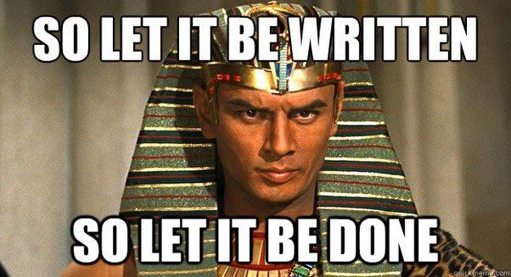

Slide 7
Chinese River Systems
Notes:
Huang He = Yellow River; Chang = Yangtze River. Rivers in early civilizations… see a trend? Why are they important? Before you answer… I have never, not once, told you the rivers were important for drinking water or bathing. Stop using that as an answer and do not put it on a test.

Slide 8
Loess
Notes:
Loess video: https://www.youtube.com/watch?app=desktop&v=nyN0e9Rgn_Q

Slide 9
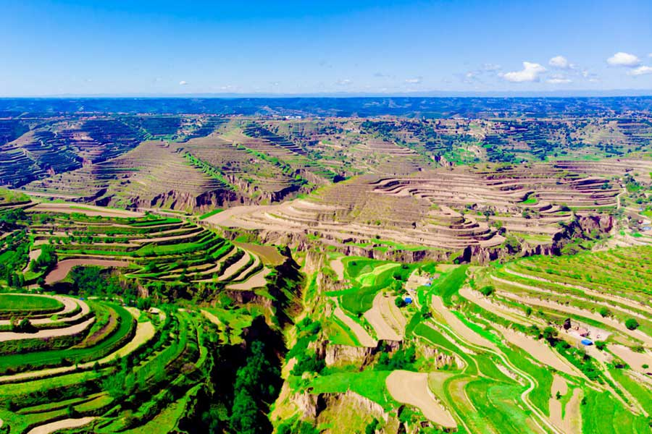
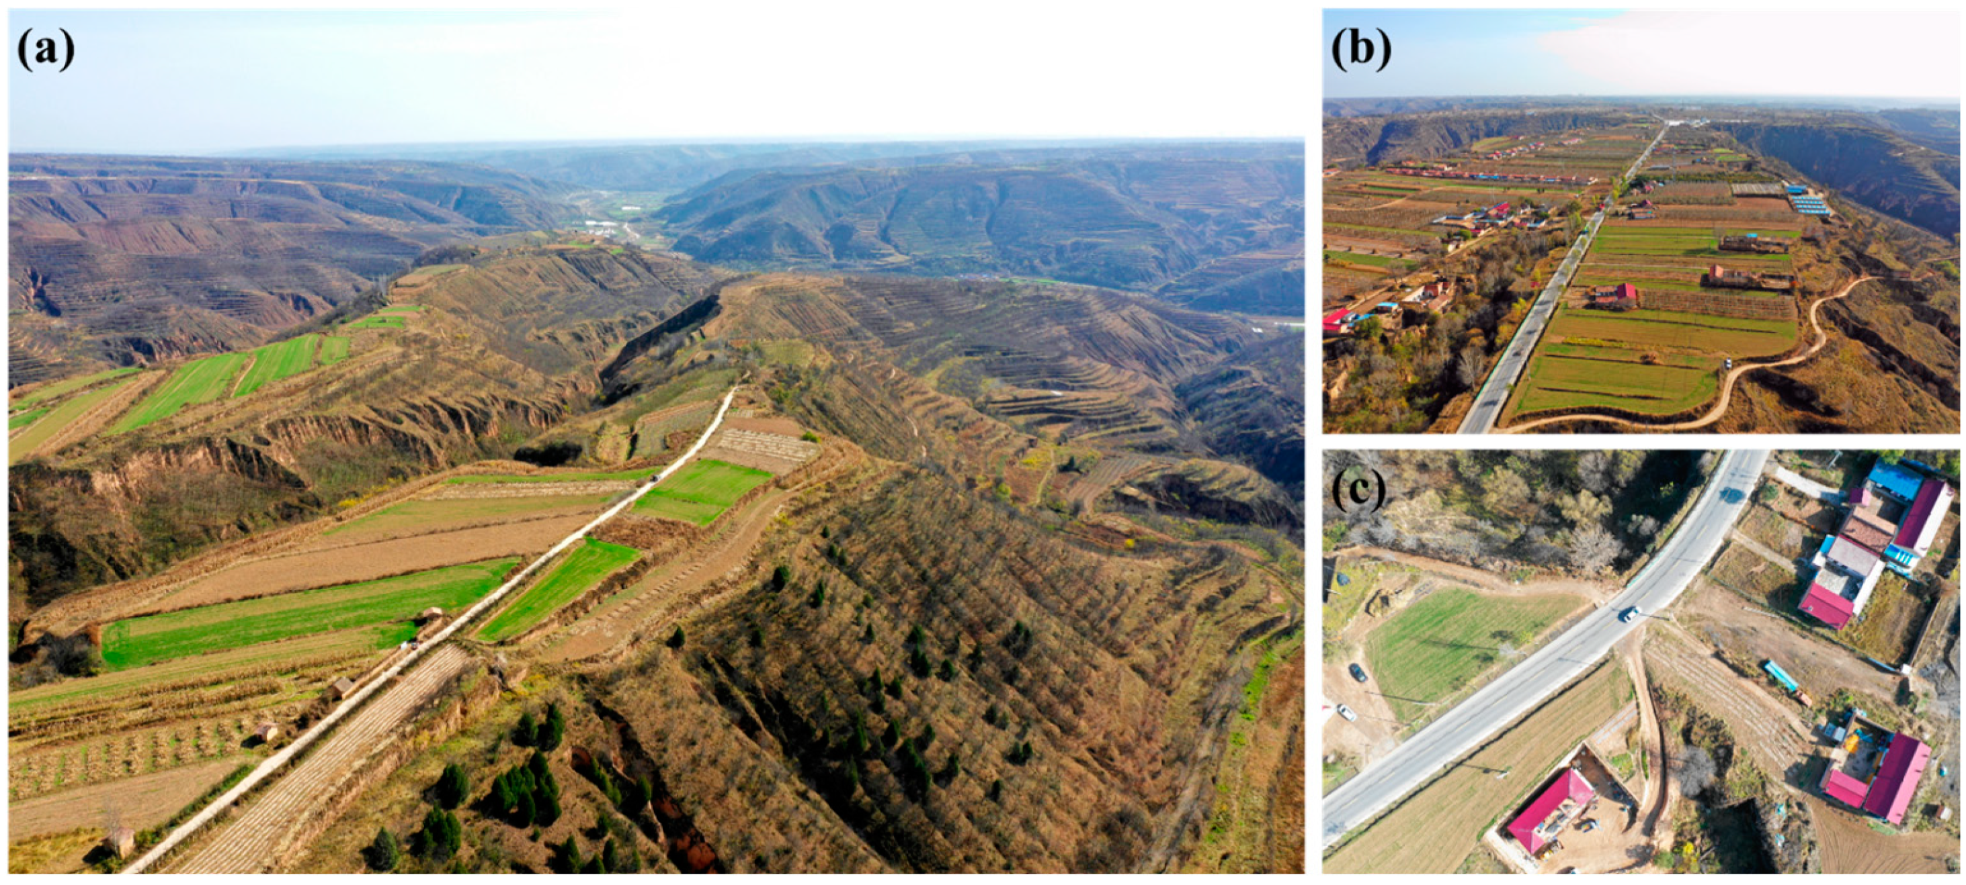

Slide 10
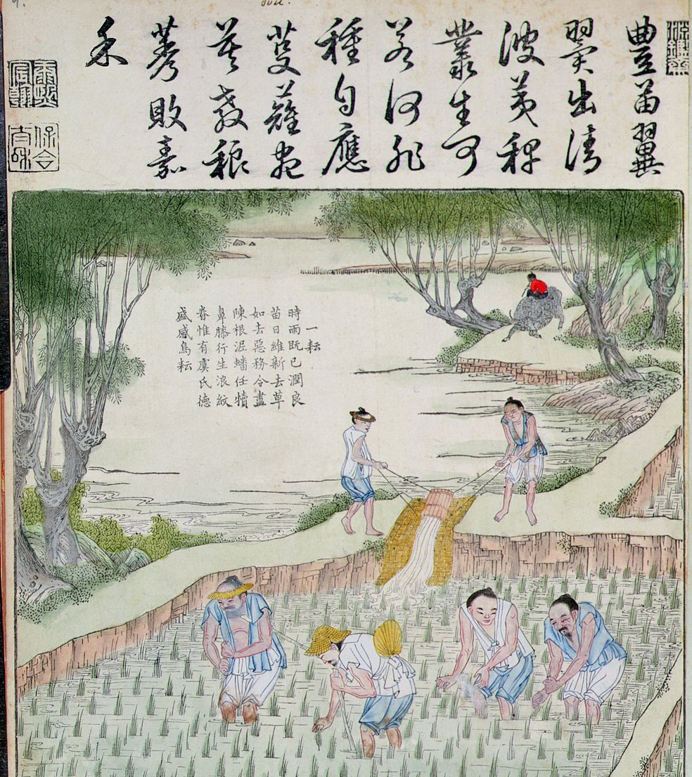

Slide 11
Geographic Isolation

Slide 12
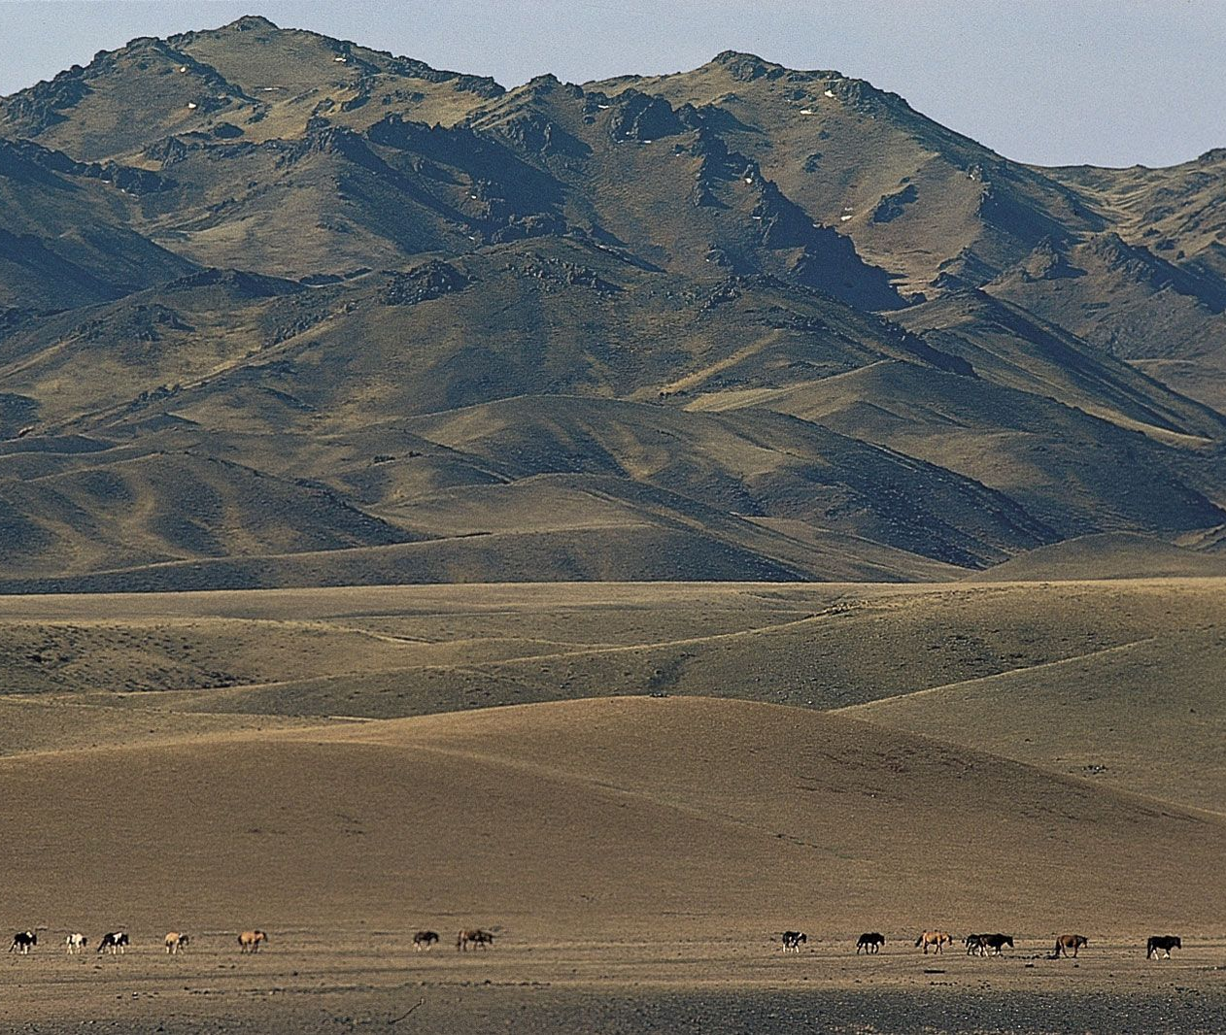
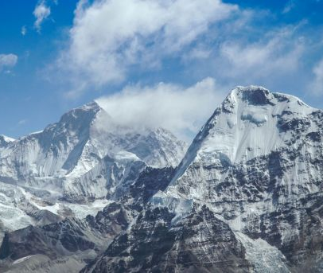
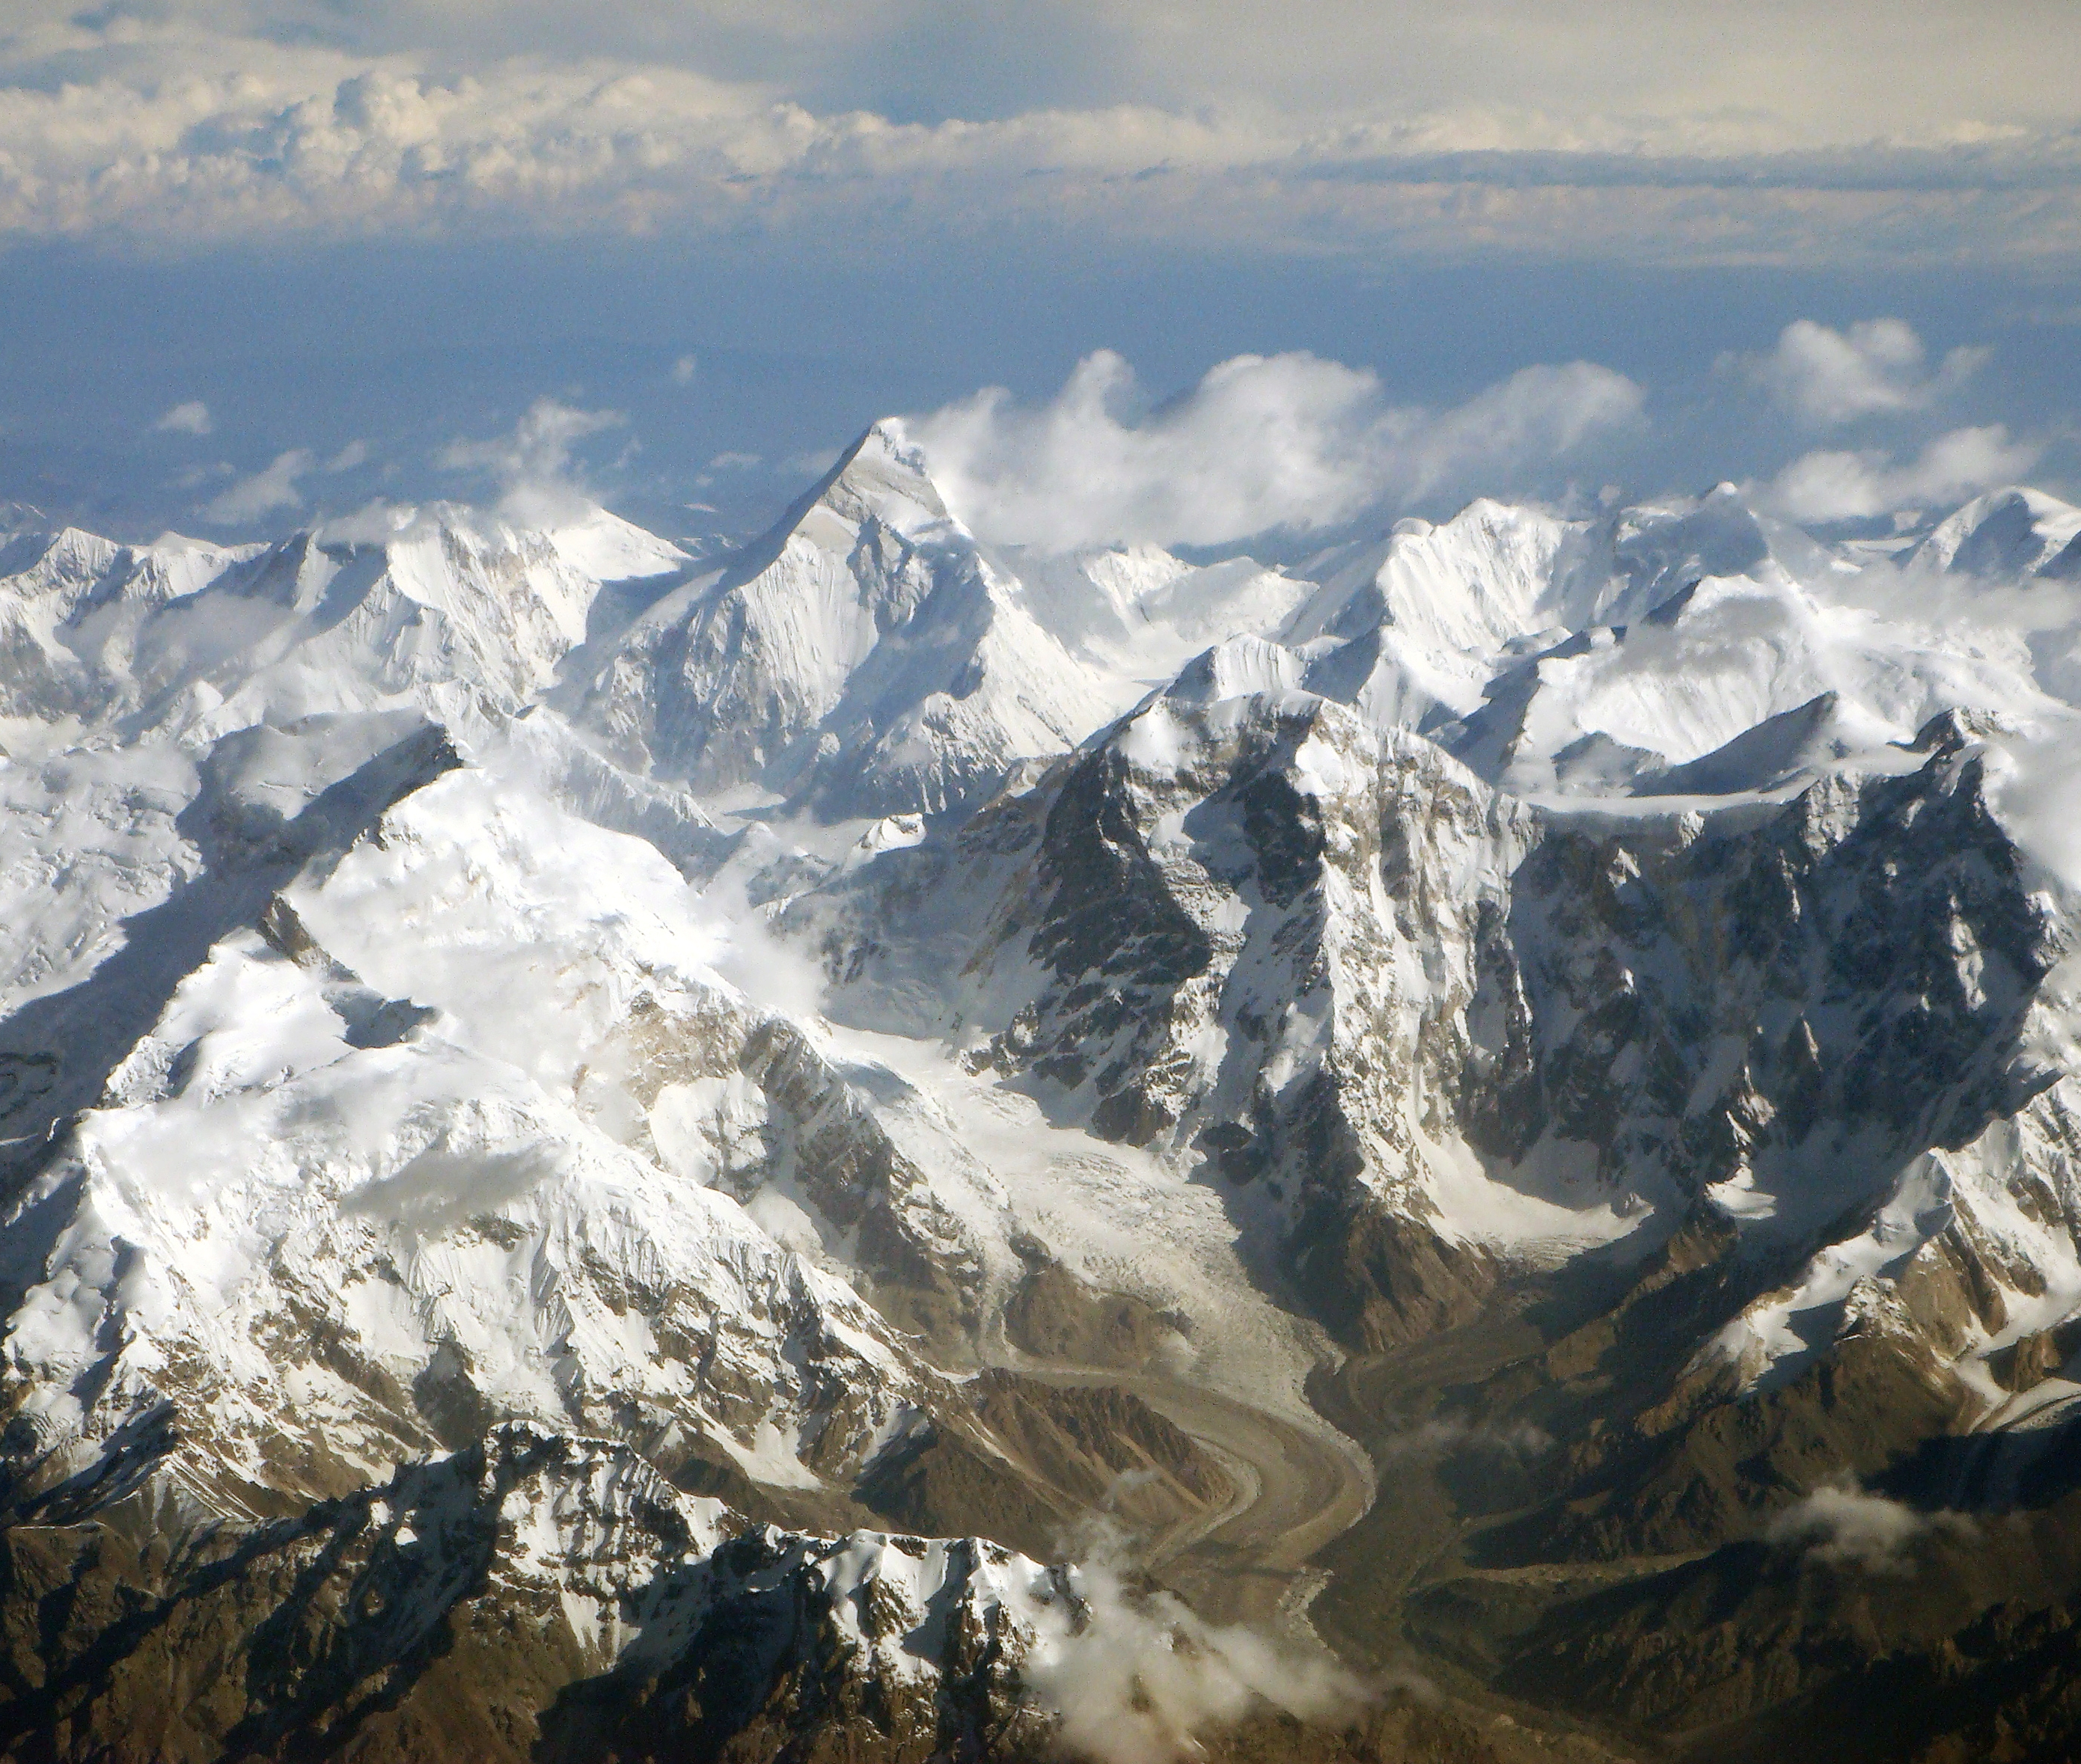
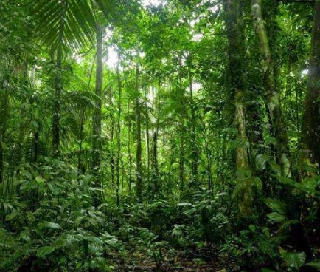
Notes:
How do you think this affected China’s development?

Slide 13
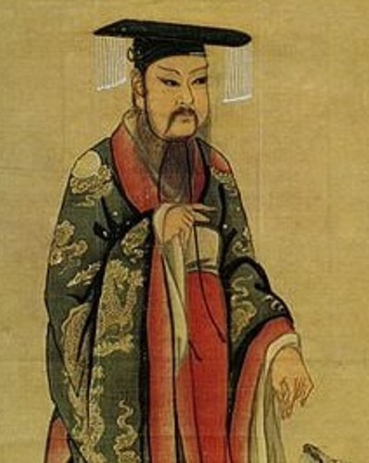
The Shang Dynasty
FamilyID=Office_ArchiveTorn
Notes:
The first ruling family was the Shang. The Shang are famous for their use of bronze, chopsticks, jade, silk, spices, oracle bones, and a system of writing. The kingship was very odd. Instead of going from father to son, it went from brother to brother or from brother to nephew. The Shang justified their right to rule using the Mandate of Heaven.

Slide 14
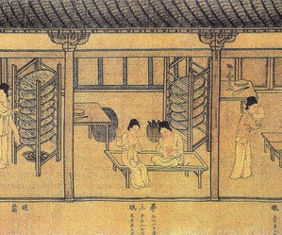
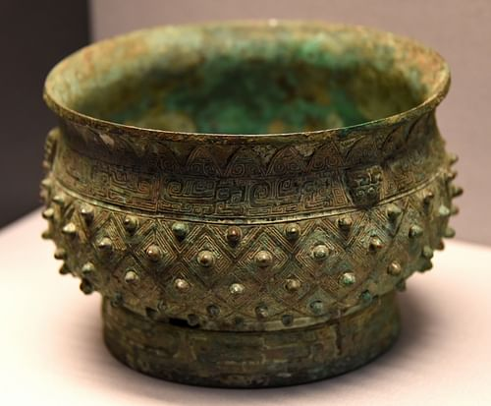
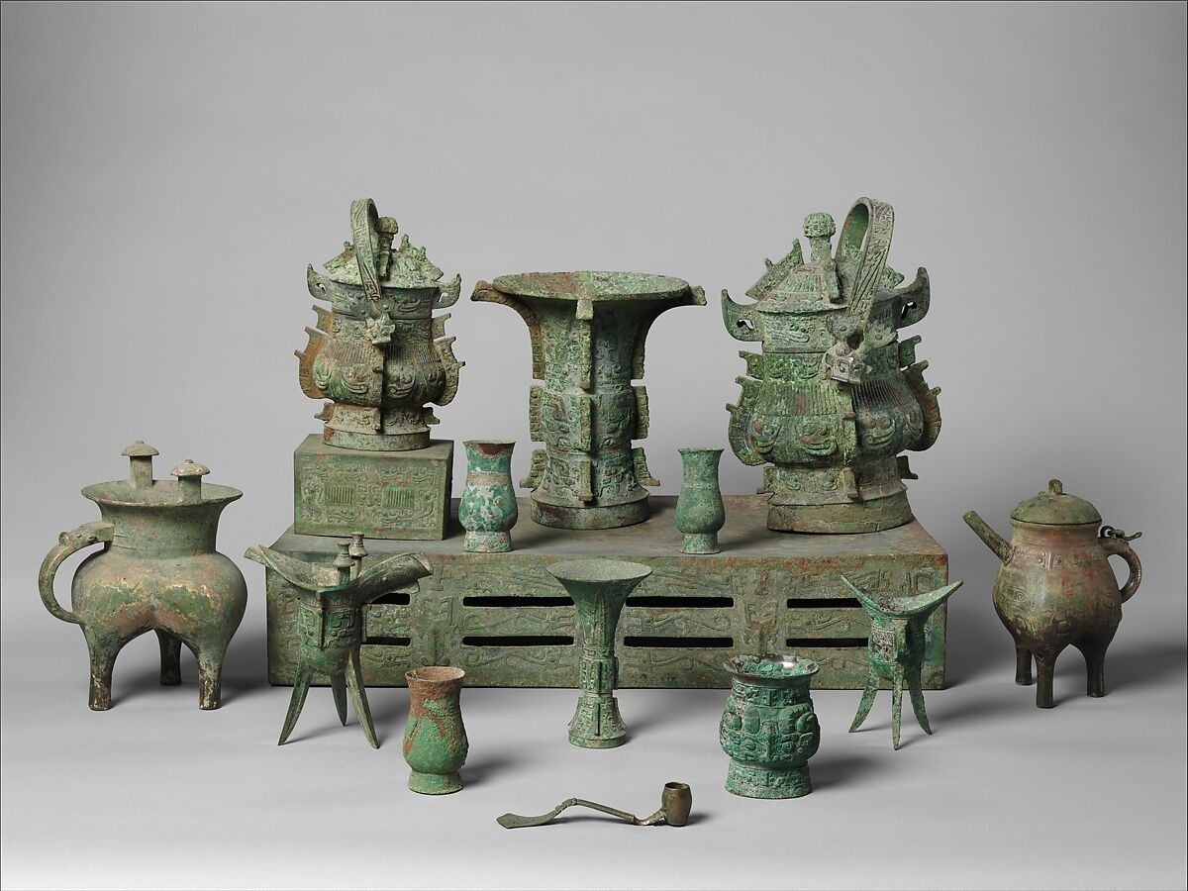
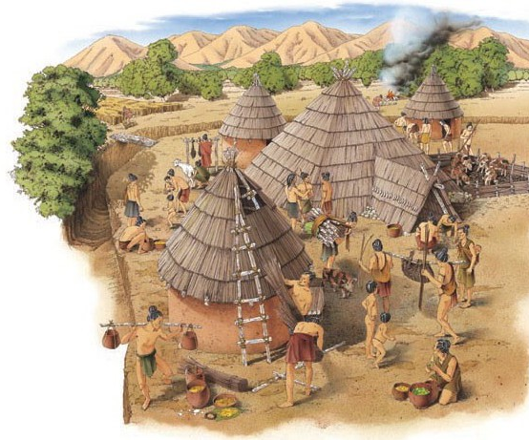

Slide 15
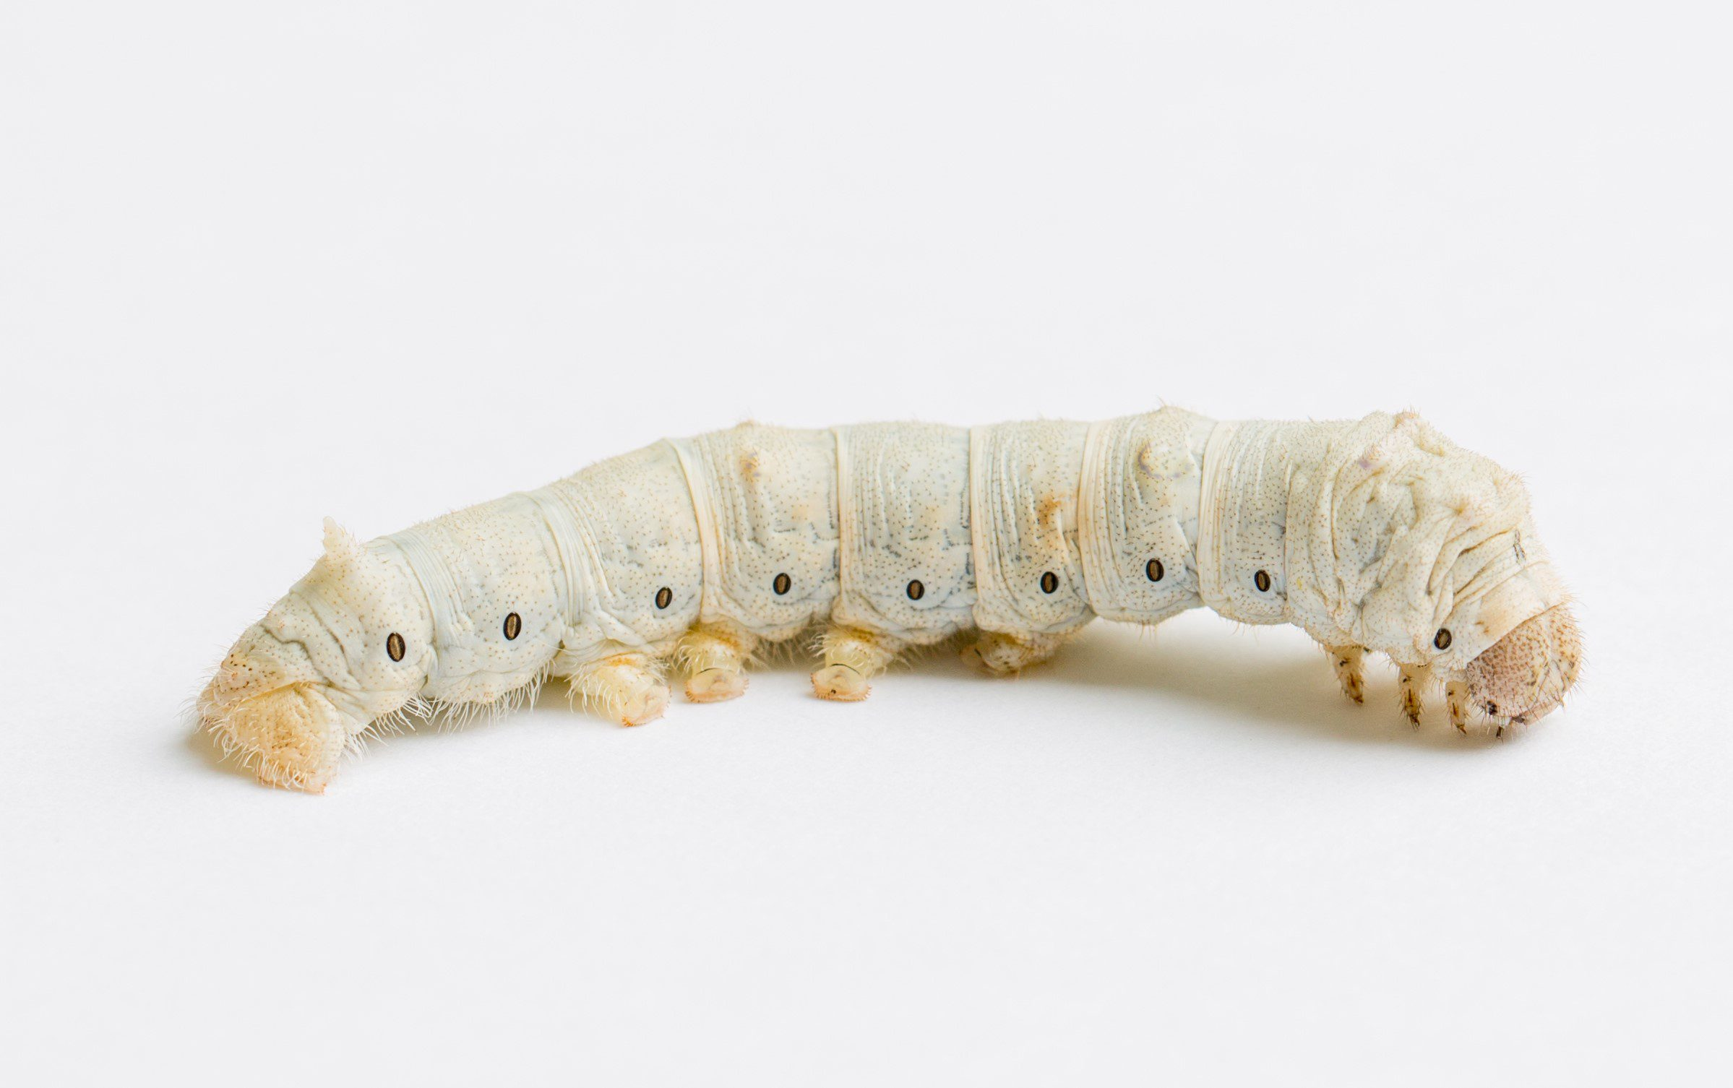
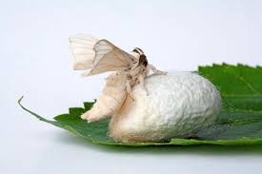

Slide 16
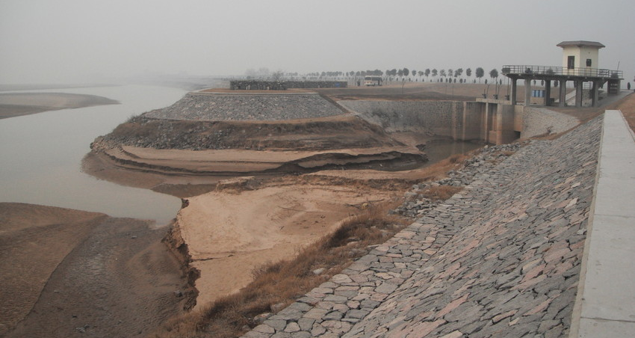
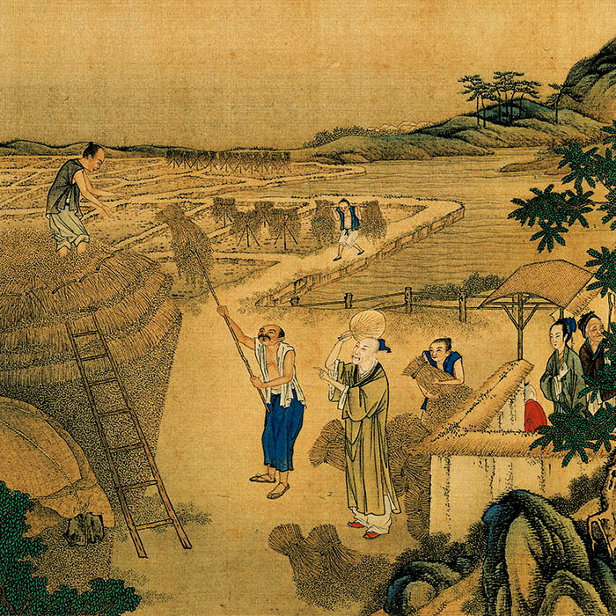
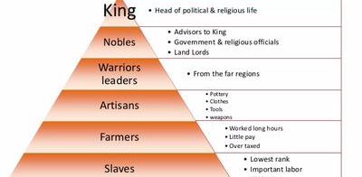

Slide 17
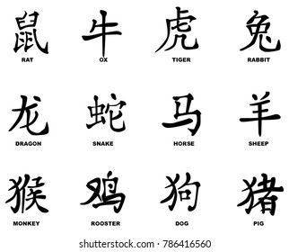
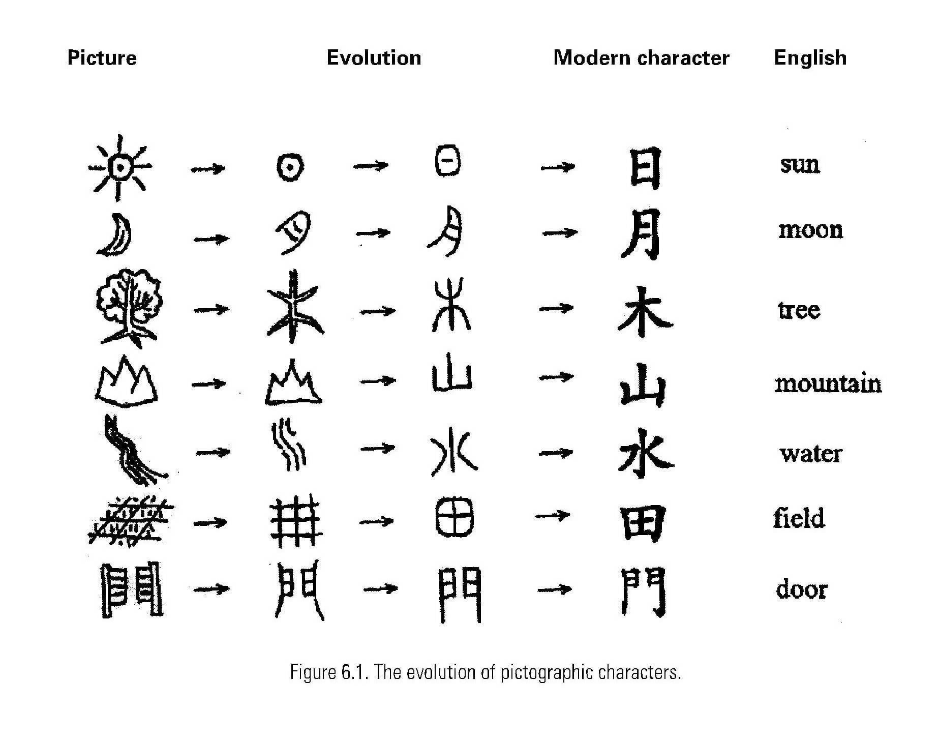
Ancient Chinese Writing

Slide 18
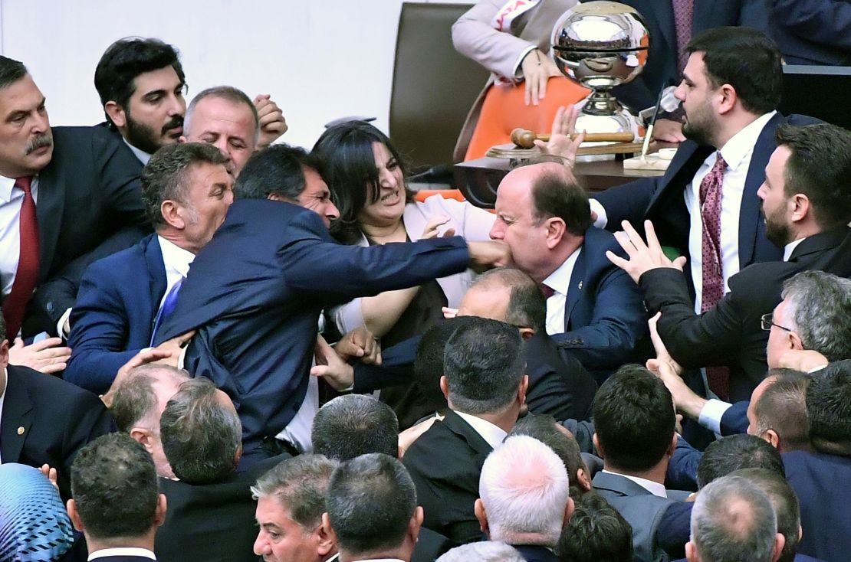
Class Discussion
Why do empires fall?
Think about all that we have seen so far from Sumer, Babylon, Egypt, etc.

Slide 19
Practice Vocab Questions (pg. 184)
1. What is loess?
2. What is a dike?

Slide 20
Exit Ticket
How did the geography of the Huang River valley affect the lives of the Chinese who settled there?

Slide 21
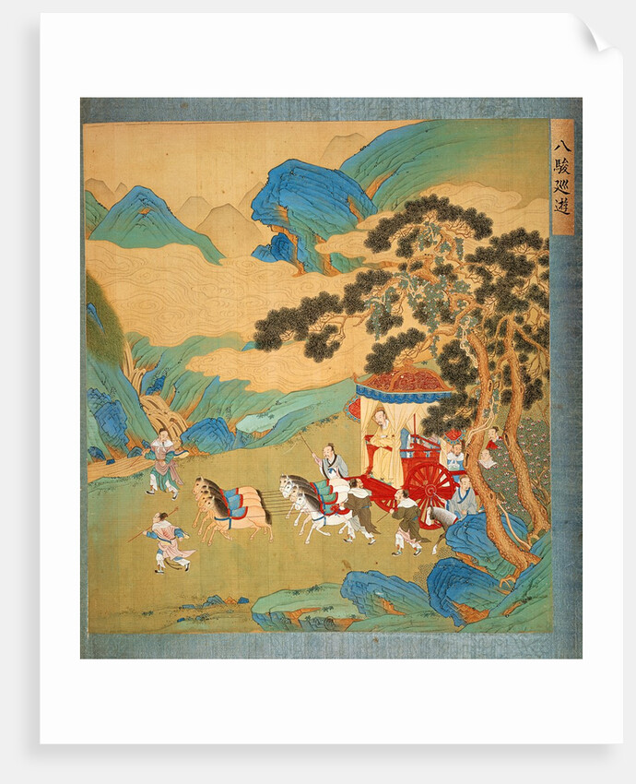
Do Now
Look at the picture on 185 of Zhou Emperor Mu Wang riding in his chariot. Come up with three questions you have about Zhou rulers based on the picture.

Slide 22
Agenda
Do Now
Song of the Day: Rich – Jinbo & G22
Rise and Fall of the Zhou
Mandate of Heaven (BIG talk about that)
The Warring States
Zhou Society
Practice Vocab Questions
Exit Ticket

Slide 23
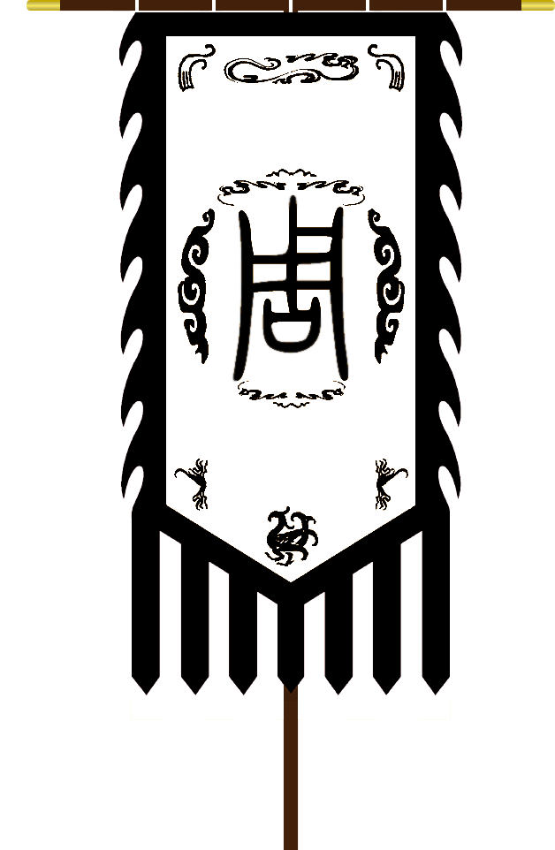
Rise and Fall of the Zhou
Shang Dynasty was messing up
Enriched themselves, didn’t care about the people
Zhou didn’t Shang and took over
Shang soldiers didn’t fight
Look at the map on pg. 186
Where was the Shang Dynasty?
Why was it located there?
What kept the Shang and Zhou from expanding to the west?

Slide 25
Class Discussion
How did the Mandate of Heaven create good leadership?
How did the Mandate of Heaven create unjust leadership?
How does the Primary Source illustrate the Mandate of Heaven?

Slide 26
Governing the Zhou
The Zhou kept conquering and getting bigger
How do you govern a big place?
Remember literally every empire and dynasty that we have ever discussed?
Distance grew between the King and the Nobles
Long time to get to each other, rough conditions… we are on our own, the King ain’t coming.
Warlords take over some states
Still loyal to the king, but doing it for themselves
Building bigger armies with iron weapons.

Slide 27
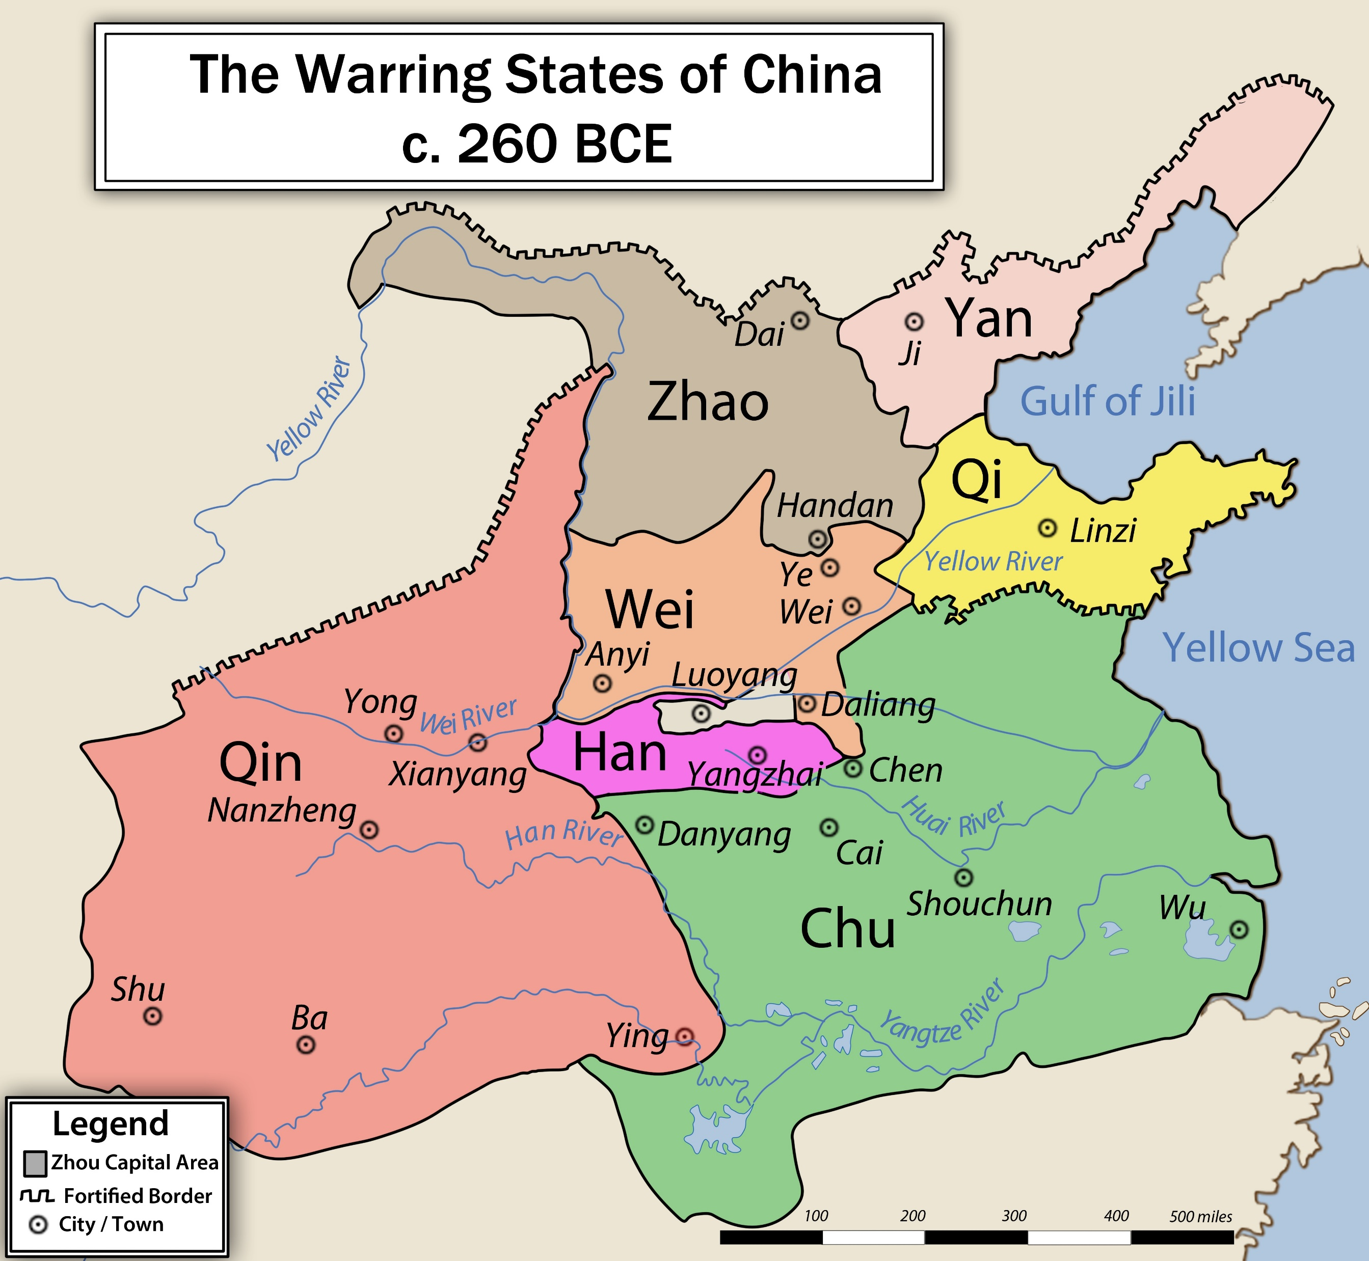
The Warring States Period
475-221 BCE
Small states and warlords starting fighting with each other
Little battles turn into full-scale warfare
Strong states conquer the weak ones
Millions die
256 BCE – Zhou gets overthrown
Still fighting until a new dynasty emerges

Slide 28
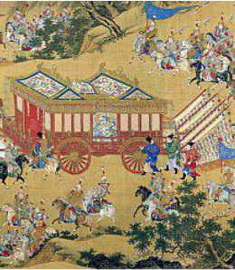
Zhou Society
No more sacrifices or oracle bones
Central government, but more power to the states and nobles
Built walls around capital cities
No, not THAT wall
Loyalty to the family
Old folks in charge; children seen but not heard
Sounds lovely!
Stronger iron weapons, better farming practices, and a network of roads for trade and travel
Everybody needs a wise man

Slide 29
Vocab Questions
What is a warlord?
Use the term chaos to write a sentence describe the Warring States period.

Slide 30
Exit Ticket
How did China’s geography make it difficult for the Zhou kings to keep their large kingdom united?

Slide 31
Do Now
Look at the picture on pg. 191 and answer these questions:
Why do you think it was built in this location?
What do you think life is like for the monks who live there?
Notes:
https://www.youtube.com/watch?app=desktop&v=xZTtILl-xpE (After Do Now)

Slide 32
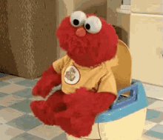
Agenda (Feel Good Friday)
Do Now
Song of the Day: Good Day – Nappy Roots
Spiritual Traditions
Honoring Ancestors
Confucius
Philosophy
Five Relationships
Daosim
Laozi
Yin and Yang
The Dao
Practice Vocab
Exit Ticket
Notes:
[

Slide 33
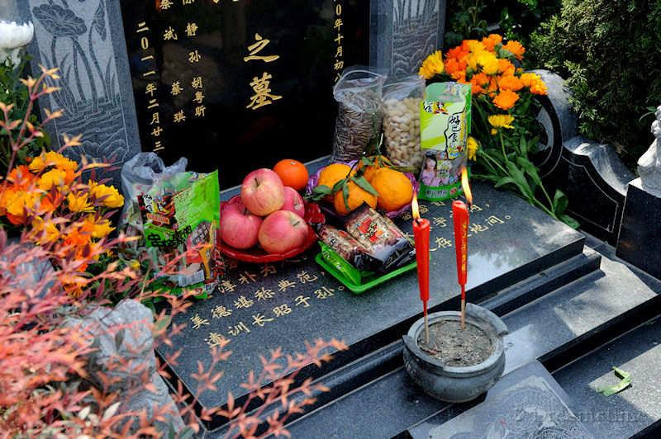
Spiritual Traditions
Many Spirits
Heaven is home to the spirits of the sun, moon, starts, and storms
Earth is home to the spirits of the hills, rivers, rocks, and seas
The spirit world ruled over the living
Good spirits do good things; bad spirits do bad things
Honoring Ancestors
Spirits of the ancestors were the most important
Ancestors never left the family; their spirits watch over and guide the living
Treat the ancestor well, good things happen; make them mad, they cause trouble

Slide 34
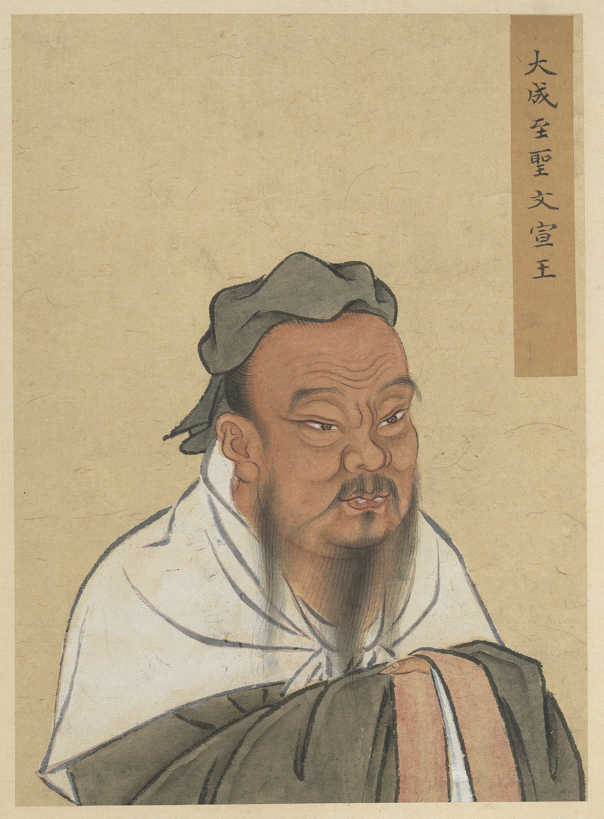
Confucius
Life
Confucius worked in government
Saw lots of greed and cruelty
Law not enforced
Peasants starved but were taxed to pay for wars
Philosophy
Go back to the values of the Zhou
Be Kind and Honest: Confucius taught that people should act with kindness and be truthful
Respect Relationships: He believed everyone has roles in life, like family and friendships, and should treat each other with respect
Learn and Improve: Confucius thought learning was important for becoming a better person and helping others

Slide 35
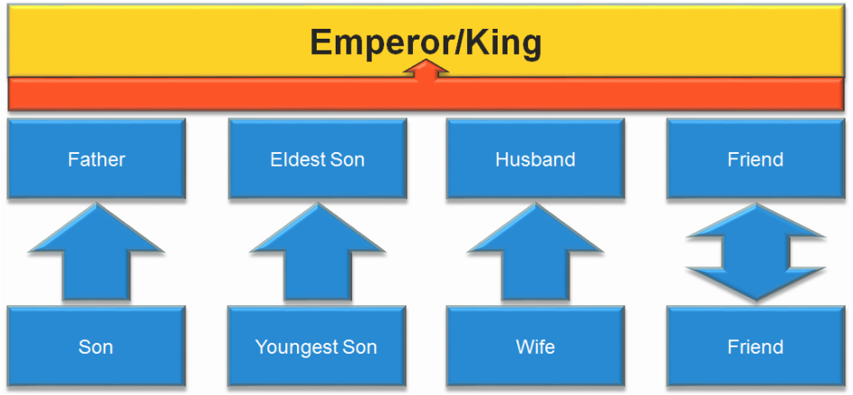

Slide 36
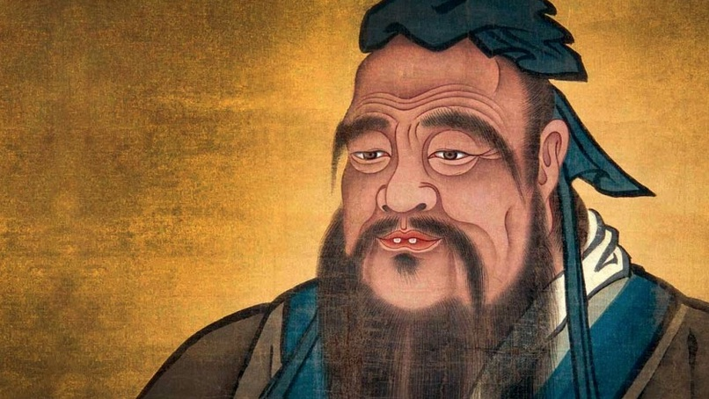
Confucius says…
To study and not think is a waste. To think and not study is dangerous.
Learning without thought is labor lost; thought without learning is perilous.
What you do not want done to yourself, do not do to others.
When you have faults, do not fear to abandon them
A scholar who loves comfort is not worthy of the name.

Slide 37
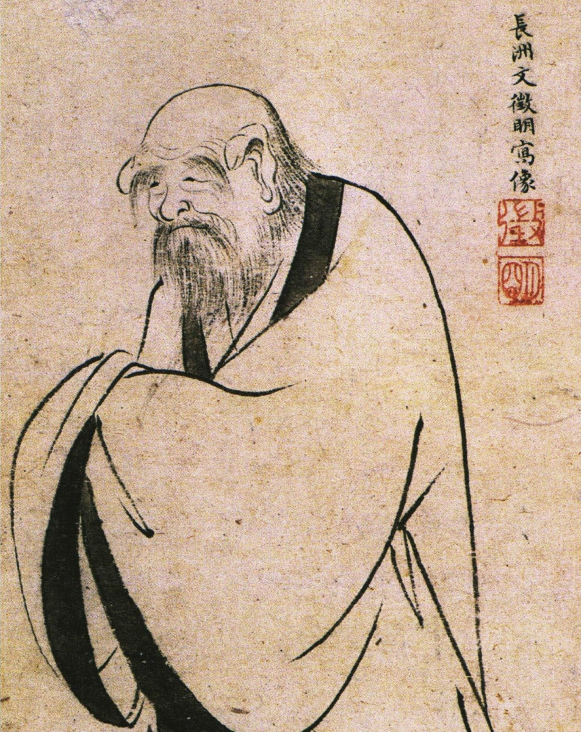
Daosim or Taoism
Dao: the natural way of the universe
A simple and natural existence
Laozi
Founder of Daoism
Wrote his beliefs in the Dao De jing
He may or may not have been a real person (just like Sun Tzu)
Yin and Yang (not Ying Yang)
Female: dark, cool, and quiet
Male: bright, warm, and active
The balance of these two brings harmony to the universe

Slide 38
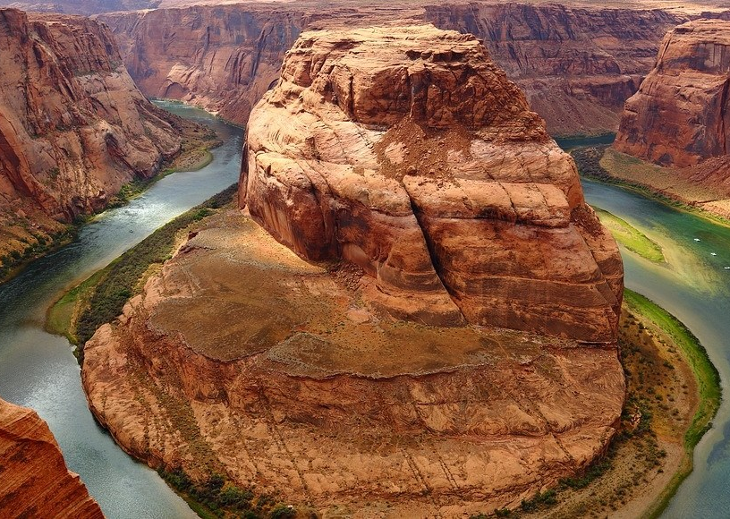
The Dao
“The Way” or “The Path”
Patient action
“Be Water”
Actions can upset the order of things
Greed, want, and competition are against the simple and natural order of life
A good leader takes little action
“When you do things right, people will think you have done nothing at all.”

Slide 39
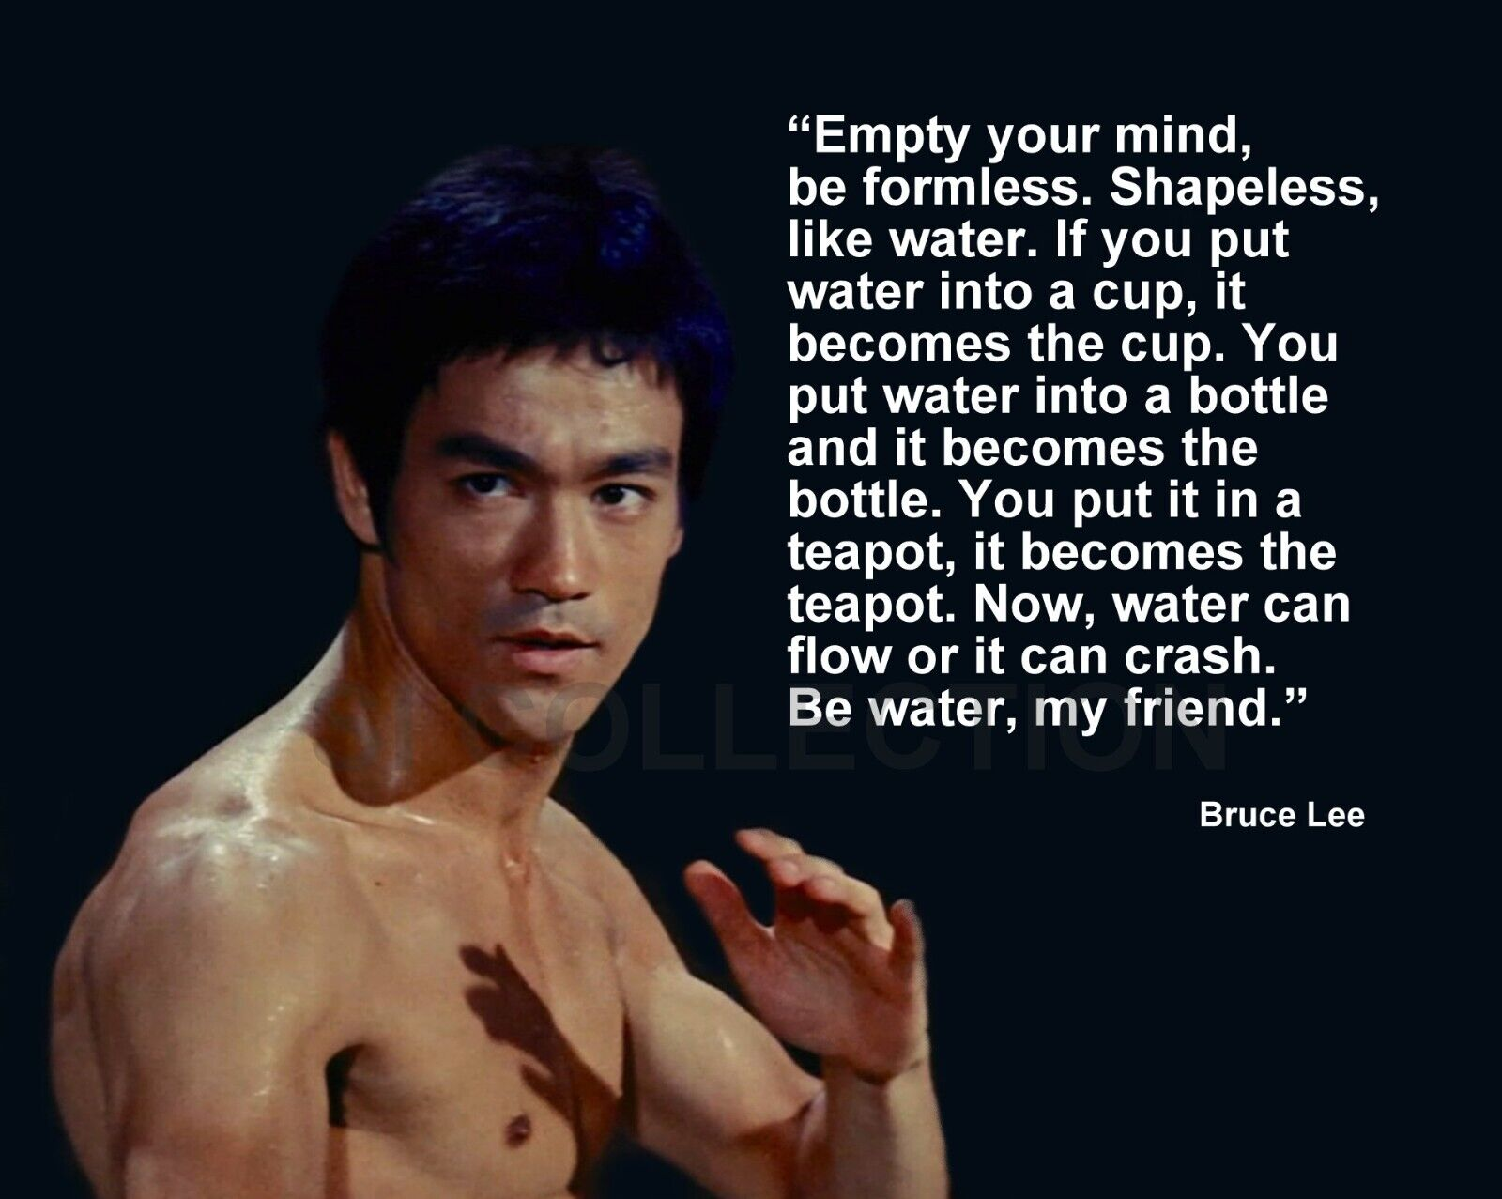

Slide 40
Vocab Questions
What is a philosophy?
What does filial piety mean?

Slide 41
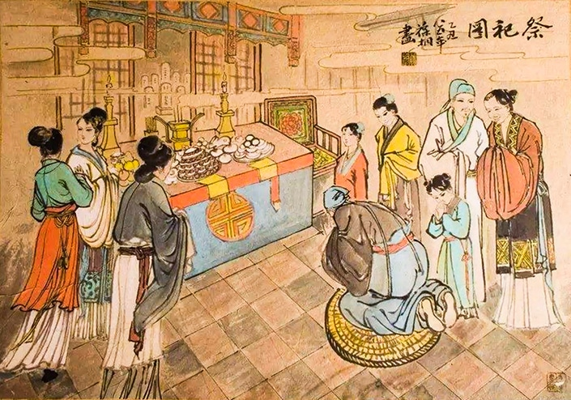
Exit Ticket
What role did ancestors play in ancient Chinese religion?

Slide 42
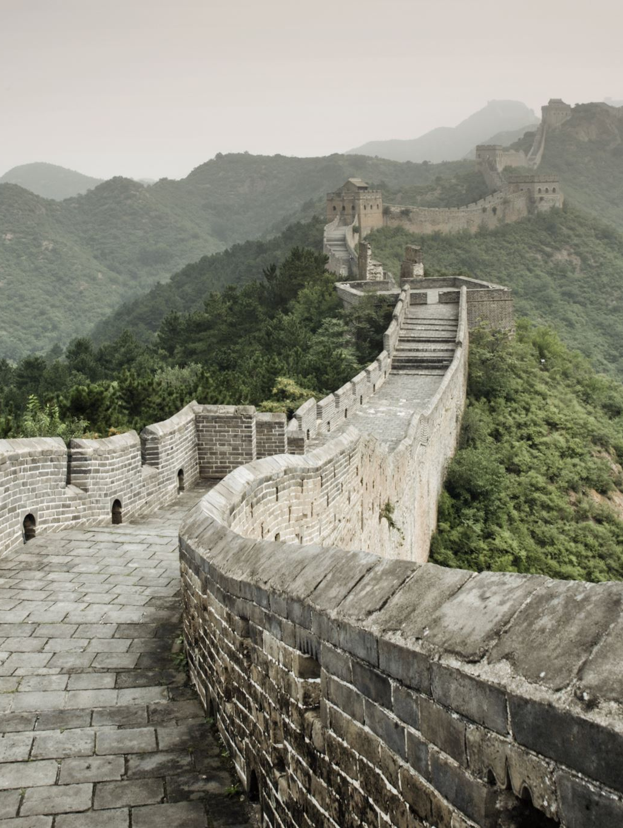
Do Now
Write down some things you know about the Great Wall of China.
Do not say that it is a wall, that it is great, and that it is in China ☺

Slide 43
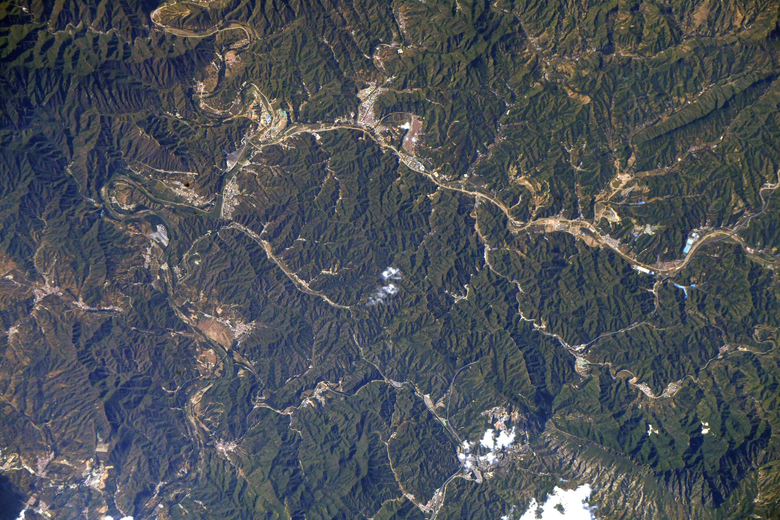
Myth Busted
You cannot see the Great Wall of China from space
Notes:
https://www.youtube.com/watch?v=Ng3L1LF8nek Toboggin ride Great Wall

Slide 44
Agenda (The Unification of China)
Do Now
Song of the Day: Wonderwall – Oasis
Unity Under the Qin
Warring States Unite
Defense
Standardization
Rule of the First Emperor
Legalism
Censorship
Fall of the Qin
Practice Vocab
Exit Ticket

Slide 45
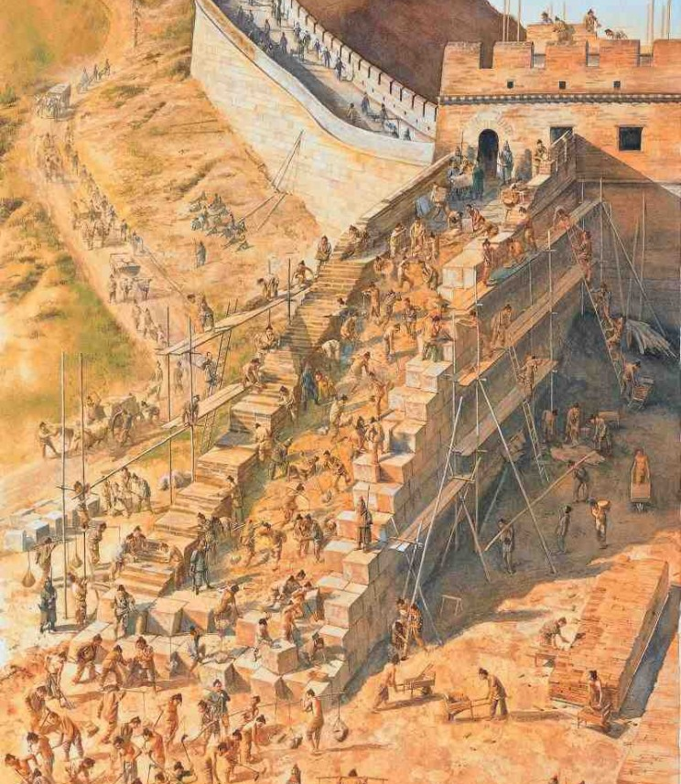
Unity Under the Qin
Warring States United
“King” Zheng comes to power
Whoops everyone, unites China
Languages and customs vary
Shi Huangdi = First Emperor
“Huangdi” was a name connected to the gods
Defense
Walls around kingdoms torn down
No walls, no defense, no rebellion
One wall was built in the north
It is a big wall
A GREAT wall

Slide 46
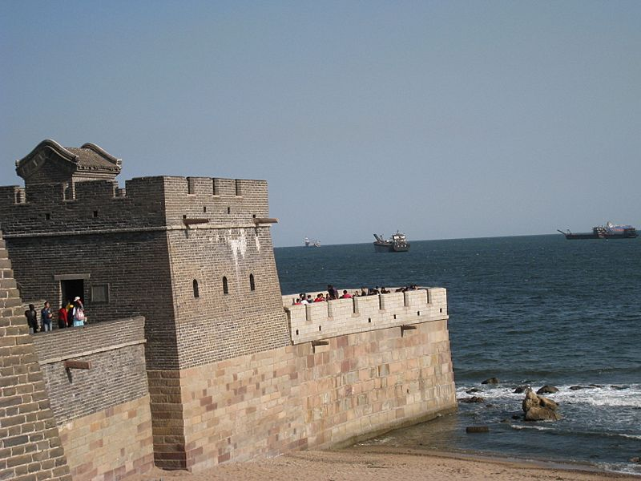
Great Wall Facts (Don’t Write This Down)
It is not one wall, but a series of walls
13,170 miles long
50 million people visit every year
2000 years to complete
400,000 people dies during its construction
Many of the bodies are buried within the wall itself

Slide 47
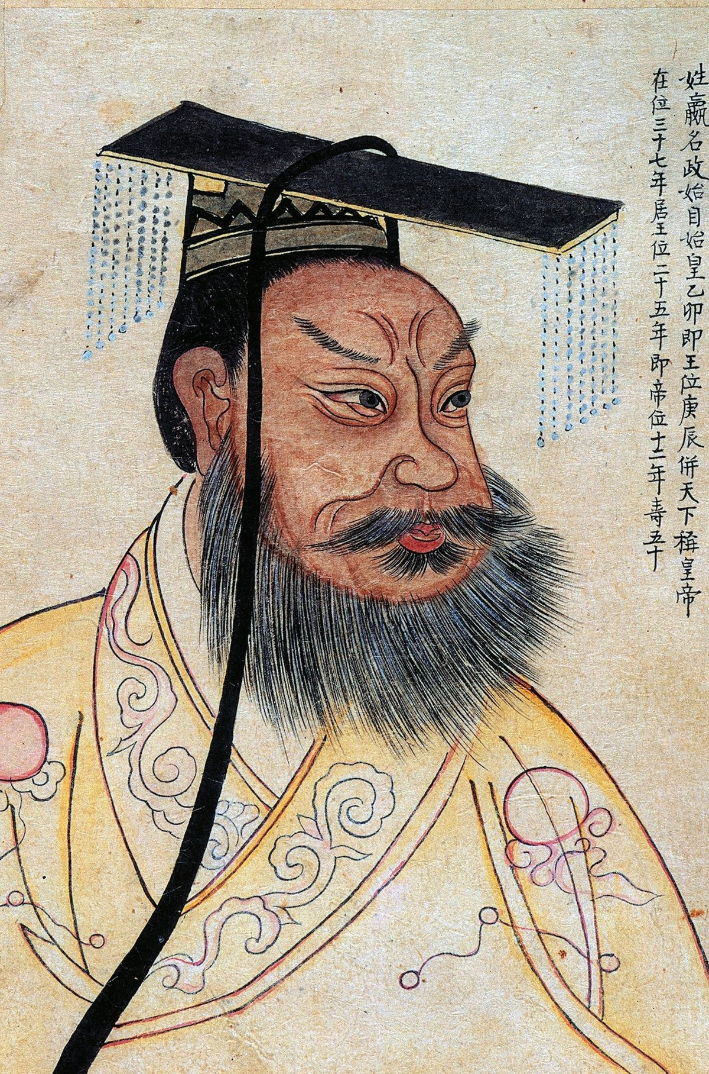
Unity Under the Qin (cont’d)
Uniform Standards
Standardize – to make things more similar
Follow the standards or be punished as a traitor
One written language w/ standard characters
Standard length for all axles of vehicles (carts, wagon, rickshaw, etc.)
Weights and measurements
Coins
Empire Organization
Central Government
36 provinces divided into counties
Every province had a leader, and every country leader reported to the province leader
Province leaders reported to central government leaders
Fail to carry out duties = Get replaced
Noble families forced to move to the capital and were spied on

Slide 48
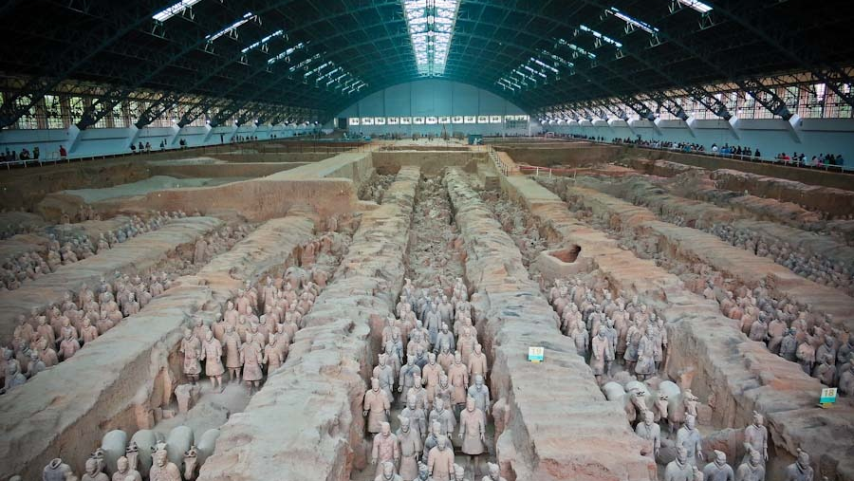

Slide 49
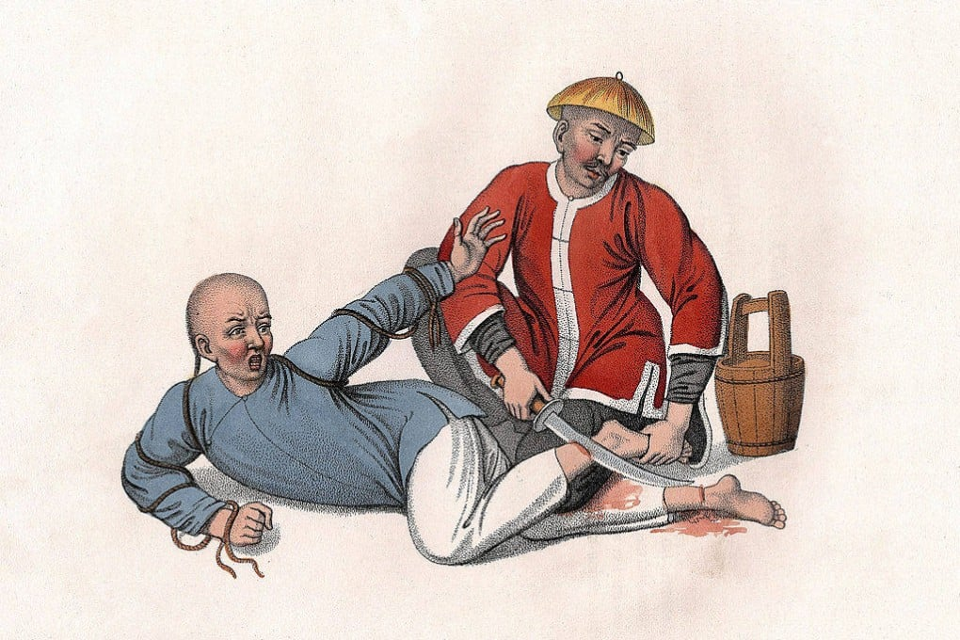
Rule of the First Emperor
Legalism
Strong Leader + Strong Laws = Social Order
Shang Yang = Advisor to Qin
Direct control over the people
Harsh laws
Don’t ask the people to be good… FORCE them to be good
Thieves get nose or feet chopped off
Beheading or cut in half
Forced labor (if you are lucky)
Thought Control
Censorship
No praise for the past, no complaints about the present

Slide 50
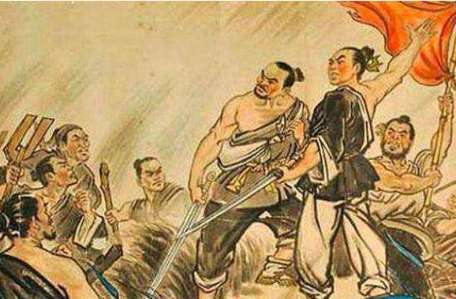
Fall of the Qin
First Emperor thought the empire would last forever…
It collapsed three years after he died
Chen Sheng
Soldier and border guard
He and his group were late because of rain
Facing severe punishment for being late
Might as well rebel
News spread and the people revolted against the government
Qin overthrown
But then the rebels fought against each other
More chaos for China

Slide 51
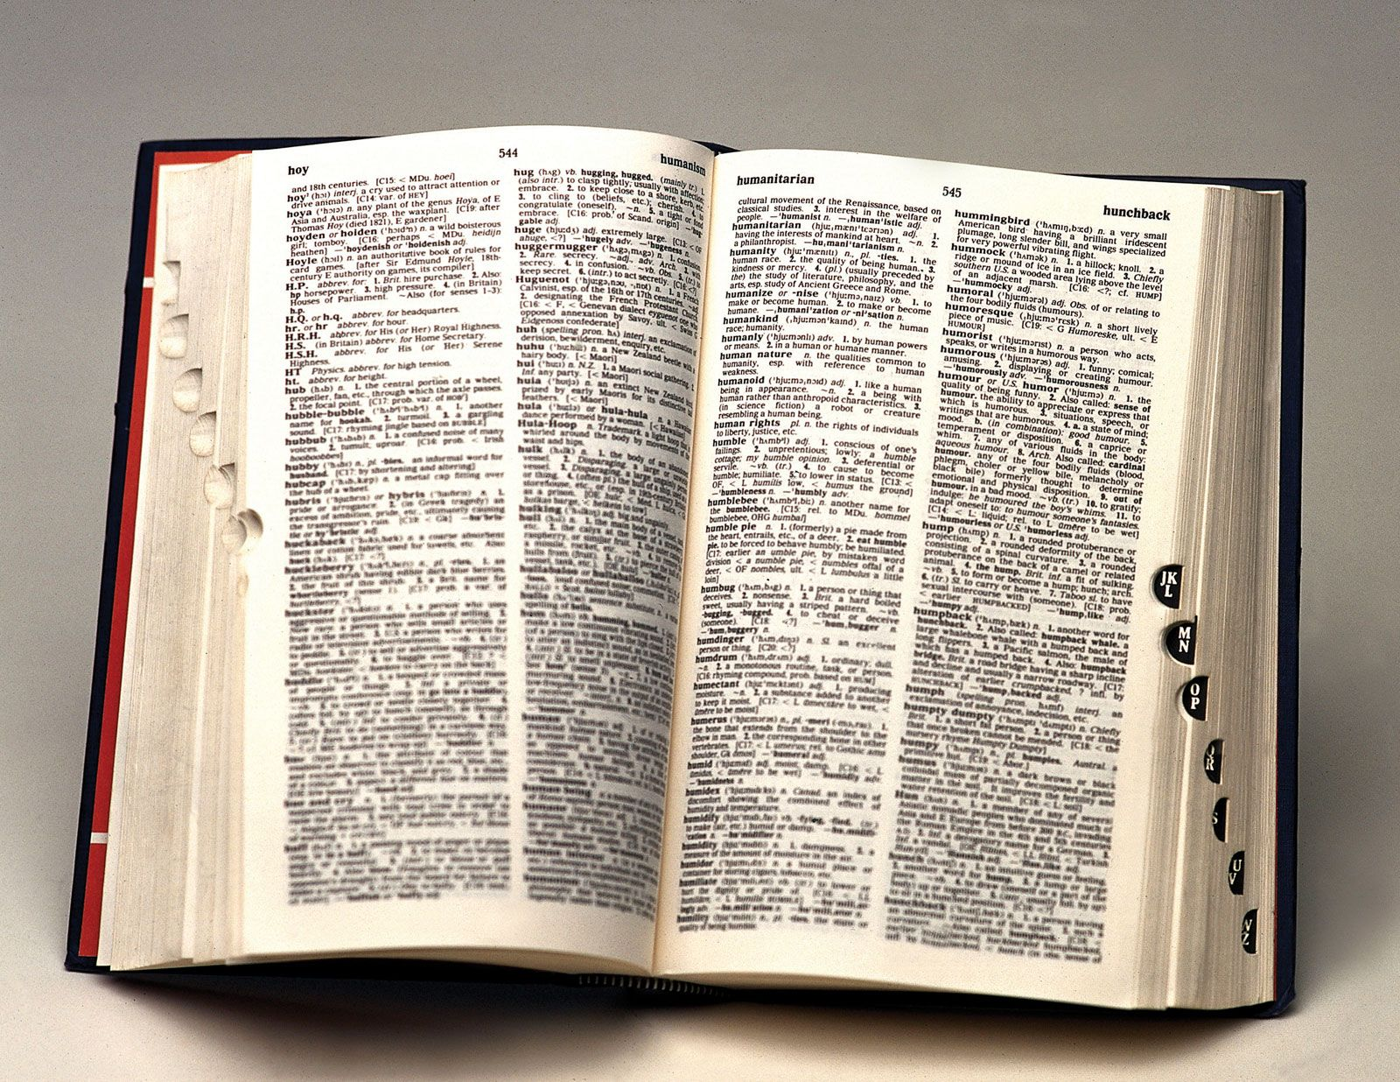
Practice Vocab
In your notes, define the following words:
Standardize
Censor

Slide 52
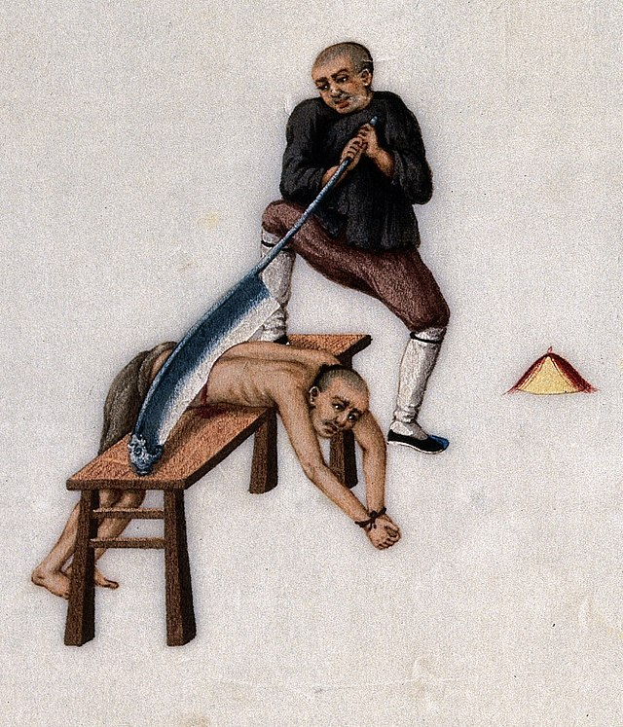
Exit Ticket
Why did Shi Huangdi create harsh punishments?

Slide 53
Agenda
Do Now
Song of the Day: Could Have Been Me – The Struts
Han Dynasty
Reuniting and Expanding China
The Silk Road
Trade Route
Exchange of Ideas
Practice Vocab
Exit Ticket

Slide 54
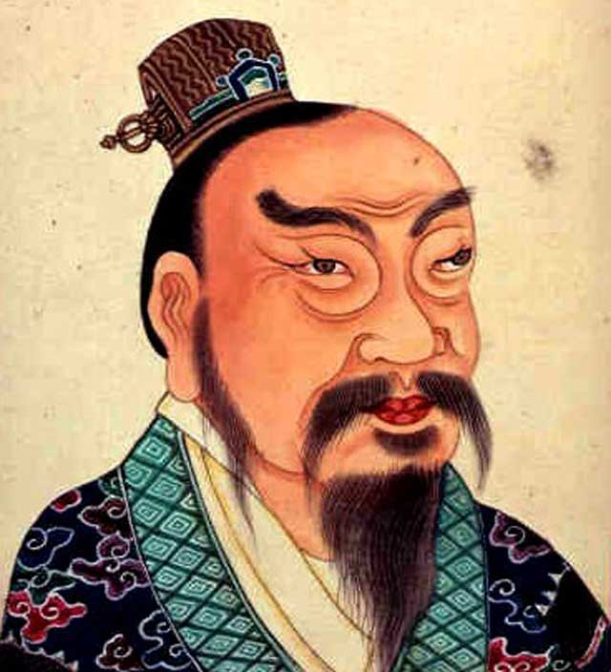
Han Dynasty
Qin Dynasty falls when Chen Sheng started his rebellion
Chinese unity is lost; everybody wants to rule the world or be left alone
General Liu Bang seizes power over China
Starts Han Dynasty in 206 BCE; lasts for 400 years
First Han Emperor was poor
Surrounded by good advisors
Confucianism: Set example of mercy and good behavior
No more Qin cruelty, but Han kept Qin laws

Slide 55
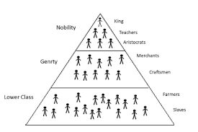
Han Government
Still a strong central government
Local leaders have weak powers so they can’t challenge
Expanded empire
Central government ruled new lands instead of appointing a noble
Government and society pyramid

Slide 56
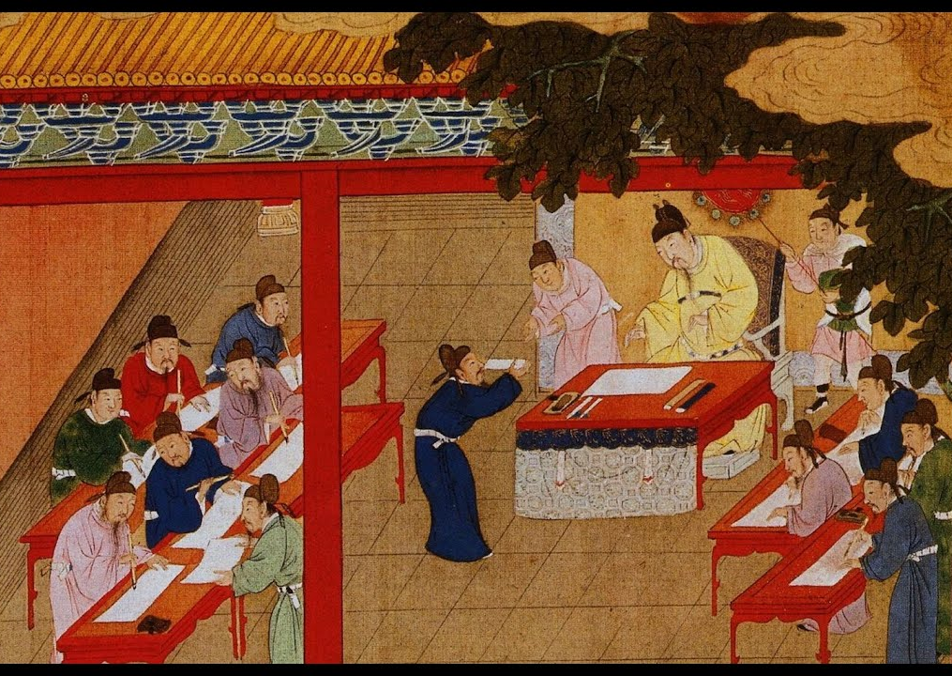
Civil Service
Civil Service
A system of government employees mainly selected for their skills and knowledge
Positions were not passed from father to son
People were recommended by their local leaders
The best were appointed
Could not serve in your home area
Prevents rebellion
Emperor Wudi created exams
These helped to identify and select civil servants
Civil servants lived the good life
Comfort, influence, special clothes…

Slide 57
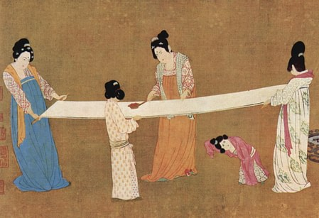
The Silk Road
Silk Road
A network of roads that crossed Asia, connecting China to central and southwest Asia
Gets its name from China’s major export: silk
Ancient Chinese Secret
Only Chinese knew how to spin silk
Exporting silkworms was illegal
Art, cuisine, animals, foods, precious stones, gunpowder, paper… all imported/exported along the Silk Road
Ideas were also spread
Buddhism, Daoism, Confucianism, etc.

Slide 58
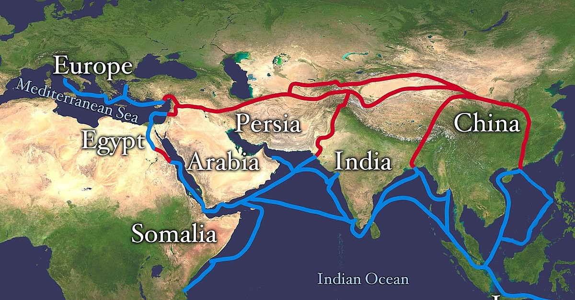

Slide 59
Practice Vocab
In your notes, define the following words:
Standardize (pg. 198)
Censor (pg. 201)
Assign (pg. 204)
Obtain (pg. 207)

Slide 60
Exit Ticket
How were the Qin and Han Dynasties the same and how were they different?
Give me one example of each.

Slide 61
Agenda
Han Society
Social Order
Family Life
Role of Women
Economy
Han Achievements
Arts
Science
Inventions
Practice Vocab
Preview of the Week
Test next Monday, 11/18

Slide 62
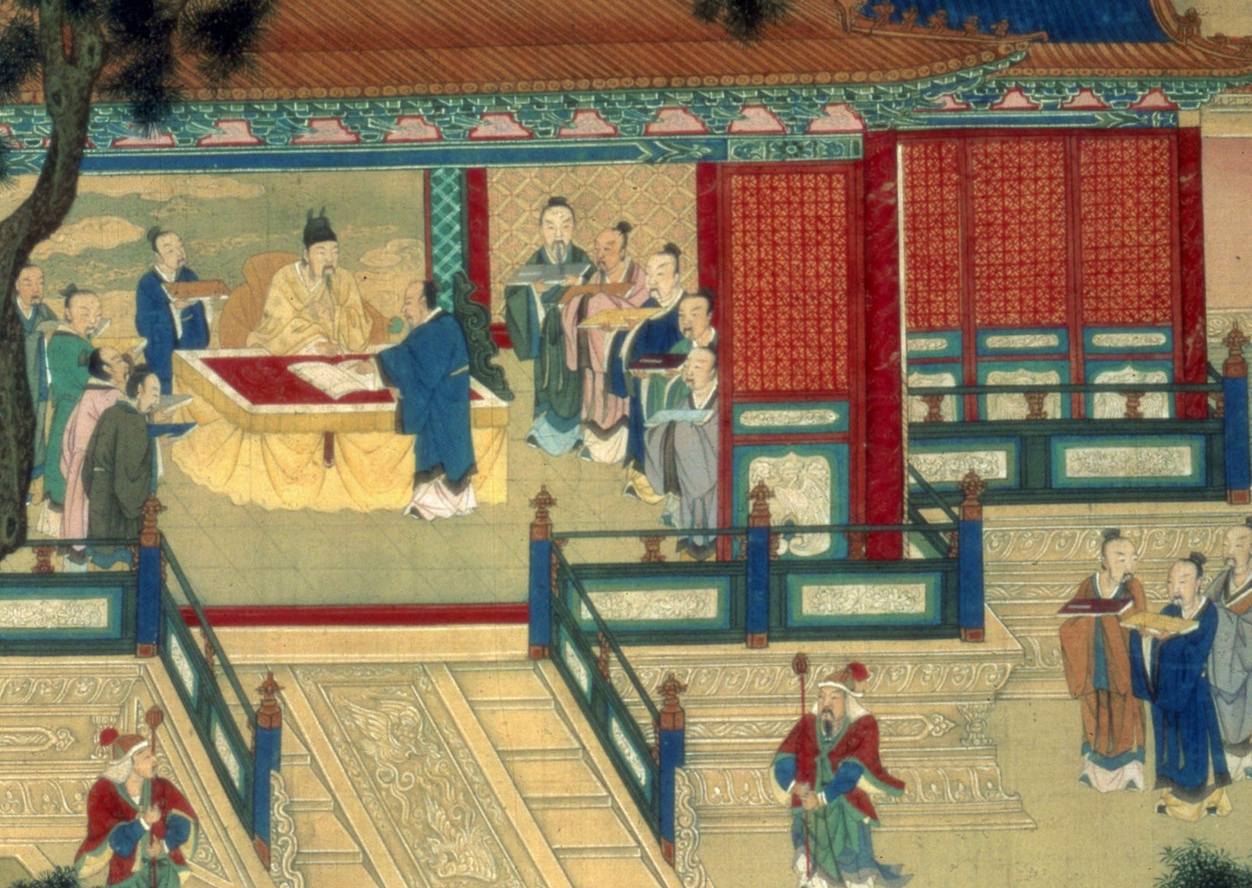
Han Society
Confucian values
Mental work > Physical Work
Teachers and students highly respected
Farmers and Artisans
Highly valued for what they make
Merchants
Little respect since they don’t make anything
Slaves
At the bottom; usually criminals or people with debt

Slide 63
Han Society
Family Life
Ancestor worship
Kids could be reported for not respecting their parents (filial piety)
Adult children get a harsh punishment
Little kids get a talking to
Women
Less power than men
Stayed at home, took care of the kids and the olds
Ban Zhao
Women deserve education but still should serve their man
Notes:
“If a wife does not serve her husband, then the proper relationship between men and women is neglected and destroyed.”

Slide 64
Han Society
Economy
Low Taxes
Mostly farming
90% of Chinese citizens were some kind of farmer
Silk production HUGE
Monopoly
One group controls an entire industry
Control price and production
Make and store extra grain in good years
Bad years: extra grain keeps prices low
Notes:
Emperor Wudi took over iron and salt industries because they were so important. Used the money for war.

Slide 65
Han Advancements
Art
Advancements in painting, sculpting, literature, poetry, and music
Calligraphy – Beautiful writing
Science
A solar year: 365 days, 5 hours, 46 minutes, and 46 seconds
New ways to explain and treat disease
Seismometer: tool to detect earthquakes
Wheelbarrow
PAPER

Slide 66
Practice Vocab
Exempt
Benefit
Acupuncture

Slide 67
Preview of the Week
Wednesday
Unit Assessment, pg. 215
Thursday
Reading Intervention
Not sure what it will be about
We can take a break from philosophy
Friday
Clean up your notes
Catch up on missed notes
Kahoot
Monday (11/18)
Ancient China Test

